Slide 1
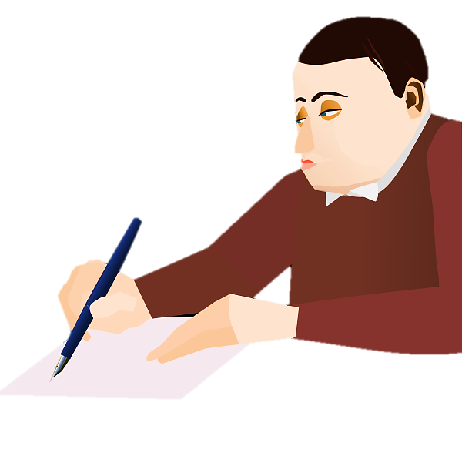
Quiz Lovers
Notes:
Notes for Teacher - < Information for further reference or explanation >
Suggestions: <Ideas/ Images/ Animations / Others – To make better representation of the content >
Source of Multimedia used in this slide -
<Quiz on TV= https://pixabay.com/illustrations/quiz-question-puzzles-play-neon-5858940/
Boy Writing on Paper= https://freesvg.org/1523097512 >

Slide 2
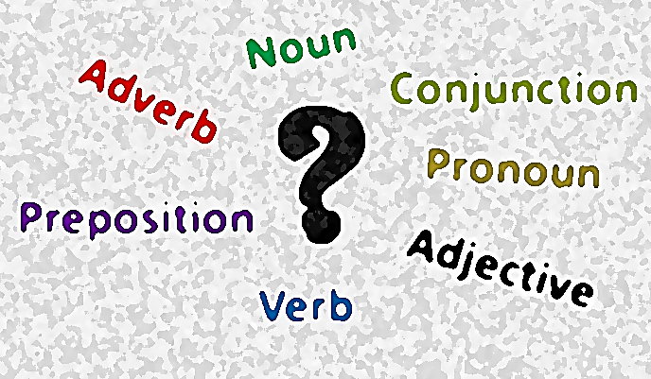
Question 1
An adjective is a word that describes a
a) verb
b) preposition
c) adverb
d) noun
Click here for Answer
Notes:
Notes for Teacher - < Information for further reference or explanation >
Suggestions: <Ideas/ Images/ Animations / Others – To make better representation of the content >
Source of Multimedia used in this slide - <Please provide source URL where we find the image and the license agreement>
Word Cloud: Self-Created by Arjun Kaul email: 1110ak1110@gmail.com
Tick: https://pixabay.com/vectors/check-mark-orange-tick-symbol-304167/

Slide 3
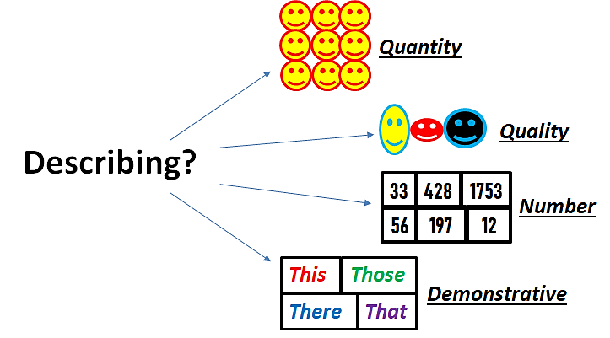
Question 2
Many children are playing in the park. What type of Adjective is many?
a) adjective of quality
b) adjective of quantity
c) adjective of number
d) demonstrative adjective
Click here for Answer
Notes:
Notes for Teacher - < Information for further reference or explanation >
Suggestions: <Ideas/ Images/ Animations / Others – To make better representation of the content >
Source of Multimedia used in this slide - <Please provide source URL where we find the image and the license agreement>
Describing: Self-Created by Arjun Kaul email: 1110ak1110@gmail.com
Tick: https://pixabay.com/vectors/check-mark-orange-tick-symbol-304167/

Slide 4
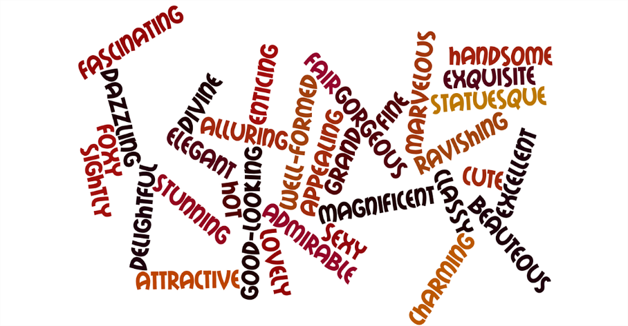
Question 3
The old man asked for help. The adjective old in this sentence is _____
a) adjective of number
b) adjective of quantity
c) adjective of quality
d) possessive adjective
Click here for Answer
Notes:
Notes for Teacher - < Information for further reference or explanation >
Suggestions: <Ideas/ Images/ Animations / Others – To make better representation of the content >
Source of Multimedia used in this slide - <Please provide source URL where we find the image and the license agreement>
Tick: https://pixabay.com/vectors/check-mark-orange-tick-symbol-304167/
Word cloud: https://pixabay.com/illustrations/words-word-cloud-adjective-stunning-639309/

Slide 5
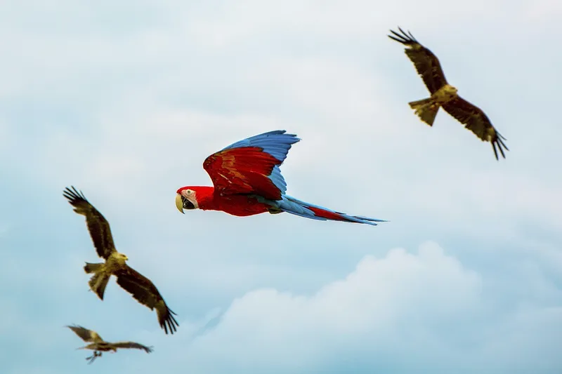
Question 4 (a)
Choose the correct adjective for the blank.
The red bird flew __________ than the other birds.
i) fast
ii) fastest
iii) fatter
iv) faster
Click here for Answer
Notes:
Notes for Teacher - < Information for further reference or explanation >
Suggestions: <Ideas/ Images/ Animations / Others – To make better representation of the content >
Source of Multimedia used in this slide –
<Birds Flying= https://www.rawpixel.com/image/3284792/free-photo-image-flying-parrot-bird-macaw>
Tick: https://pixabay.com/vectors/check-mark-orange-tick-symbol-304167/

Slide 6
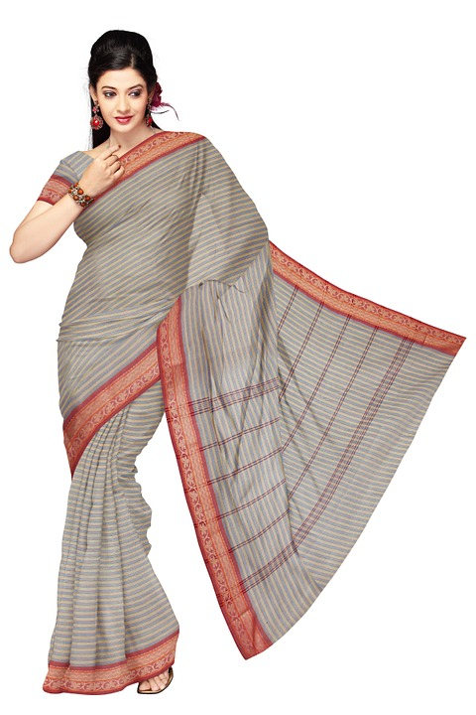
Question 4 (b)
Choose the correct adjective for the blank.
Sunita is wearing a _________ dress for the party.
i) stylish
ii) thin
iii) shabby
iv) dirty
Click here for Answer
Notes:
Notes for Teacher - < Information for further reference or explanation >
Suggestions: <Ideas/ Images/ Animations / Others – To make better representation of the content >
Source of Multimedia used in this slide –
Woman: https://pixabay.com/photos/sari-indian-clothing-fashion-silk-351106/
Tick: https://pixabay.com/vectors/check-mark-orange-tick-symbol-304167/

Slide 7
Question 4 (c)
Choose the correct adjective for the blank.
(c) There are ____ colours in a rainbow.
i) ten
ii) six
iii) seven
iv) four
Click here for Answer
Notes:
Notes for Teacher - < Information for further reference or explanation >
Suggestions: <Ideas/ Images/ Animations / Others – To make better representation of the content >
Source of Multimedia used in this slide –
Rainbow: https://pixabay.com/vectors/rainbow-multicoloured-prism-2278774/
Tick: https://pixabay.com/vectors/check-mark-orange-tick-symbol-304167/

Slide 8
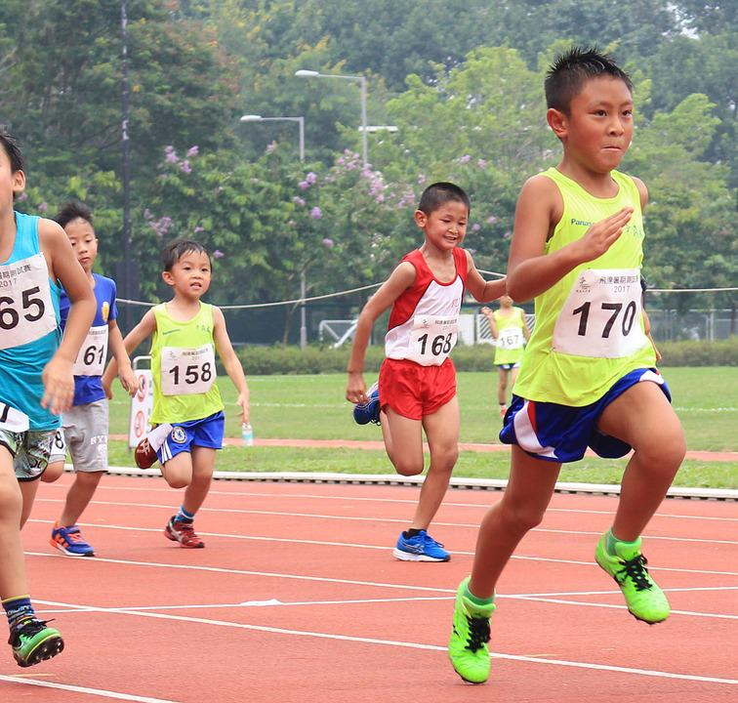
Question 4 (d)
Choose the correct adjective for the blank.
Anil came ______ in the race.
i) first
ii) late
iii) low
iv) happy
Click here for Answer
Notes:
Notes for Teacher - < Information for further reference or explanation >
Suggestions: <Ideas/ Images/ Animations / Others – To make better representation of the content >
Source of Multimedia used in this slide –
Boy running: https://www.maxpixel.net/Children-Sports-Running-2837486
Tick: https://pixabay.com/vectors/check-mark-orange-tick-symbol-304167/

Slide 9
Question 5
Fill in the blank with a suitable adjective.
Tanya is a ____ dancer.
Possible Answers:
Good
Graceful
Wonderful
Beautiful
Click here for Possible Answers
Notes:
Notes for Teacher - < Information for further reference or explanation >
Suggestions: <Ideas/ Images/ Animations / Others – To make better representation of the content >
Source of Multimedia used in this slide –
<Girl Dancer= https://pixabay.com/photos/girl-indian-dance-red-oriental-1505407/ >

Slide 10
Question 6
Q6. Provide the comparative form of the adjectives:
pretty
bad
good
lazy
a) prettier than
b) worse than
c) better than
d) lazier than
Notes:
Notes for Teacher - < Information for further reference or explanation >
Suggestions: <Ideas/ Images/ Animations / Others – To make better representation of the content >
Source of Multimedia used in this slide - <Please provide source URL where we find the image and the license agreement>

Slide 11
MM Index
Slide # | Thumbnail | Source link and Attribution
1 |  | https://pixabay.com/illustrations/quiz-question-puzzles-play-neon-5858940/
1 |  | https://freesvg.org/1523097512
4 |  | https://pixabay.com/illustrations/words-word-cloud-adjective-stunning-639309/
5 |  | https://www.rawpixel.com/image/3284792/free-photo-image-flying-parrot-bird-macaw
6 |  | https://pixabay.com/photos/sari-indian-clothing-fashion-silk-351106/
7 |  | https://pixabay.com/vectors/rainbow-multicoloured-prism-2278774/
8 |  | https://www.maxpixel.net/Children-Sports-Running-2837486
9 |  | https://pixabay.com/photos/girl-indian-dance-red-oriental-1505407/
2 - 8 |  | https://pixabay.com/vectors/check-mark-orange-tick-symbol-304167/
Notes:
Notes for Teacher - < Information for further reference or explanation >
Suggestions: <Ideas/ Images/ Animations / Others – To make better representation of the content >
Source of Multimedia used in this slide - <Please provide source URL where we find the image and the license agreement>

