Slide 1
Board Game
Demonstrative Adjectives
Notes:
Notes for Teacher - < Information for further reference or explanation >
Suggestions: <Ideas/ Images/ Animations / Others – To make better representation of the content >
Source of Multimedia used in this slide - <Please provide source URL where we find the image and the license agreement>

Slide 2
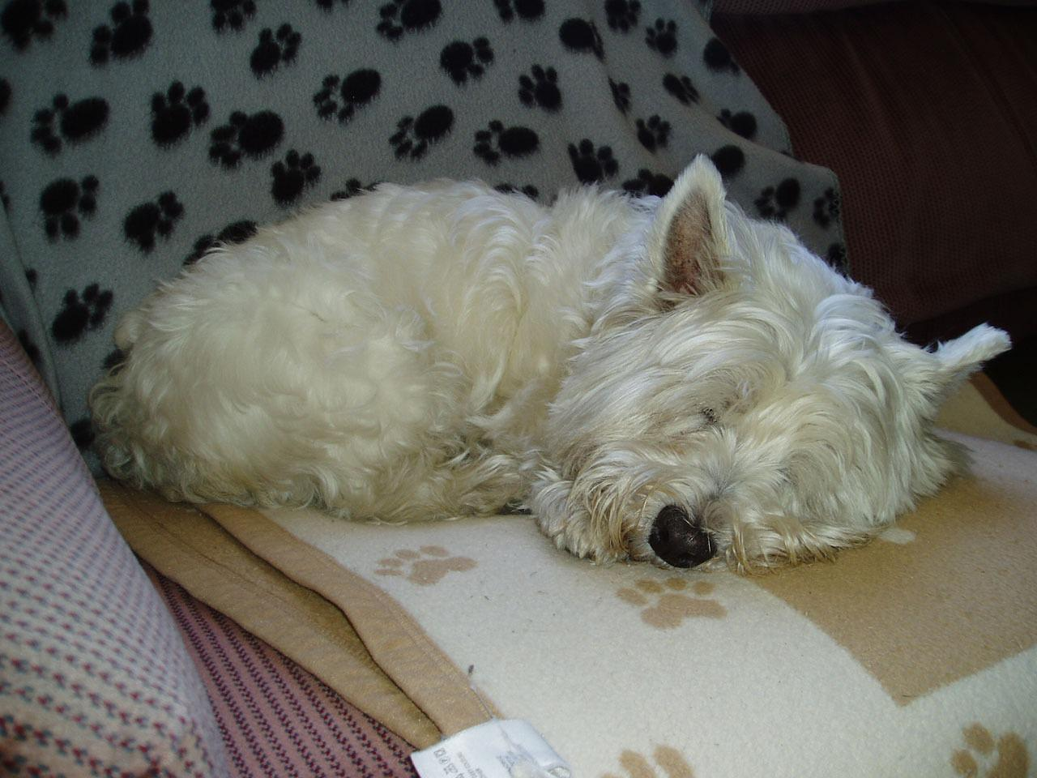
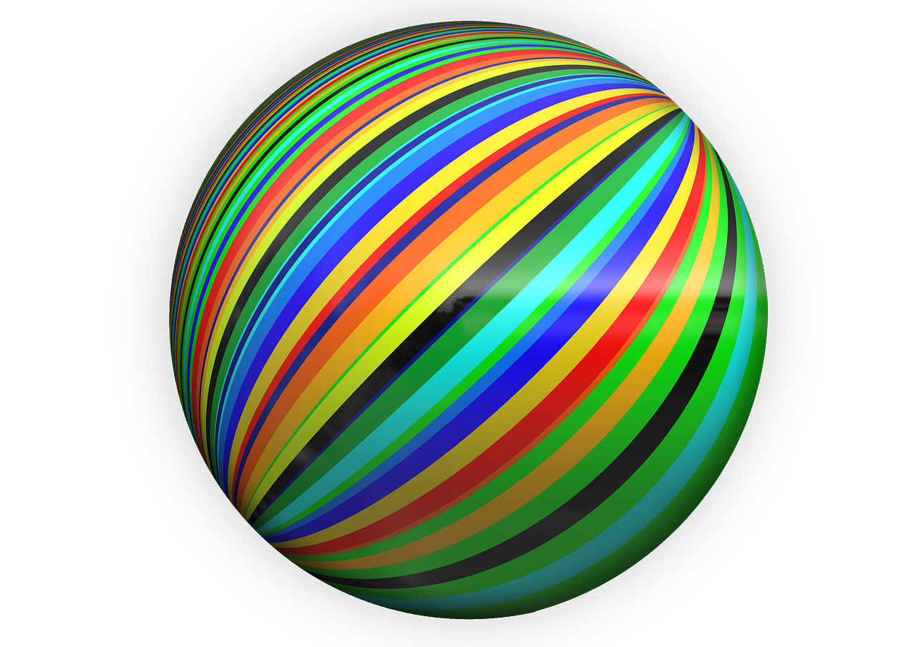
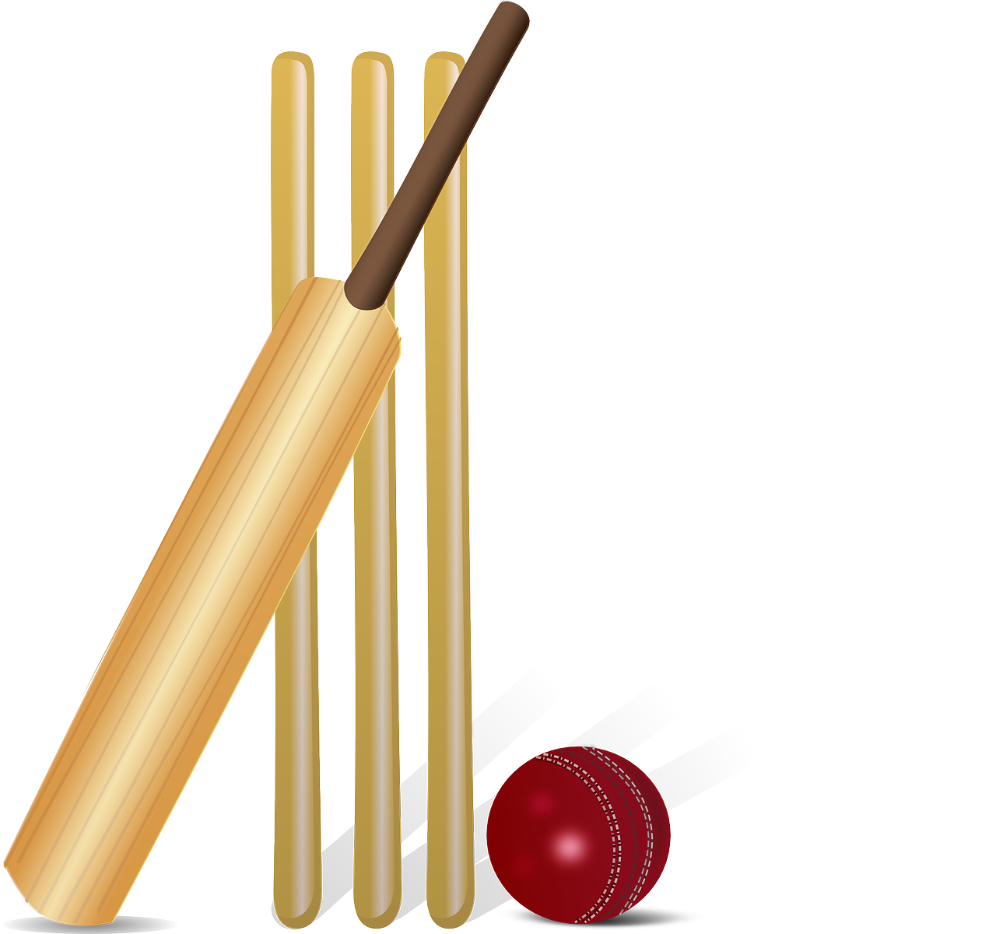
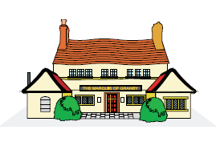
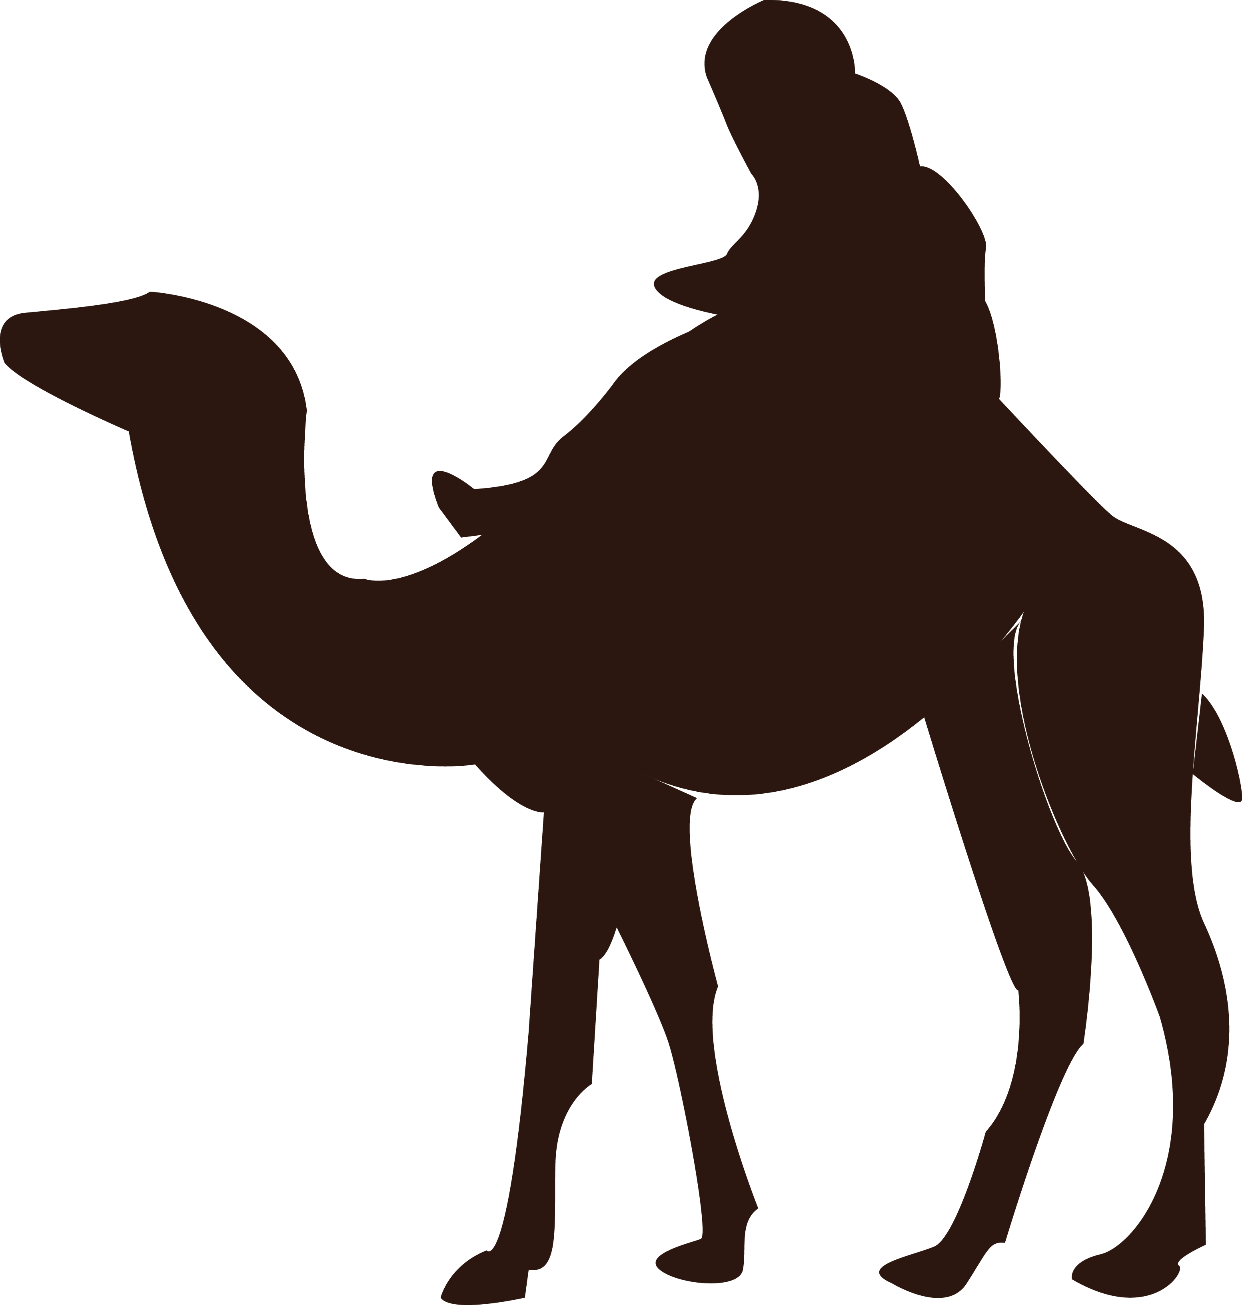
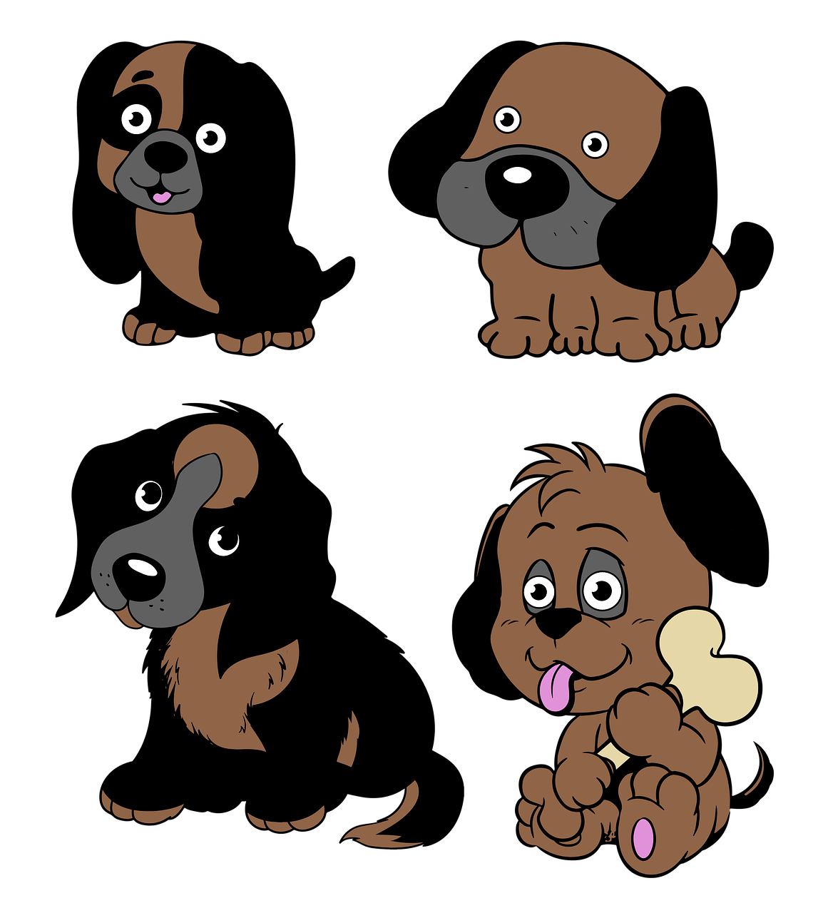
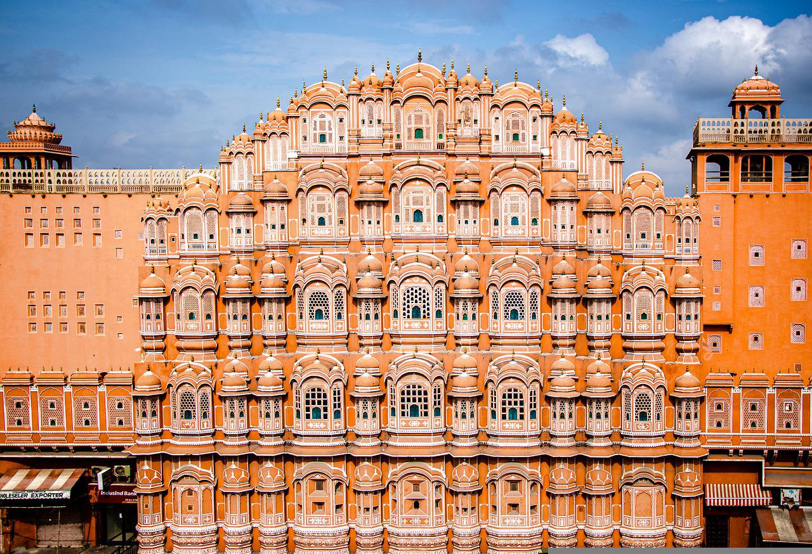
The Game
Go
Back
Start
Cats
Dogs
For images use this or these
Ball
People
Move
ahead
Eggs
Book
Parrot
For noun words use that or those
School
Go
Back
Girls
Egg
Cats
Balls
Bull
Cow
Adjective bank
long, new, nice, OK, old, orange,
sleepy, white, young
big, colourful, fine, cute, good, black, hot, little
Finish
Notes:
Notes for Teacher - < Information for further reference or explanation >
Suggestions: <Ideas/ Images/ Animations / Others – To make better representation of the content >
Source of Multimedia used in this slide - <Please provide source URL where we find the image and the license agreement>
<veda book> - <SSSVV – book, veda book>
<boy, man> - <SSSVV - boy>
<house> <SSSVV-house>
<recorder> - <SSSVV– recorder>
<camel> - <SSSVV – camel>
<kittens> - <https://pixabay.com/vectors/kitty-cuddling-cat-kitten-feline-151949/>
<colourful ball > - <https://pixabay.com/illustrations/to-dye-ball-round-bullet-262808/>
<orange ball> - <https://pixabay.com/vectors/basketball-ball-sport-orange-ball-155997/>
<football> <https://pixabay.com/vectors/football-ball-sport-soccer-round-157930/>
<cricket> <https://pixabay.com/vectors/cricket-cricket-bat-bat-ball-155965/>
<dog sleeping> <https://pixabay.com/photos/molly-sleeping-dog-canine-west-14171/>
<orange flower> - <https://pixabay.com/illustrations/chrysanthemum-flower-bloom-5683416/>
<baby girl> <https://pixabay.com/photos/baby-small-girl-indian-child-love-3588097/>
<sweets> <https://pixabay.com/photos/fresh-jalebi-indian-sweet-dessert-818316/>
<dogs> <https://pixabay.com/illustrations/dogs-puppies-cartoon-pets-animals-6990170/>
<cat> <https://pixabay.com/vectors/cat-animal-the-silhouette-1583462/>
<palace> https://pixabay.com/photos/hawa-mahal-palace-architecture-6156123/>

Slide 3
MM INDEX
Slide # | Thumbnail | Source link and Attribution
1 |  | <kittens> - <https://pixabay.com/vectors/kitty-cuddling-cat-kitten-feline-151949/> <colourful ball > - <https://pixabay.com/illustrations/to-dye-ball-round-bullet-262808/> <orange ball> - <https://pixabay.com/vectors/basketball-ball-sport-orange-ball-155997/> <football> <https://pixabay.com/vectors/football-ball-sport-soccer-round-157930/>
1 |  | <cricket> <https://pixabay.com/vectors/cricket-cricket-bat-bat-ball-155965/> <dog sleeping> <https://pixabay.com/photos/molly-sleeping-dog-canine-west-14171/> <orange flower> - <https://pixabay.com/illustrations/chrysanthemum-flower-bloom-5683416/> <baby girl> <https://pixabay.com/photos/baby-small-girl-indian-child-love-3588097/>
1 |  | <sweets> <https://pixabay.com/photos/fresh-jalebi-indian-sweet-dessert-818316/> <dogs> <https://pixabay.com/illustrations/dogs-puppies-cartoon-pets-animals-6990170/> <cat> <https://pixabay.com/vectors/cat-animal-the-silhouette-1583462/> <palace> https://pixabay.com/photos/hawa-mahal-palace-architecture-6156123/>
Notes:
Notes for Teacher - < Information for further reference or explanation >
Suggestions: <Ideas/ Images/ Animations / Others – To make better representation of the content >
Source of Multimedia used in this slide - <Please provide source URL where we find the image and the license agreement>

