Slide 1
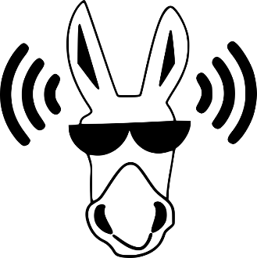
Neighbouring Sounds
Notes:
Notes for Teacher - < Information for further reference or explanation >
Suggestions: <Ideas/ Images/ Animations / Others – To make better representation of the content >
Source of Multimedia used in this slide - <Please provide source URL where we find the image and the license agreement>
Donkey – https://pixabay.com/vectors/ass-cool-animal-sound-2025922/
Sounds - https://freesvg.org/audio-signal-vector-silhouette

Slide 2
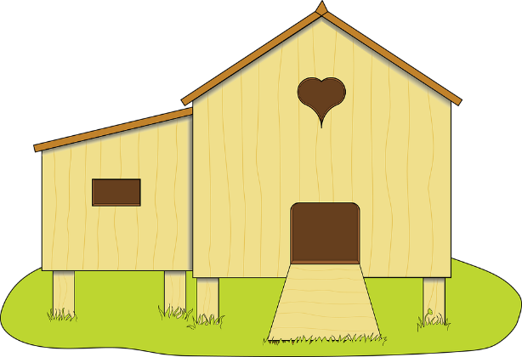
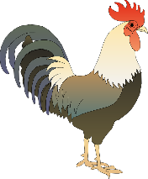
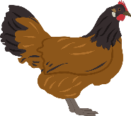
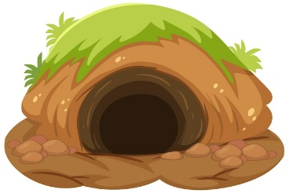
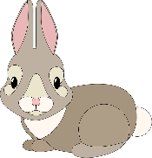
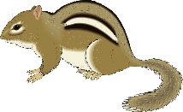
Neighbouring Sounds
This rooster and this hen,
Live in a coop,
‘Cause they like it there.
But that hare and that squirrel,
Live in a hole.
‘Cause they feel safe there.
Notes:
Notes for Teacher - < Information for further reference or explanation >
Suggestions: <Ideas/ Images/ Animations / Others – To make better representation of the content >
Source of Multimedia used in this slide - <Please provide source URL where we find the image and the license agreement>
Coop - https://pixabay.com/illustrations/chicken-coop-farm-chicken-poultry-3998367/
Rooster - https://pixabay.com/vectors/rooster-cock-tap-faucet-hammer-161546/
Hen - https://pixabay.com/vectors/chicken-hen-poultry-bird-farm-5412952/
Hare - https://pixabay.com/vectors/graphic-bunny-rebbit-cute-cuddly-4064917/
Squirrel - https://pixabay.com/vectors/small-chipmunk-forest-animal-still-48430/
Burrow - https://www.freepik.com/free-vector/ground-animal-hole-isolated-white-background_19763506.htm#query=burrow&position=0&from_view=search (Attribution – brgfx)
Cow - https://pixabay.com/vectors/cow-gray-white-barn-farm-standing-48434/
Sheep - https://pixabay.com/vectors/farm-sheep-front-animal-mammal-46741/
Farm - https://www.freepik.com/free-vector/farm-fresh-graphic_8230621.htm#page=4&query=farmhouse&position=45&from_view=search (Attribution – studiogstock)

Slide 3
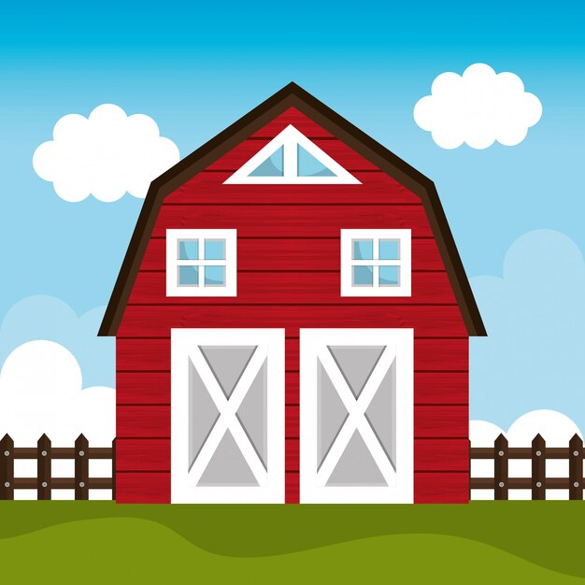
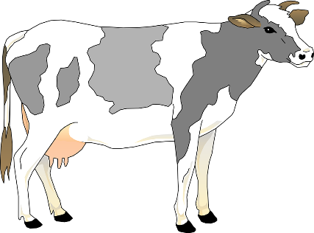
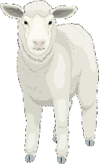
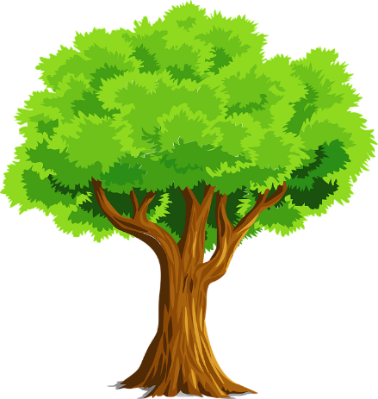
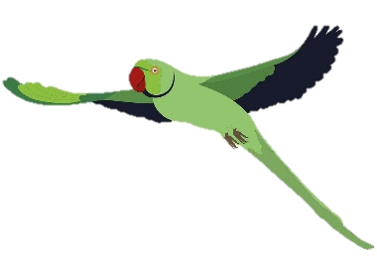
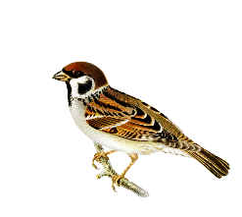
Neighbouring Sounds
These cows and these sheep,
Live on my farm,
Chewing the green grass.
But those sparrows and
those parrots live on trees,
Chirping and chattering in the breeze.
Notes:
Notes for Teacher - < Information for further reference or explanation >
Suggestions: <Ideas/ Images/ Animations / Others – To make better representation of the content >
Source of Multimedia used in this slide - <Please provide source URL where we find the image and the license agreement>
Sparrow - https://pixabay.com/illustrations/bird-sparrow-ornithology-species-6638808/
Parrot - https://pixabay.com/illustrations/parakeet-parrot-flying-bird-6595535/
Tree - https://pixabay.com/vectors/nature-plant-tree-2027899/
Rooster - https://pixabay.com/vectors/rooster-cock-tap-faucet-hammer-161546/
Hen - https://pixabay.com/vectors/chicken-hen-poultry-bird-farm-5412952/
Hare - https://pixabay.com/vectors/graphic-bunny-rebbit-cute-cuddly-4064917/
Squirrel - https://pixabay.com/vectors/small-chipmunk-forest-animal-still-48430/
Cow - https://pixabay.com/vectors/cow-gray-white-barn-farm-standing-48434/
Sheep - https://pixabay.com/vectors/farm-sheep-front-animal-mammal-46741/
Musical Notes - https://www.freepik.com/free-vector/musical-symbols-wave-white-background_20829356.htm#page=2&query=sounds&position=22&from_view=search (Attribution – brgfx)

Slide 4
Neighbouring Sounds
But this rooster and that hare,
This hen and that squirrel,
These cows and those sheep,
Those sparrows and those parrots.
All make a lot of noise…
Do you know why ?
Notes:
Notes for Teacher - < Information for further reference or explanation >
Suggestions: <Ideas/ Images/ Animations / Others – To make better representation of the content >
Source of Multimedia used in this slide - <Please provide source URL where we find the image and the license agreement>
Sparrow - https://pixabay.com/illustrations/bird-sparrow-ornithology-species-6638808/
Parrot - https://pixabay.com/illustrations/parakeet-parrot-flying-bird-6595535/
Tree - https://pixabay.com/vectors/nature-plant-tree-2027899/
Rooster - https://pixabay.com/vectors/rooster-cock-tap-faucet-hammer-161546/
Hen - https://pixabay.com/vectors/chicken-hen-poultry-bird-farm-5412952/
Hare - https://pixabay.com/vectors/graphic-bunny-rebbit-cute-cuddly-4064917/
Squirrel - https://pixabay.com/vectors/small-chipmunk-forest-animal-still-48430/
Cow - https://pixabay.com/vectors/cow-gray-white-barn-farm-standing-48434/
Sheep - https://pixabay.com/vectors/farm-sheep-front-animal-mammal-46741/
Musical Notes - https://www.freepik.com/free-vector/musical-symbols-wave-white-background_20829356.htm#page=2&query=sounds&position=22&from_view=search (Attribution – brgfx)

Slide 5
MM Index
Slide # | Thumbnail | Source link and Attribution
1, 2, 3, 4 |  | Donkey – https://pixabay.com/vectors/ass-cool-animal-sound-2025922/ Sounds - https://freesvg.org/audio-signal-vector-silhouette
2 |  | Coop - https://pixabay.com/illustrations/chicken-coop-farm-chicken-poultry-3998367/ Burrow - https://www.freepik.com/free-vector/ground-animal-hole-isolated-white-background_19763506.htm (Attribution – brgfx)
2, 4 |  | Rooster - https://pixabay.com/vectors/rooster-cock-tap-faucet-hammer-161546/ Hen - https://pixabay.com/vectors/chicken-hen-poultry-bird-farm-5412952/ Hare - https://pixabay.com/vectors/graphic-bunny-rebbit-cute-cuddly-4064917/ Squirrel - https://pixabay.com/vectors/small-chipmunk-forest-animal-still-48430/
3 |  | Tree - https://pixabay.com/vectors/nature-plant-tree-2027899/ Farm - https://www.freepik.com/free-vector/farm-fresh-graphic_8230621.htm (Attribution – studiogstock)
3, 4 |  | Sparrow - https://pixabay.com/illustrations/bird-sparrow-ornithology-species-6638808/ Parrot - https://pixabay.com/illustrations/parakeet-parrot-flying-bird-6595535/ Cow - https://pixabay.com/vectors/cow-gray-white-barn-farm-standing-48434/ Sheep - https://pixabay.com/vectors/farm-sheep-front-animal-mammal-46741/
4 |  | Musical Notes - https://www.freepik.com/free-vector/musical-symbols-wave-white-background_20829356.htm (Attribution – brgfx)
Notes:
Notes for Teacher - < Information for further reference or explanation >
Suggestions: <Ideas/ Images/ Animations / Others – To make better representation of the content >
Source of Multimedia used in this slide - <Please provide source URL where we find the image and the license agreement>

