Slide 1
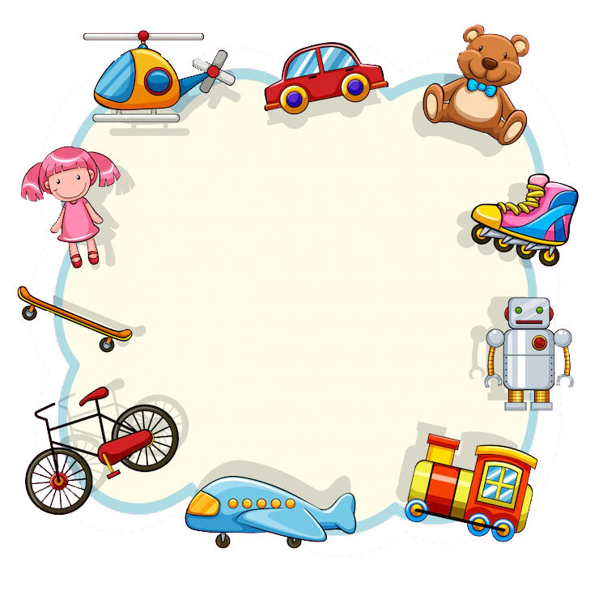
Conversation
at a
Toy Shop
Notes:
Notes for Teacher - The teacher may ask the students to bring some toy cars, create a shop like scene in the classroom and ask three students to read the conversation.
Suggestions: <Ideas/ Images/ Animations / Others – To make better representation of the content >
Source of Multimedia used in this slide - <Please provide source URL where we find the image and the license agreement>
https://www.freepik.com/free-vector/pink-frame-with-children-toys_4537258.htm#query=toys&position=1&from_view=search (Attribution – brgfx)

Slide 2
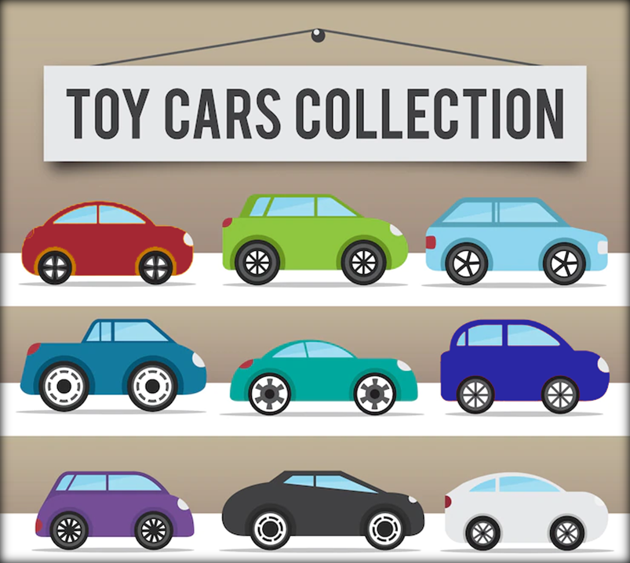
Conversation at a Toy Shop
Vinay: I would like to buy some of those small cars.
Sanjay: Why don’t you ask the shopkeeper?
Notes:
Notes for Teacher - The teacher may ask the students to bring some toy cars, create a shop like scene in the classroom and ask three students to read the conversation.
Fill in the blanks with suitable demonstrative adjectives in the conversation given below.
Suggestions: <Ideas/ Images/ Animations / Others – To make better representation of the content >
Source of Multimedia used in this slide - <Please provide source URL where we find the image and the license agreement>
Toy Cars - https://www.freepik.com/free-vector/collection-toy-vehicles_974565.htm#page=7&query=toy%20cars&position=5&from_view=search (Attribution – freepik)
Boys - https://www.freepik.com/free-vector/two-boy-characters-with-happy-face_4955111.htm#query=two%20boys&position=0&from_view=search (Attribution – brgfx)

Slide 3
Conversation at a Toy Shop
Vinay: Excuse me Sir, I would like to buy some cars for my younger brother.
Shopkeeper: Of course, which ones do you like?
I like the blue ones.
Notes:
Notes for Teacher - < Information for further reference or explanation >
Suggestions: <Ideas/ Images/ Animations / Others – To make better representation of the content >
Source of Multimedia used in this slide - <Please provide source URL where we find the image and the license agreement>
Toy Cars - https://www.freepik.com/free-vector/collection-toy-vehicles_974565.htm#page=7&query=toy%20cars&position=5&from_view=search (Attribution – freepik)
Boy - https://www.hiclipart.com/free-transparent-background-png-clipart-izoeq
Man - https://www.freepik.com/free-vector/cartoon-boy-character-template_4175458.htm#page=2&query=man&position=14&from_view=search (Attribution – pikisuperstar)

Slide 4
Conversation at a Toy Shop
Shopkeeper: You may take a look at ____ car, it is the latest model.
this
Sanjay: My friend is not fond of _____ type of a car.
that
Click on the speech bubble to see the demonstrative adjective
Notes:
Notes for Teacher - < Information for further reference or explanation >
Suggestions: <Ideas/ Images/ Animations / Others – To make better representation of the content >
Source of Multimedia used in this slide - <Please provide source URL where we find the image and the license agreement>
Toy Cars - https://www.freepik.com/free-vector/collection-toy-vehicles_974565.htm#page=7&query=toy%20cars&position=5&from_view=search (Attribution – freepik)
Boy - https://www.freepik.com/free-vector/two-boy-characters-with-happy-face_4955111.htm#query=two%20boys&position=0&from_view=search (Attribution – brgfx)
Man - https://www.freepik.com/free-vector/cartoon-boy-character-template_4175458.htm#page=2&query=man&position=14&from_view=search (Attribution – pikisuperstar)

Slide 5
Conversation at a Toy Shop
Shopkeeper: ______ ones?
Vinay: I like _____ blue cars the most.
These
those
Click on the speech bubble to see the demonstrative adjective
Notes:
Notes for Teacher - < Information for further reference or explanation >
Suggestions: <Ideas/ Images/ Animations / Others – To make better representation of the content >
Source of Multimedia used in this slide - <Please provide source URL where we find the image and the license agreement>
Toy Cars - https://www.freepik.com/free-vector/collection-toy-vehicles_974565.htm#page=7&query=toy%20cars&position=5&from_view=search (Attribution – freepik)
Boy - https://www.hiclipart.com/free-transparent-background-png-clipart-hbuyw
Man - https://www.freepik.com/free-vector/cartoon-boy-character-template_4175458.htm#page=2&query=man&position=14&from_view=search (Attribution – pikisuperstar)

Slide 6
Conversation at a Toy Shop
Vinay: Yes. How much are they for?
Shopkeeper: They are for sixty rupees.
That’s fine. I’ll take them.
Notes:
Notes for Teacher - < Information for further reference or explanation >
Suggestions: <Ideas/ Images/ Animations / Others – To make better representation of the content >
Source of Multimedia used in this slide - <Please provide source URL where we find the image and the license agreement>
Toy Cars - https://www.freepik.com/free-vector/collection-toy-vehicles_974565.htm#page=7&query=toy%20cars&position=5&from_view=search (Attribution – freepik)
Boy - https://www.freepik.com/free-vector/two-boy-characters-with-happy-face_4955111.htm#query=two%20boys&position=0&from_view=search (Attribution – brgfx)
Man - https://www.freepik.com/free-vector/cartoon-boy-character-template_4175458.htm#page=2&query=man&position=14&from_view=search (Attribution – pikisuperstar)

Slide 7
MM Index
Slide # | Thumbnail | Source link and Attribution
1 |  | https://www.freepik.com/free-vector/pink-frame-with-children-toys_4537258.htm (Attribution – brgfx)
2 - 6 |  | https://www.freepik.com/free-vector/collection-toy-vehicles_974565.htm (Attribution – freepik)
2, 4 |  | https://www.freepik.com/free-vector/two-boy-characters-with-happy-face_4955111.htm (Attribution – brgfx)
3, 6 |  | https://www.hiclipart.com/free-transparent-background-png-clipart-izoeq
3 - 6 |  | https://www.freepik.com/free-vector/cartoon-boy-character-template_4175458.htm (Attribution – pikisuperstar)
5 |  | https://www.hiclipart.com/free-transparent-background-png-clipart-hbuyw
Notes:
Notes for Teacher - < Information for further reference or explanation >
Suggestions: <Ideas/ Images/ Animations / Others – To make better representation of the content >
Source of Multimedia used in this slide - <Please provide source URL where we find the image and the license agreement>

