Slide 1
Watch your behaviour
Notes:
Notes for Teacher - < Information for further reference or explanation >
Suggestions: <Ideas/ Images/ Animations / Others – To make better representation of the content >
Source of Multimedia used in this slide - <Please provide source URL where we find the image and the license agreement>

Slide 2
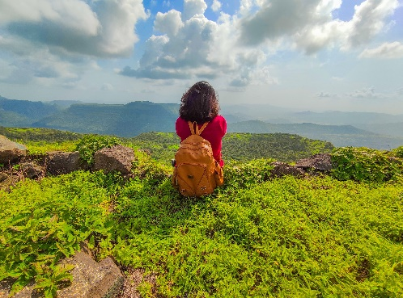
Demonstrative Adjective
Demonstrative adjective is used to specifically describe the position of something or someone in place or time.
Similarly, the way we speak, act or conduct ourselves describes our behaviour.
Notes:
Notes for Teacher - < Teachers can present a few scenarios given below and ask children to respond whether the act is right or wrong.
1. Ram brought that chair for his grandfather to sit on.
2. Those boys were throwing litter on the ground.
3. Atul comes and cleans this park every week.
4. Rita made some delicious cookies for these poor children.
5. This boy always listened and respected his parents.
6. These boys were throwing stones at the dog.
Discussion points
There are countless ways of expressing good behavior that we need to follow. Here are the few examples of polite behaviour or etiquette that we can practice in our day-to-day life:
· Use the magic words like please, thank you, excuse me, sorry etc. wherever and whenever necessary.
· Be honest and truthful.
· Have a smiling face.
· Be friendly and play without fighting.
· Always greet elders with respect.
· Help others and care for them.
Suggestions: <Ideas/ Images/ Animations / Others – To make better representation of the content >
Source of Multimedia used in this slide - <Please provide source URL where we find the image and the license agreement>

Slide 3
Value Song
We have learned, we have learned
What the words Right Action say
We must do what we know is right
Every day and every night.
Think of Love, think of Peace
Think of Truth in all you do
Find these values in your heart
As each new day you do start.
If you use these values true
Right is all that you can do
And happiness with all you'll share
Because with these they'll know you care.
CLICK ME!
Notes:
Notes for Teacher - <http://sssbpt.org/audio/EHV/Track10.mp3>
Suggestions: <Ideas/ Images/ Animations / Others – To make better representation of the content >
Source of Multimedia used in this slide - <Please provide source URL where we find the image and the license agreement>

Slide 4
Reflection
Be Courteous and use kind words.
1
It is very important to behave well at all times, whether it is home, school or society
2
Good behaviour helps keep
good relationship with everyone.
Always be positive and cheerful.
3
Notes:
Notes for Teacher - < As an extension: Teacher can ask students to write how they would like to share or help others who are in need in their own small ways.>
Suggestions: <Ideas/ Images/ Animations / Others – To make better representation of the content >
Source of Multimedia used in this slide - <Please provide source URL where we find the image and the license agreement>

Slide 5
MM INDEX
Slide # | Thumbnail | Source link and Attribution
2 |  | https://pixabay.com/vectors/speech-icon-voice-talking-audio-2797263/ Hill Top: https://pixabay.com/photos/mountains-mountain-top-tourist-6470614/ By Ankita Gkd
3 |  | https://pixabay.com/illustrations/singing-children-song-sing-child-18382/
4 |  | https://pixabay.com/vectors/handshake-shaking-hands-partners-148695/
Notes:
Notes for Teacher - < Information for further reference or explanation >
Suggestions: <Ideas/ Images/ Animations / Others – To make better representation of the content >
Source of Multimedia used in this slide - <Please provide source URL where we find the image and the license agreement>

