Slide 1
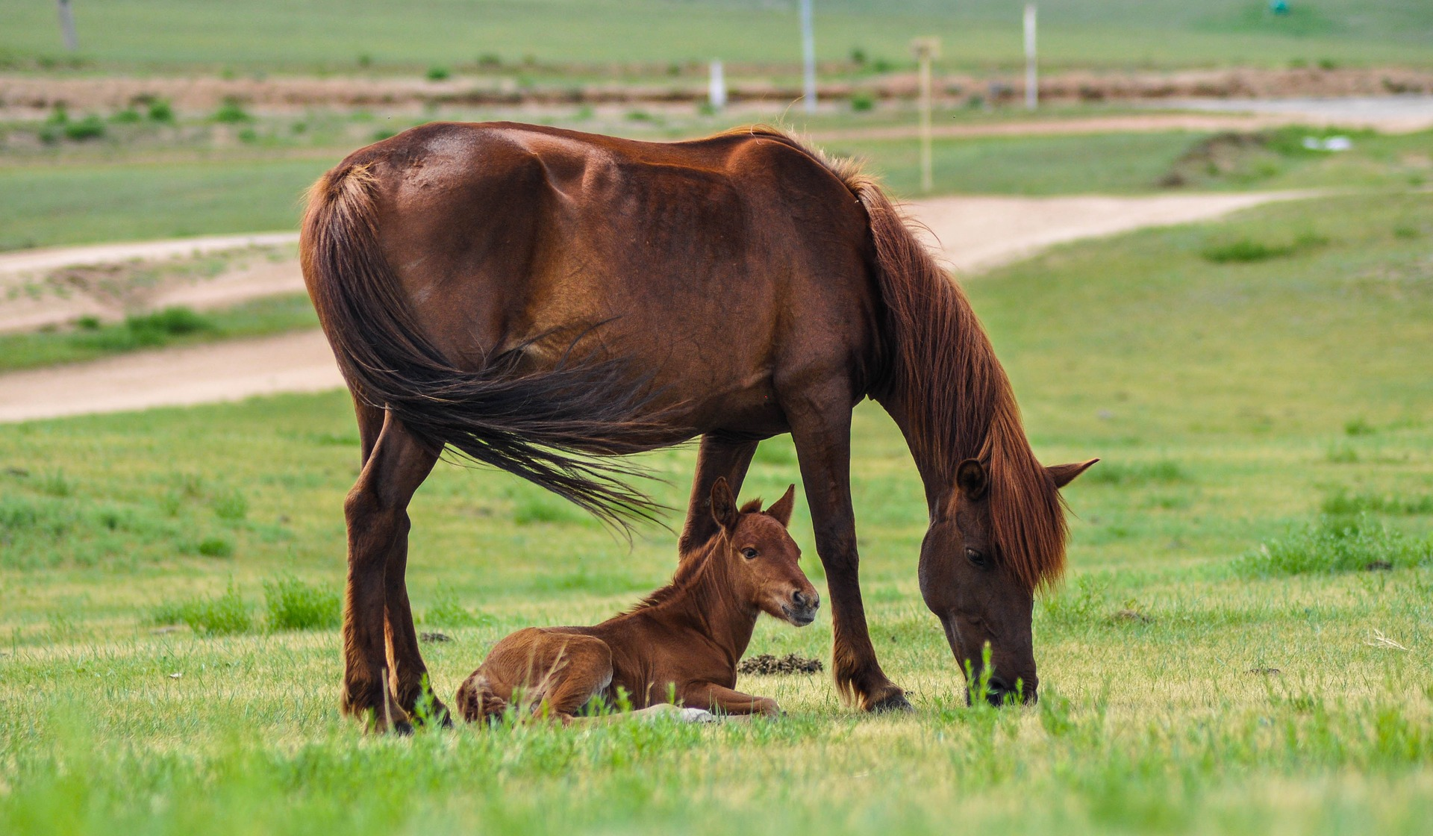
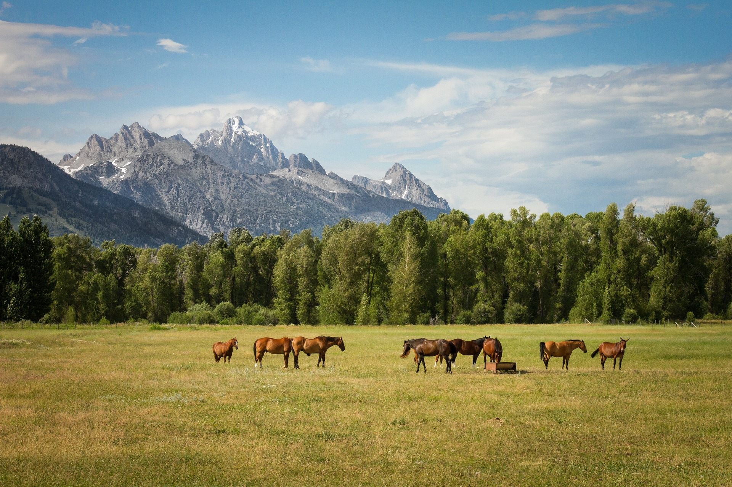
Demonstrative Adjectives
Near
Far
Notes:
Notes for Teacher - < Information for further reference or explanation >
Suggestions: <Ideas/ Images/ Animations / Others – To make better representation of the content >
Source of Multimedia used in this slide - <Please provide source URL where we find the image and the license agreement>
Horse Graze: https://pixabay.com/photos/horse-animal-eating-green-grass-2562792/ By StockSnap
Horse: https://pixabay.com/photos/horses-mare-foal-animal-nature-2504677/ By Erdenebayar

Slide 2
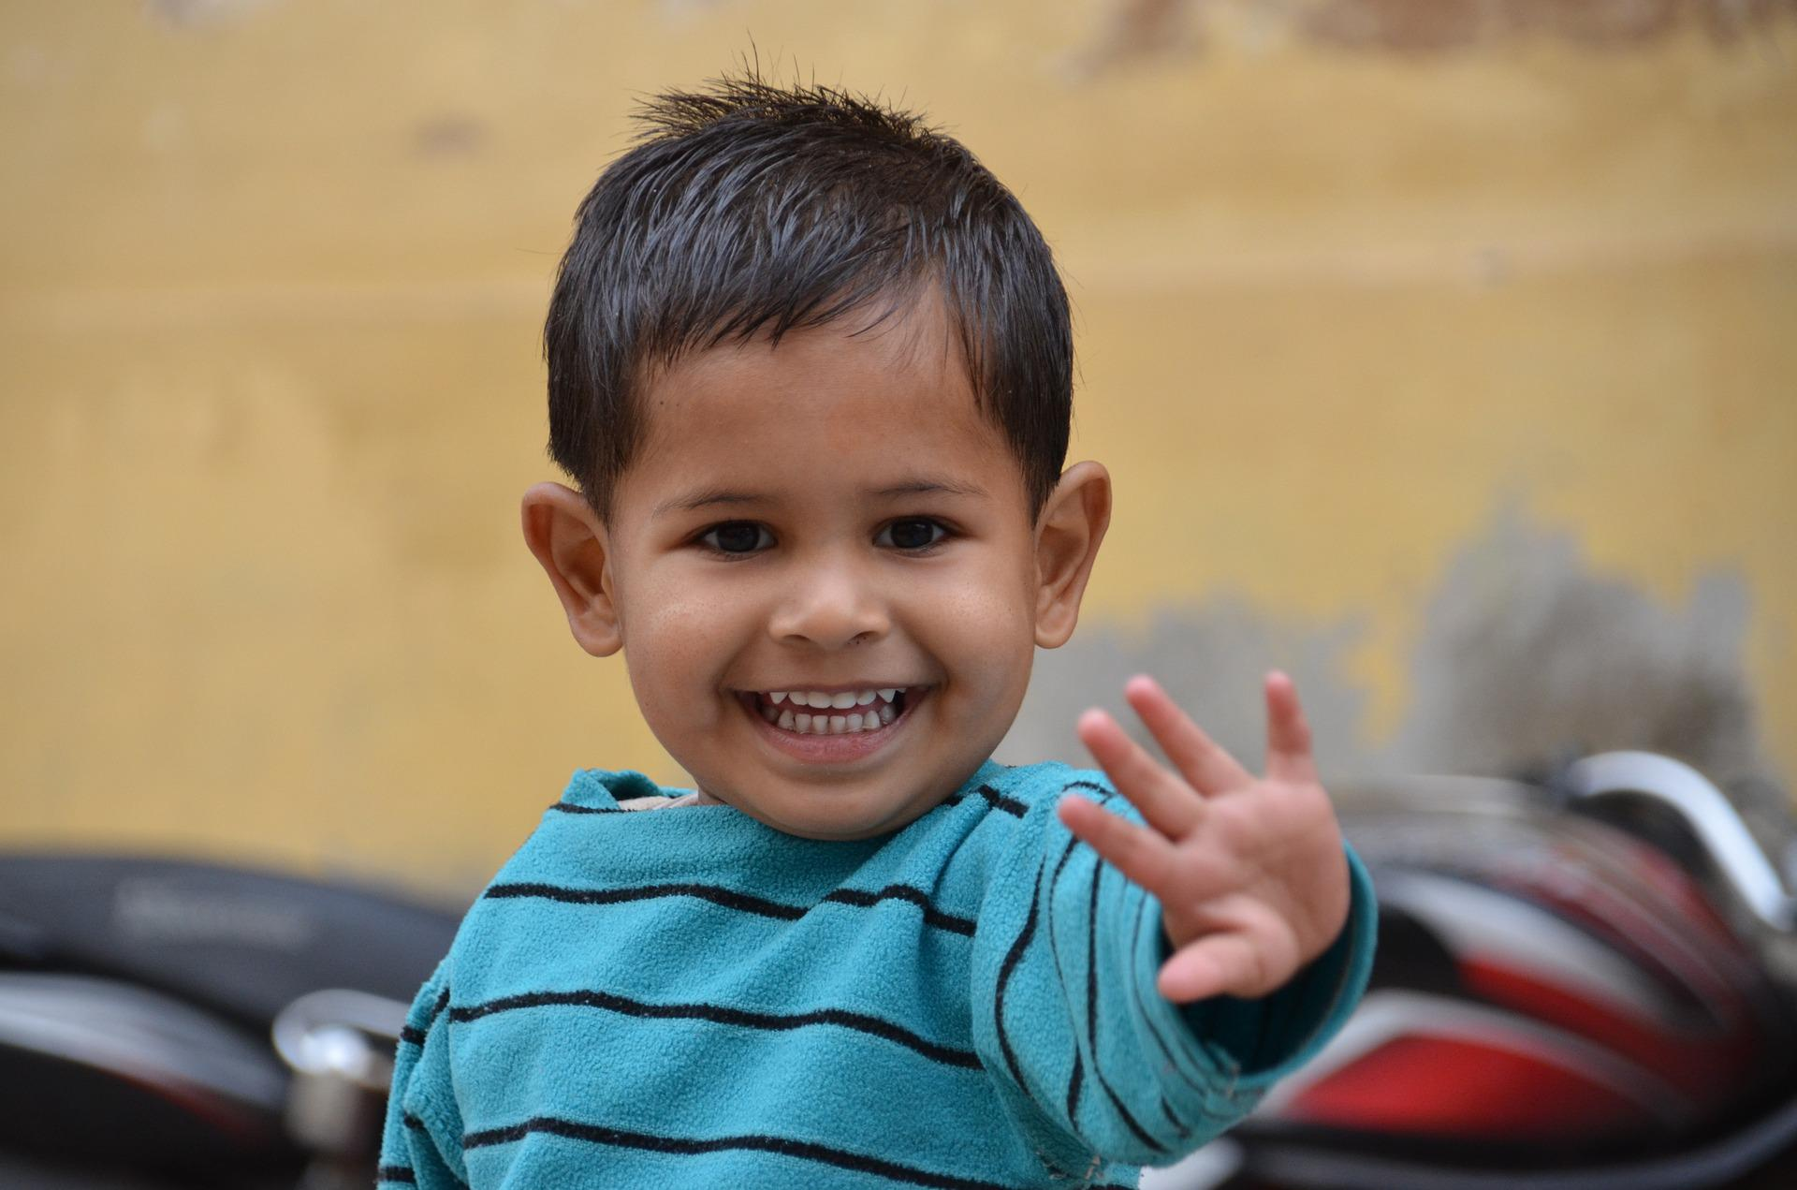
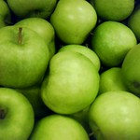
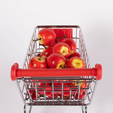
Demonstrative Adjectives
THIS
THAT
Demonstrative Adjectives
THESE
THOSE
Notes:
Notes for Teacher - < Information for further reference or explanation >
Suggestions: <Ideas/ Images/ Animations / Others – To make better representation of the content >
Source of Multimedia used in this slide - <Please provide source URL where we find the image and the license agreement>

Slide 3
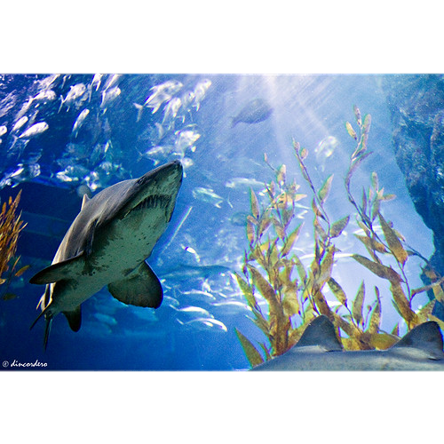
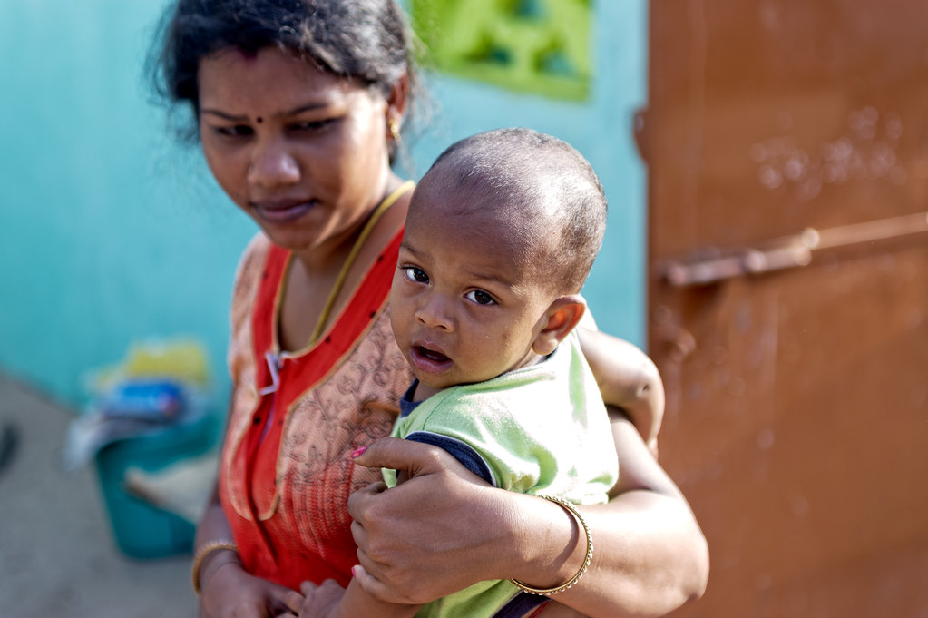
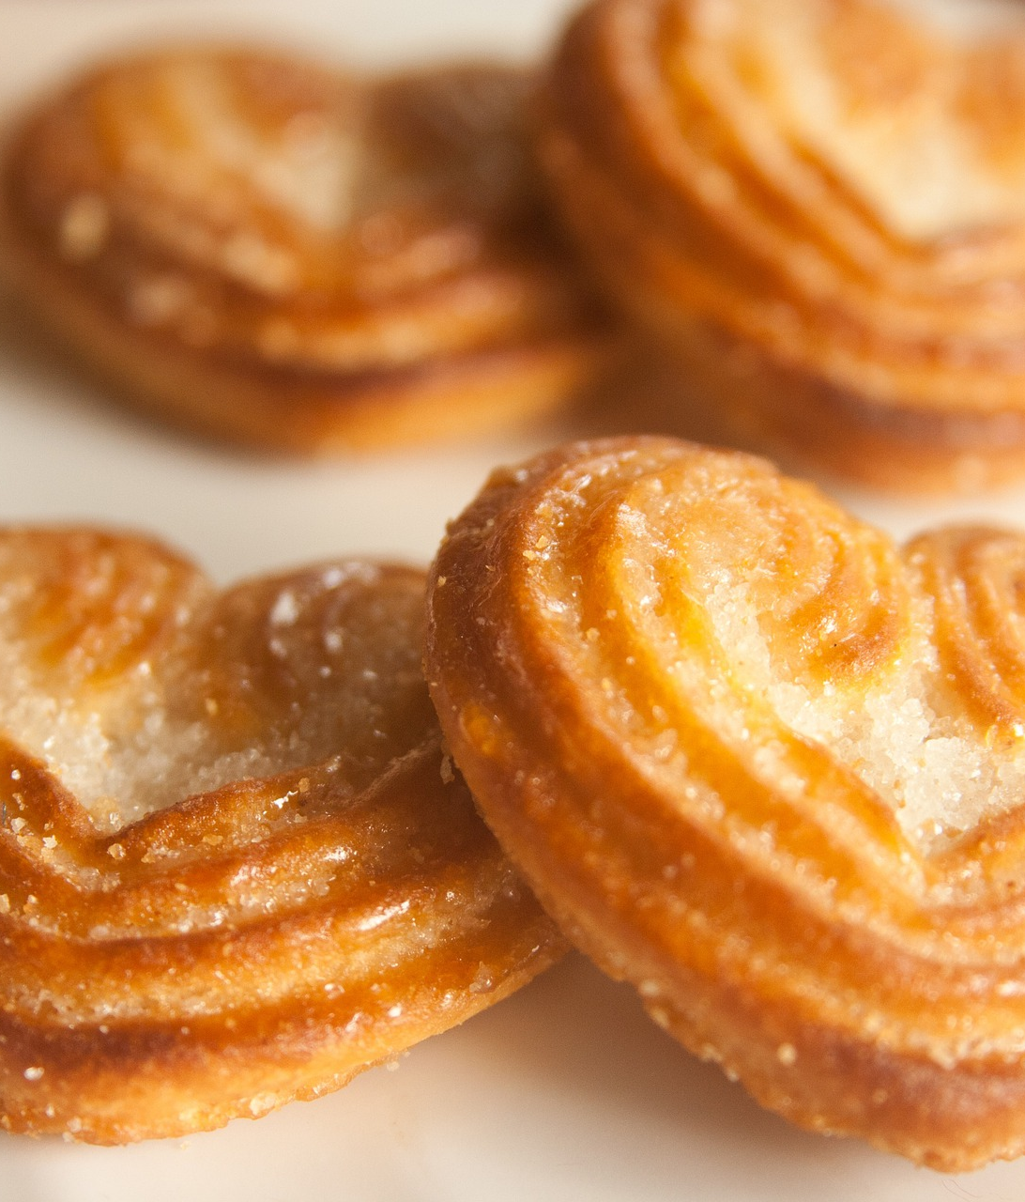
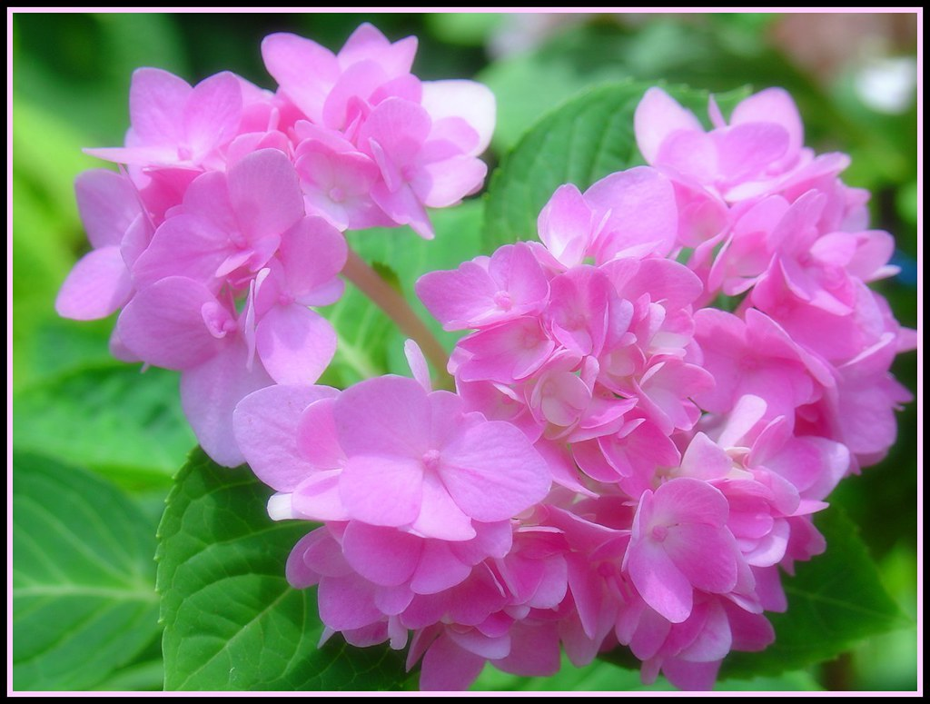
Demonstrative Adjectives come before the noun
THIS SHARK
THAT LADY
THOSE BISCUITS
THESE FLOWERS
Notes:
Notes for Teacher - < Information for further reference or explanation >
Suggestions: <Ideas/ Images/ Animations / Others – To make better representation of the content >
Source of Multimedia used in this slide - <Please provide source URL where we find the image and the license agreement>

Slide 4
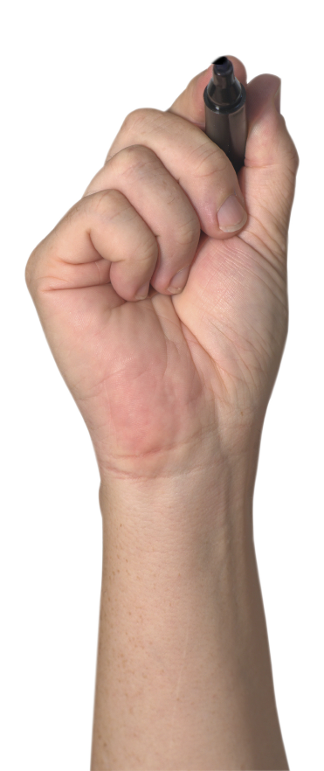
What are Demonstrative adjectives?
Demonstrative Adjectives or Determiners are special adjectives. They are – This, That, These and Those.
Determiners that identify a noun or pronoun.
Show the distance-how far or how near?
Denote whether the noun is singular or plural.
Notes:
Notes for Teacher - < Information for further reference or explanation >
Suggestions: <Ideas/ Images/ Animations / Others – To make better representation of the content >
Source of Multimedia used in this slide - <Please provide source URL where we find the image and the license agreement>

Slide 5
What are Demonstrative adjectives?
This book belongs to me.
These books belong to me.
That book is my sister’s.
Those books are my brother’s.
Notes:
Notes for Teacher - < Information for further reference or explanation >
Suggestions: <Ideas/ Images/ Animations / Others – To make better representation of the content >
Source of Multimedia used in this slide - <Please provide source URL where we find the image and the license agreement>
Book: https://pixabay.com/vectors/book-learn-schoolbook-education-146937/ By OpenClipart-Vectors

Slide 6
Ordinal numbers as Demonstrative Adjectives
The first examination was on Thursday
FIRST
THIRD
NINETEENTH
SEVENTH
FIFTH
Our house is on the third floor
The telephone was invented in the nineteenth century
Red is the seventh colour in the rainbow
Its her fifth birthday
Notes:
Notes for Teacher – < Information for further reference or explanation >
Suggestions: <Ideas/ Images/ Animations / Others – To make better representation of the content >
Source of Multimedia used in this slide - <Please provide source URL where we find the image and the license agreement>

Slide 7
MM INDEX
Slide # | Thumbnail | Source link and Attribution
1 |  | Horse Graze: https://pixabay.com/photos/horse-animal-eating-green-grass-2562792/ By StockSnap Horse: https://pixabay.com/photos/horses-mare-foal-animal-nature-2504677/ By Erdenebayar
2 |  | Boy: https://pixabay.com/photos/balloon-blue-boy-expression-funny-1840075/ Red Apples: https://www.flickr.com/photos/30478819@N08/45859413484 By Marco Verch Professional Photographer Green Apples: https://www.flickr.com/photos/75662745@N00/272310471 By Paola Boy: https://pixabay.com/photos/child-merry-india-pleasure-young-787712/ By Yolanda
3 |  | Shark: https://www.flickr.com/photos/51952142@N00/2630253045 By din Lady: https://www.flickr.com/photos/47850033@N08/37800455514 By Nithi Anand Cookies: https://pixabay.com/photos/heart-cookies-biscuits-sugar-baked-166918/ By PDPics Flowers:https://www.flickr.com/photos/22193699@N04/2505178376 by Thai jasmine
5 |  | Book: https://pixabay.com/vectors/book-learn-schoolbook-education-146937/ By OpenClipart-Vectors
Notes:
Notes for Teacher - < Information for further reference or explanation >
Suggestions: <Ideas/ Images/ Animations / Others – To make better representation of the content >
Source of Multimedia used in this slide - <Please provide source URL where we find the image and the license agreement>

