Slide 1
QUIZ
Testing Demonstrative Adjectives
Notes:
Notes for Teacher - The teacher may present the questions and allow the students to write or say the answers before revealing them. The teacher may write the exercises on the blackboard for students to do in their exercise books or take printouts of the exercises and distribute them to the children.
Suggestions: <Ideas/ Images/ Animations / Others – To make better representation of the content >
Source of Multimedia used in this slide - <Please provide source URL where we find the image and the license agreement>

Slide 2
ROUND 1
Demonstrative Adjectives
Underline the Demonstrative adjectives in the sentences given below.
i. This blue dress here is mine, but that red one is hers.
ii. These books are hers, but those books are mine.
iii. I want those green marbles.
iv. Please give this pen to me.
v. These cakes are delicious. May I have another one?
CLICK ON THE PICTURE FOR THE CORRECT ANSWER
Notes:
Notes for Teacher - < Information for further reference or explanation >
Suggestions: All Images are PPT ICONS, Green Marbles are Self Created by K Rinku <rinku1237@gmail.com>
Source of Multimedia used in this slide - <Please provide source URL where we find the image and the license agreement>

Slide 3
ROUND 1
Demonstrative Adjectives
Underline the Demonstrative adjectives in the sentences given below.
vi. I can’t finish reading those letters today. I’ll read them tomorrow.
This picture was taken in India.
Those mountains you see in the backdrop are the Himalayas.
viii. He wants those skating shoes for practice.
Kavita, could you please make those delicious vadas
you made, again on my birthday?
x. These girls are my classmates.
CLICK ON THE PICTURE FOR THE CORRECT ANSWER
Notes:
Notes for Teacher - < Information for further reference or explanation >
Suggestions: All Images are PPT ICONS
Source of Multimedia used in this slide - <Please provide source URL where we find the image and the license agreement>

Slide 4
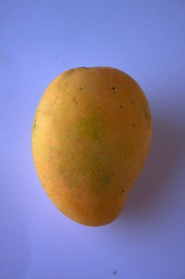
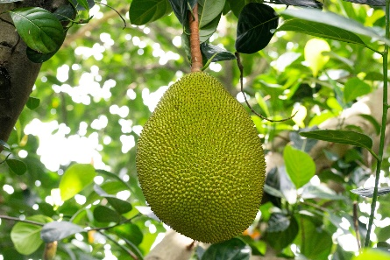
ROUND 2
Plural Form of Demonstrative Adjectives
III. Convert the Demonstrative adjectives into their Plural form.
Example. This mouse is grey.
i. That child is very active.
ii. This mango is very tasty.
iii. This pencil is not mine.
iv. That jackfruit is expensive.
v. That baby is sleeping.
ANS
These mice are grey.
ANS i
Those children are very active.
ANS ii
These mangoes are very tasty.
ANS iii
These pencils are not mine.
ANS iv
Those jackfruits are very expensive.
ANS v
Those babies are sleeping.
CLICK ON THE ARROW FOR THE CORRECT ANSWER
Notes:
Notes for Teacher - < Information for further reference or explanation >
Suggestions:
Source of Multimedia used in this slide - <Please provide source URL where we find the image and the license agreement>
Mango: https://pixabay.com/photos/alphonso-mango-mangoes-sweet-tasty-390423/ By PDPics
Jackfruit: https://pixabay.com/photos/jack-fruit-fruit-tree-jackfruit-5429143/ By balouriarajesh

Slide 5
ROUND 3
Read The Picture Story
Look at this advertisement!
This shop has a huge sale today.
Well I need some…..
Shall I get all these items from this store?
Live Sale !!!! Only For Today
SALE !
You will get all those items at reduced prices.
SALE !
Preeti
SALE IN A SHOP!!!!
Pooja
Sure you should get all these items from this store.
Let’s hurry and not miss this golden opportunity.
Notes:
Notes for Teacher - < Information for further reference or explanation >
Suggestions: All Images are PPT ICONS, Images of Girls are Self created
Source of Multimedia used in this slide - <Please provide source URL where we find the image and the license agreement>

Slide 6
Answer the questions below
Q1. What is ‘this’ referring to in the story?
ANS
‘This’ refers to the advertisement in the story.
Q2. Which demonstrative adjectives are used for the items?
Q2. Which demonstrative adjectives are used for the items?
ANS
The demonstrative adjectives ‘these‘ and ‘those’ have been used for the items on sale in the shop.
Q3. Which demonstrative adjective is used for the phrase ‘golden opportunity’?
ANS
The demonstrative adjective ‘this’ has been used for ‘golden opportunity.’
CLICK ON ‘ANS’ FOR THE CORRECT ANSWER

Slide 7
MM INDEX
Slide # | Thumbnail | Source link and Attribution
4 |  | Mango: https://pixabay.com/photos/alphonso-mango-mangoes-sweet-tasty-390423/ By PDPics Jackfruit: https://pixabay.com/photos/jack-fruit-fruit-tree-jackfruit-5429143/ By balouriarajesh
Notes:
Notes for Teacher - < Information for further reference or explanation >
Suggestions: <Ideas/ Images/ Animations / Others – To make better representation of the content >
Source of Multimedia used in this slide - <Please provide source URL where we find the image and the license agreement>

