Slide 1
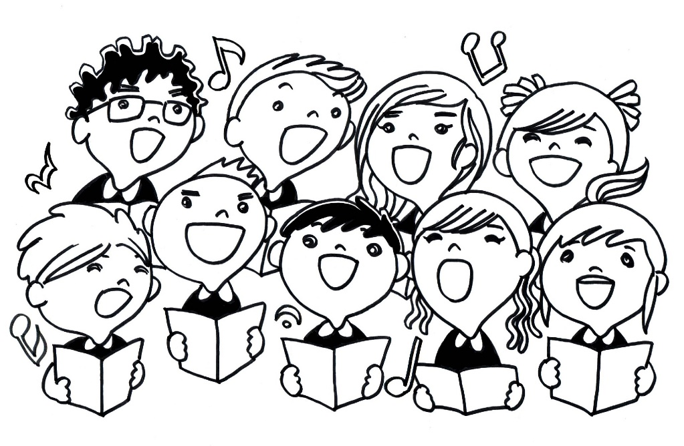
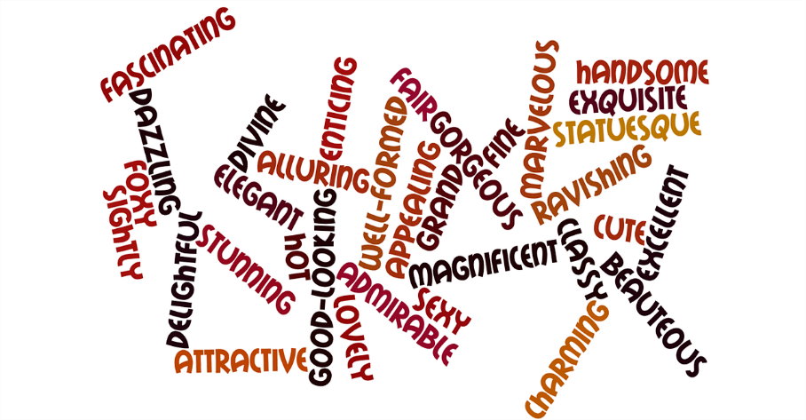
Summary of Demonstrative Adjectives
Notes:
Notes for Teacher - < Information for further reference or explanation >
Suggestions: <Ideas/ Images/ Animations / Others – To make better representation of the content >
Source of Multimedia used in this slide - <Please provide source URL where we find the image and the license agreement>

Slide 2
Summary of Demonstrative Adjectives
Kinds of adjectives of quality & quantity
Use of this, these, that, those
Identify demonstrative adjectives
Use in daily conversations
Makes our language meaningful
The value of good behaviour
Make meaningful sentences using the correct word
Different exercises

Slide 3
MM INDEX
Slide # | Thumbnail | Source link and Attribution
1 |  | https://pixabay.com/illustrations/singing-children-song-sing-child-18382/
1 |  | https://www.freepik.com/free-vector/two-boy-characters-with-happy-face _4955111.htm (Attribution – brgfx)
1 |  | https://pixabay.com/illustrations/words-word-cloud-adjective-stunning-639309/
Notes:
Notes for Teacher - < Information for further reference or explanation >
Suggestions: <Ideas/ Images/ Animations / Others – To make better representation of the content >
Source of Multimedia used in this slide - <Please provide source URL where we find the image and the license agreement>

