Slide 1
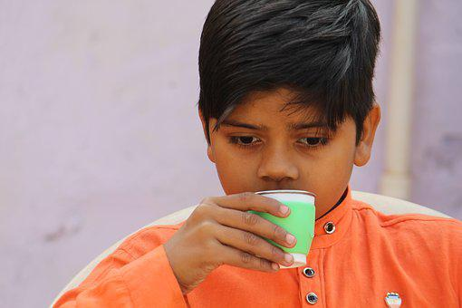
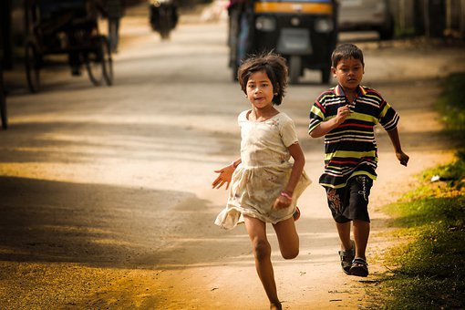
Importance of Adverbs
Notes:
Notes for Teacher - < Information for further reference or explanation >
Suggestions: <Ideas/ Images/ Animations / Others – To make better representation of the content >
Source of Multimedia used in this slide -
1. Drinking: https://pixabay.com/photos/poor-boy-cute-village-boy-child-4133642/
2. Running: https://pixabay.com/photos/children-kids-running-young-girl-5559749/

Slide 2
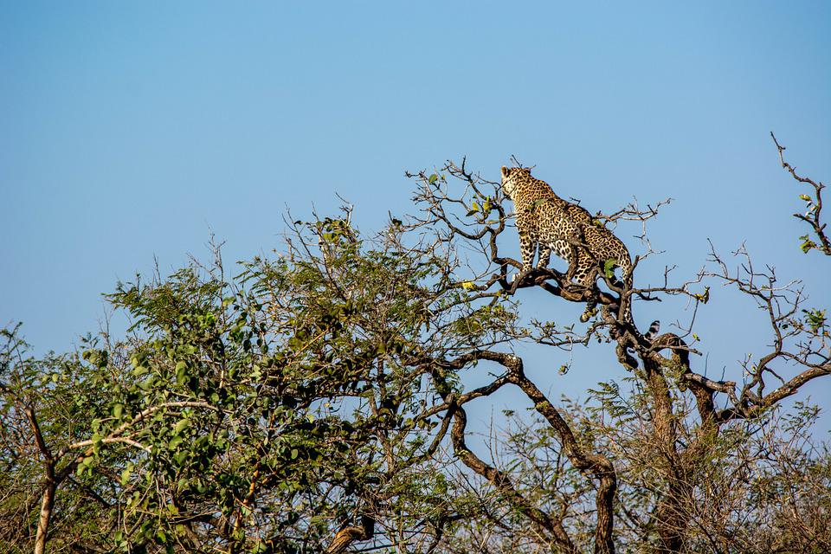
The Leopard and the Zebra
It was a beautiful day. The Sun was shining. Ronnie,
the Zebra walked in the park enjoying the sunny
weather. He heard a crying sound from a nearby
tree. He ignored the cry and kept walking. He
thought to himself, “Maybe someone is in trouble.”
Though he was scared, he walked towards the tree
and looked up to find out who was crying. He saw
a leopard on the tree. Ronnie began to walk away
from the tree. “Please help me,” cried the leopard
that was up on the tree. “I am afraid to jump down.
Please stand under the tree so that I can jump on
your back.” Ronnie replied, “I will help you but you
must promise me that you will not eat me up after
you land on my back.” The leopard replied,
“I promise you; one day, I shall repay your kindness.”
Notes:
Notes for Teacher - The teacher could ask the follow up questions before showing the story with adverbs added.
1. Do You like the story? Answer: Yes or No
2. Did you understand the story? Answer: Yes or No
3. Did you find anything missing in the sentences? Answer: Yes. The passage does not
contain any descriptive words like brightly, quickly etc.
4. Why should we add words like brightly, quickly etc? Answer: They tell us how the Sun
shines etc. These words that tell us more about a verb or an adjective are called ‘Adverbs’. Suggestions: <Ideas/ Images/ Animations / Others – To make better representation of the content >
Source of Multimedia used in this slide -
1. Leopard: https://pixabay.com/photos/leopard-tiger-wildlife-travel-3670069/
2. Zebra: https://pixabay.com/photos/grass-nature-mammal-zebra-park-3222285/
3. Sun: https://pixabay.com/photos/sun-nature-gratitude-dawn-979325/
4. Scroll: https://pixabay.com/illustrations/paper-stationery-parchment-old-68833/

Slide 3
The Leopard and the Zebra
It was a beautiful day. The Sun was shining brightly. Ronnie, the Zebra, walked slowly in the park enjoying the sunny weather. Suddenly, he heard a crying sound from a nearby tree. First, he ignored the cry and kept walking. Then, he thought to himself, “Maybe someone is in trouble.”Though he was scared, he bravely walked towards the tree and looked up to find out who was crying. Ronnie began to quietly walk away from the tree. “Please help me” cried the leopard that was up on the tree. “I am afraid to jump down. Please stand under the tree and I shall jump on your back.” Ronnie replied, “I will help you happily but promise me that you will not eat me up after you land on my back.”
The leopard quickly replied, “I promise you; that one day, I shall repay your kindness.”
Notes:
Notes for Teacher - < Information for further reference or explanation >
Suggestions: <Ideas/ Images/ Animations / Others – To make better representation of the content >
Source of Multimedia used in this slide -
1. Scroll: https://pixabay.com/illustrations/paper-stationery-parchment-old-68833/

Slide 4
MM Index
1 |  | 1. Drinking: https://pixabay.com/photos/poor-boy-cute-village-boy-child-4133642/ 2. Running: https://pixabay.com/photos/children-kids-running-young-girl-5559749/
2 |  | 1. Leopard: https://pixabay.com/photos/leopard-tiger-wildlife-travel-3670069/ 2. Zebra: https://pixabay.com/photos/grass-nature-mammal-zebra-park-3222285/ 3. Sun: https://pixabay.com/photos/sun-nature-gratitude-dawn-979325/
2,3 |  | Scroll: https://pixabay.com/illustrations/paper-stationery-parchment-old-68833/
Notes:
Notes for Teacher - < Information for further reference or explanation >
Suggestions: <Ideas/ Images/ Animations / Others – To make better representation of the content >
Source of Multimedia used in this slide - <Please provide source URL where we find the image and the license agreement>

