Slide 1
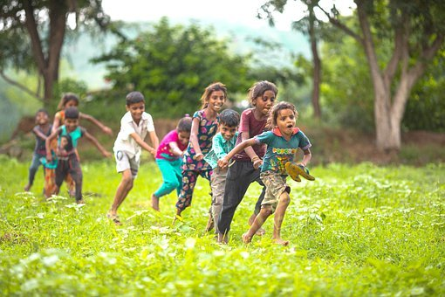
Types of Adverbs
Notes:
Notes for Teacher - < Information for further reference or explanation >
Suggestions: <Ideas/ Images/ Animations / Others – To make better representation of the content >
Source of Multimedia used in this slide -
Dancing gracefully/: https://pixabay.com/photos/girl-indian-dance-red-oriental-1505407/
Playing happily: https://pixabay.com/photos/children-kids-playing-rajasthan-7186580/

Slide 2
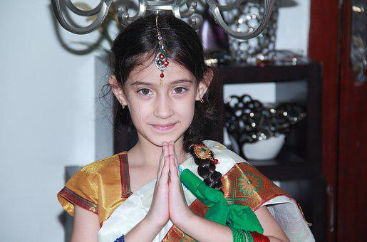
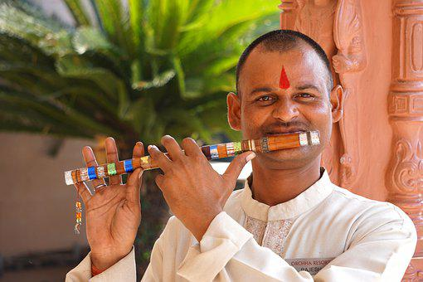
Adverbs
Adverbs of Manner
What do the words written in bold mean to you?
Ram ran quickly.
Anita smiles sweetly.
Rahul played the flute beautifully.
Rani dances gracefully.
The words quickly, softly, beautifully and gracefully tell us more about the verbs ran, smiles, played and dances. They are called ‘Adverbs’.
These adverbs also tell us ‘how’ something happens or happened and are hence called
‘Adverbs of Manner’. They are placed after the main verb or the object.
Notes:
Notes for Teacher
Sentence 1: Adverb ‘quickly’ tells us how Ram ran and is placed after the verb ‘ran’.
Sentence 2: Adverb ‘sweetly’ tells us how Anita smiles and is placed after the verb ‘smiles’.
Sentence 3: Adverb ‘beautifully’ tells us how Rahul played the flute and is placed after the object ‘flute’.
Sentence 4: Adverb ‘gracefully’ tells us how Rani dances and is placed after the verb ‘dances’.
Suggestions: <Ideas/ Images/ Animations / Others – To make better representation of the content >
Source of Multimedia used in this slide -
Boy: https://pixabay.com/photos/children-kids-running-young-girl-5559749/
Girl, smile: https://pixabay.com/photos/girl-india-style-cute-traditional-2829399/
Flute: https://pixabay.com/photos/india-man-flute-instrument-5978576/
Dancing:
https://pixabay.com/photos/girl-indian-dance-red-oriental-1505407/

Slide 3
Adverbs
Adverbs of Sequence
Arjun’s daily routine
First, he brushes his teeth.
Then, he takes a bath.
After that, he has breakfast.
Finally, he goes to play with Akshay.
First, then, after that and finally are called ‘Sequence Adverbs’. They describe the order in which two or more actions happen.
Notes:
Notes for Teacher
Suggestions: <Ideas/ Images/ Animations / Others – To make better representation of the content >
Source of Multimedia used in this slide -
1. https://youtu.be/lLB1NtbMTls?t=128 (Attribution: TicTacLearn English)
<Please provide source URL where we find the image and the license agreement>

Slide 4
MM INDEX
Slide # | Thumbnail | Source link and Attribution
1 |  | Dancing gracefully/: https://pixabay.com/photos/girl-indian-dance-red-oriental-1505407/ Playing happily: https://pixabay.com/photos/children-kids-playing-rajasthan-7186580/
2 |  | Boy: https://pixabay.com/photos/children-kids-running-young-girl-5559749/ Girl, smile: https://pixabay.com/photos/girl-india-style-cute-traditional-2829399/ Flute: https://pixabay.com/photos/india-man-flute-instrument-5978576/ Dancing: https://pixabay.com/photos/girl-indian-dance-red-oriental-1505407/
3. |  | 1. https://youtu.be/lLB1NtbMTls?t=128 (Attribution: TicTacLearn English)
Notes:
Notes for Teacher - < Information for further reference or explanation >
Suggestions: <Ideas/ Images/ Animations / Others – To make better representation of the content >
Source of Multimedia used in this slide - <Please provide source URL where we find the image and the license agreement>

