Slide 1
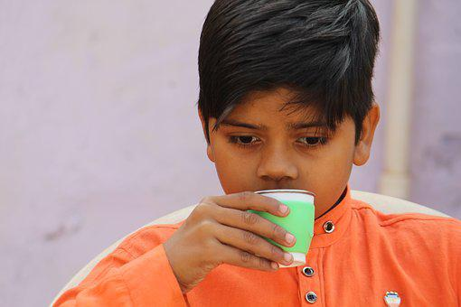
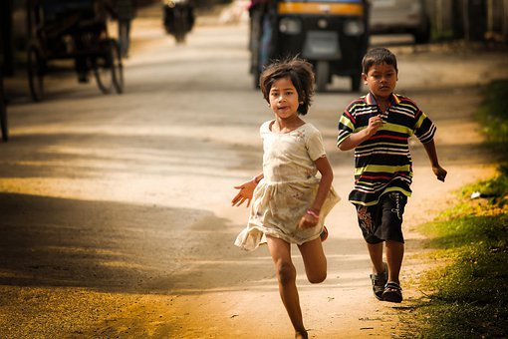
Adverbs-The Enhancers
Notes:
Notes for Teacher - < Information for further reference or explanation >
Suggestions: <Ideas/ Images/ Animations / Others – To make better representation of the content >
Source of Multimedia used in this slide -
1. Drinking: https://pixabay.com/photos/poor-boy-cute-village-boy-child-4133642/
2. Running: https://pixabay.com/photos/children-kids-running-young-girl-5559749/

Slide 2
Adverbs
An adverb is a word used to tell more about a verb, an adverb or an adjective. It answers the questions How? When? Where? How often? and In what way?.
Notes:
Notes for Teacher - < Information for further reference or explanation >
Suggestions: <Ideas/ Images/ Animations / Others – To make better representation of the content >
Source of Multimedia used in this slide -
Boy with placard: https://pixabay.com/vectors/man-person-alert-billboard-placard-160602/

Slide 3
Adverbs
Manner
How the action is performed. Examples: slowly, quickly
Place
Where the action takes place. Examples: near, up, down
Time
When the action takes place. Examples: today, yesterday
Notes:
Notes for Teacher - The teacher can explain to the students that there are many types of adverbs that enhance the meaning of sentences. Though they have learnt only adverbs of manner and sequence, the teacher can then show the ppt to give the names of other adverbs. Suggestions: <Ideas/ Images/ Animations / Others – To make better representation of the content >
Source of Multimedia used in this slide -

Slide 4
More Adverbs
Frequency
Frequency
How often the action takes place. Examples: never, always
Sequence
In what order the action takes place. Examples: first, next
Degree
To which extent the action is performed. Examples: nearly, hardly
Notes:
Notes for Teacher - < Information for further reference or explanation >
Suggestions: <Ideas/ Images/ Animations / Others – To make better representation of the content >
Source of Multimedia used in this slide - <Please provide source URL where we find the image and the license agreement>

Slide 5
MM Index
Slide # | Thumbnail | Source link and Attribution
1 |  | 1. Drinking: https://pixabay.com/photos/poor-boy-cute-village-boy-child-4133642/ 2. Running: https://pixabay.com/photos/children-kids-running-young-girl-5559749/
2 |  | 1 Boy with placard: https://pixabay.com/vectors/man-person-alert-billboard-placard-160602/
Notes:
Notes for Teacher - < Information for further reference or explanation >
Suggestions: <Ideas/ Images/ Animations / Others – To make better representation of the content >
Source of Multimedia used in this slide - <Please provide source URL where we find the image and the license agreement>

