Slide 1
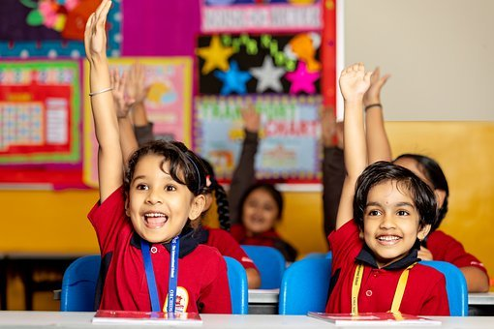
A Game with Adverbs
Notes:
Notes for Teacher - < Information for further reference or explanation >
Suggestions: <Ideas/ Images/ Animations / Others – To make better representation of the content >
Source of Multimedia used in this slide -
1. Children: https://pixabay.com/photos/children-kindergarten-school-7339441/

Slide 2
1. Fill in the blanks
angrily
slowly
first
quickly
suddenly
happily
honestly
easily
As soon as my friends left, I ______ opened my birthday gift.
quickly
It started raining _________ and I did not even have an umbrella.
suddenly
My sister _______ played in the garden the whole day.
happily
The teacher looked ______ at all of us.
angrily
The cat was not in a hurry. It walked ______ across the street.
slowly
Notes:
Notes for Teacher –5 sentences for 5 teams.The teacher has to click for both the question and the answer.
Suggestions: <Ideas/ Images/ Animations / Others – To make better representation of the content >
Source of Multimedia used in this slide - <Please provide source URL where we find the image and the license agreement>

Slide 3
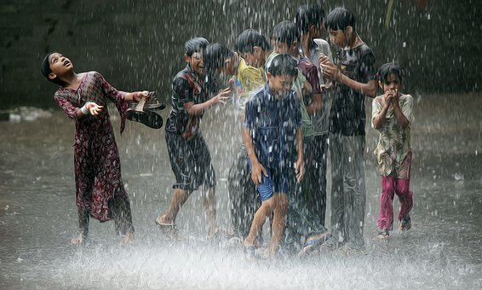
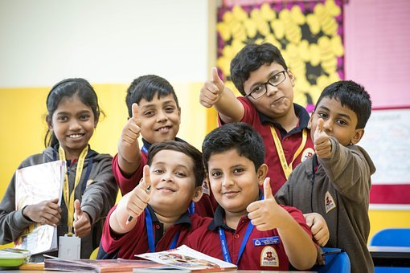
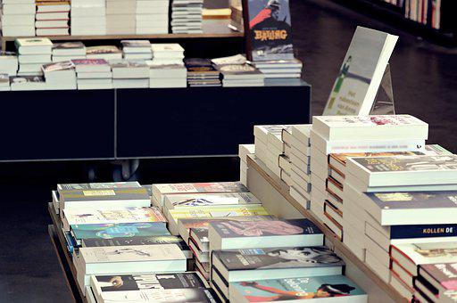
2. See the Image and fill the blanks
first
heavily
friendly
politely
neatly
It rained ______ yesterday. We all danced in the rain.
heavily
Varun, the boy with spectacles is _______ with everyone in class.
friendly
The books in the library are ______arranged.
neatly
Notes:
Notes for Teacher - < Information for further reference or explanation >
Suggestions: <Ideas/ Images/ Animations / Others – To make better representation of the content >
Source of Multimedia used in this slide -
Rain: https://pixabay.com/illustrations/rain-children-joy-pleasure-summer-4363454/
2. Friends: Children: https://pixabay.com/photos/school-children-classroom-school-
7047131/
3. Books: https://pixabay.com/photos/library-books-read-bookstore-4317851/

Slide 4
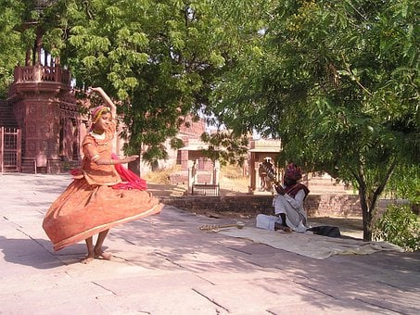
Continued...See the Image and fill the blanks
first
gracefully
loudly
politely
patiently
My English teacher always speaks _______.
politely
After waking up at 6o’clock, Raju brushes his teeth ____ of all.
first
Mala is dancing _________ to the music.
gracefully
Notes:
Notes for Teacher - < Information for further reference or explanation >
Suggestions: <Ideas/ Images/ Animations / Others – To make better representation of the content >
Source of Multimedia used in this slide -
1. Teacher: SSSVV Gallery ( Key word teacher , mother)
2. Boy: https://www.freepik.com/free-vector/set-happy-children-different-
actions_5874504.htm (Attribution:brgfx)
Brush: https://youtu.be/lLB1NtbMTls?t=128 (Attribution: TicTacLearn English)
Dance: https://pixabay.com/photos/india-to-dance-child-349/

Slide 5
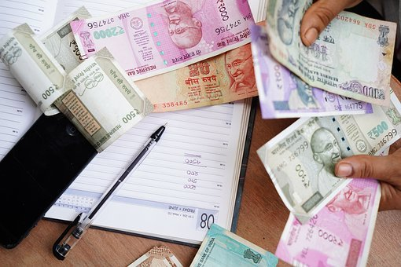
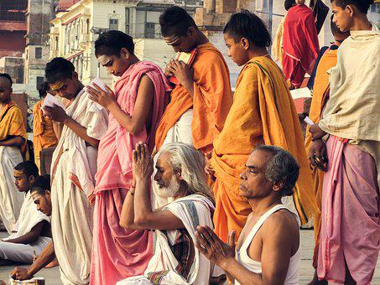
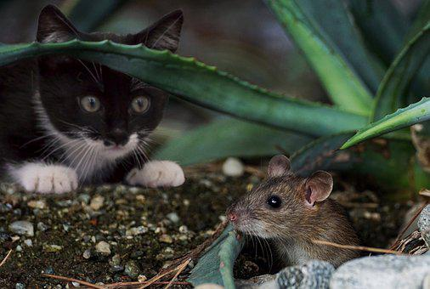
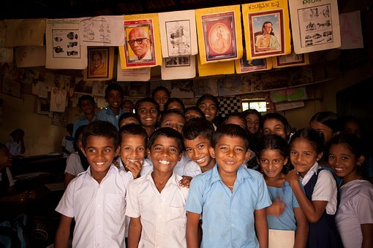
Continued...See the Image and fill the blanks
correctly
silently
loudly
sweetly
patiently
My father counted the money _______.
correctly
People pray ______ in the temple.
silently
The cat waited _______ for the rat to come out.
patiently
All the children smiled ______ for the photograph.
sweetly
Notes:
Notes for Teacher - < Information for further reference or explanation >
Suggestions: <Ideas/ Images/ Animations / Others – To make better representation of the content >
Source of Multimedia used in this slide -
Money: https://pixabay.com/photos/india-rupee-occupation-3887567/
Pray: https://pixabay.com/photos/the-brahmanas-varanasi-india-pray-3735328/
Cat: https://pixabay.com/photos/katz-mouse-animal-cute-fun-catch-2821316/
Children: https://pixabay.com/photos/children-infants-india-mangalore-298679/

Slide 6
MM INDEX
Slide # | Thumbnail | Source link and Attribution
1 |  | 1. Children: https://pixabay.com/photos/children-kindergarten-school-7339441/
3 |  | 1. Rain: https://pixabay.com/illustrations/rain-children-joy-pleasure-summer-4363454/ 2. Friends: Children: https://pixabay.com/photos/school-children-classroom-school- 7047131/ 3. Books: https://pixabay.com/photos/library-books-read-bookstore-4317851/
4 |  | 1. Teacher: SSSVV Gallery ( Key word teacher , mother) 2. Boy: https://www.freepik.com/free-vector/set-happy-children-different- actions_5874504.htm (Attribution:brgfx) Brush: https://youtu.be/lLB1NtbMTls?t=128 (Attribution: TicTacLearn English) Dance: https://pixabay.com/photos/india-to-dance-child-349/
5 |  | Money: https://pixabay.com/photos/india-rupee-occupation-3887567/ Pray: https://pixabay.com/photos/the-brahmanas-varanasi-india-pray-3735328/ Cat: https://pixabay.com/photos/katz-mouse-animal-cute-fun-catch-2821316/ Children: https://pixabay.com/photos/children-infants-india-mangalore-298679/
Notes:
Notes for Teacher - < Information for further reference or explanation >
Suggestions: <Ideas/ Images/ Animations / Others – To make better representation of the content >
Source of Multimedia used in this slide - <Please provide source URL where we find the image and the license agreement>

