Slide 1
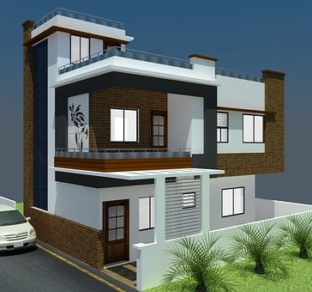
Adverbs in daily life
Notes:
Notes for Teacher - < Information for further reference or explanation >
Suggestions: <Ideas/ Images/ Animations / Others – To make better representation of the content >
Source of Multimedia used in this slide -
Home: https://pixabay.com/illustrations/architecture-indian-home-home-house-6055047/
School: https://pixabay.com/vectors/school-building-education-property-295210/

Slide 2
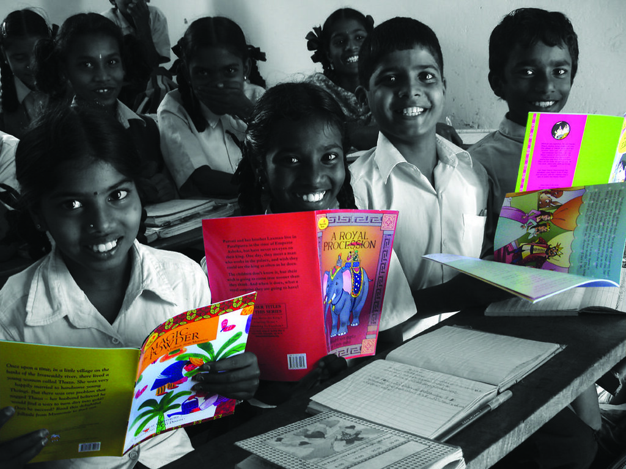
At School
Arun
Teacher: Arun, please read this paragraph loudly so that everyone can hear.
Arun: Miss, should I read it slowly or quickly?
Teacher: Read it the way you normally do.
Notes:
Notes for Teacher - < Information for further reference or explanation >
Suggestions: <Ideas/ Images/ Animations / Others – To make better representation of the content >
Source of Multimedia used in this slide -
children: https://wordpress.org/openverse/image/956e8fe6-9c6c-4e1c-a41e-a9e71d9c2ad1 (Attribution: Pratham Books)
Teacher: SSSVV gallery (Keyword-teacher, mother)

Slide 3
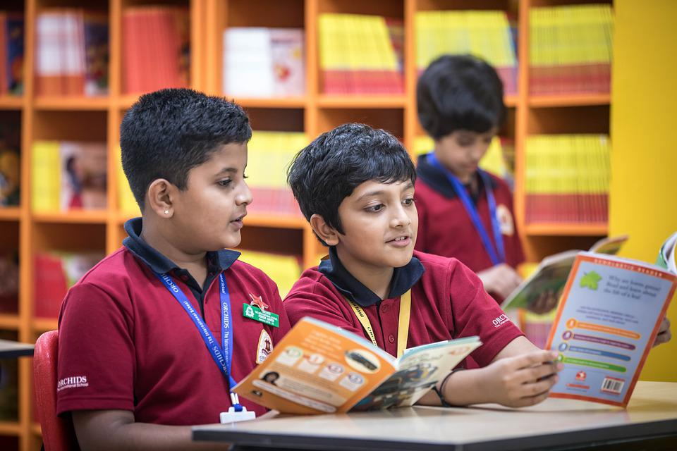
In the Library
Children, you are in
the library.
Please read silently.
Do not talk loudly.
If you want to leave
the library, do so
quietly.
Notes:
Notes for Teacher - < Information for further reference or explanation >
Suggestions: <Ideas/ Images/ Animations / Others – To make better representation of the content >
Source of Multimedia used in this slide -
Teacher: SSSVV gallery
Boys: https://pixabay.com/photos/children-classroom-grade-school-7047132/

Slide 4
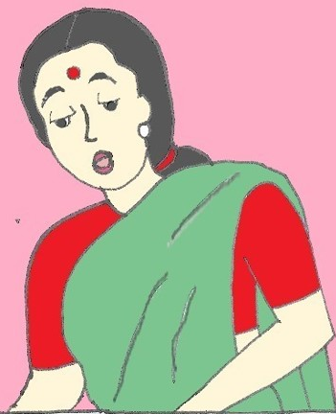
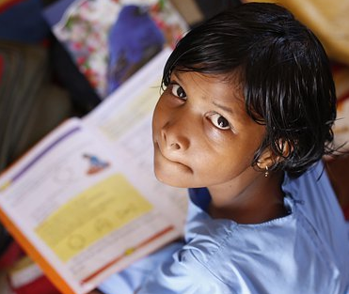
At Home
Rani, please write the English answers neatly in your notebook.
Okay mother. If I finish my homework quickly, can I go and play?
First, finish all your
homework. Think carefully and do your maths sums correctly.
Notes:
Notes for Teacher - < Information for further reference or explanation >
Suggestions: <Ideas/ Images/ Animations / Others – To make better representation of the content >
Source of Multimedia used in this slide -
Girl: https://pixabay.com/photos/children-infant-girl-school-306607/
Mother: SSSVV gallery (mother, teacher)

Slide 5
MM Index
Slide # | Thumbnail | Source link and Attribution
1 |  | Home: https://pixabay.com/illustrations/architecture-indian-home-home-house-6055047/ School: https://pixabay.com/vectors/school-building-education-property-295210/
2 |  | children: https://wordpress.org/openverse/image/956e8fe6-9c6c-4e1c-a41e-a9e71d9c2ad1 (Attribution: Pratham Books) Teacher: SSSVV gallery (Keyword-teacher, mother)
3 |  | Teacher: SSSVV gallery Boys: https://pixabay.com/photos/children-classroom-grade-school-7047132/
4 |  | Girl: https://pixabay.com/photos/children-infant-girl-school-306607/ Mother: SSSVV gallery (mother, teacher)
Notes:
Notes for Teacher - < Information for further reference or explanation >
Suggestions: <Ideas/ Images/ Animations / Others – To make better representation of the content >
Source of Multimedia used in this slide - <Please provide source URL where we find the image and the license agreement>

