Slide 1
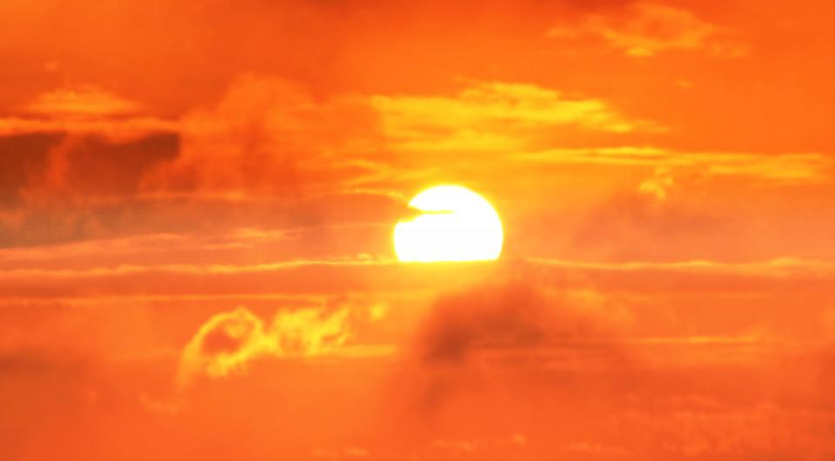
Recalling Adverbs
Notes:
Notes for Teacher - < Information for further reference or explanation >
Suggestions: <Ideas/ Images/ Animations / Others – To make better representation of the content >
Source of Multimedia used in this slide -
Sunrise: https://pixabay.com/photos/sunrise-sun-clouds-heaven-nature-3533193/
Shirts: https://pixabay.com/photos/jacket-fashion-male-style-suit-1868990/

Slide 2
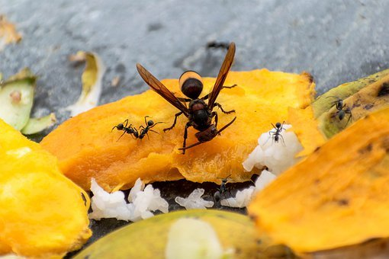
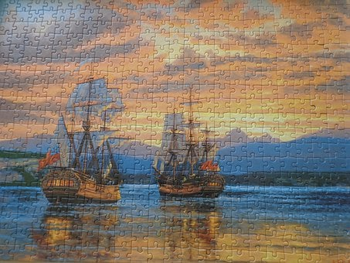
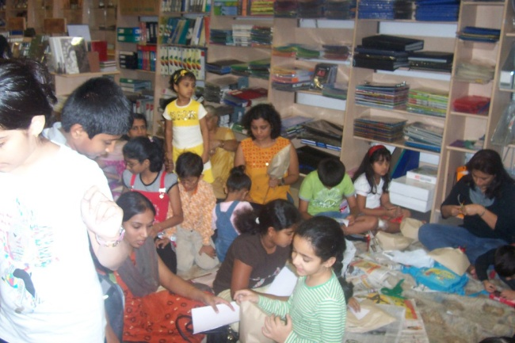
1. Choose the correct adverb
busily
The ants _____ gathered food for the winter.
(busily, heavily)
1
correctly
2
Mona solved all the puzzles _______.
(correctly, bravely)
The teacher stopped talking ________.
(lazily, suddenly)
3
suddenly
brightly
4
The sun is shining _______today.
(brightly, slowly)
Notes:
Notes for Teacher - There are 4 sections.
1. Choose the correct adverb
2. Look at the picture, choose a correct adverb and fill in the blanks
3. Put the sentences in the correct order
4. Underline the adverbs in the word box. Use them correctly to complete the sentences.
Suggestions: <Ideas/ Images/ Animations / Others – To make better representation of the content >
Source of Multimedia used in this slide -
Ants: https://pixabay.com/photos/insects-hornet-black-ants-wasp-7345839/
Puzzles: https://pixabay.com/photos/jigsaw-puzzle-jigsaw-puzzle-ships-286595/
Students: https://www.flickr.com/photos/35026043@N03/3671656156 (Attribution: Pratham Books)
Sunrise: https://pixabay.com/photos/sunrise-sun-clouds-heaven-nature-3533193/

Slide 3
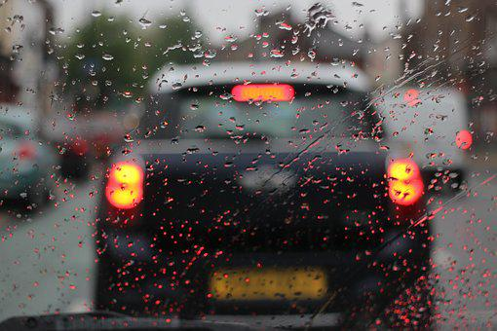
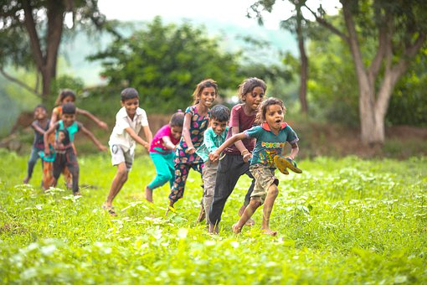
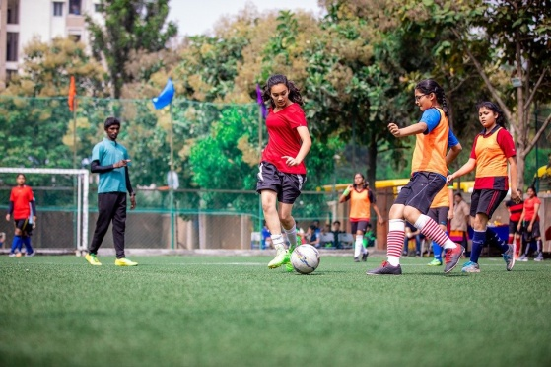
2. Look at the pictures
Look at the pictures, choose the correct adverb and fill in the blanks
neatly
carefully
happily
finally
1
It is raining. Drive _______.
2
The children are playing ______
carefully
happily.
3
4
finally
neatly
Team B _____ won the game.
The shirts are folded _____.
Notes:
Notes for Teacher - < Information for further reference or explanation >
Suggestions: <Ideas/ Images/ Animations / Others – To make better representation of the content >
Source of Multimedia used in this slide -
Rain: https://pixabay.com/photos/car-rain-gloomy-raindrop-water-2150838/
Children: https://cdn.pixabay.com/photo/2022/05/10/09/49/children-7186580__340.jpg
Football: https://pixabay.com/photos/football-sports-soccer-7047125/
Shirts: https://pixabay.com/photos/jacket-fashion-male-style-suit-1868990/

Slide 4
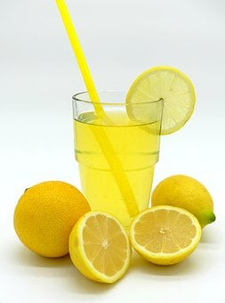
3. Put the sentences in the correct order
Making lemonade
a
After that, add 2 tablespoons of sugar and mix well.
b
Finally pour into glasses and add 2 ice cubes into each glass.
c
Then, squeeze out their juice. To it add 4 glasses of water.
d
First, take 4 lemons and wash them well. Cut them into halves.
SEQUENCE
d
c
a
b
Notes:
Notes for Teacher – If the wishes, a demonstration may be done in class.
Suggestions: <Ideas/ Images/ Animations / Others – To make better representation of the content >
Source of Multimedia used in this slide -
1. Lemonade: https://pixabay.com/photos/lemonade-drink-soft-drink-lemons-2097312/

Slide 5
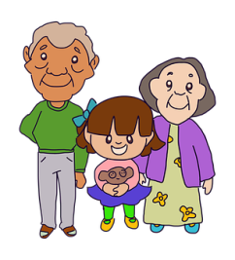
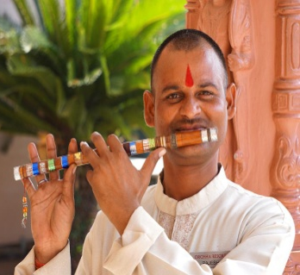
4. Identify the adverbs and use them in the sentences
cute
big
softly
neatly
fat
nice
politely
jump
slowly
beautifully
neatly
1
My father dressed up _____ for the parent
teacher meeting
Anita and Anju speak _____ in class so that the
teacher cannot hear them.
2
softly
3
slowly
3
My grandparents walk very ______ because
they are old.
4
beautifully
Raju plays the flute _________.
Notes:
Notes for Teacher - < Information for further reference or explanation >
Suggestions: <Ideas/ Images/ Animations / Others – To make better representation of the content >
Source of Multimedia used in this slide -
Elders: https://pixabay.com/vectors/grandparents-family-people-4387074/
Father: https://pixabay.com/photos/man-chairman-person-important-367355/
Flute: https://pixabay.com/photos/india-man-flute-instrument-5978576/
Girls: https://pixabay.com/illustrations/children-girls-school-friends-4888996/

Slide 6
MM INDEX
Slide # | Thumbnail | Source link and Attribution
1 |  | Sunrise: https://pixabay.com/photos/sunrise-sun-clouds-heaven-nature-3533193/ Shirts: https://pixabay.com/photos/jacket-fashion-male-style-suit-1868990/
2 |  | Ants: https://pixabay.com/photos/insects-hornet-black-ants-wasp-7345839/ Puzzles: https://pixabay.com/photos/jigsaw-puzzle-jigsaw-puzzle-ships-286595/ Students: https://www.flickr.com/photos/35026043@N03/3671656156 (Attribution: Pratham Books) Sunrise: https://pixabay.com/photos/sunrise-sun-clouds-heaven-nature-3533193/
3 |  | Rain: https://pixabay.com/photos/car-rain-gloomy-raindrop-water-2150838/ Children: https://cdn.pixabay.com/photo/2022/05/10/09/49/children-7186580__340.jpg Football: https://pixabay.com/photos/football-sports-soccer-7047125/ Shirts: https://pixabay.com/photos/jacket-fashion-male-style-suit-1868990/
4 |  | . Lemonade: https://pixabay.com/photos/lemonade-drink-soft-drink-lemons-2097312/
5 |  | Elders: https://pixabay.com/vectors/grandparents-family-people-4387074/ Father: https://pixabay.com/photos/man-chairman-person-important-367355/ Flute: https://pixabay.com/photos/india-man-flute-instrument-5978576/ Girls: https://pixabay.com/illustrations/children-girls-school-friends-4888996/
Notes:
Notes for Teacher - < Information for further reference or explanation >
Suggestions: <Ideas/ Images/ Animations / Others – To make better representation of the content >
Source of Multimedia used in this slide - <Please provide source URL where we find the image and the license agreement>

