Slide 1
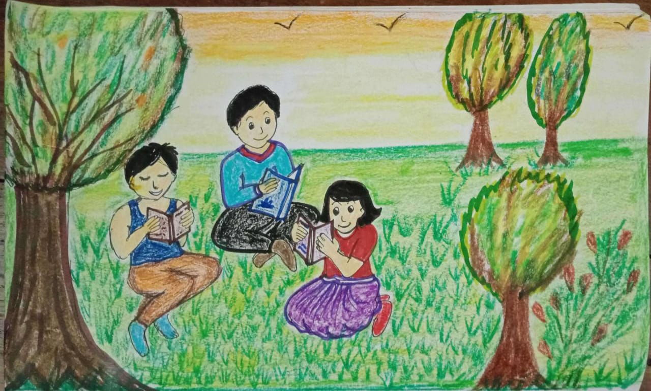
Learning always helps
Notes:
Notes for Teacher - < Information for further reference or explanation >
Suggestions: <Ideas/ Images/ Animations / Others – To make better representation of the content >
Source of Multimedia used in this slide - <Please provide source URL where we find the image and the license agreement>
<studying> <Studying in outdoors, studying on the grass>

Slide 2
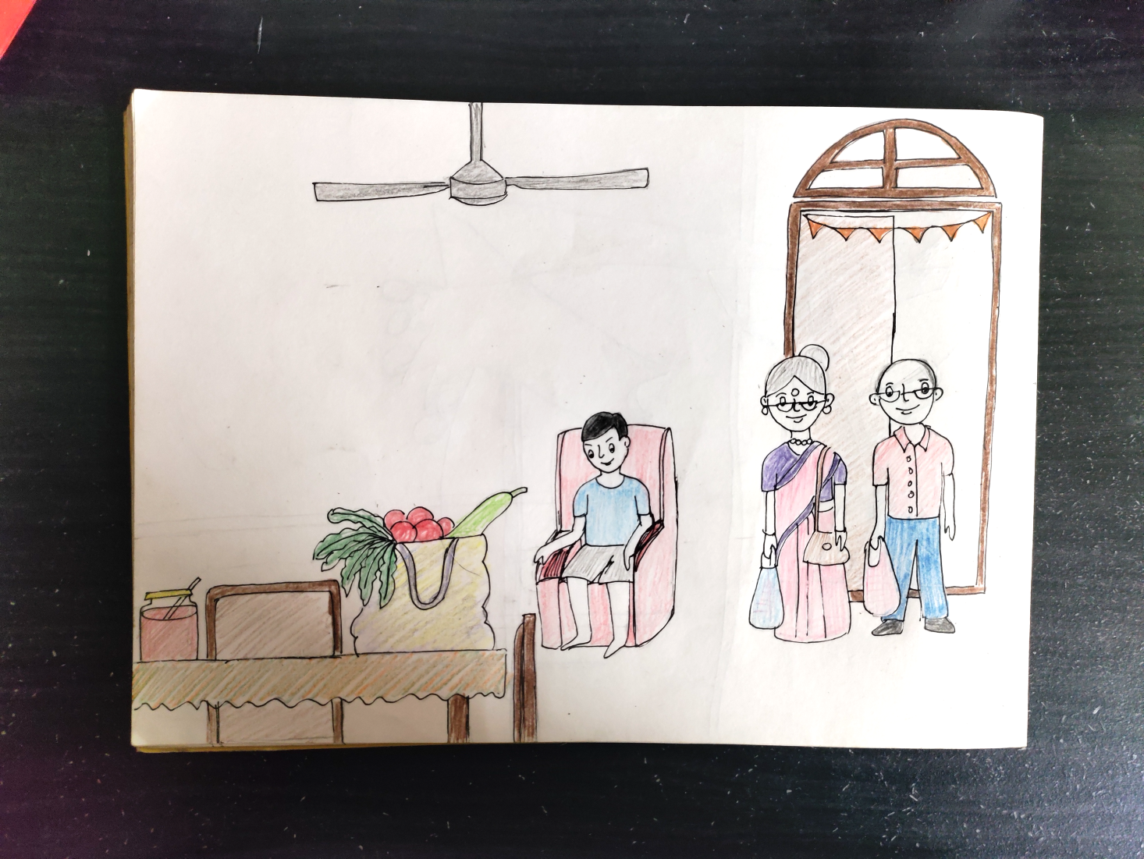
Scene 1 – Living room
It is a relaxing Sunday afternoon and Rohan’s grandparents have come to see him.
Grandpa, did you buy these vegetables from the market?
No, Rohan. These are home-grown vegetables. This tomato jam was prepared by your grandma using home-grown tomatoes.
JAM
Notes:
Notes for Teacher - Concept- Value Connection
An adverb adds value to the action verb.
2. Likewise in life, any additional skill or knowledge always adds value to our lifestyle.
Suggestions: <Ideas/ Images/ Animations / Others – To make better representation of the content >
Source of Multimedia used in this slide -
1. Living room: MM app

Slide 3
Scene 2 - Garden
It started off as a hobby, but it has been very useful.
Wow! Is it your hobby?
How grandfather?
It keeps me healthy and has taught me patience and sharing. I share the extra vegetables with my neighbours.
Notes:
Notes for Teacher - < Information for further reference or explanation >
Suggestions: <Ideas/ Images/ Animations / Others – To make better representation of the content >
Source of Multimedia used in this slide - <Please provide source URL where we find the image and the license agreement>
<gareden> <MM app>

Slide 4
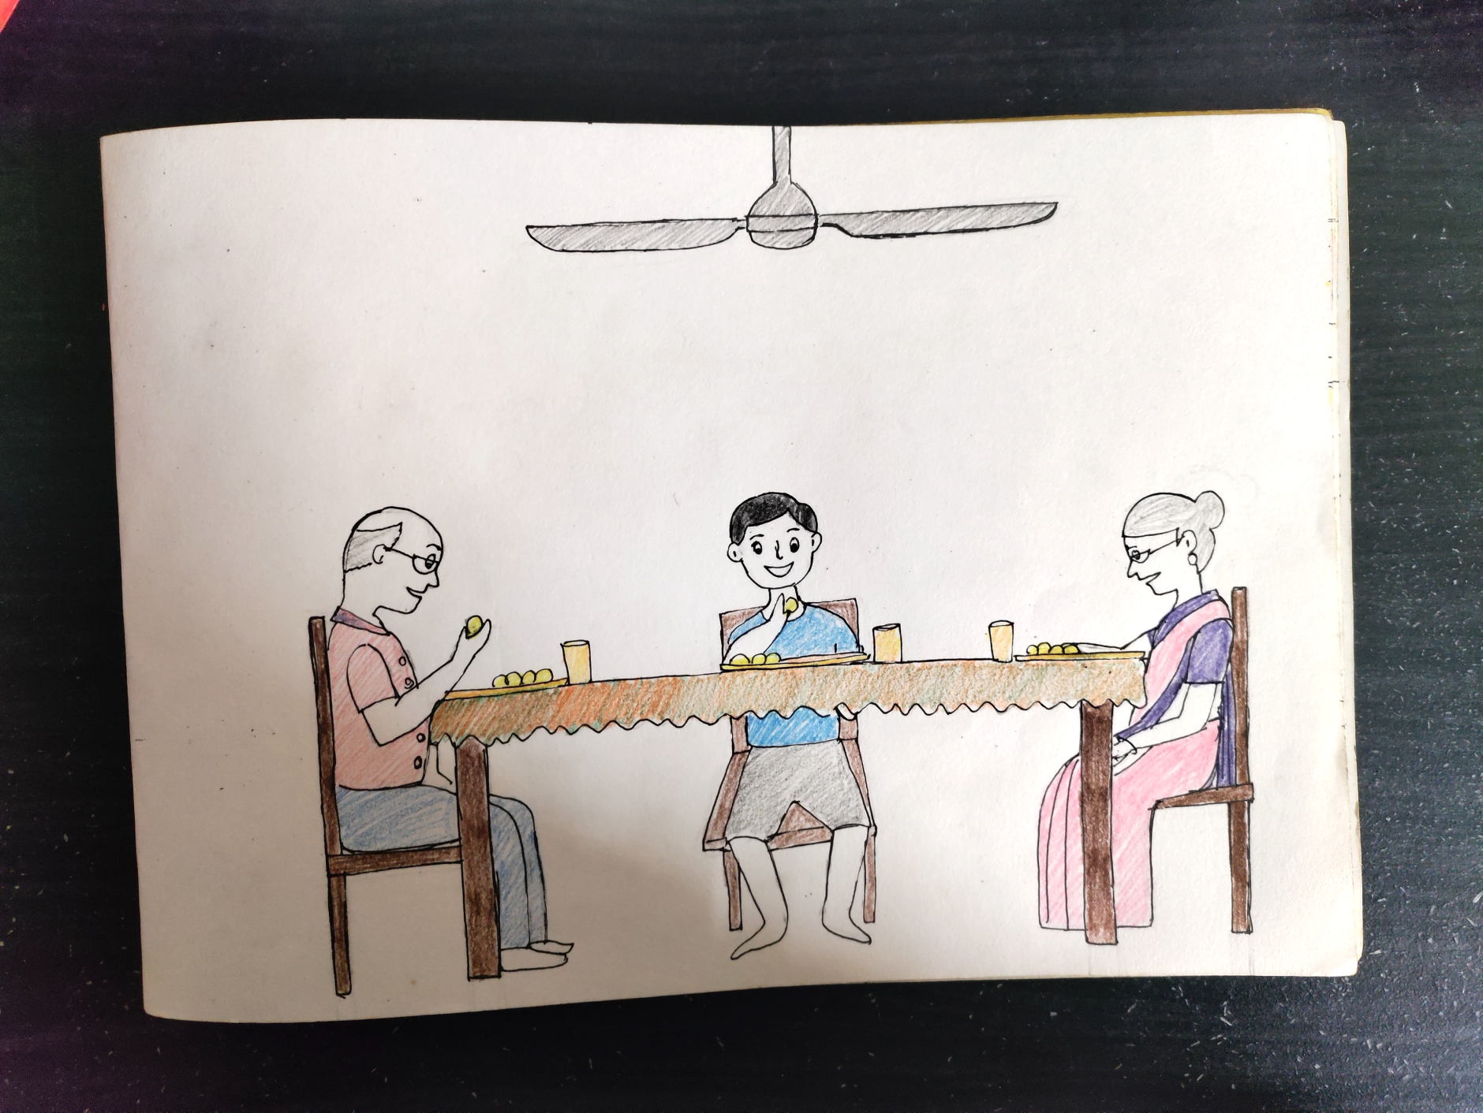
Scene 3 – Dining room
Gardening makes you a responsible person as you start caring for the environment.
Rohan, subjects like science and geography help you understand what the plants need.
Notes:
Notes for Teacher - Grandfather: Gardening makes you a responsible person as you start caring for the environment. Moreover, you become creative and try to grow different varieties of fruits and vegetables according to the season.
Suggestions: <Ideas/ Images/ Animations / Others – To make better representation of the content >
Source of Multimedia used in this slide - <Please provide source URL where we find the image and the license agreement>
<dining table> <<MM app>

Slide 5
Points to Ponder
Learning something new is never a waste of time.
It keeps your mind engaged and body active.
It adds value to our existing knowledge or skill.
Notes:
Notes for Teacher - < Information for further reference or explanation >
Suggestions: <Ideas/ Images/ Animations / Others – To make better representation of the content >
Source of Multimedia used in this slide - <Please provide source URL where we find the image and the license agreement>
<dining table> <<MM app>

Slide 6
MM INDEX
Slide # | Thumbnail | Source link and Attribution
1 |  | <studying> <Studying in outdoors, studying on the grass>
2 |  | <living room> <MM app>
3 |  | <gareden> <MM app>
4 |  | <dining table> <<MM app>
Notes:
Notes for Teacher - < Information for further reference or explanation >
Suggestions: <Ideas/ Images/ Animations / Others – To make better representation of the content >
Source of Multimedia used in this slide - <Please provide source URL where we find the image and the license agreement>

