Slide 1
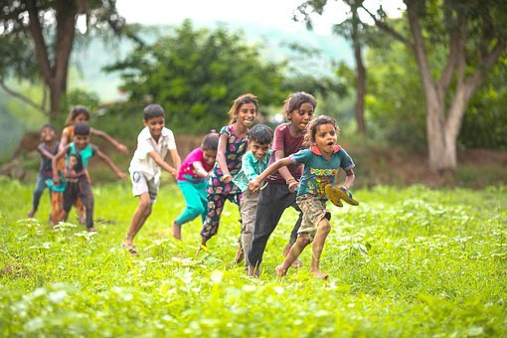
Summary ADVERBS
Notes:
Notes for Teacher - < Information for further reference or explanation >
Suggestions: <Ideas/ Images/ Animations / Others – To make better representation of the content >
Source of Multimedia used in this slide -
Dancing gracefully/: https://pixabay.com/photos/girl-indian-dance-red-oriental-1505407/
Playing happily: https://pixabay.com/photos/children-kids-playing-rajasthan-7186580/

Slide 2
Summary
Adverbs of Manner
Tell us ‘how’ something happens or happened.
They are placed after the main verb or object.
Adverbs of Sequence
First, then, after that and finally are sequence adverbs.
They describe the order in which two or more actions happen.
Notes:
Notes for Teacher
< Information for further reference or explanation >
Suggestions: <Ideas/ Images/ Animations / Others – To make better representation of the content >
Source of Multimedia used in this slide -
<Please provide source URL where we find the image and the license agreement>

Slide 3
MM INDEX
Slide # | Thumbnail | Source link and Attribution
1 |  | Dancing gracefully/: https://pixabay.com/photos/girl-indian-dance-red-oriental-1505407/ Playing happily: https://pixabay.com/photos/children-kids-playing-rajasthan-7186580/
Notes:
Notes for Teacher - < Information for further reference or explanation >
Suggestions: <Ideas/ Images/ Animations / Others – To make better representation of the content >
Source of Multimedia used in this slide - <Please provide source URL where we find the image and the license agreement>

