Slide 1
Introducing Articles
A
a
An
an
The
the
Notes:
Notes for Teacher - < Information for further reference or explanation >
Suggestions: <Ideas/ Images/ Animations / Others – To make better representation of the content >
Source of Multimedia used in this slide - <Please provide source URL where we find the image and the license agreement>

Slide 2
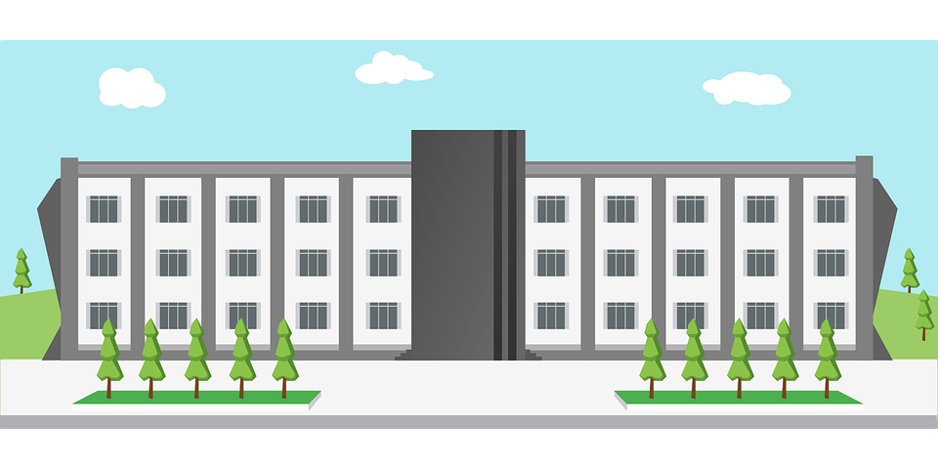
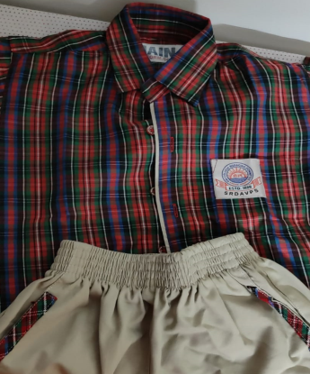
Articles
We use the article ‘a’
to talk about one person, animal or thing
for singular nouns that begin with a consonant
sound (a boy, a cat or a ball)
when the naming word starts with ‘u’ as in ‘you’
(a university, a uniform etc)
Notes:
Notes for Teacher
< Information for further reference or explanation >
Suggestions: <Ideas/ Images/ Animations / Others – To make better representation of the content >
Source of Multimedia used in this slide -
1. Boy: https://pixabay.com/photos/indian-boy-child-male-asian-1119236/
2. Cat: https://pixabay.com/photos/cat-kitten-pet-kitty-young-cat-551554/
3. Ball: https://pixabay.com/vectors/football-ball-sport-soccer-round-157930/
4. University: https://pixabay.com/vectors/school-design-building-learning-1727586/
5. Uniform: self - sabithaa_sankkar@yahoo.com
<Please provide source URL where we find the image and the license agreement>

Slide 3
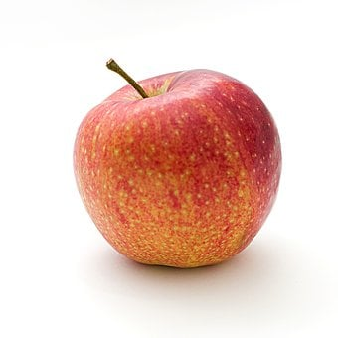
Articles
We use the article ‘an’
to talk about one person, animal or thing
for singular nouns that begin with a vowel sound
(an old man, an elephant, an apple etc)
when the naming word starts with ‘h’ and ‘h’ is
silent (an hour)
12
1
Notes:
Notes for Teacher - < Information for further reference or explanation >
Suggestions: <Ideas/ Images/ Animations / Others – To make better representation of the content >
Source of Multimedia used in this slide –
Old man: https://pixabay.com/photos/people-street-travel-outdoors-man-3152130/
Elephant: https://pixabay.com/photos/elephant-animal-safari-mammal-114543/
Apple: https://pixabay.com/photos/apple-red-fruit-food-fresh-ripe-1834639/
Clock: PPT shapes

Slide 4
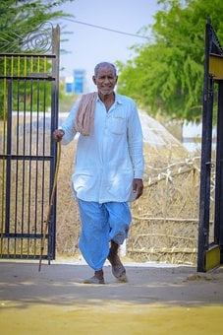
Articles
We use the article ‘the’
for both singular and plural nouns
when the identity of the noun(specific or
particular) is known to the reader
Example: I saw a man and a dog
The man was old and the dog was hungry
Notes:
Notes for Teacher - < Information for further reference or explanation >
Suggestions: <Ideas/ Images/ Animations / Others – To make better representation of the content >
Source of Multimedia used in this slide –
Old man: https://pixabay.com/photos/man-old-old-man-person-portrait-6539729/
Dog: https://pixabay.com/photos/indian-dog-stray-dog-puppy-dog-5392796/

Slide 5
Fill in the Blanks with ‘a’, ‘an’, or ‘the’
I saw __ giraffe and ____ alligator in the Zoo.
a
an
1
an
a
Ram has ___ orange pen and __ black pen.
2
I saw ___ tree. ____ tree had orange and yellow leaves.
3
a
The
Aditya went to buy ___ umbrella because it was raining.
4
an
an
5
Ramya is ____ honest girl.
a
6
Aladdin had ___ magic lamp.
a
The
7
Muna and Mina have __ pink dress. ____ dress has flowers printed on it.
Notes:
Notes for Teacher – Teacher can highlight that it is capital T for ‘the’ in the 3rd and 7th sentences as it is the beginning of a sentence.
Suggestions: <Ideas/ Images/ Animations / Others – To make better representation of the content >
Source of Multimedia used in this slide - <Please provide source URL where we find the image and the license agreement>

Slide 6
MM INDEX
Slide # | Thumbnail | Source link and Attribution
2 |  | 1. Boy: https://pixabay.com/photos/indian-boy-child-male-asian-1119236/ 2. Cat: https://pixabay.com/photos/cat-kitten-pet-kitty-young-cat-551554/ 3. Ball: https://pixabay.com/vectors/football-ball-sport-soccer-round-157930/ 4 . University: https://pixabay.com/vectors/school-design-building-learning-1727586/ 5. Uniform: self - sabithaa_sankkar@yahoo.com
3 |  | Old man: https://pixabay.com/photos/people-street-travel-outdoors-man-3152130/ Elephant: https://pixabay.com/photos/elephant-animal-safari-mammal-114543/ Apple: https://pixabay.com/photos/apple-red-fruit-food-fresh-ripe-1834639/ Clock: PPT shapes
4 |  | Old man: https://pixabay.com/photos/man-old-old-man-person-portrait-6539729/ Dog: https://pixabay.com/photos/indian-dog-stray-dog-puppy-dog-5392796/
Notes:
Notes for Teacher - < Information for further reference or explanation >
Suggestions: <Ideas/ Images/ Animations / Others – To make better representation of the content >
Source of Multimedia used in this slide - <Please provide source URL where we find the image and the license agreement>

