Slide 1
The WHOLE
Notes:
Notes for Teacher - < Information for further reference or explanation >
Suggestions: <Ideas/ Images/ Animations / Others – To make better representation of the content >
Source of Multimedia used in this slide -
1. Circle:PPT shapes

Slide 2
Chair
This is a chair
This is an old chair
This is chair
This is old chair
Notes:
Notes for Teacher –
The teacher can explain how if a part of something is missing, it is not WHOLE.
Likewise, articles are important to make one’s understanding WHOLE.
A chair should have 4 legs so that one can sit without falling down. Even if one leg is missing, one cannot sit or if you do you will risk falling off the chair. Likewise, even if a letter is missing in a sentence, the meaning may not be clear.
Suggestions: <Ideas/ Images/ Animations / Others – To make better representation of the content >
Source of Multimedia used in this slide -
1. Red chair: https://pixabay.com/illustrations/chair-armchair-antique-vintage-old-6669291/
2. Tick: https://pixabay.com/vectors/check-mark-tick-mark-check-correct-1292787/
3. cross: PPT shapes

Slide 3
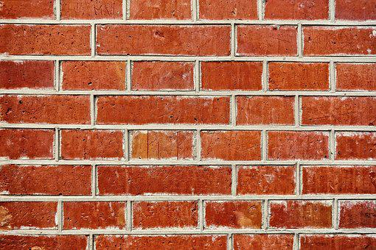
Brick wall
This is a red brick wall
Missing brick
This is red brick wall
Notes:
Notes for Teacher - < Information for further reference or explanation >
Suggestions: <Ideas/ Images/ Animations / Others – To make better representation of the content >
Source of Multimedia used in this slide -
Brick wall: https://pixabay.com/photos/wall-brick-wall-red-brick-wall-seam-3075100/
Tick: https://pixabay.com/vectors/check-mark-tick-mark-check-correct-1292787/
Cross: PPT shapes

Slide 4
Conclusion
Articles a, an, and the, are important to give a wholesome meaning to sentences.
Notes:
Notes for Teacher - < Information for further reference or explanation >
Suggestions: <Ideas/ Images/ Animations / Others – To make better representation of the content >
Source of Multimedia used in this slide -
1. Boy: https://pixabay.com/vectors/man-person-alert-billboard-placard-160602/

Slide 5
MM Index
Slide # | Thumbnail | Source link and Attribution
1 |  | 1. Circle:PPT shapes
2 |  | 1 . Red chair: https://pixabay.com/illustrations/chair-armchair-antique-vintage-old-6669291/ 2. Tick: https://pixabay.com/vectors/check-mark-tick-mark-check-correct-1292787/ 3. cross: PPT shapes
3 |  | Brick wall: https://pixabay.com/photos/wall-brick-wall-red-brick-wall-seam-3075100/ Tick: https://pixabay.com/vectors/check-mark-tick-mark-check-correct-1292787/ Cross: PPT shapes
4 |  | 1. . Boy: https://pixabay.com/vectors/man-person-alert-billboard-placard-160602/
Notes:
Notes for Teacher - < Information for further reference or explanation >
Suggestions: <Ideas/ Images/ Animations / Others – To make better representation of the content >
Source of Multimedia used in this slide - <Please provide source URL where we find the image and the license agreement>

