Slide 1
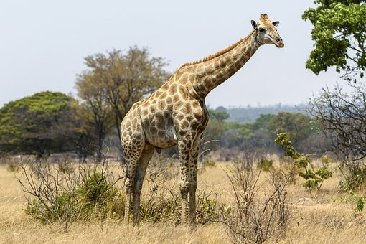
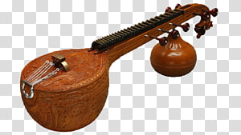
Definite Article-The / the
The tallest
The Veena
Notes:
Notes for Teacher - < Information for further reference or explanation >
Suggestions: <Ideas/ Images/ Animations / Others – To make better representation of the content >
Source of Multimedia used in this slide -
Giraffe: https://pixabay.com/photos/giraffe-animal-safari-mammal-5848468/
Veena: https://www.hiclipart.com/free-transparent-background-png-clipart-mtwgg

Slide 2
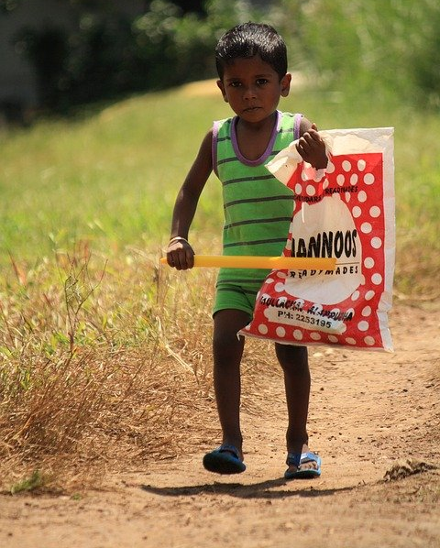
Using definite article ‘the’
Before a noun when the listener/reader knows exactly what we are referring to
1
The dog that barked at me ran away.
Before a noun when the listener/reader knows exactly what we are referring to because there is only ONE
2
The moon is very bright tonight.
Notes:
Notes for Teacher
The dog that barked at me ran away.
In this sentence we are talking about the specific dog-the dog that barked at me.
Suggestions: <Ideas/ Images/ Animations / Others – To make better representation of the content >
Source of Multimedia used in this slide -
Dog: https://pixabay.com/photos/dog-bad-dangerous-german-shepherd-2141358/
Boy: https://pixabay.com/photos/outdoors-child-fun-boy-lifestyle-3308020/
Moon: https://pixabay.com/photos/moon-full-moon-sky-night-sky-lunar-1859616/

Slide 3
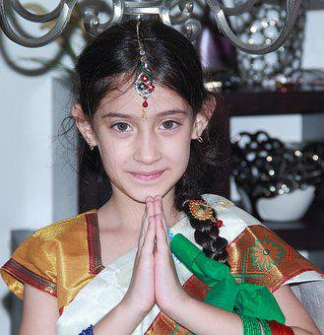
Using definite article ‘the’
3
Before superlative adjectives
Varun
Varun is the tallest boy in my class.
4
Before musical instruments
Gayathri plays the veena very well.
Notes:
Notes for Teacher
< Information for further reference or explanation >
Suggestions: <Ideas/ Images/ Animations / Others – To make better representation of the content >
Source of Multimedia used in this slide -
Children: https://pixabay.com/photos/school-children-classroom-school-7047131/
Veena: https://www.hiclipart.com/free-transparent-background-png-clipart-mtwgg
Girl: https://pixabay.com/photos/girl-india-style-cute-traditional-2829399/

Slide 4
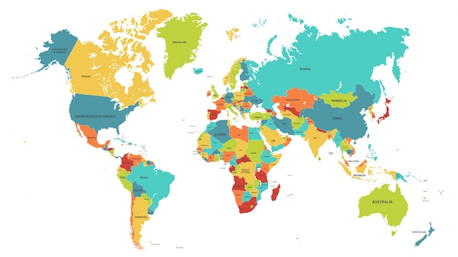
Using definite article ‘the’
5
Before countries whose name includes kingdom, states and republics
The United Kingdom
The United States
of America
The Republic of Congo
Notes:
Notes for Teacher - < Information for further reference or explanation >
Suggestions: <Ideas/ Images/ Animations / Others – To make better representation of the content >
Source of Multimedia used in this slide –
Map: https://www.freepik.com/premium-vector/colored-world-map-political-maps-
colourful-world-countries-country-names-
illustration_8637139.htm#query=uk%20map&position=28&from_view=search
(Attribution:tartila)

Slide 5
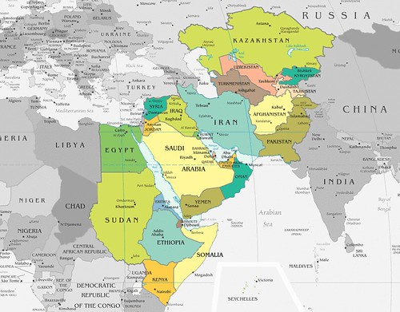
Using definite article ‘the’
6
Before countries with plural nouns as their names
The Seychelles
The Bahamas
The
Bahamas
The
Seychelles
Notes:
Notes for Teacher – The Seychelles- Group of 115 islands in the Indian Ocean, Off East Africa.
Suggestions: <Ideas/ Images/ Animations / Others – To make better representation of the content >
Source of Multimedia used in this slide –
The Seychelles: https://www.flickr.com/photos/11304375@N07/2327740463 (Attribution: Image Editor)
The Bahamas: https://pixabay.com/vectors/world-map-continents-africa-151576/

Slide 6
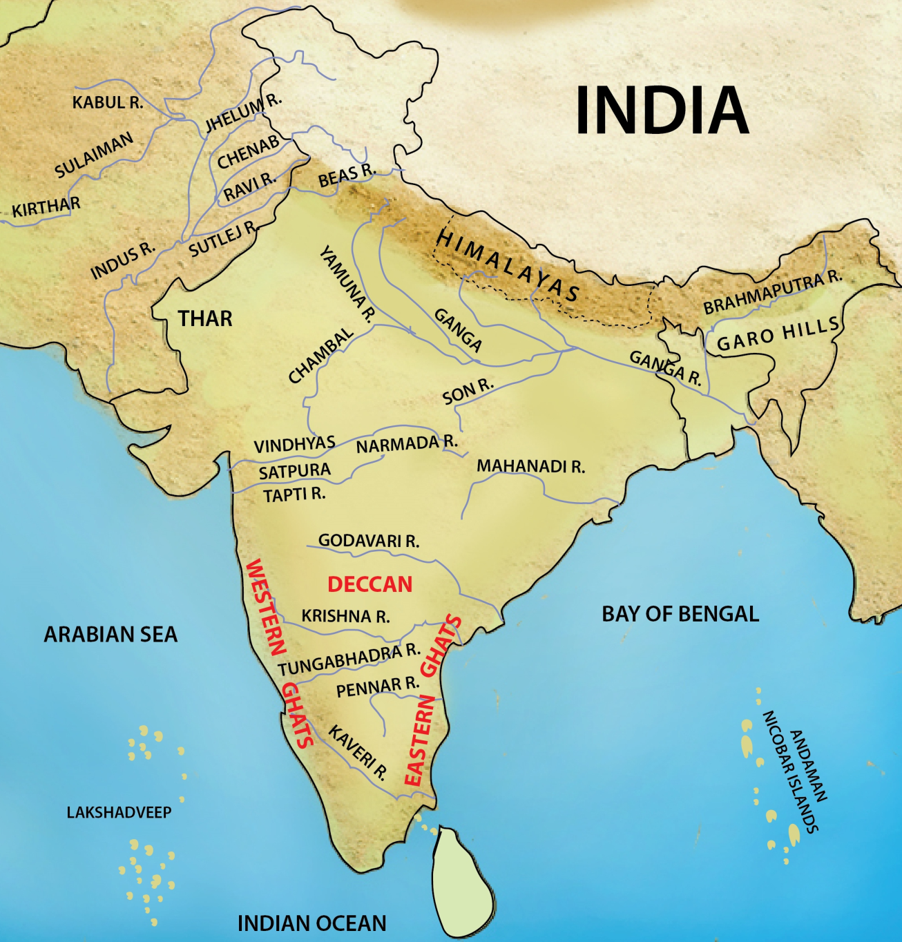
Using ‘the’- Geographical Features
7
The Himalayas
The River Ganga /The Ganges
The Arabian Sea
The Indian Ocean
Notes:
Notes for Teacher - < Information for further reference or explanation >
Suggestions: <Ideas/ Images/ Animations / Others – To make better representation of the content >
Source of Multimedia used in this slide –
1. Map: SSSVV gallery

Slide 7
Using definite article ‘the’
8
Before family names in plural form
The Shankars
The Singhs
Notes:
Notes for Teacher - < Information for further reference or explanation >
Suggestions: <Ideas/ Images/ Animations / Others – To make better representation of the content >
Source of Multimedia used in this slide –
The Shankars: SSSVV Gallery (Family)
The Singhs: https://www.flickr.com/photos/36106429@N00/5156316458 (Attribution: Navdeep Dhillon)

Slide 8
MM INDEX
Slide # | Thumbnail | Source link and Attribution
1 |  | Giraffe: https://pixabay.com/photos/giraffe-animal-safari-mammal-5848468/ Veena: https://www.hiclipart.com/free-transparent-background-png-clipart-mtwgg
2 |  | Dog: https://pixabay.com/photos/dog-bad-dangerous-german-shepherd-2141358/ Boy: https://pixabay.com/photos/outdoors-child-fun-boy-lifestyle-3308020/ Moon: https://pixabay.com/photos/moon-full-moon-sky-night-sky-lunar-1859616/
3 |  | Children: https://pixabay.com/photos/school-children-classroom-school-7047131/ Veena: https://www.hiclipart.com/free-transparent-background-png-clipart-mtwgg Girl: https://pixabay.com/photos/girl-india-style-cute-traditional-2829399/
4 |  | Map: https://www.freepik.com/premium-vector/colored-world-map-political-maps- colourful-world-countries-country-names- illustration_8637139.htm#query=uk%20map&position=28&from_view=search (Attribution:tartila)
5 |  | The Seychelles: https://www.flickr.com/photos/11304375@N07/2327740463 (Attribution: Image Editor) The Bahamas: https://pixabay.com/vectors/world-map-continents-africa-151576/
7 |  | 1. Map: SSSVV gallery
7 |  | The Shankars: SSSVV Gallery (Family) The Singhs: https://www.flickr.com/photos/36106429@N00/5156316458 (Attribution: Navdeep Dhillon)
Notes:
Notes for Teacher - < Information for further reference or explanation >
Suggestions: <Ideas/ Images/ Animations / Others – To make better representation of the content >
Source of Multimedia used in this slide - <Please provide source URL where we find the image and the license agreement>

