Slide 1
A Game with ARTICLES
A
a
An
an
The
the
Notes:
Notes for Teacher - < Information for further reference or explanation >
Suggestions: <Ideas/ Images/ Animations / Others – To make better representation of the content >
Source of Multimedia used in this slide - <Please provide source URL where we find the image and the license agreement>

Slide 2
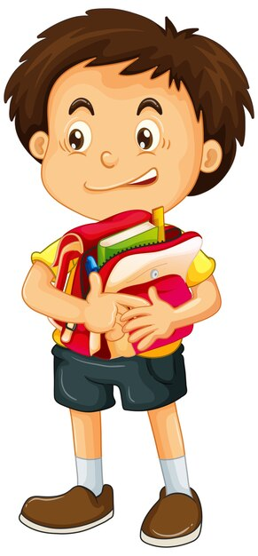
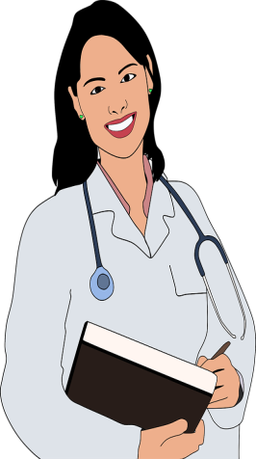
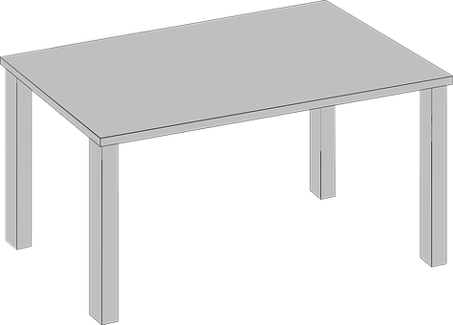
The Game Begins...
1. Ram put ___ orange in his bag.
an
2. Geetha is ___doctor.
a
3. I will be ____hour late.
an
4. There is a blue plate on ___ table.
the
12
1
Notes:
Notes for Teacher - < Information for further reference or explanation >
Suggestions: <Ideas/ Images/ Animations / Others – To make better representation of the content >
Source of Multimedia used in this slide -
Boy: https://www.freepik.com/free-vector/boy-holding-school-bag_11575520.htm#page=4&query=boy%20bag&position=21&from_view=search
(Attribution: brgfx)
Orange: https://pixabay.com/vectors/orange-fruit-food-mandarin-citrus-158258/
Doctor: https://pixabay.com/vectors/cartoon-checkup-clinic-comic-2027771/
Table: https://pixabay.com/vectors/table-furniture-living-room-3d-297193/
Plate, clock: PPT shapes

Slide 3
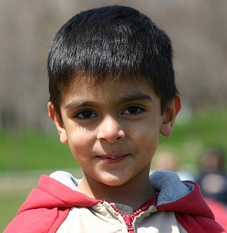
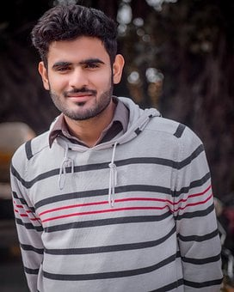
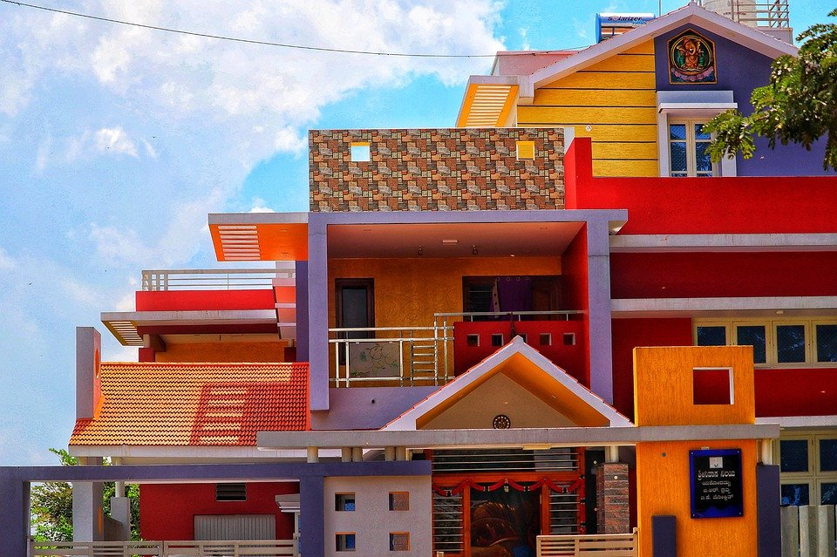
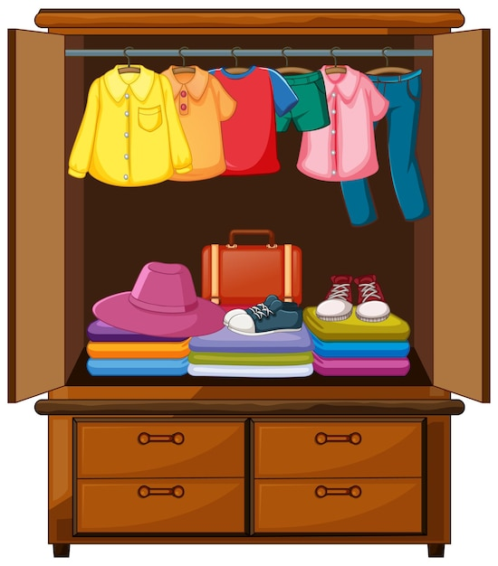
The Game Continues...
5. Kevin is ___ good friend.
a
6. Sam is ___ honest man.
an
7. ____house is very colourful.
The
8. ____ pink shirt is mine.
The
Notes:
Notes for Teacher - < Information for further reference or explanation >
Suggestions: <Ideas/ Images/ Animations / Others – To make better representation of the content >
Source of Multimedia used in this slide -
Friend: https://pixabay.com/photos/boy-child-young-cute-smiling-1514820/
Man: https://pixabay.com/photos/indian-man-fashion-men-s-fashion-5882625/
House: https://pixabay.com/photos/house-colored-house-architecture-4800940/
Shirt: https://www.freepik.com/free-vector/clothes-wardrobe_12364823.htm#page=5&query=wardrobe&position=23&from_view=search
(Attribution: brgfx)

Slide 4
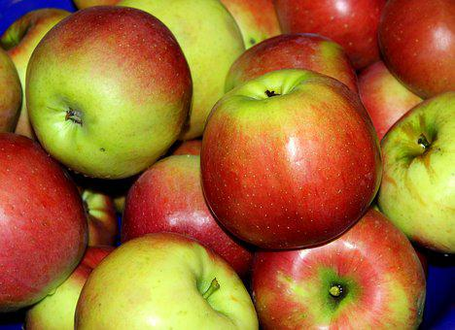
The Game Continues...
9. I want to eat ___ apple.
an
10. Did you bring ___umbrella?
an
11. Ramu is ___intelligent boy.
an
12. My sister is _ very good dancer.
a
Notes:
Notes for Teacher - < Information for further reference or explanation >
Suggestions: <Ideas/ Images/ Animations / Others – To make better representation of the content >
Source of Multimedia used in this slide -
Apple: https://pixabay.com/photos/apples-fruit-autumn-vitamins-3709749/
Umbrella: https://pixabay.com/photos/umbrella-red-weather-249346/
Boy: https://pixabay.com/photos/indian-boy-child-male-asian-1119236/
Sister: https://pixabay.com/photos/girl-indian-dance-red-oriental-1505407/

Slide 5
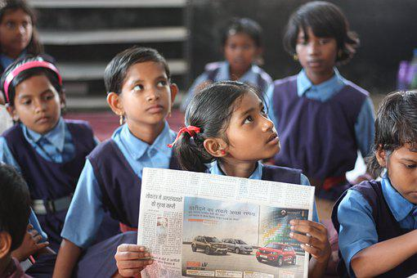
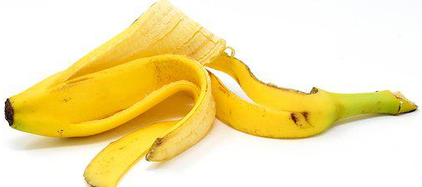
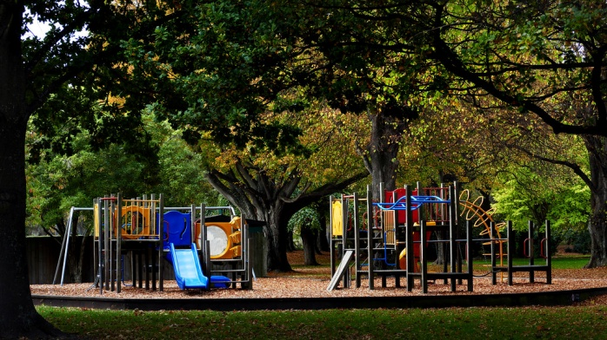
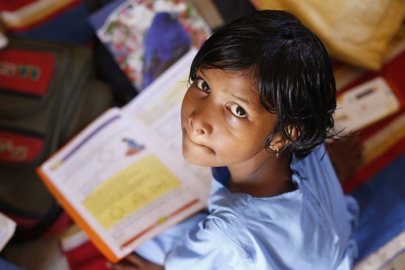
The Game Continues...
13. We decided to study for ___ exams.
the
14. Janaki ate all ___ bananas.
the
the
15. Vani finished reading ___ full
book in one day.
16. I like going to ___ park near
my house.
the
Notes:
Notes for Teacher - < Information for further reference or explanation >
Suggestions: <Ideas/ Images/ Animations / Others – To make better representation of the content >
Source of Multimedia used in this slide -
Studying: https://pixabay.com/photos/child-education-learning-school-4637663/
Bananas: https://pixabay.com/photos/banana-peel-fruit-healthy-yellow-3404376/
Book: https://pixabay.com/photos/children-infant-girl-school-306607/
Park: https://www.flickr.com/photos/88123769@N02/34262948212 (Attribution: Bernard Spragg. NZ)

Slide 6
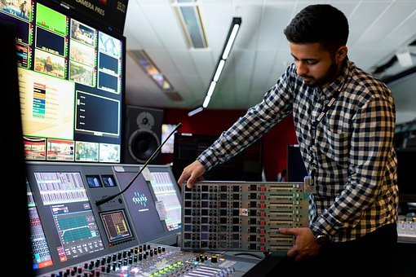
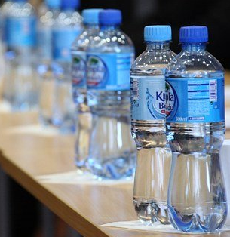
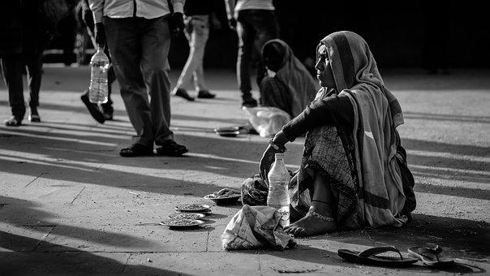
The Game Continues...
17. Give me ___ red pencil.
an
the
18. Akshay is training to be ___
engineer.
19. I need _ bottle of water.
a
20. We should help ___ poor.
the
Notes:
Notes for Teacher - < Information for further reference or explanation >
Suggestions: <Ideas/ Images/ Animations / Others – To make better representation of the content >
Source of Multimedia used in this slide -
Red pencil: https://pixabay.com/photos/colored-pencil-color-pencil-3985284/
Engineer: https://pixabay.com/photos/engineer-engineering-broadcast-4922423/
Water: https://pixabay.com/photos/water-minerals-bottle-plastic-cap-19659/
Poor: https://pixabay.com/photos/street-beggar-woman-homeless-2248101/

Slide 7
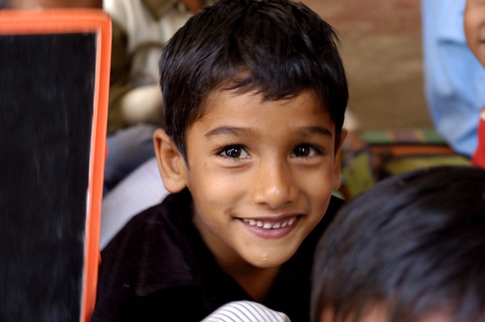
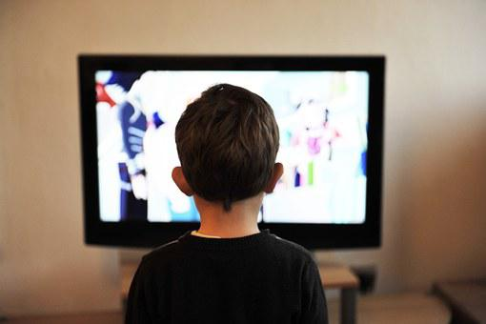
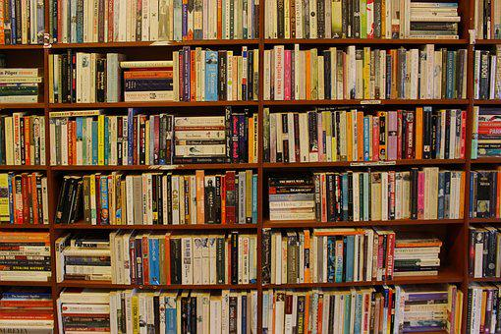
The Game Continues...
21. I read _ story book yesterday.
a
22. My brother is ___intelligent boy.
an
the
the
23. I spent all day in front of ___TV.
24. My school has ___ best library.
Notes:
Notes for Teacher - < Information for further reference or explanation >
Suggestions: <Ideas/ Images/ Animations / Others – To make better representation of the content >
Source of Multimedia used in this slide -
Intelligent: https://www.flickr.com/photos/35026043@N03/3292434700 (Attribution: Pratham Books)
TV: https://pixabay.com/photos/children-tv-child-television-home-403582/
Library: https://pixabay.com/photos/books-bookcase-library-bookshelf-2007660/
Book: https://www.flickr.com/photos/35026043@N03/3364199159 (Attribution: Pratham Books)

Slide 8
MM INDEX
Slide # | Thumbnail | Source link and Attribution
2 |  | Boy: https://www.freepik.com/free-vector/boy-holding-school-bag_11575520.htm#page=4&query=boy%20bag&position=21&from_view=search (Attribution: brgfx) Orange: https://pixabay.com/vectors/orange-fruit-food-mandarin-citrus-158258/ Doctor: https://pixabay.com/vectors/cartoon-checkup-clinic-comic-2027771/ Table: https://pixabay.com/vectors/table-furniture-living-room-3d-297193/ Plate, clock: PPT shapes
3 |  | Friend: https://pixabay.com/photos/boy-child-young-cute-smiling-1514820/ Man: https://pixabay.com/photos/indian-man-fashion-men-s-fashion-5882625/ House: https://pixabay.com/photos/house-colored-house-architecture-4800940/ Shirt: https://www.freepik.com/free-vector/clothes-wardrobe_12364823.htm#page=5&query=wardrobe&position=23&from_view=search (Attribution: brgfx)
4 |  | Apple: https://pixabay.com/photos/apples-fruit-autumn-vitamins-3709749/ Umbrella: https://pixabay.com/photos/umbrella-red-weather-249346/ Boy: https://pixabay.com/photos/indian-boy-child-male-asian-1119236/ Sister: https://pixabay.com/photos/girl-indian-dance-red-oriental-1505407/
5 |  | Studying: https://pixabay.com/photos/child-education-learning-school-4637663/ Bananas: https://pixabay.com/photos/banana-peel-fruit-healthy-yellow-3404376/ Book: https://pixabay.com/photos/children-infant-girl-school-306607/ Park: https://www.flickr.com/photos/88123769@N02/34262948212 (Attribution: Bernard Spragg. NZ)
6 |  | Red pencil: https://pixabay.com/photos/colored-pencil-color-pencil-3985284/ Engineer: https://pixabay.com/photos/engineer-engineering-broadcast-4922423/ Water: https://pixabay.com/photos/water-minerals-bottle-plastic-cap-19659/ Poor: https://pixabay.com/photos/street-beggar-woman-homeless-2248101/
7 |  | Intelligent: https://www.flickr.com/photos/35026043@N03/3292434700 (Attribution: Pratham Books) TV: https://pixabay.com/photos/children-tv-child-television-home-403582/ Library: https://pixabay.com/photos/books-bookcase-library-bookshelf-2007660/ Book: https://www.flickr.com/photos/35026043@N03/3364199159 (Attribution: Pratham Books)
12
1
Notes:
Notes for Teacher - < Information for further reference or explanation >
Suggestions: <Ideas/ Images/ Animations / Others – To make better representation of the content >
Source of Multimedia used in this slide - <Please provide source URL where we find the image and the license agreement>

