Slide 1
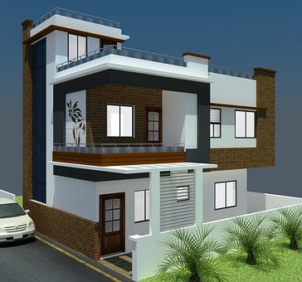
Articles in our daily lives
HOME
Notes:
Notes for Teacher - < Information for further reference or explanation >
Suggestions: <Ideas/ Images/ Animations / Others – To make better representation of the content >
Source of Multimedia used in this slide -
Home: https://pixabay.com/illustrations/architecture-indian-home-home-house-6055047/
School: https://pixabay.com/vectors/school-building-education-property-295210/
Supermarket: https://www.freepik.com/free-vector/shop-flat-banner-set_3817815.htm#query=supermarket%20banner&position=4&from_view=keyword (Attribution: macrovector)

Slide 2
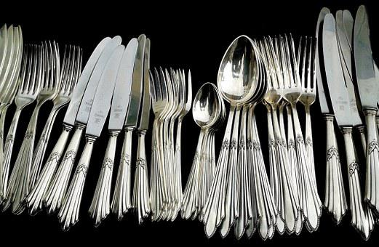
At Home
There are many spoons here. Which one do you want?
Raju, please bring me a spoon.
The biggest one, Raju.
Notes:
Notes for Teacher - < Information for further reference or explanation >
Suggestions: <Ideas/ Images/ Animations / Others – To make better representation of the content >
Source of Multimedia used in this slide -
1. Mother: SSSVV Gallery ( Key word teacher , mother)
2. Boy: https://www.freepik.com/free-vector/set-happy-children-different-
actions_5874504.htm (Attribution:brgfx)
3. Spoons: https://pixabay.com/photos/cutlery-silverware-knives-forks-377700/

Slide 3
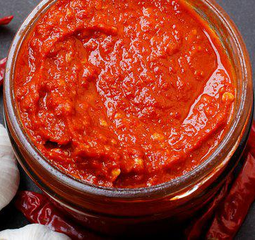
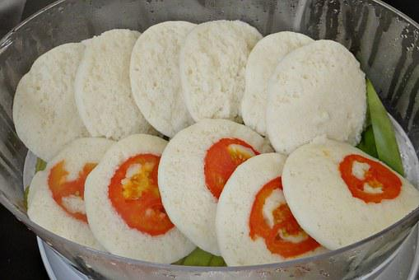
At Home
Raju, eat your breakfast.
The tomato chutney is very tasty.
I don’t want breakfast today.
Notes:
Notes for Teacher - < Information for further reference or explanation >
Suggestions: <Ideas/ Images/ Animations / Others – To make better representation of the content >
Source of Multimedia used in this slide -
Chutney: https://pixabay.com/photos/sauce-cooking-chilli-garlic-hot-5012291/
2. Mother: SSSVV Gallery ( Key word teacher , mother)
3. Boy: https://www.freepik.com/free-vector/set-happy-children-different-
actions_5874504.htm (Attribution:brgfx)
4. Idlis: https://pixabay.com/photos/idli-idly-steamed-garnished-371417/

Slide 4
At School
Vinaya, can I have a pencil?
Which colour pencil do you want? The red one or the green?
Give me the yellow one, please.
Notes:
Notes for Teacher - < Information for further reference or explanation >
Suggestions: <Ideas/ Images/ Animations / Others – To make better representation of the content >
Source of Multimedia used in this slide -
2nd girl: https://www.hiclipart.com/free-transparent-background-png-clipart-labdq (Attribution:brgfx)
2. 1st girl: https://www.freepik.com/free-vector/set-happy-children-different-
actions_5874504.htm (Attribution:brgfx)
3. Colour pencils: https://pixabay.com/photos/green-art-wood-sharp-pencil-group-1738220/

Slide 5
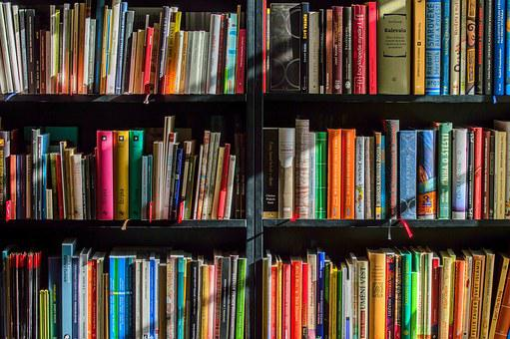
At School
Vinaya, where are you going?
Ankita, I am going to the library.
Our school library is the best.
Notes:
Notes for Teacher - < Information for further reference or explanation >
Suggestions: <Ideas/ Images/ Animations / Others – To make better representation of the content >
Source of Multimedia used in this slide -
2nd girl: https://www.hiclipart.com/free-transparent-background-png-clipart-labdq (Attribution:brgfx)
2. 1st girl: https://www.freepik.com/free-vector/set-happy-children-different-
actions_5874504.htm (Attribution:brgfx)
3. Library: https://pixabay.com/photos/books-bookstore-book-reading-1204029/

Slide 6
At The Supermarket
Biju, please take the blue trolley.
I will take the choco bar.
Father, can I buy an ice cream?
Do you want a choco bar or an orange bar?
Notes:
Notes for Teacher - < Information for further reference or explanation >
Suggestions: <Ideas/ Images/ Animations / Others – To make better representation of the content >
Source of Multimedia used in this slide -
Father and son: https://pixabay.com/vectors/family-vector-dad-mother-sons-1266237/
Ice creams: https://pixabay.com/vectors/ice-cream-food-dessert-sweet-1569334/

Slide 7
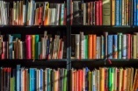
MM Index
Slide # | Thumbnail | Source link and Attribution
1 |  | Home: https://pixabay.com/illustrations/architecture-indian-home-home-house-6055047/ School: https://pixabay.com/vectors/school-building-education-property-295210/ Supermarket: https://www.freepik.com/free-vector/shop-flat-banner-set_3817815.htm#query=supermarket%20banner&position=4&from_view=keyword (Attribution: macrovector)
2 |  | 1. Mother: SSSVV Gallery ( Key word teacher , mother) 2. Boy: https://www.freepik.com/free-vector/set-happy-children-different- actions_5874504.htm (Attribution:brgfx) 3. Spoons: https://pixabay.com/photos/cutlery-silverware-knives-forks-377700/
3 |  | Chutney: https://pixabay.com/photos/sauce-cooking-chilli-garlic-hot-5012291/ 2. Mother: SSSVV Gallery ( Key word teacher , mother) 3. Boy: https://www.freepik.com/free-vector/set-happy-children-different- actions_5874504.htm (Attribution:brgfx) Idlis: https://pixabay.com/photos/idli-idly-steamed-garnished-371417/
4 |  | 2nd girl: https://www.hiclipart.com/free-transparent-background-png-clipart-labdq (Attribution:brgfx) 2. : 1st girl https://www.freepik.com/free-vector/set-happy-children-different- actions_5874504.htm (Attribution:brgfx) 3. Colour pencils: https://pixabay.com/photos/green-art-wood-sharp-pencil-group-1738220/
5 |  | 2nd girl: https://www.hiclipart.com/free-transparent-background-png-clipart-labdq (Attribution:brgfx) 2. 1st girl: https://www.freepik.com/free-vector/set-happy-children-different- actions_5874504.htm (Attribution:brgfx) 3. Library: https://pixabay.com/photos/books-bookstore-book-reading-1204029/
6 |  | Father and son: https://pixabay.com/vectors/family-vector-dad-mother-sons-1266237/ Ice creams: https://pixabay.com/vectors/ice-cream-food-dessert-sweet-1569334/
Notes:
Notes for Teacher - < Information for further reference or explanation >
Suggestions: <Ideas/ Images/ Animations / Others – To make better representation of the content >
Source of Multimedia used in this slide - <Please provide source URL where we find the image and the license agreement>

