Slide 1
Recalling Articles
Notes:
Notes for Teacher - < Information for further reference or explanation >
Suggestions: <Ideas/ Images/ Animations / Others – To make better representation of the content >
Source of Multimedia used in this slide -
1. https://pixabay.com/illustrations/q-and-a-question-answer-q-sign-2453376/

Slide 2
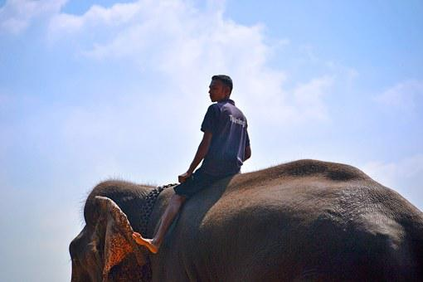
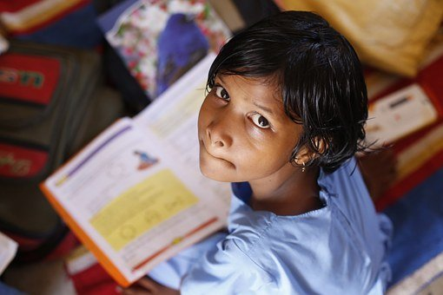
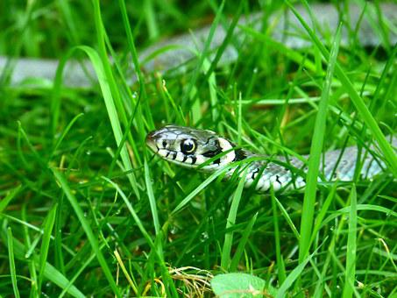
Section 1 – Fill in the blanks
Fill in the blanks with ‘a’, ‘an’, and ‘the’
1
Tinku rode on ___ elephant.
an
Raju gave me __ book to read.
2
a
3
We saw __ snake in ___ grass.
a
the
Notes:
Notes for Teacher - There are 3 sections.
1. Fill in the blanks with ‘a’, ‘an’ or ‘the’
2. Complete the story using definite and indefinite articles.
3. Complete the sentence using the appropriate article.
4. See the image and add the correct articles ‘a’, ‘ an’ or ‘the’
Suggestions: <Ideas/ Images/ Animations / Others – To make better representation of the content >
Source of Multimedia used in this slide -
Elephant: https://pixabay.com/photos/elephant-ride-ride-on-elephant-266100/
Read: https://pixabay.com/photos/children-infant-girl-school-306607/
Snake, grass: https://pixabay.com/photos/grass-snake-line-head-section-634639/

Slide 3
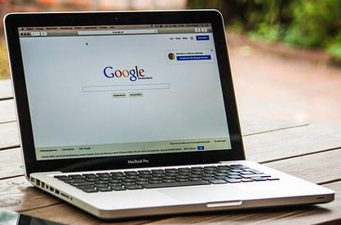
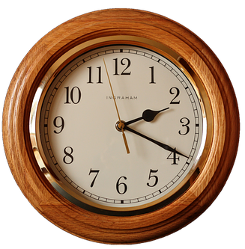
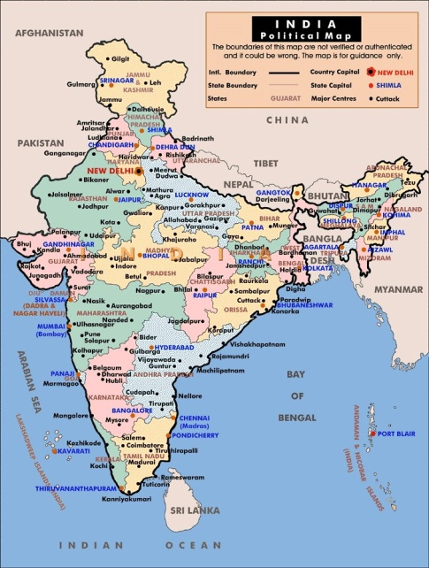
Section 1 – Fill in the blanks
Fill in the blanks with ‘a’, ‘an’, and ‘the’
4
Do you know who invented ___ computer?
the
5
I left the house ___hour ago.
an
What is ___ capital of India?
6
the
Notes:
Notes for Teacher - There are 3 sections.
1. Fill in the blanks with ‘a’, ‘an’ or ‘the’
2. Complete the story using definite and indefinite articles.
3. Complete the sentence using the appropriate article.
4. See the image and add the correct articles ‘a’, ‘ an’ or ‘the’
Suggestions: <Ideas/ Images/ Animations / Others – To make better representation of the content >
Source of Multimedia used in this slide -
Computer: https://pixabay.com/photos/macbook-laptop-google-display-459196/
Clock: https://pixabay.com/photos/clock-wall-clock-clock-face-pointer-2634551/
India: https://www.flickr.com/photos/41383869@N07/7458321320 (Attribution: Nathan Hughes Hamilton)

Slide 4
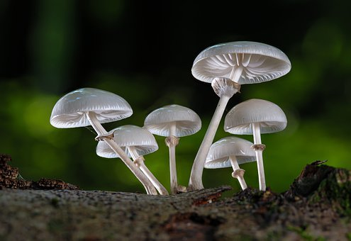
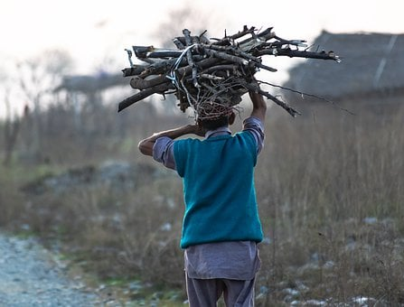
Section 2 – Complete the story
Complete the story using definite and indefinite articles
Long ago __ poor wood man and his wife lived at ___ edge
of ___thick forest. Everyday ____ poor wood man would go into ___ forest to collect mushrooms and also gather twigs and
firewood to sell in ____ market.
____ wood man left early in ____morning as usual.
He walked for ___hour in ____ forest. He did not find any mushrooms. He decided not to go to ____market but returned home instead.
a
the
a
the
the
the
The
the
an
the
the
Notes:
Notes for Teacher – The teacher can display the story for 2 minutes and allow the children to read and be ready with the answers. Answers can be revealed after discussing with the children.
Suggestions: <Ideas/ Images/ Animations / Others – To make better representation of the content >
Source of Multimedia used in this slide –
Mushrooms: https://pixabay.com/photos/mushrooms-book-mucus-oyster-mushroom-5580235/
Man: https://pixabay.com/photos/man-carrying-firewood-wood-carrying-6008734/

Slide 5
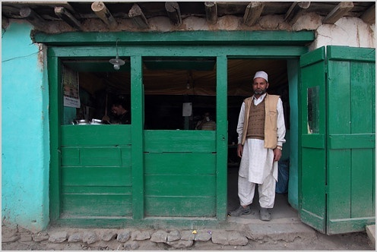
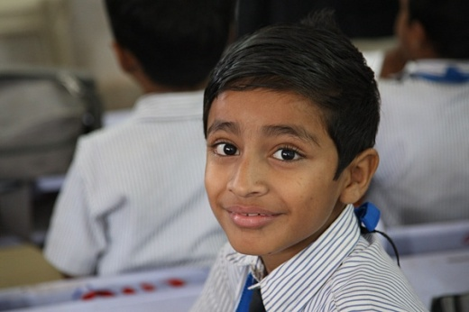
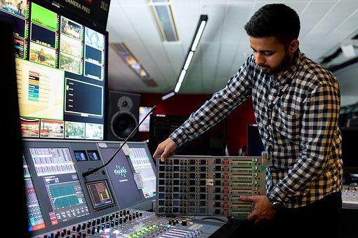
Section 3 – Correct the sentences
Rewrite the sentences using definite and indefinite articles
Who is man at door?
Who is the man at the door?
Ram bought new pen yesterday
Ram bought a new pen yesterday
My father is engineer
My father is an engineer
Notes:
Notes for Teacher - < Information for further reference or explanation >
Suggestions: <Ideas/ Images/ Animations / Others – To make better representation of the content >
Source of Multimedia used in this slide -
1. Man: https://www.flickr.com/photos/43109416@N00/4929855138 (Attribution: nevil
zaveri)
2. Boy: https://www.flickr.com/photos/10816734@N03/3492484806 (Attribution: World Bank
Photo Collections photostream)
2. Pen: https://pixabay.com/photos/pen-write-office-notes-take-notes-3201385/
3. Engineer: https://pixabay.com/photos/engineer-engineering-broadcast-4922423/

Slide 6
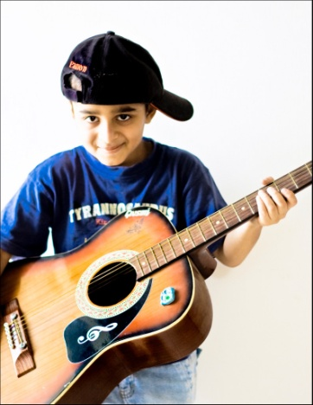
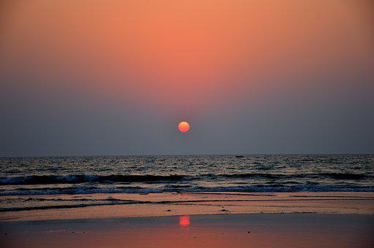
Section 3 – Correct the sentences
Rewrite the sentences using definite and indefinite articles
Aarav always plays guitar at home
Aarav always plays the guitar at home
We never go out in evenings
We never go out in the evenings
Notes:
Notes for Teacher - < Information for further reference or explanation >
Suggestions: <Ideas/ Images/ Animations / Others – To make better representation of the content >
Source of Multimedia used in this slide -
Guitar: https://www.flickr.com/photos/7927132@N08/4706296135 (Attribution: Abhisek Sarda)
Sunset: https://pixabay.com/photos/sunset-beach-sea-ocean-water-sky-3885886/

Slide 7
Section 4 – Choose the correct answer
Choose the correct article
1
Suma has ____ aunt in Delhi
a) a b) an c) the
2
I never listen to _____ radio
a) a b) an c) the
3
I saw ____ donkey near my house
a) a b) an c) the
4
What is ____name of your school?
a) a b) an c) the
5
My father is ___ honest man
a) a b) an c) the
6
I can see an ant on ____wall
a) a b) an c) the
Notes:
Notes for Teacher - < Information for further reference or explanation >
Suggestions: <Ideas/ Images/ Animations / Others – To make better representation of the content >
Source of Multimedia used in this slide - <Please provide source URL where we find the image and the license agreement>

Slide 8
MM INDEX
Slide # | Thumbnail | Source link and Attribution
1 |  | 1. https://pixabay.com/illustrations/q-and-a-question-answer-q-sign-2453376/
2 |  | Elephant: https://pixabay.com/photos/elephant-ride-ride-on-elephant-266100/ Read: https://pixabay.com/photos/children-infant-girl-school-306607/ Snake, grass: https://pixabay.com/photos/grass-snake-line-head-section-634639/
3 |  | Computer: https://pixabay.com/photos/macbook-laptop-google-display-459196/ Clock: https://pixabay.com/photos/clock-wall-clock-clock-face-pointer-2634551/ India: https://www.flickr.com/photos/41383869@N07/7458321320 (Attribution: Nathan Hughes Hamilton)
4 |  | Mushrooms: https://pixabay.com/photos/mushrooms-book-mucus-oyster-mushroom-5580235/ Man: https://pixabay.com/photos/man-carrying-firewood-wood-carrying-6008734/
5 |  | 1. Man: https://www.flickr.com/photos/43109416@N00/4929855138 (Attribution: nevil zaveri) 2. Boy: https://www.flickr.com/photos/10816734@N03/3492484806 (Attribution: World Bank Photo Collections photostream) 2 . Pen: https://pixabay.com/photos/pen-write-office-notes-take-notes-3201385/ 3 . Engineer: https://pixabay.com/photos/engineer-engineering-broadcast-4922423/
6 |  | Guitar: https://www.flickr.com/photos/7927132@N08/4706296135 (Attribution: Abhisek Sarda) Sunset: https://pixabay.com/photos/sunset-beach-sea-ocean-water-sky-3885886/
Notes:
Notes for Teacher - < Information for further reference or explanation >
Suggestions: <Ideas/ Images/ Animations / Others – To make better representation of the content >
Source of Multimedia used in this slide - <Please provide source URL where we find the image and the license agreement>

