Slide 1
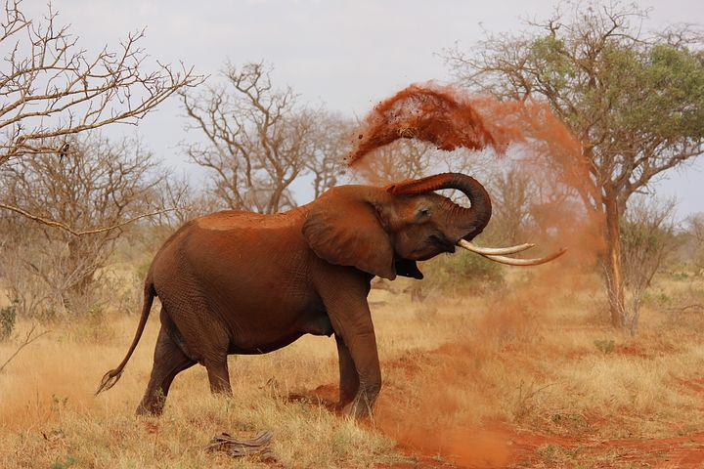
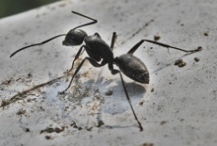
Nothing is small
Notes:
Notes for Teacher - < Information for further reference or explanation >
Suggestions: <Ideas/ Images/ Animations / Others – To make better representation of the content >
Source of Multimedia used in this slide -
Elephant: https://pixabay.com/photos/elephant-animal-zoo-111695/
Ant: https://pixabay.com/photos/insect-ant-entomology-animal-6563756/

Slide 2
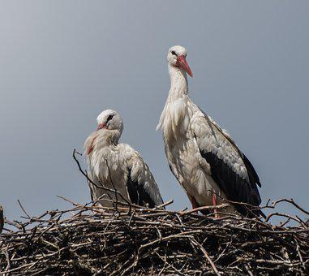
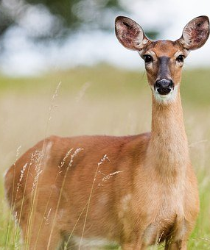
The Ant and the Proud Elephant
Once upon a time...
An arrogant elephant was proud of its size and strength...
Notes:
Notes for Teacher - Children you all know that articles are used before nouns. Though they are simple one, two or three lettered words they are important because they provide certain information about the noun. So, we cannot ignore or avoid them in a sentence. Likewise, everything in this Creation whether big or small has some value. So, our physical strength or might should not make one arrogant. All things big and small deserve our respect and reverence.
Story: Once upon a time, a big arrogant elephant lived in a forest. He was so proud of his size and strength that he always troubled other small creatures in the forest by destroying the nests of birds and small burrows where rabbits lived. The small creatures in the forest were worried and scared of the mighty elephant
Suggestions: <Ideas/ Images/ Animations / Others – To make better representation of the content >
Source of Multimedia used in this slide -
Ant: https://pixabay.com/photos/insect-ant-entomology-animal-6563756/
Elephant: https://pixabay.com/photos/elephant-animal-zoo-111695/
Rabbit: https://pixabay.com/photos/rabbit-hare-bunny-ears-grass-1882699/
Deer: https://pixabay.com/photos/roe-deer-deer-animal-roe-1367182/
Bird: https://pixabay.com/photos/bird-stork-nest-wildlife-animal-3163234/
Monkey: https://pixabay.com/photos/monkeys-cambodia-angkor-temple-603415/

Slide 3
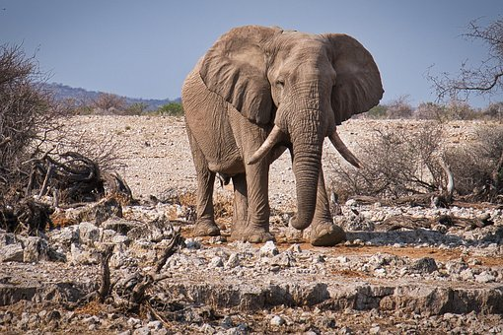
The Ant and the Proud Elephant
Look at you, Oh! tiny little ant. You look so small and weak...
.
Dear brother, you are stronger and bigger than me. But you should not make fun of others.
Notes:
Notes for Teacher - But among them was a brave little ant. She decided to teach the arrogant elephant a lesson. The ant went to meet the elephant. As soon as he saw the ant, the elephant burst out laughing. He said, “Look at you, Oh! tiny little ant. You look so small and weak. You can easily get stamped in a second. One needs to have magnifying glasses to look at you. How will you escape if you come under my feet?” Saying this, the elephant laughed loudly again
Hearing these words, the ant did not get angry. But she politely replied. “Dear brother, I agree you are stronger than me in size and strength. But you should not make fun of others like this. I am happy the way I am. In God’s creation everything big or small has a value. So please be respectful and polite to all”.
Suggestions: <Ideas/ Images/ Animations / Others – To make better representation of the content >
Source of Multimedia used in this slide -
Elephant: https://pixabay.com/photos/elephant-etosha-namibia-wildlife-3832516/
Ant: https://pixabay.com/photos/insect-ant-entomology-animal-6563756/

Slide 4
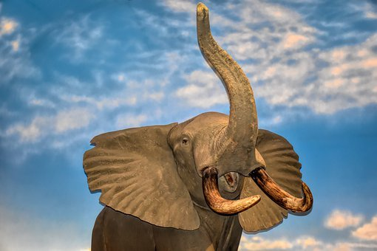
The Ant and the Proud Elephant
The arrogant elephant continued to insult the ant
Notes:
Notes for Teacher - But the arrogant elephant continued to insult the tiny little ant and swished the ant away. The ant wasn’t bothered. She quietly clung onto the tail of the elephant and slowly went and hid deep inside the elephant’s ear. With all her might, she bit hard.
Suggestions: <Ideas/ Images/ Animations / Others – To make better representation of the content >
Source of Multimedia used in this slide -
1. Elephant: https://pixabay.com/photos/elephant-wildlife-africa-animal-4308822/

Slide 5
The Ant and the Proud Elephant
The ant bit the elephant’s ear real hard
The elephant scratched his ear, shook his head
The pain was unbearable
The mighty elephant fell down crying in pain
Calm down proud elephant!
The mighty elephant apologized to all the tiny
creatures in the forest
He promised never to look down upon others
and treat all with love and respect
Notes:
Notes for Teacher - The elephant fell down crying in pain. He scratched his ears and shook his head, but the pain was intense. Slowly the ant came out of the Elephant’s ear and calmed him down. The elephant learnt his lesson. A tiny ant was enough to bring the mighty elephant down to the ground. He understood that size doesn’t matter and everything in God’s Creation is special.
The elephant apologized to all the tiny creatures in the forest and promised that he would never look down upon others as small and treat all with love and respect. So, Children always remember - Nothing is small in this Universe.
Suggestions: <Ideas/ Images/ Animations / Others – To make better representation of the content >
Source of Multimedia used in this slide -
Elephant: https://pixabay.com/photos/elephant-wildlife-africa-animal-4308822/
Ant: https://pixabay.com/photos/insect-ant-entomology-animal-6563756/

Slide 6
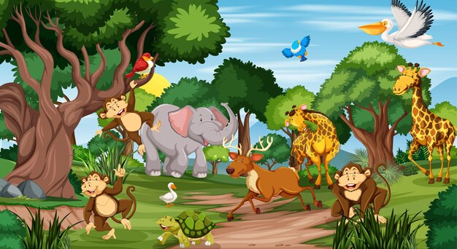
The Ant and the Proud Elephant
NOTHING IS SMALL
Notes:
Notes for Teacher - < Information for further reference or explanation >
Suggestions: <Ideas/ Images/ Animations / Others – To make better representation of the content >
Source of Multimedia used in this slide -
https://www.freepik.com/free-vector/many-different-animals-forest-scene_12735484.htm#query=forest%20animals&position=4&from_view=search (Attribution:brgfx)
Ant: https://pixabay.com/photos/insect-ant-entomology-animal-6563756/

Slide 7
MM INDEX
Slide # | Thumbnail | Source link and Attribution
1, 2 |  | Elephant: https://pixabay.com/photos/elephant-animal-zoo-111695/
1, 2, 3, 5, 6 |  | Ant: https://pixabay.com/photos/insect-ant-entomology-animal-6563756/
2 |  | Rabbit: https://pixabay.com/photos/rabbit-hare-bunny-ears-grass-1882699/ Deer: https://pixabay.com/photos/roe-deer-deer-animal-roe-1367182/ Bird: https://pixabay.com/photos/bird-stork-nest-wildlife-animal-3163234/ Monkey: https://pixabay.com/photos/monkeys-cambodia-angkor-temple-603415/
3 |  | Elephant: https://pixabay.com/photos/elephant-etosha-namibia-wildlife-3832516/
4,5 |  | Elephant: https://pixabay.com/photos/elephant-wildlife-africa-animal-4308822/
6 |  | https://www.freepik.com/free-vector/many-different-animals-forest-scene_12735484.htm (Attribution:brgfx)
Notes:
Notes for Teacher - < Information for further reference or explanation >
Suggestions: <Ideas/ Images/ Animations / Others – To make better representation of the content >
Source of Multimedia used in this slide - <Please provide source URL where we find the image and the license agreement>

