Slide 1
Food for Thought
Notes:
Notes for Teacher - < Information for further reference or explanation >
Suggestions: <Ideas/ Images/ Animations / Others – To make better representation of the content >
Source of Multimedia used in this slide -
https://www.freepik.com/free-vector/man-with-empty-callout_2872879.htm

Slide 2
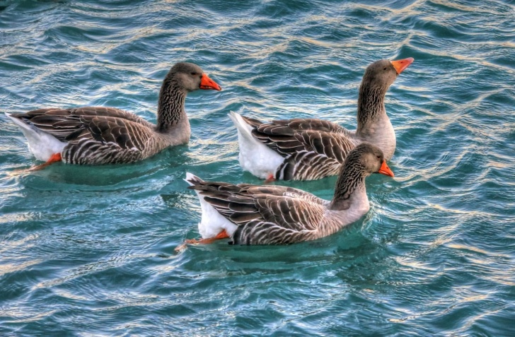
Fill in the blanks
Read the following paragraph and fill in the blanks. Use the words in the help box.
rice
mother
pond
food
Rajesh
ducks
peas
father
Komal
The park has a big pond. A paddling of ducks floated in the pond. _________ and ________ went to the ______ with their ________ and _________. They gave _______ and ______ to the ________. The ducks came close to them to get their _______.
Rajesh
Komal
pond
Click here for the answer
father
mother
rice
peas
ducks
food
Notes:
Notes for Teacher - The teacher could use the following paragraph to enable the students to think and come out with as many answers as possible before giving out the right answers. After the exercise is complete, the questions that follow could be posed. The students’ attention could be drawn to the last question and sum it up.
Suggestions: <Ideas/ Images/ Animations / Others – To make better representation of the content >
Source of Multimedia used in this slide
- https://pxhere.com/en/photo/1007254

Slide 3
Question no.1
The words used to fill in the blanks are verbs. Say, true or false
If false, give the right answer.
False, they are nouns.
Click here for the answer
Notes:
Notes for Teacher - < Information for further reference or explanation >
Suggestions: <Ideas/ Images/ Animations / Others – To make better representation of the content >
Source of Multimedia used in this slide -
https://www.freepik.com/free-photo/red-bubble-dislike-button-icon-thumbs-down-unlike-sign-feedback-concept-white-background-3d-rendering_22405815.htm

Slide 4
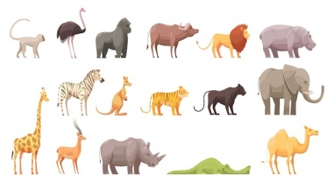
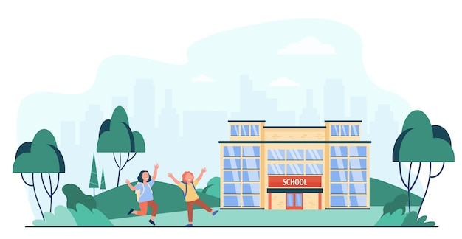
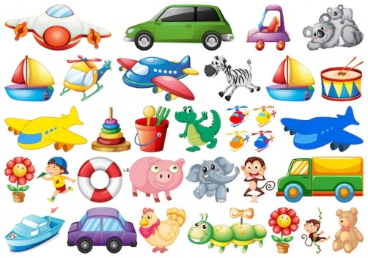
Question no.2
Why are they called so?
They are naming words as they name people, places, animals and things.
Click here for the answer
Notes:
Notes for Teacher - < Information for further reference or explanation >
Suggestions: <Ideas/ Images/ Animations / Others – To make better representation of the content >
Source of Multimedia used in this slide -
People: https://www.freepik.com/free-vector/diverse-crowd-people-different-ages-races_7732608.htm
Animals: https://www.freepik.com/free-vector/wild-animals_4324775.htm
Place: https://www.freepik.com/free-vector/happy-kids-running-outside-near-school-isolated-flat-vector-illustration-cartoon-children-going-along-road-school-entrance-education-childhood-concept_11671726.htm
Things: https://www.freepik.com/free-vector/set-children-toy_4453066.htm

Slide 5
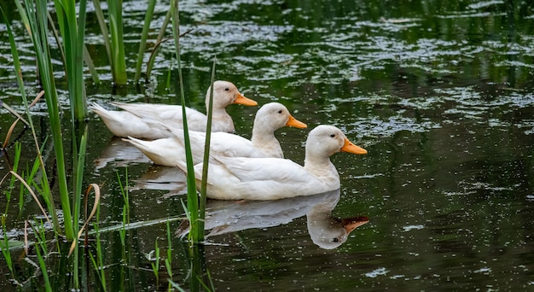
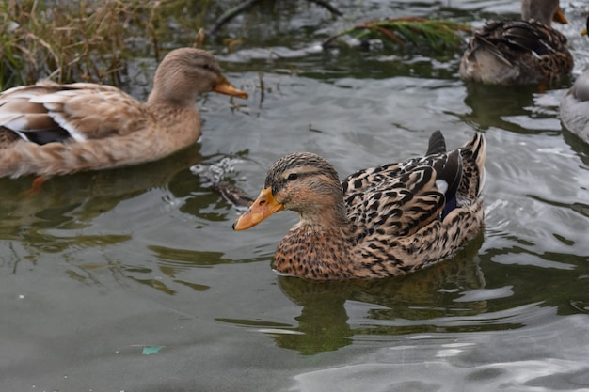
Question no.3
What is the meaning of the sentence ‘A paddling of ducks float in the pond.’?
many ducks, group of ducks, family of ducks
Click here for the answer
Notes:
Notes for Teacher - < Information for further reference or explanation >
Suggestions: <Ideas/ Images/ Animations / Others – To make better representation of the content >
Source of Multimedia used in this slide -
Ducks: https://www.freepik.com/free-photo/white-ducks-swimming-pond_18088766.htm
Ducks: https://www.freepik.com/free-photo/group-ducks-swimming-around-shallow-lake-waters_19309988.htm

Slide 6
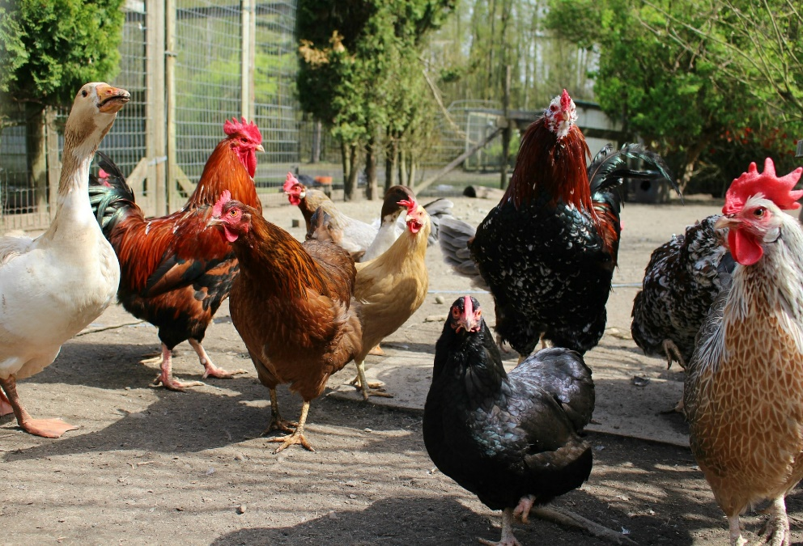
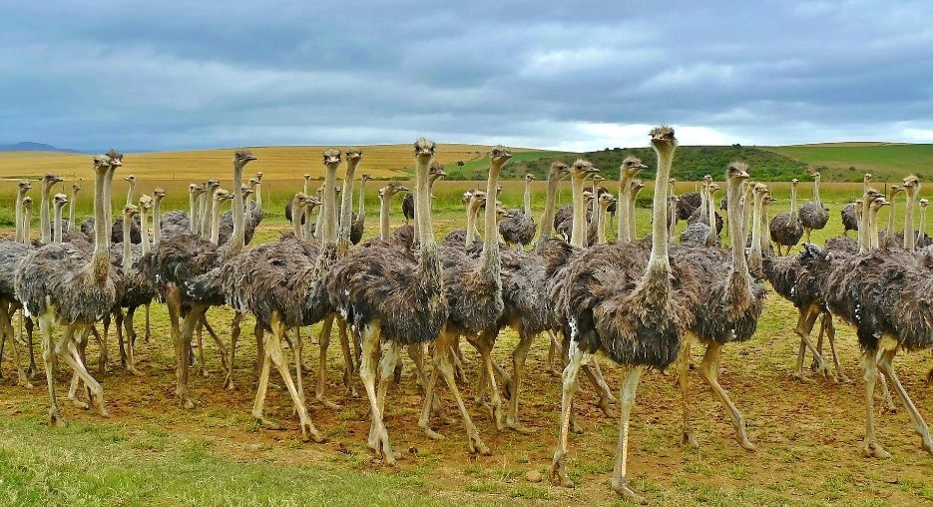
Question no.4
What are such nouns called? Why?
Collective nouns, as they show many nouns of the same kind together.
Click here for the answer
Notes:
Notes for Teacher - < Information for further reference or explanation >
Suggestions: <Ideas/ Images/ Animations / Others – To make better representation of the content >
Source of Multimedia used in this slide -
Ostrich: https://pixabay.com/photos/ostriches-birds-ostrich-animal-838976/
Chicken: https://pixabay.com/photos/chickens-farm-poultry-farm-animals-1221342/

Slide 7
MM Index
Slide # | Thumbnail | Source link and Attribution
1 |  | https://www.freepik.com/free-vector/man-with-empty-callout_2872879.htm By brgfx
2 |  | https://pxhere.com/en/photo/1007254
3 |  | https://www.freepik.com/free-photo/red-bubble-dislike-button-icon-thumbs-down-unlike-sign-feedback-concept-white-background-3d-rendering_22405815.htm By mamewmy
4 |  | People: https://www.freepik.com/free-vector/diverse-crowd-people-different-ages-races_7732608.htm By pch.vector Animals: https://www.freepik.com/free-vector/wild-animals_4324775.htm By macrovector Place: https://www.freepik.com/free-vector/happy-kids-running-outside-near-school-isolated-flat-vector-illustration-cartoon-children-going-along-road-school-entrance-education-childhood-concept_11671726.htm By pch.vector Things: https://www.freepik.com/free-vector/set-children-toy_4453066.htm By brgfx
5 |  | Ducks: https://www.freepik.com/free-photo/white-ducks-swimming-pond_18088766.htm By wirestock Ducks: https://www.freepik.com/free-photo/group-ducks-swimming-around-shallow-lake-waters_19309988.htm By DejaVu Designs
6 |  | Ostrich: https://pixabay.com/photos/ostriches-birds-ostrich-animal-838976/ Chicken: https://pixabay.com/photos/chickens-farm-poultry-farm-animals-1221342/
Notes:
Notes for Teacher - < Information for further reference or explanation >
Suggestions: <Ideas/ Images/ Animations / Others – To make better representation of the content >
Source of Multimedia used in this slide - <Please provide source URL where we find the image and the license agreement>

