Slide 1
Knowing All About Collective Nouns
Notes:
Notes for Teacher – N/A
Suggestions: N/A
Source of Multimedia Objects (Image/audio/ Video/Animation) used in this slide - N/A

Slide 2
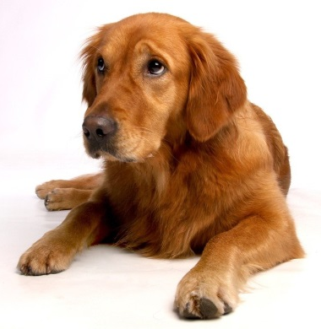
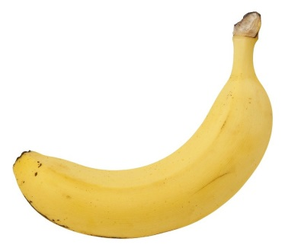
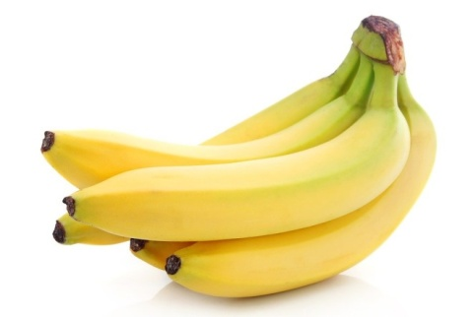
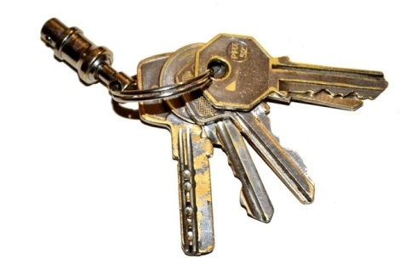
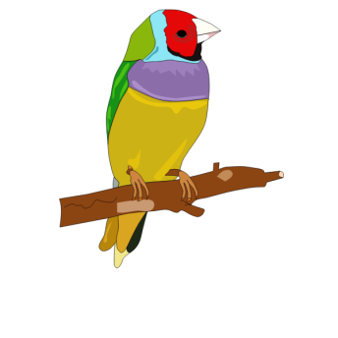
Collective Nouns
Dog
Dogs
Banana
Bananas
Key
Keys
Bird
Birds
Notes:
Notes for Teacher – The teacher could begin the class by showing a few pictures of dog and dogs, banana and bananas, key and keys, bird and birds, or show things in class like pen and pens, book and books and ask what they are.
The most expected answers would be the plural form of the nouns shown.(The main intention of asking such questions is to trigger their thinking and generate curiosity. The stress need not be on the right answers alone. Teachers should encourage as many answers as possible.)
Through these examples the teacher could introduce the collective nouns.
Suggestions: N/A
Source of Multimedia Objects (Image/audio/ Video/Animation) used in this slide -
Dog: https://pixabay.com/photos/golden-retriever-dog-loyal-to-dear-642016/
Dogs: https://pixabay.com/photos/burgundy-mastiff-dog-animal-white-869036/
Banana: https://pixabay.com/photos/fruits-healthy-vitamins-eat-diet-2202411/
Bananas: https://pixabay.com/photos/banana-minimum-fruit-tropical-2449019/
Key: https://publicdomainvectors.org/en/free-clipart/Old-style-hollow-door-key-vector-image/19940.html
Keys: https://pixabay.com/photos/keys-keychain-keyset-1023939/
Bird: https://freesvg.org/colorful-bird
Birds: https://freesvg.org/clip-art-of-three-different-flying-birds

Slide 3
Collective Nouns
pencil
pencils
a set of pencils
book
books
a pile/set/shelf/ library of books
dog
dogs
a pack of dogs
key
keys
a bunch of keys
cow
cows
a herd of cows
Notes:
Notes for Teacher – N/A
Suggestions: N/A
Source of Multimedia Objects (Image/audio/ Video/Animation) used in this slide - N/A

Slide 4
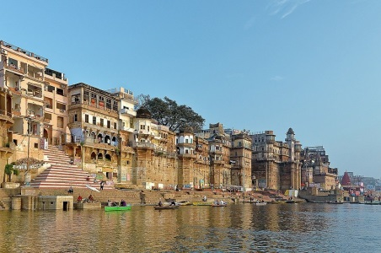
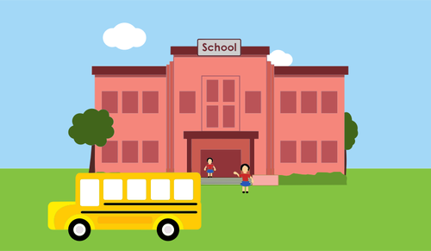
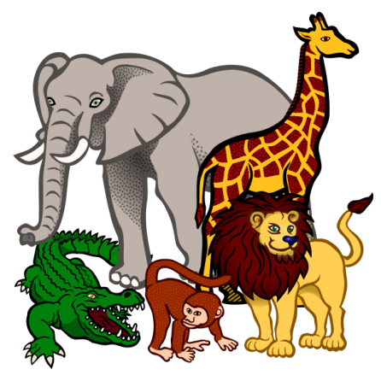
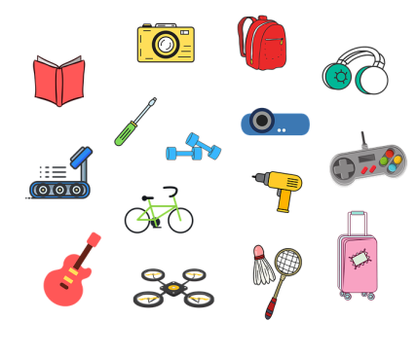
Collective Nouns
Nouns which indicate a group of persons, places, animals and things of the same kind are called collective nouns.
Persons
Places
Animals
Things
Notes:
Notes for Teacher – N/A
Suggestions: N/A
Source of Multimedia Objects (Image/audio/ Video/Animation) used in this slide -
Persons: https://pixabay.com/illustrations/head-people-group-young-students-1556566/
Varanasi: https://pixabay.com/photos/india-varanasi-ghat-architecture-3086808/
School: https://publicdomainvectors.org/en/free-clipart/School/40808.html
Animals: https://freesvg.org/african-animals-vector-illustration
Things: https://pixabay.com/illustrations/things-stuff-share-mess-messy-4697014/

Slide 5
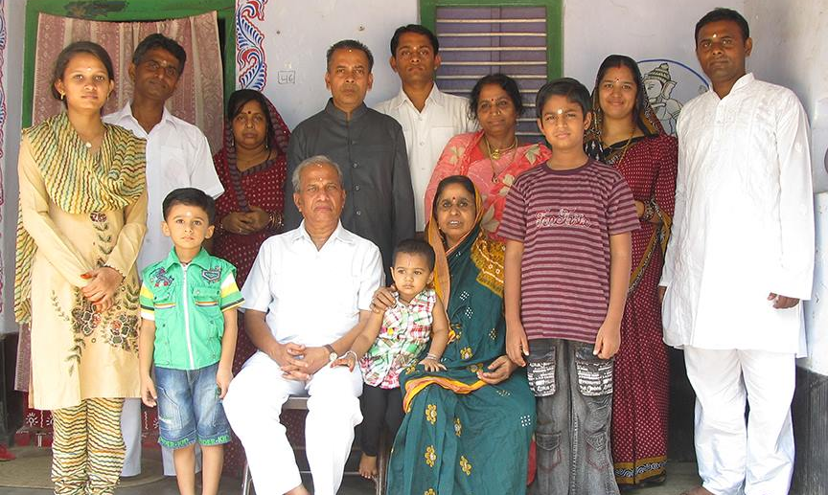
Collective Nouns
Collective nouns include words like group, class, team, number, audience and family.
Notes:
Notes for Teacher – N/A
Suggestions: N/A
Source of Multimedia Objects (Image/audio/ Video/Animation) used in this slide -
Group: https://publicdomainvectors.org/en/free-clipart/Vector-image-of-population-icon/8176.html
Family: SSSVV Image Gallery: Search Keyword “family”

Slide 6
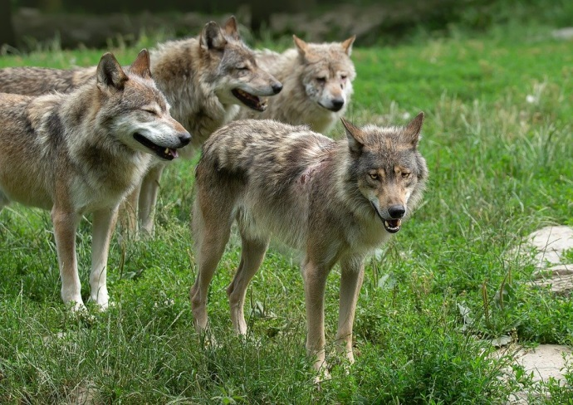
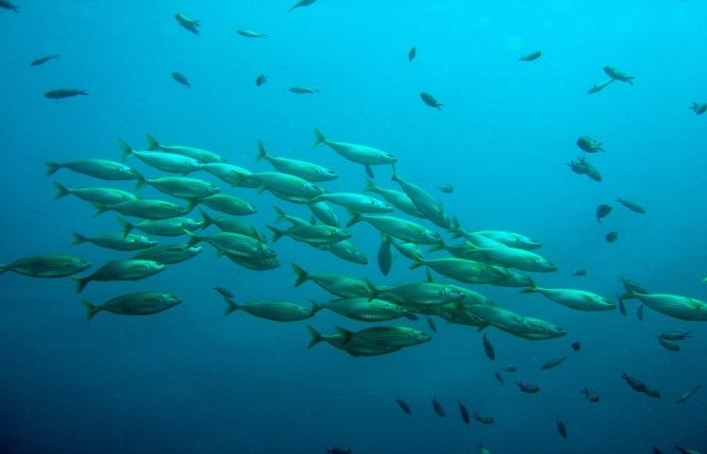
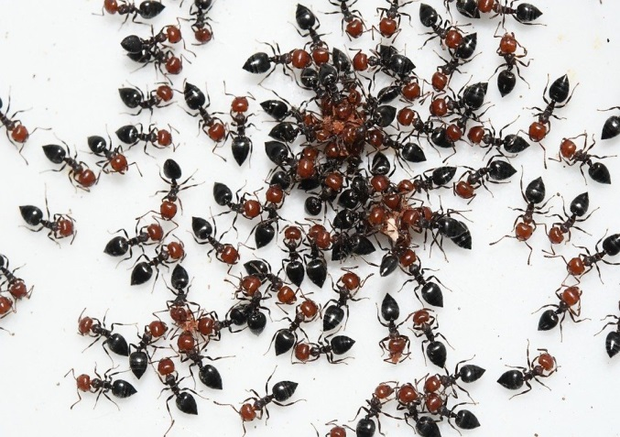
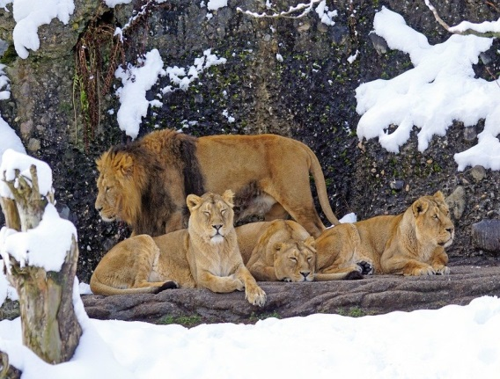
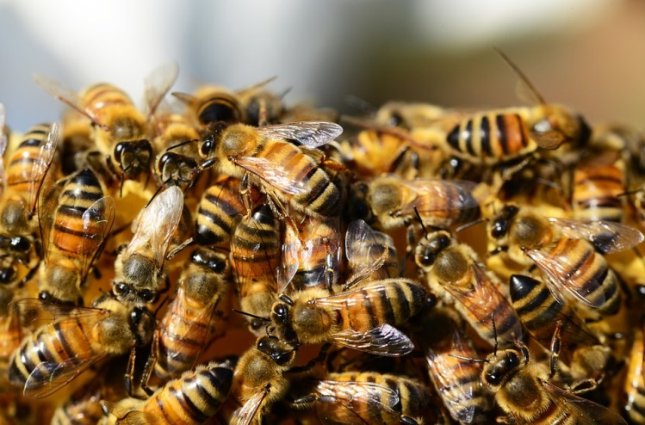
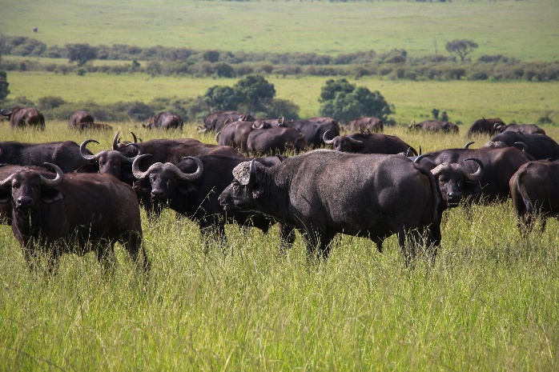
Example Phrases of Collective Nouns
a pack of wolves
a school of fish
a colony of ants
a pride of lions
a swarm of bees
a herd of buffaloes
Notes:
Notes for Teacher – N/A
Suggestions: N/A
Source of Multimedia Objects (Image/audio/ Video/Animation) used in this slide -
Wolves: https://pixabay.com/photos/wolves-wolf-pack-predator-animal-4377376/
Fishes: https://pixabay.com/photos/school-of-fish-fish-nature-water-756460/
Lions: https://pixabay.com/photos/lion-pride-of-lions-predator-1972786/
Ants: https://pixabay.com/photos/ants-insects-community-entomology-6367022/
Bees: https://www.maxpixel.net/Swarm-Of-Bees-Beehive-Honey-Bees-Honey-Bees-326334
Buffaloes: https://pixabay.com/photos/cape-buffaloes-animals-safari-5929180/

Slide 7
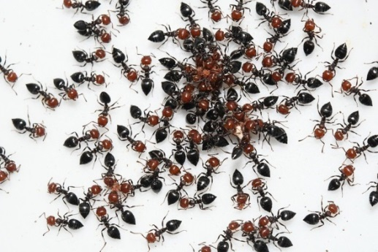
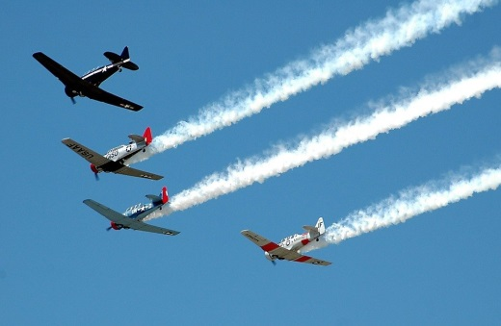
Using ‘a’ or ‘an’ with Collective Nouns
a family of five
an army of ants
a fleet of aeroplanes
a bouquet of flowers
Notes:
Notes for Teacher – N/A
Suggestions: N/A
Source of Multimedia Objects (Image/audio/ Video/Animation) used in this slide -
Family: https://pixabay.com/vectors/family-people-mother-and-father-310364/
Ants: https://pixabay.com/photos/ants-insects-community-entomology-6367022/
Aeroplanes: https://pixabay.com/photos/aircraft-airplanes-vintage-airshow-2086517/
Bouquet: https://pixabay.com/photos/date-of-birth-flower-valentine-s-day-1192373/

Slide 8
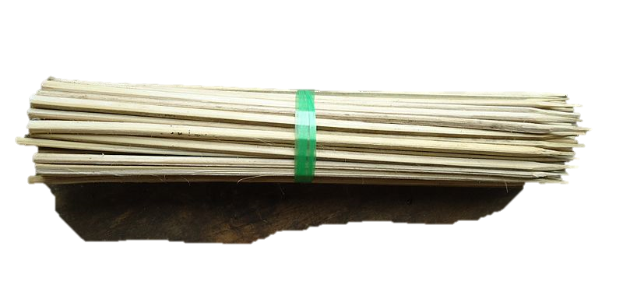
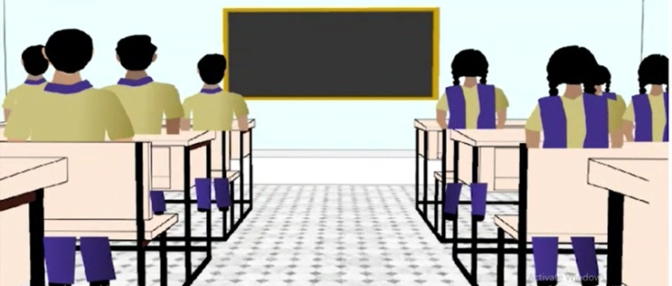
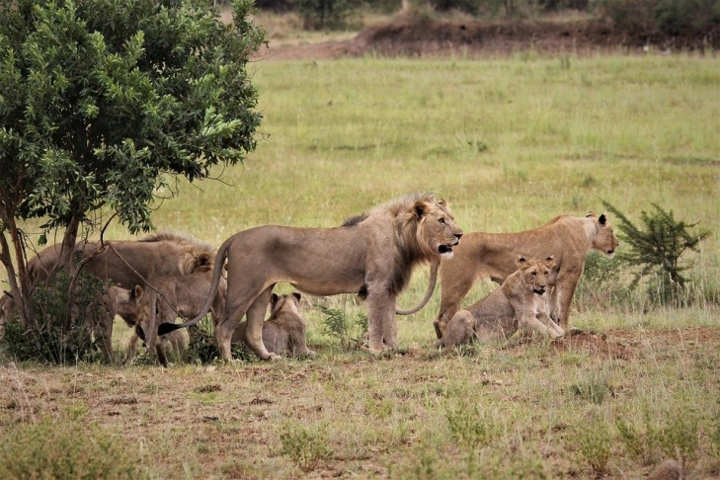
Using ‘of’ with Collective Nouns
a class of ‘students’
a bundle of ‘sticks’
a pride of ‘lions’
Notes:
Notes for Teacher – N/A
Suggestions: N/A
Source of Multimedia Objects (Image/audio/ Video/Animation) used in this slide -
School: SSSVV Gallery
A bundle of sticks: https://commons.wikimedia.org/wiki/File:A_bundle_of_bamboo_skewers.jpg-Attribute to Obsidian Soul
Lions: https://pixabay.com/photos/pride-lion-king-stare-eyes-royal-4536972/

Slide 9
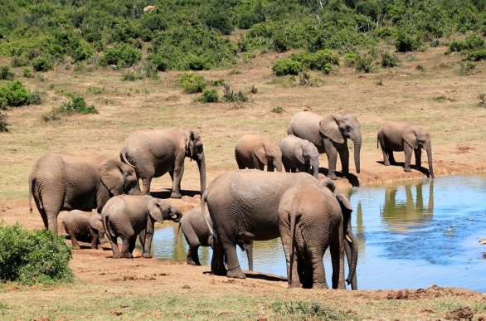
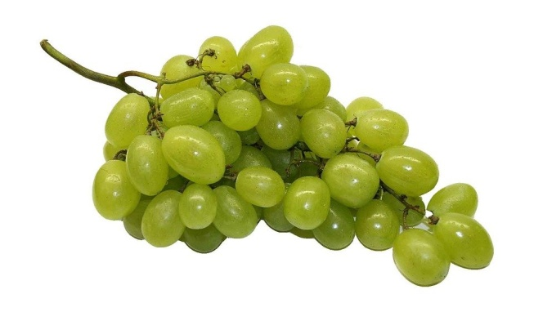
Collective Nouns
Some collective nouns that describe groups of animals/things can be used for more than one group of animals/things.
A herd of
A bunch of
buffaloes, elephants, deers, cattle, zebras, cows
keys, grapes, bananas
Notes:
Notes for Teacher – N/A
Suggestions: N/A
Source of Multimedia Objects (Image/audio/ Video/Animation) used in this slide -
Elephants: https://pixabay.com/photos/elephants-african-bush-elephant-241624/
Grapes: https://pixabay.com/photos/table-grapes-grapes-fruit-healthy-74344/

Slide 10
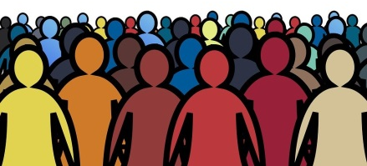
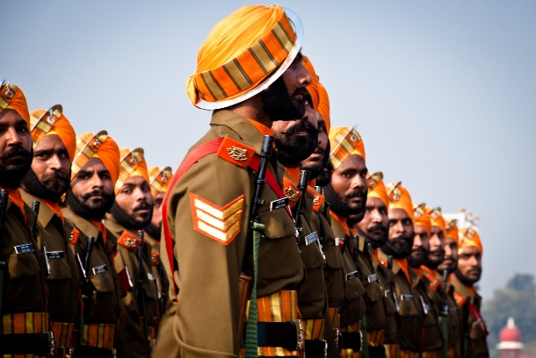
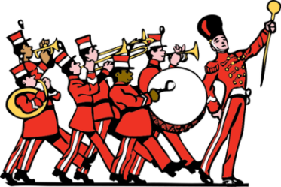
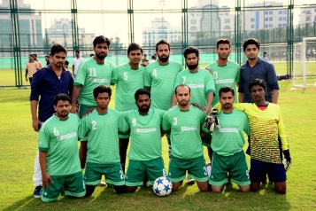
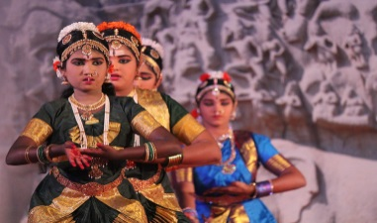
Examples of Collective Nouns: People
crowd
a crowd of people
army
an army of soldiers
band
a band of musicians
team
a team of players
troupe
a troupe of dancers
Notes:
Notes for Teacher – N/A
Suggestions: N/A
Source of Multimedia Objects (Image/audio/ Video/Animation) used in this slide -
Crowd: https://pixabay.com/illustrations/crowd-people-silhouettes-2045498/
Soldiers: https://www.flickr.com/photos/58419684@N00/5356170563 By Jaskirat Singh Bawa
Musicians: https://publicdomainvectors.org/en/free-clipart/Marching-band-vector-clip-art/1584.html
Dancers: https://www.flickr.com/photos/azwegers/9902423066-Attribute to Arian Zwegers
Team: https://pixabay.com/photos/football-middle-east-team-together-1333835/

Slide 11
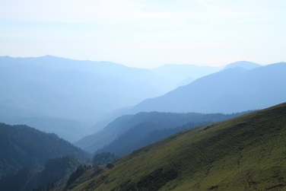
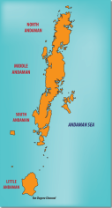
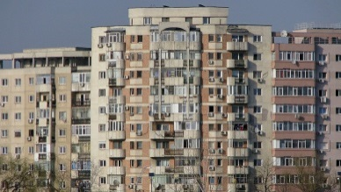
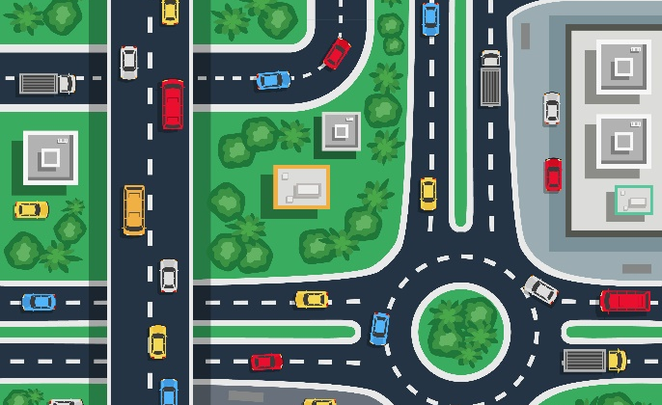
Examples of Collective Nouns: Places
group/chain
a group/chain of islands
chain/range
a chain/range of mountains
block
a block of flats
alliance
an alliance of countries
network
a network of roads
Notes:
Notes for Teacher – N/A
Suggestions: N/A
Source of Multimedia Objects (Image/audio/ Video/Animation) used in this slide -
Islands: SSSVV Gallery
Mountains: https://pixabay.com/photos/mountains-mountain-range-mountainous-5603248/
Flats: https://pixabay.com/photos/block-of-flats-architecture-2462069/
Continents: https://pixabay.com/photos/map-earth-world-planet-environment-4818844/
Roads: https://www.freepik.com/free-vector/traffic-city-top-flat_6127624.htm By macrovector

Slide 12
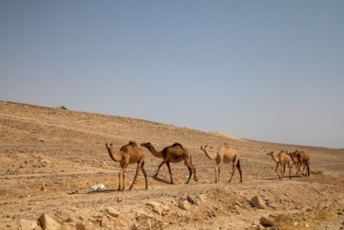
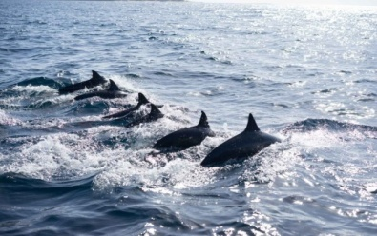
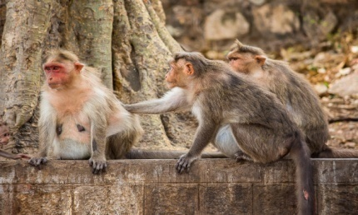
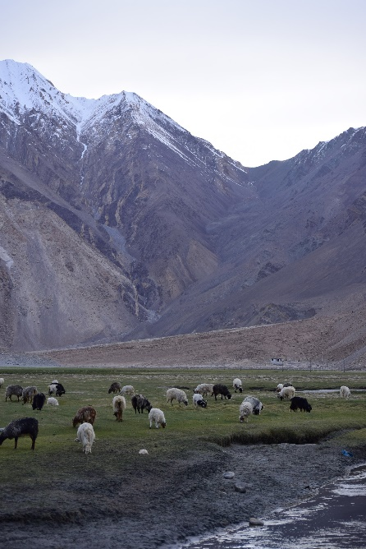
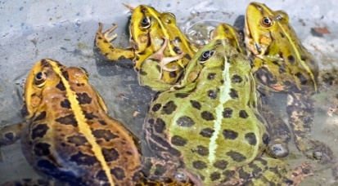
Examples of Collective Nouns: Animals
school
a school of whales
caravan
a caravan of camels
flock
a flock of sheep
troop
a troop of monkeys
army
an army of frogs
Notes:
Notes for Teacher – N/A
Suggestions: N/A
Source of Multimedia Objects (Image/audio/ Video/Animation) used in this slide - N/A
Frogs: https://pixabay.com/photos/frog-green-frog-toad-aquatic-animal-1406238/
Monkeys: https://pixahive.com/photo/portrait-of-monkeys/
Whales: https://pxhere.com/en/photo/833196
Camels: https://pixabay.com/photos/camels-mammals-animals-desert-5590597/
Sheep: https://pixabay.com/photos/mountains-sheep-leh-ladakh-india-2674181/

Slide 13
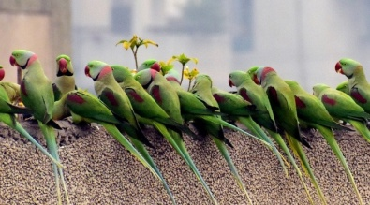
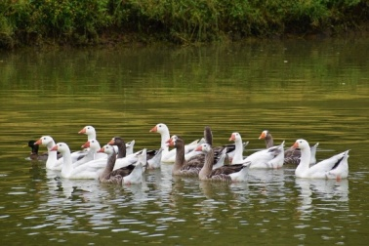
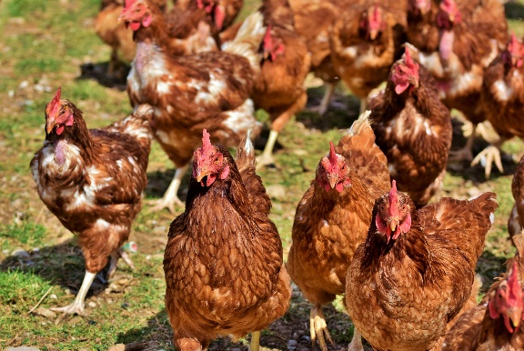
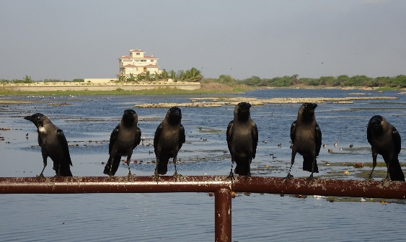
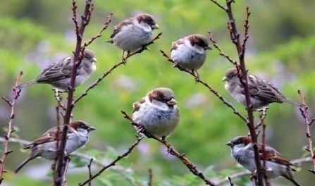
Examples of Collective Nouns: Birds
gaggle
a gaggle of geese
company/pandemonium
a company of parrots
brood
a brood of chickens, hens
murder
a murder of crows
host
a host of sparrows
Notes:
Notes for Teacher – N/A
Suggestions: N/A
Source of Multimedia Objects (Image/audio/ Video/Animation) used in this slide -
Geese: https://pixabay.com/photos/geese-birds-animals-flock-plumage-6826863/
Parrots: https://pixabay.com/photos/parrots-waiting-in-a-row-3814673/
Sparrows: https://pixabay.com/photos/birds-sparrows-perched-tree-winter-4382794/
Chickens: https://pixabay.com/photos/chicken-hen-poultry-rump-4155959/
Crows: https://pixabay.com/photos/bird-crow-house-crow-murder-flock-4195545/

Slide 14
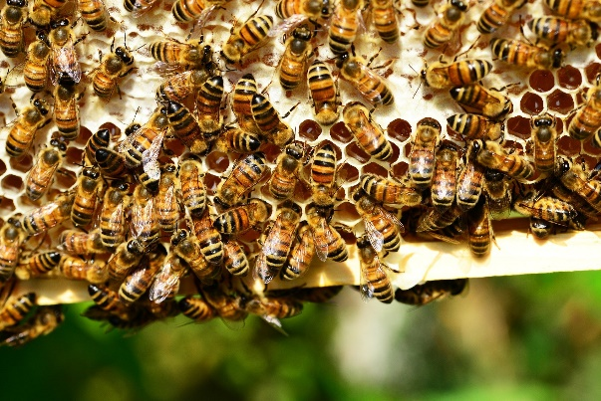
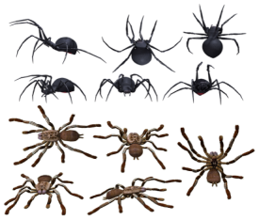
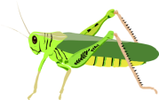
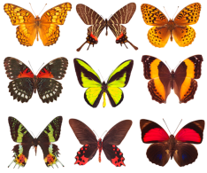
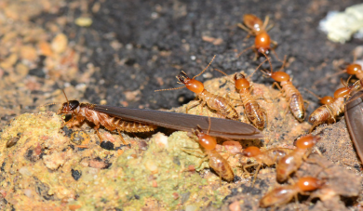
Examples of Collective Nouns: Insects
swarm
a swarm of bees
cluster
a cluster of spiders
flight
a flight of butterflies
cloud
a cloud of grasshoppers
colony
a colony of bees, ants, termites
Notes:
Notes for Teacher – N/A
Suggestions: N/A
Source of Multimedia Objects (Image/audio/ Video/Animation) used in this slide -
Termites: https://www.flickr.com/photos/jean_hort/35303727436-Attribute to Jean and Fred Hort
Spiders: https://pixabay.com/illustrations/spider-spiders-arachnid-3369690/
Butterflies: https://pixabay.com/illustrations/butterflies-collection-of-butterflies-4159874/
Grasshopper: https://pixabay.com/vectors/grasshopper-insect-hop-jump-legs-24635/
Bees: https://pixabay.com/photos/honey-bees-insects-hive-bee-hive-401238/

Slide 15
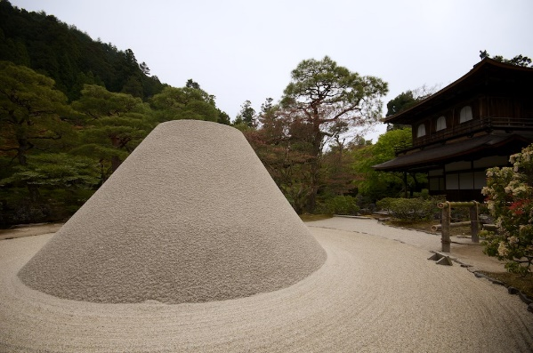
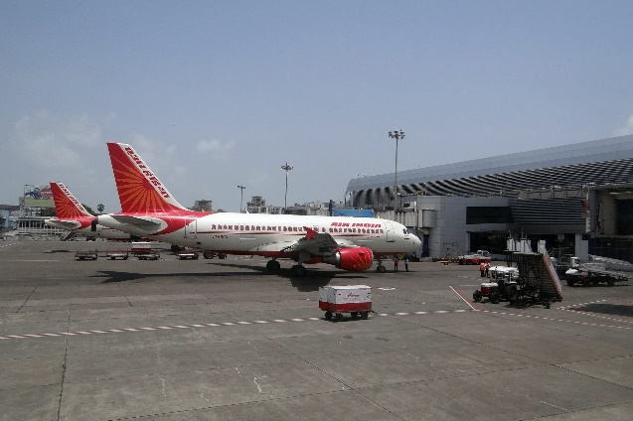
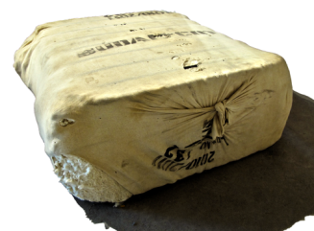
Examples of Collective Nouns: Things
bowl
a bowl of rice
heap
a heap of sand
bale
a bale of cotton
fleet
a fleet of aeroplanes, ships, cars, vehicles
galaxy
a galaxy of stars
Notes:
Notes for Teacher – N/A
Suggestions: N/A
Source of Multimedia Objects (Image/audio/ Video/Animation) used in this slide -
Bowl of rice: https://freesvg.org/1551746353
https://www.flickr.com/photos/79112147@N00/14177869842 By David Haberthür
Cotton: https://pixabay.com/photos/bale-cotton-cotton-bales-packaging-2432780/
Planes: https://pixabay.com/photos/airport-mumbai-aircraft-air-india-385293/
Stars: https://pixabay.com/illustrations/night-stars-starry-sky-heaven-927168/

Slide 16
MM INDEX
Slide # | Thumbnail | Source link and Attribution
2 |  | Dog: https://pixabay.com/photos/golden-retriever-dog-loyal-to-dear-642016/ Dogs: https://pixabay.com/photos/burgundy-mastiff-dog-animal-white-869036/ Banana: https://pixabay.com/photos/fruits-healthy-vitamins-eat-diet-2202411/ Bananas: https://pixabay.com/photos/banana-minimum-fruit-tropical-2449019/ Key: https://publicdomainvectors.org/en/free-clipart/Old-style-hollow-door-key-vector-image/19940.html Keys: https://pixabay.com/photos/keys-keychain-keyset-1023939/ Bird: https://freesvg.org/colorful-bird Birds: https://freesvg.org/clip-art-of-three-different-flying-birds
4 |  | 1. Persons: https://pixabay.com/illustrations/head-people-group-young-students-1556566/ 2. Varanasi: https://pixabay.com/photos/india-varanasi-ghat-architecture-3086808/ 3. School: https://publicdomainvectors.org/en/free-clipart/School/40808.html 4. Animals: https://freesvg.org/african-animals-vector-illustration 5. Things: https://pixabay.com/illustrations/things-stuff-share-mess-messy-4697014/
5 |  | Group: https://publicdomainvectors.org/en/free-clipart/Vector-image-of-population-icon/8176.html
6 |  | 1. Wolves: https://pixabay.com/photos/wolves-wolf-pack-predator-animal-4377376/ 2. Fishes: https://pixabay.com/photos/school-of-fish-fish-nature-water-756460/ 3. Lions: https://pixabay.com/photos/lion-pride-of-lions-predator-1972786/ 4. Ants: https://pixabay.com/photos/ants-insects-community-entomology-6367022/ 5. Bees: https://www.maxpixel.net/Swarm-Of-Bees-Beehive-Honey-Bees-Honey-Bees-326334 6. Buffaloes: https://pixabay.com/photos/cape-buffaloes-animals-safari-5929180/
7 |  | Family: https://pixabay.com/vectors/family-people-mother-and-father-310364/ Ants: https://pixabay.com/photos/ants-insects-community-entomology-6367022/ Aeroplanes: https://pixabay.com/photos/aircraft-airplanes-vintage-airshow-2086517/ Bouquet: https://pixabay.com/photos/date-of-birth-flower-valentine-s-day-1192373/
8 |  | A bundle of sticks: https://commons.wikimedia.org/wiki/File:A_bundle_of_bamboo_skewers.jpg-Attribute to Obsidian Soul Lions: https://pixabay.com/photos/pride-lion-king-stare-eyes-royal-4536972/
9 |  | Elephants: https://pixabay.com/photos/elephants-african-bush-elephant-241624/ Grapes: https://pixabay.com/photos/table-grapes-grapes-fruit-healthy-74344/

Slide 17
MM INDEX
Slide # | Thumbnail | Source link and Attribution
10 |  | Crowd: https://pixabay.com/illustrations/crowd-people-silhouettes-2045498/ Soldiers: https://www.flickr.com/photos/58419684@N00/5356170563 By Jaskirat Singh Bawa Musicians: https://publicdomainvectors.org/en/free-clipart/Marching-band-vector-clip-art/1584.html Dancers: https://www.flickr.com/photos/azwegers/9902423066-Attribute to Arian Zwegers Team: https://pixabay.com/photos/football-middle-east-team-together-1333835/
11 |  | Islands: SSSVV Gallery Mountains: https://pixabay.com/photos/mountains-mountain-range-mountainous-5603248/ Flats: https://pixabay.com/photos/block-of-flats-architecture-2462069/ Continents: https://pixabay.com/photos/map-earth-world-planet-environment-4818844/ Roads: https://www.freepik.com/free-vector/traffic-city-top-flat_6127624.htm By macrovector
12 |  | Frogs: https://pixabay.com/photos/frog-green-frog-toad-aquatic-animal-1406238/ Monkeys: https://pixahive.com/photo/portrait-of-monkeys/ Whales: https://pxhere.com/en/photo/833196 Camels: https://pixabay.com/photos/camels-mammals-animals-desert-5590597/ Sheep: https://pixabay.com/photos/mountains-sheep-leh-ladakh-india-2674181/
13 |  | Geese: https://pixabay.com/photos/geese-birds-animals-flock-plumage-6826863/ Parrots: https://pixabay.com/photos/parrots-waiting-in-a-row-3814673/ Sparrows: https://pixabay.com/photos/birds-sparrows-perched-tree-winter-4382794/ Chickens: https://pixabay.com/photos/chicken-hen-poultry-rump-4155959/ Crows: https://pixabay.com/photos/bird-crow-house-crow-murder-flock-4195545/
14 |  | Termites: https://www.flickr.com/photos/jean_hort/35303727436-Attribute to Jean and Fred Hort Spiders: https://pixabay.com/illustrations/spider-spiders-arachnid-3369690/ Butterflies: https://pixabay.com/illustrations/butterflies-collection-of-butterflies-4159874/ Grasshopper: https://pixabay.com/vectors/grasshopper-insect-hop-jump-legs-24635/ Bees: https://pixabay.com/photos/honey-bees-insects-hive-bee-hive-401238/
15 |  | Bowl of rice: https://freesvg.org/1551746353 https://www.flickr.com/photos/79112147@N00/14177869842 By David Haberthür Cotton: https://pixabay.com/photos/bale-cotton-cotton-bales-packaging-2432780/ Planes: https://pixabay.com/photos/airport-mumbai-aircraft-air-india-385293/ Stars: https://pixabay.com/illustrations/night-stars-starry-sky-heaven-927168/

