Slide 1
A Day In The Life Of Arun
Notes:
Notes for Teacher - Please increase the speaker volume and play the slides in presentation mode as there is an audio narration.
Suggestions: <Ideas/ Images/ Animations / Others – To make better representation of the content >
Source of Multimedia used in this slide - <Please provide source URL where we find the image and the license agreement>

Slide 2
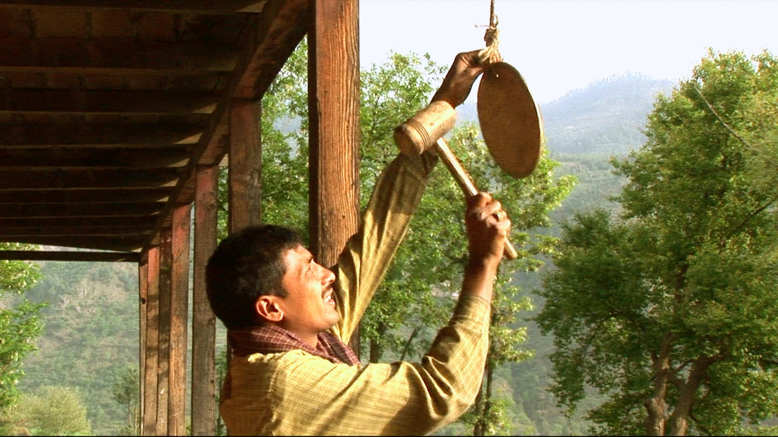
A Day in Arun’s Life
Notes:
Notes for Teacher –
Suggestions: <Ideas/ Images/ Animations / Others – To make better representation of the content >
Source of Multimedia used in this slide - <Please provide source URL where we find the image and the license agreement>

Slide 3
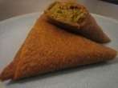
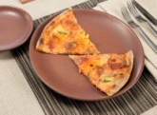
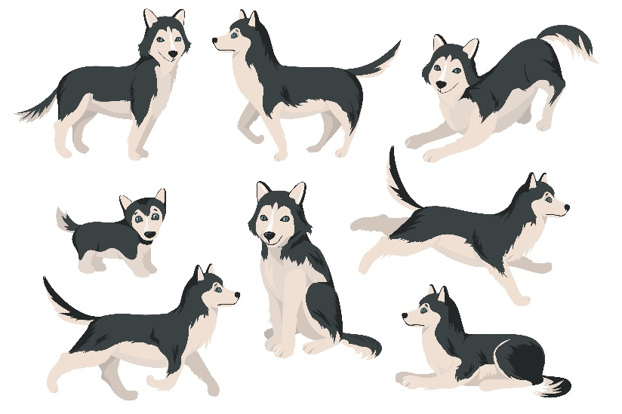
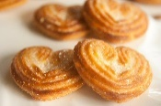
A Day in Arun’s Life
Notes:
Notes for Teacher - < Information for further reference or explanation >
Suggestions: <Ideas/ Images/ Animations / Others – To make better representation of the content >
Source of Multimedia used in this slide - <Please provide source URL where we find the image and the license agreement>

Slide 4
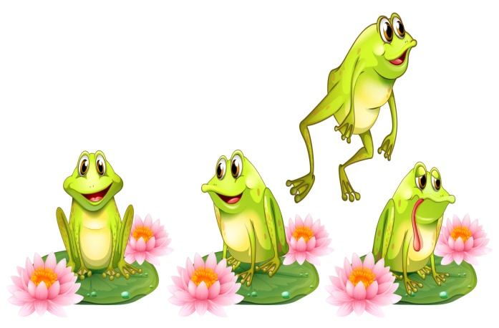
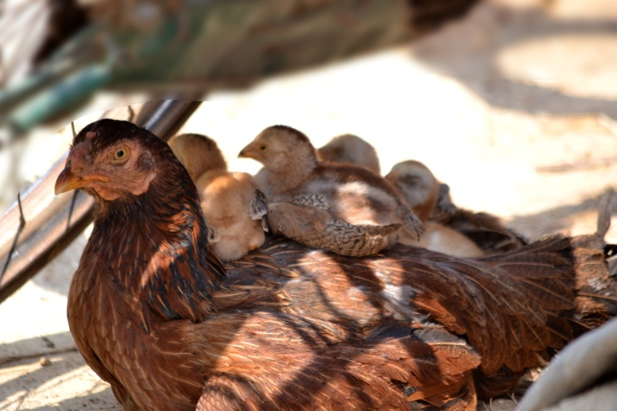
A Day in Arun’s Life
Notes:
Notes for Teacher - < Information for further reference or explanation >
Suggestions: <Ideas/ Images/ Animations / Others – To make better representation of the content >
Source of Multimedia used in this slide - <Please provide source URL where we find the image and the license agreement>

Slide 5
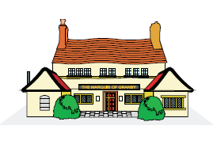
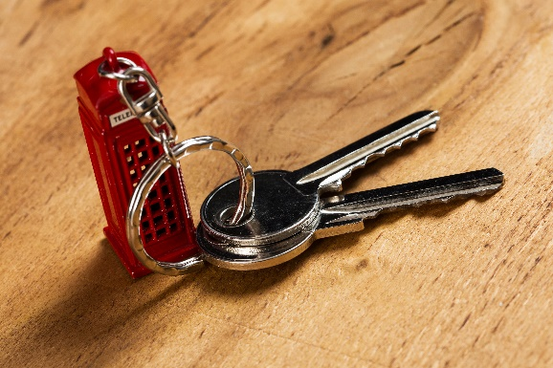
A Day in Arun’s Life
Notes:
Notes for Teacher - < Information for further reference or explanation >
Suggestions: <Ideas/ Images/ Animations / Others – To make better representation of the content >
Source of Multimedia used in this slide - <Please provide source URL where we find the image and the license agreement>

Slide 6
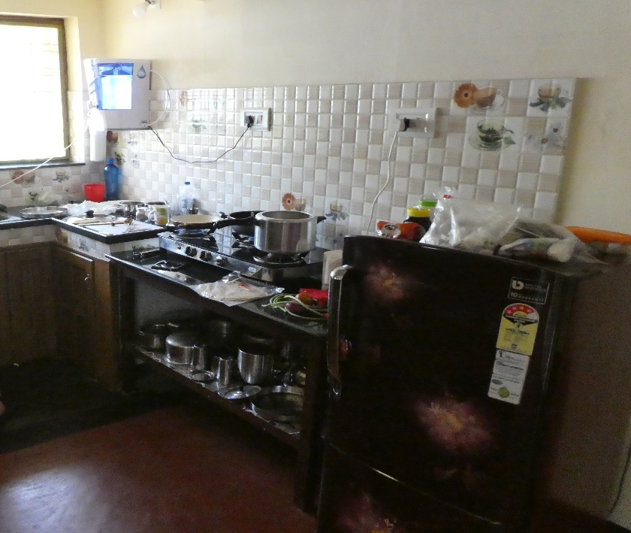
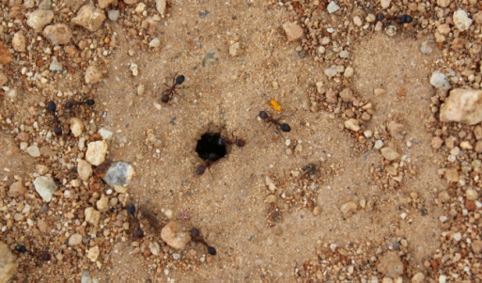
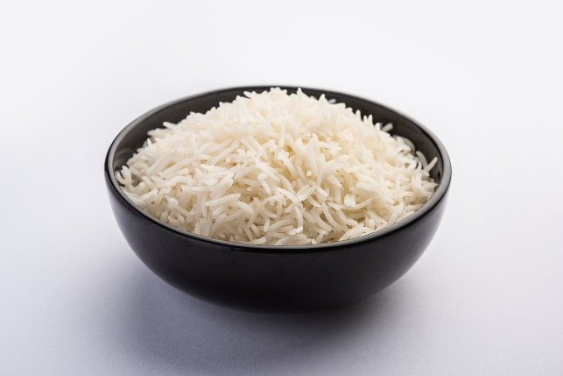
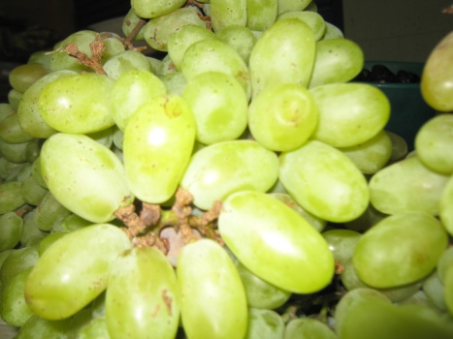
A Day in Arun’s Life
Notes:
Notes for Teacher - < Information for further reference or explanation >
Suggestions: <Ideas/ Images/ Animations / Others – To make better representation of the content >
Source of Multimedia used in this slide - <Please provide source URL where we find the image and the license agreement>

Slide 7
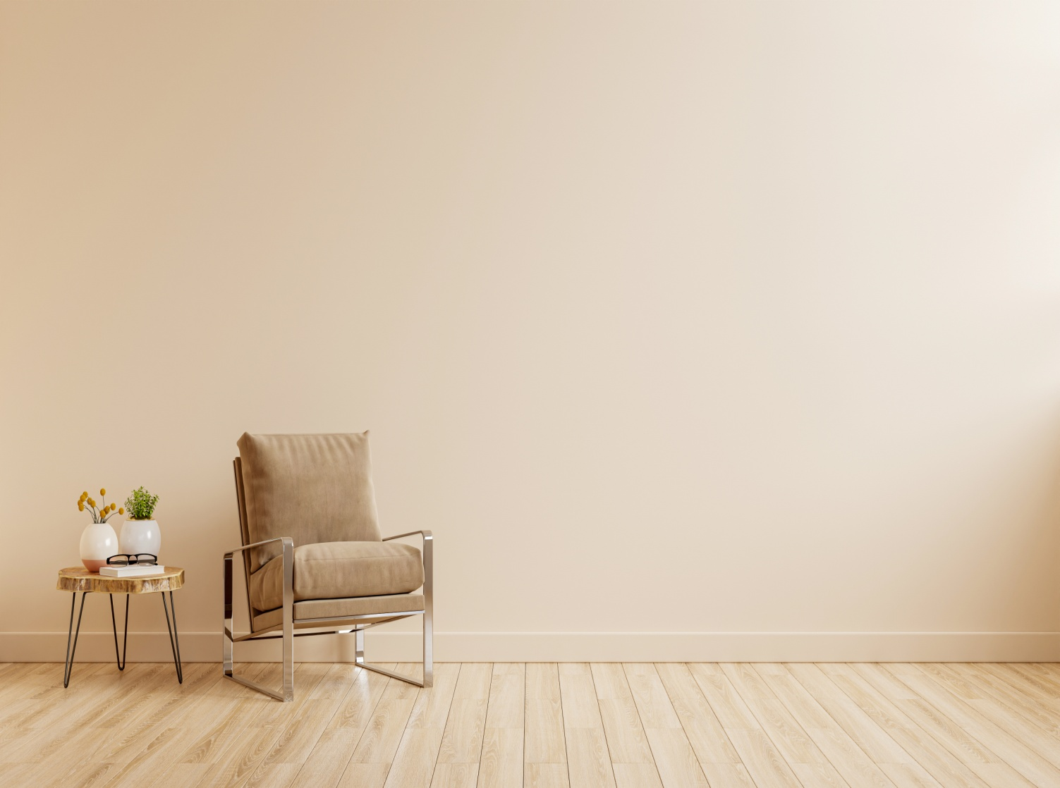
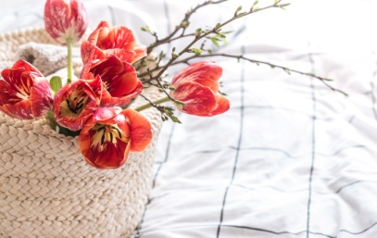
A Day in Arun’s Life
Notes:
Notes for Teacher - < Information for further reference or explanation >
Suggestions: <Ideas/ Images/ Animations / Others – To make better representation of the content >
Source of Multimedia used in this slide - <Please provide source URL where we find the image and the license agreement>

Slide 8
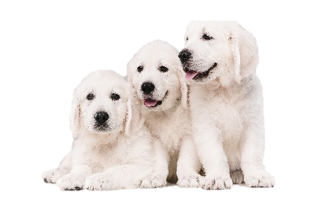
A Day in Arun’s Life
Notes:
Notes for Teacher - < Information for further reference or explanation >
Suggestions: <Ideas/ Images/ Animations / Others – To make better representation of the content >
Source of Multimedia used in this slide - <Please provide source URL where we find the image and the license agreement>

Slide 9
MM Index
Slide # | Thumbnail | Source link and Attribution
2 |  | https://www.flickr.com/photos/55922554@N00/238714204 By kiran Valipa Venkat
2, 3, 4, 5 |  | https://www.freepik.com/free-vector/back-school-schoolboy-with-book-backpack-elementary-school-pupil-going-lesson_16495301.htm by nizovatina
3, 4 |  | https://www.flickr.com/photos/78528740@N00/3151021075 By Melissa Bernais https://www.flickr.com/photos/49889671@N03/6987213057 By Didriks https://pixabay.com/photos/heart-cookies-biscuits-sugar-baked-166918/
3 |  | https://www.freepik.com/free-vector/cute-husky-dog-different-poses-flat-set_12698391.htm by pch.vector
4 |  | https://www.freepik.com/free-vector/four-green-frogs-water-lily_4932764.htm by brgfx SSSVV Image gallery: Hens
5 |  | SSSVV image gallery: House https://www.freepik.com/free-photo/bunch-keys-table_10741144.htm by Rakool Studio
6 |  | Kitchen: https://www.flickr.com/photos/26445715@N00/39596921405 By Mike Finn Rice: https://www.freepik.com/free-photo/cooked-plain-white-basmati-rice-steamed-rice-bowl_20886095.htm by stockimagefactorycom SSSVV image gallery: Grapes SSSVV image gallery: Ants
7 |  | Room: https://www.freepik.com/free-photo/modern-minimalist-interior-with-armchair-empty-cream-color-wall-background-3d-rendering_21142928.htm by vanitjan Pots: https://www.freepik.com/free-vector/vandalism-scene-with-two-broken-pots_13832461.htm by brgfx Flowers: https://www.freepik.com/free-photo/still-life-with-beautiful-red-tulips-basket_10920652.htm by pvproductions Books: https://www.freepik.com/free-photo/old-books-with-white-background-copy-space_13130595.htm by freepik Dog: https://www.freepik.com/free-photo/beagles-puppies-looking-something_5598032.htm by jcomp
8 |  | https://www.freepik.com/free-vector/dust-cloud-with-soil-particles-realistic-vector_5900539.htm by vectorpocket https://www.freepik.com/free-photo/english-cream-golden-retrievers-posing-cute-playful-doggies-purebred-pets-looks-playful-cute-isolated-white-wall-concept-motion-action-movement-dogs-pets-love-copyspace_15803374.htm by master1305
Notes:
Notes for Teacher - < Information for further reference or explanation >
Suggestions: <Ideas/ Images/ Animations / Others – To make better representation of the content >
Source of Multimedia used in this slide - <Please provide source URL where we find the image and the license agreement>

