Slide 1
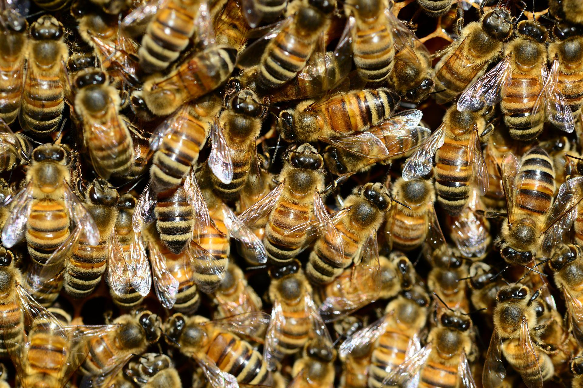
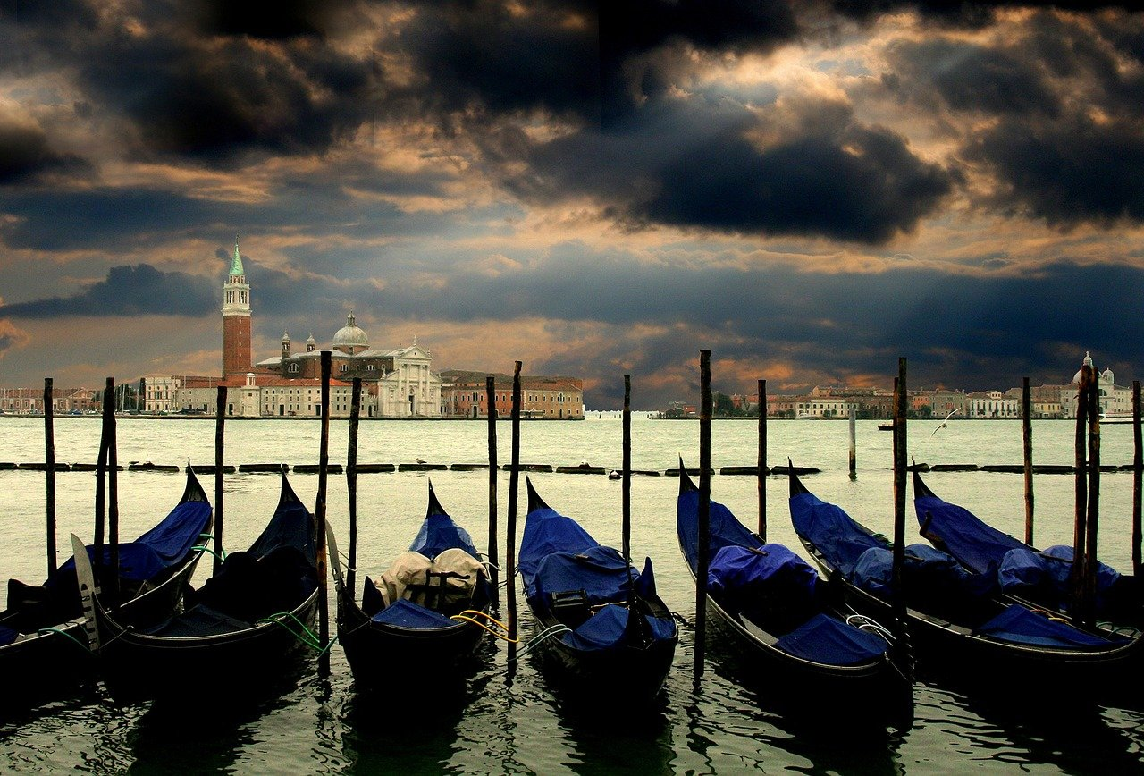
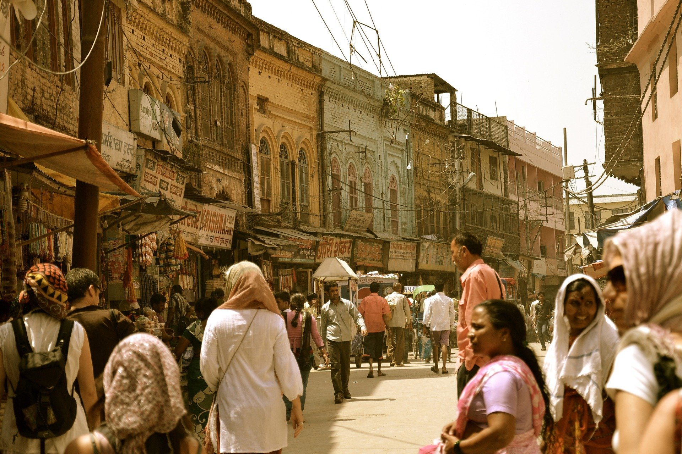
Fun with Collective Nouns
Notes:
Notes for Teacher - The teacher could divide the class into groups of five students each. Each group could be given a specific noun and each child asked to bring a picture of the said collective noun, a day before she/he conducts the activity.
Aim: Students will be able to demonstrate their understanding of collective nouns.
Resources Required: chart papers, glue and pictures of various collective nouns
Setting for the activity: Indoor
Type of activity: Group
Preparation: Chart papers to be brought by the teacher to the class. Based on the groups the children are in, they bring the required pictures of collective nouns
Note to the teacher: The pictures could be got from old newspapers, magazines or old books. Children good at drawing could be encouraged to even draw and colour them.
Suggestions: <Ideas/ Images/ Animations / Others – To make better representation of the content >
Source of Multimedia used in this slide - <Please provide source URL where we find the image and the license agreement>
Bees: https://pixabay.com/photos/bees-insects-macro-honey-bees-292132/
Boats: https://pixabay.com/photos/gondolas-port-canal-waterway-194835/
People: https://pixabay.com/photos/street-road-people-crowd-buildings-5703332/

Slide 2
Fun with Collective Nouns
Group | Nouns
1
Animals
2
Birds
3
Things
4
People
5
Insects
Notes:
Notes for Teacher - The teacher could divide the class into groups of five students each. Each group could be given a specific noun and each child asked to bring a picture of the said collective noun, a day before she/he conducts the activity.
The pictures could be got from old newspapers, magazines or old books. Children good at drawing could be encouraged to even draw and colour them.
Suggestions: <Ideas/ Images/ Animations / Others – To make better representation of the content >
Source of Multimedia used in this slide - <Please provide source URL where we find the image and the license agreement>
PPT Icons

Slide 3
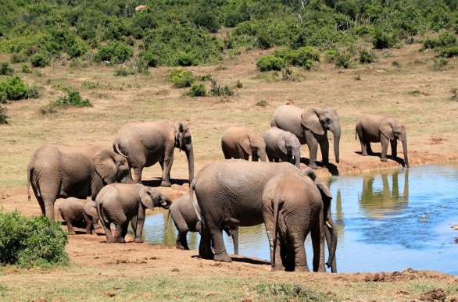
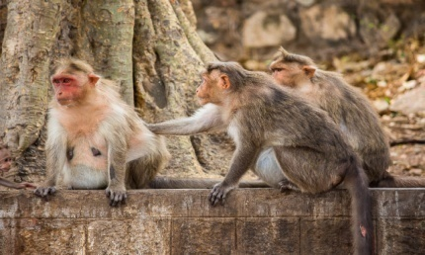
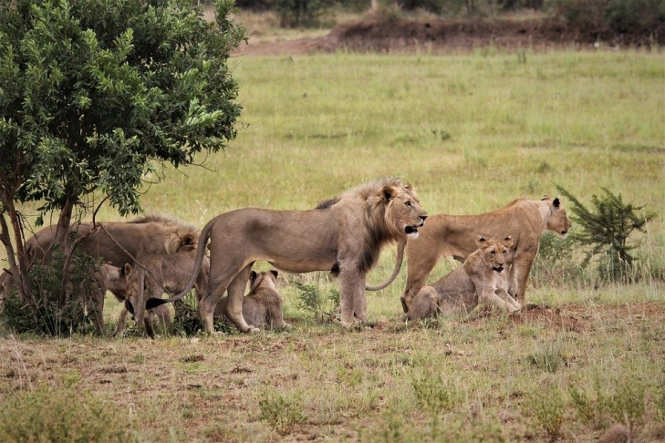
Examples of Collective Nouns: Animals
A herd of ‘elephants’
A troop of ‘monkeys’
A pride of ‘lions’
Notes:
Notes for Teacher – Examples
a herd of elephants, a pride of lions, a troop of monkeys, a flock of sheep, an army of frogs
Suggestions: <Ideas/ Images/ Animations / Others – To make better representation of the content >
Source of Multimedia used in this slide - <Please provide source URL where we find the image and the license agreement>
Lions: https://pixabay.com/photos/pride-lion-king-stare-eyes-royal-4536972/
Elephants: https://pixabay.com/photos/elephants-african-bush-elephant-241624/
Monkeys: https://pixahive.com/photo/portrait-of-monkeys/

Slide 4
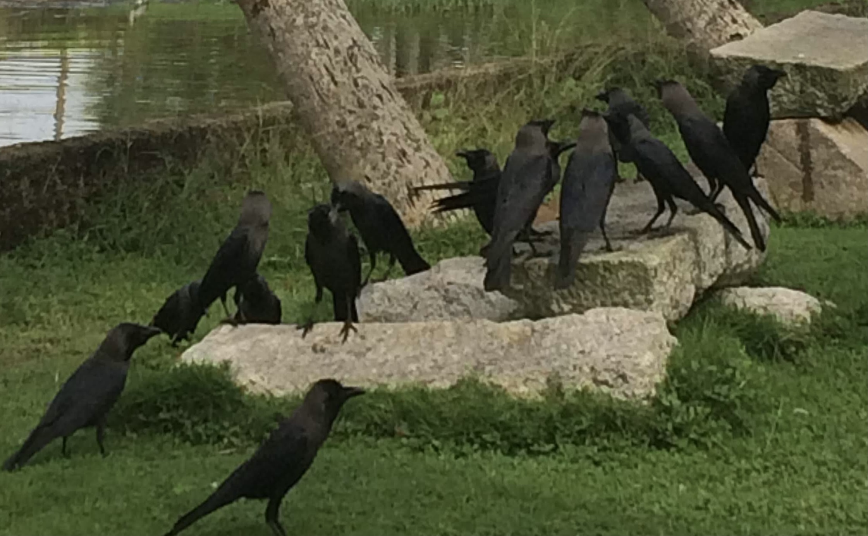
Examples of Collective Nouns: Birds
A gaggle of geese
A murder of crows
Notes:
Notes for Teacher – Examples:
a gaggle of geese, a company of parrots, a brood of chickens, a murder of crows, a host of sparrows
Suggestions: <Ideas/ Images/ Animations / Others – To make better representation of the content >
Source of Multimedia used in this slide - <Please provide source URL where we find the image and the license agreement>
Crows : photo by self @anithasawhney.
Seagulls: photo by self @anithasawhney

Slide 5
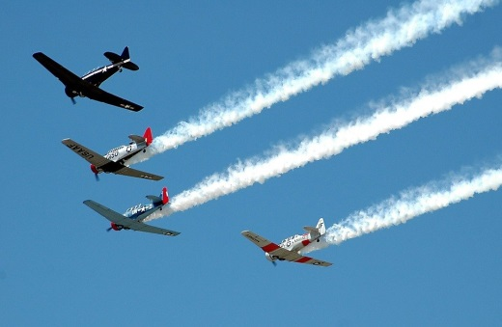
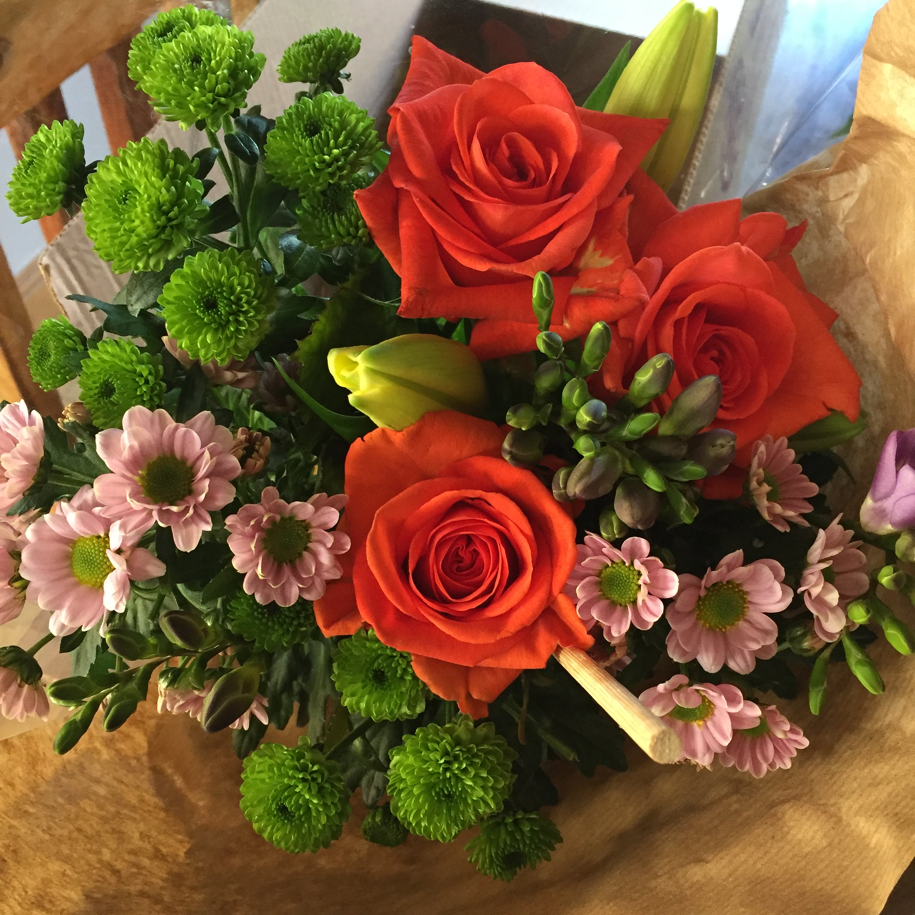
Examples of Collective Nouns: Things
A fleet of aeroplanes
A bunch of grapes
A bouquet of flowers
Notes:
Notes for Teacher – Examples
a bowl of rice, a heap of sand, a bale of cotton, a fleet of aeroplanes/cars/ships, a galaxy of stars
Suggestions: <Ideas/ Images/ Animations / Others – To make better representation of the content >
Source of Multimedia used in this slide - <Please provide source URL where we find the image and the license agreement>
Grapes: https://www.flickr.com/photos/27203298@N02/9592235689 By Ian Lee
Aeroplanes: https://pixabay.com/photos/aircraft-airplanes-vintage-airshow-2086517/
Flowers: https://www.flickr.com/photos/100497674@N04/33482027440 By Beki Winchel

Slide 6
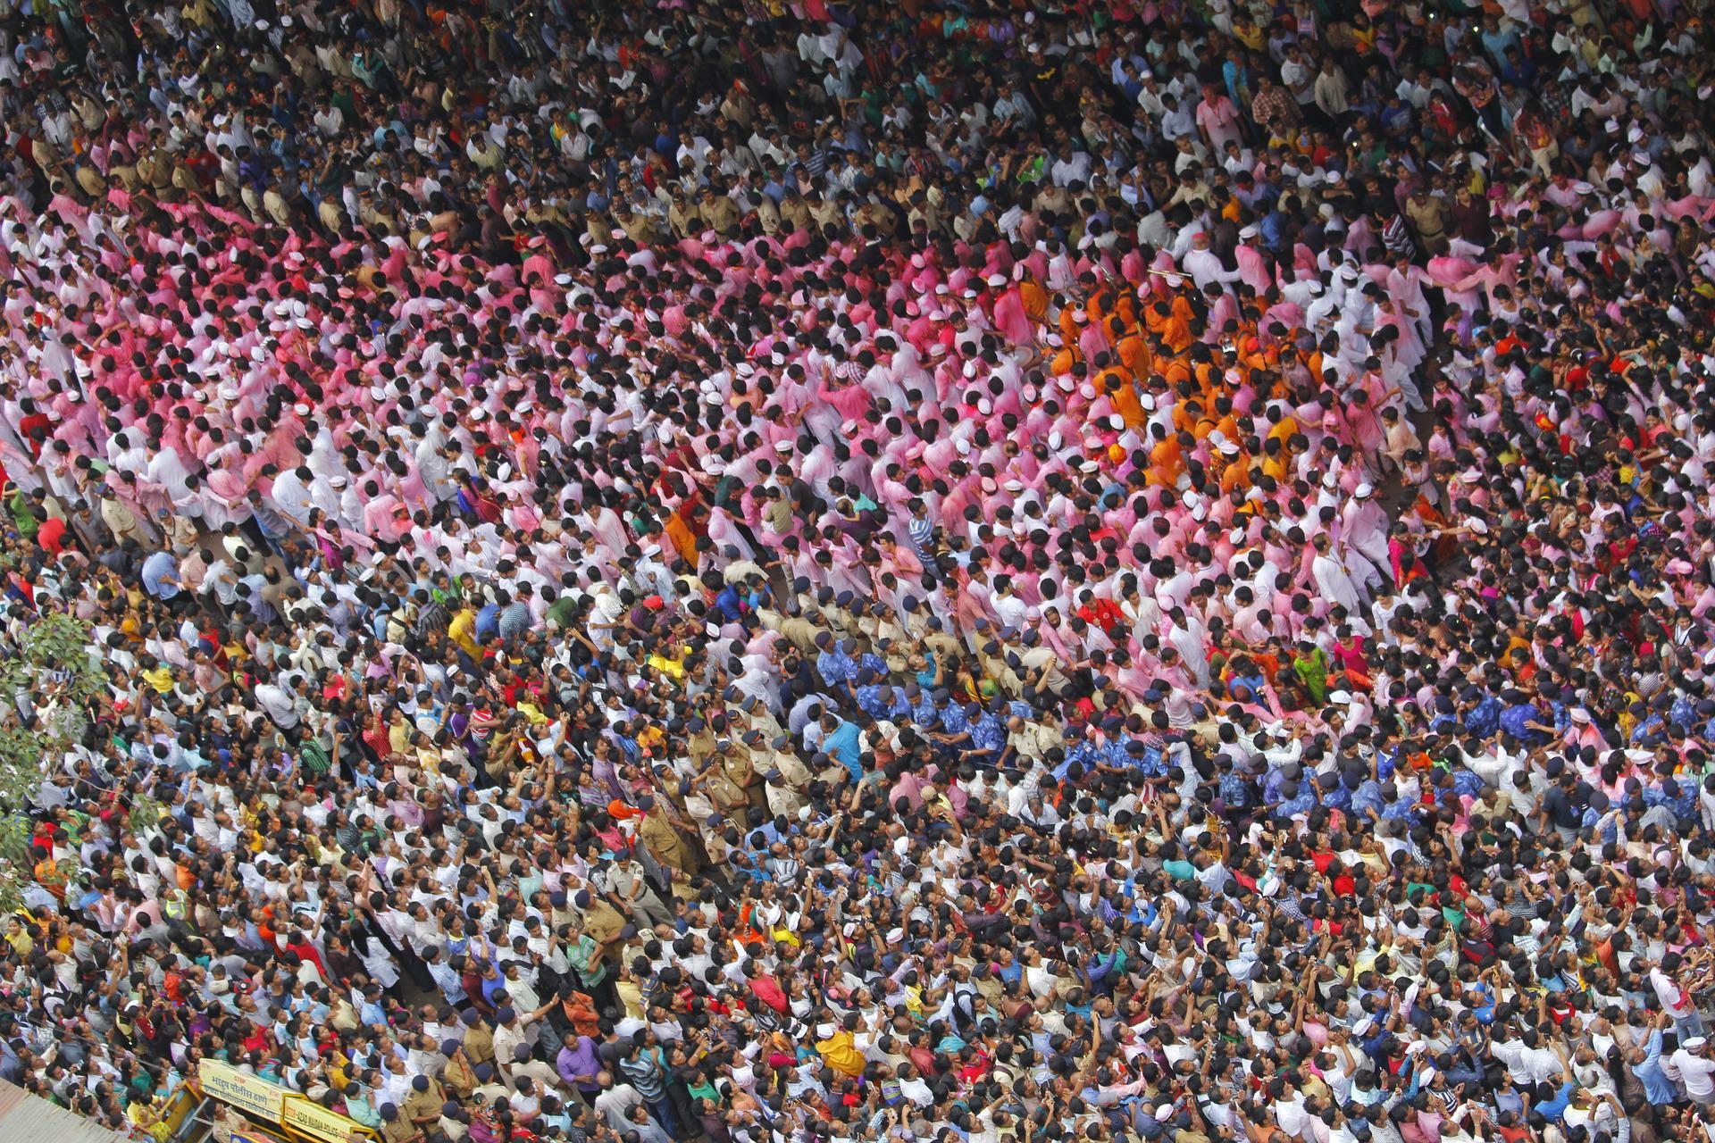
Examples of Collective Nouns: People
A crowd of people
An army of soldiers
A band of musicians
Notes:
Notes for Teacher – Examples
a crowd of people, an army of soldiers, a band of musicians, a team of players, a troupe of dancers
Suggestions: <Ideas/ Images/ Animations / Others – To make better representation of the content >
Source of Multimedia used in this slide - <Please provide source URL where we find the image and the license agreement>
Army: https://www.flickr.com/photos/58419684@N00/5376686125 By Jaskirat Singh Bawa
Band: https://www.flickr.com/photos/61997808@N00/4970264551 By RubyGoes
Crowd: https://pixabay.com/photos/lalbaug-ganesh-festival-india-1063511/

Slide 7
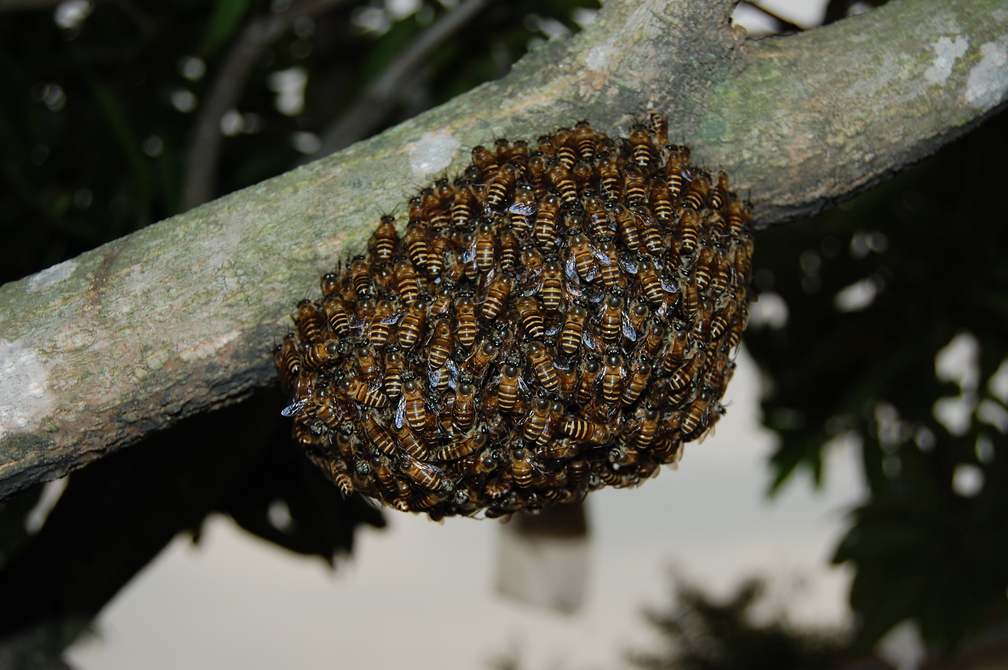
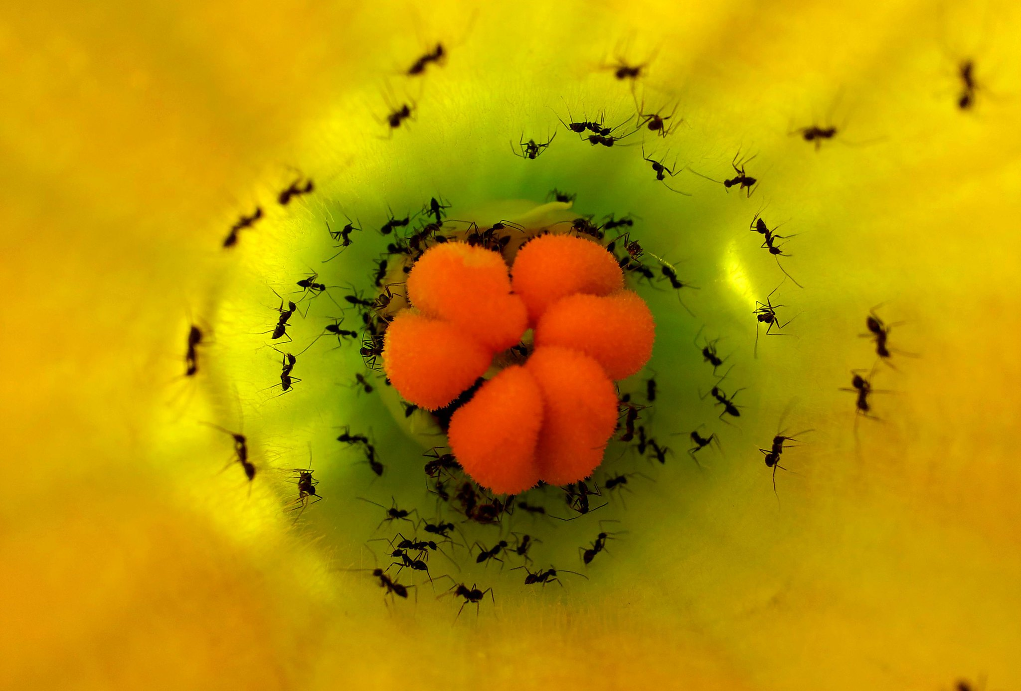
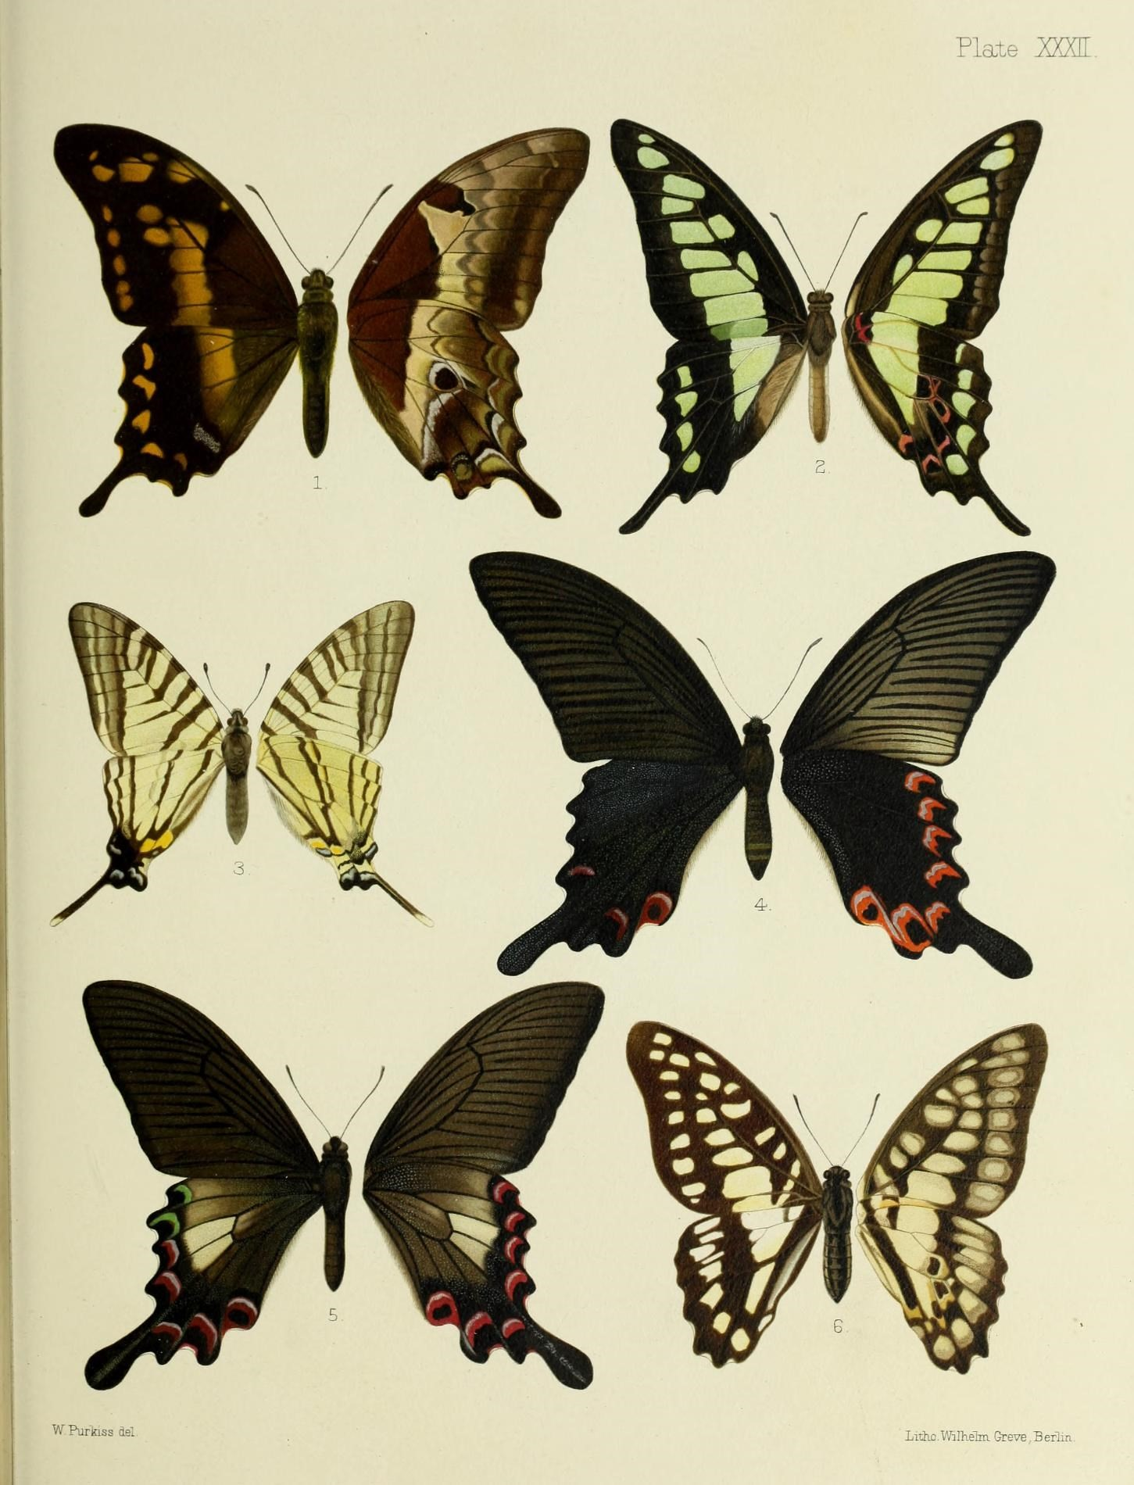
Examples of Collective Nouns: Insects
A swarm of bees
A colony of ants
A flight of butterflies
Notes:
Notes for Teacher – Examples
a swarm of bees, a cluster of spiders, a flight of butterflies, a cloud of grasshoppers, a colony of bees
Suggestions: <Ideas/ Images/ Animations / Others – To make better representation of the content >
Source of Multimedia used in this slide - <Please provide source URL where we find the image and the license agreement>
Butterfly: https://www.flickr.com/photos/61021753@N02/19142252800 by Biodiversity Heritage Library
Ants.: https://www.flickr.com/photos/52476811@N07/6647509509 by Pison Jaujip
Bees: https://www.flickr.com/photos/94837166@N00/5679408346 By Francis Chung

Slide 8
MM INDEX
Slide # | Thumbnail | Source link and Attribution
1 |  | Bees: https://pixabay.com/photos/bees-insects-macro-honey-bees-292132/ Boats: https://pixabay.com/photos/gondolas-port-canal-waterway-194835/ People: https://pixabay.com/photos/street-road-people-crowd-buildings-5703332/
3 |  | Lions: https://pixabay.com/photos/pride-lion-king-stare-eyes-royal-4536972/ Elephants: https://pixabay.com/photos/elephants-african-bush-elephant-241624/ Monkeys: https://pixahive.com/photo/portrait-of-monkeys/
4 |  | Crows : photo by self @anithasawhney. Seagulls: photo by self @anithasawhney
5 |  | Grapes: https://www.flickr.com/photos/27203298@N02/9592235689 By Ian Lee Aeroplanes: https://pixabay.com/photos/aircraft-airplanes-vintage-airshow-2086517/ Flowers: https://www.flickr.com/photos/100497674@N04/33482027440 By Beki Winchel
6 |  | Army: https://www.flickr.com/photos/58419684@N00/5376686125 By Jaskirat Singh Bawa Band: https://www.flickr.com/photos/61997808@N00/4970264551 By RubyGoes Crowd: https://pixabay.com/photos/lalbaug-ganesh-festival-india-1063511/
7 |  | Butterfly: https://www.flickr.com/photos/61021753@N02/19142252800 by Biodiversity Heritage Library Ants.: https://www.flickr.com/photos/52476811@N07/6647509509 by Pison Jaujip Bees: https://www.flickr.com/photos/94837166@N00/5679408346 By Francis Chung
Notes:
Notes for Teacher - < Information for further reference or explanation >
Suggestions: <Ideas/ Images/ Animations / Others – To make better representation of the content >
Source of Multimedia used in this slide - <Please provide source URL where we find the image and the license agreement>

