Slide 1
Guess Who We Are?
Notes:
Notes for Teacher - < Information for further reference or explanation >
Suggestions: <Ideas/ Images/ Animations / Others – To make better representation of the content >
Source of Multimedia used in this slide - <Please provide source URL where we find the image and the license agreement>
https://pixabay.com/illustrations/ask-asking-guess-business-3070333/

Slide 2
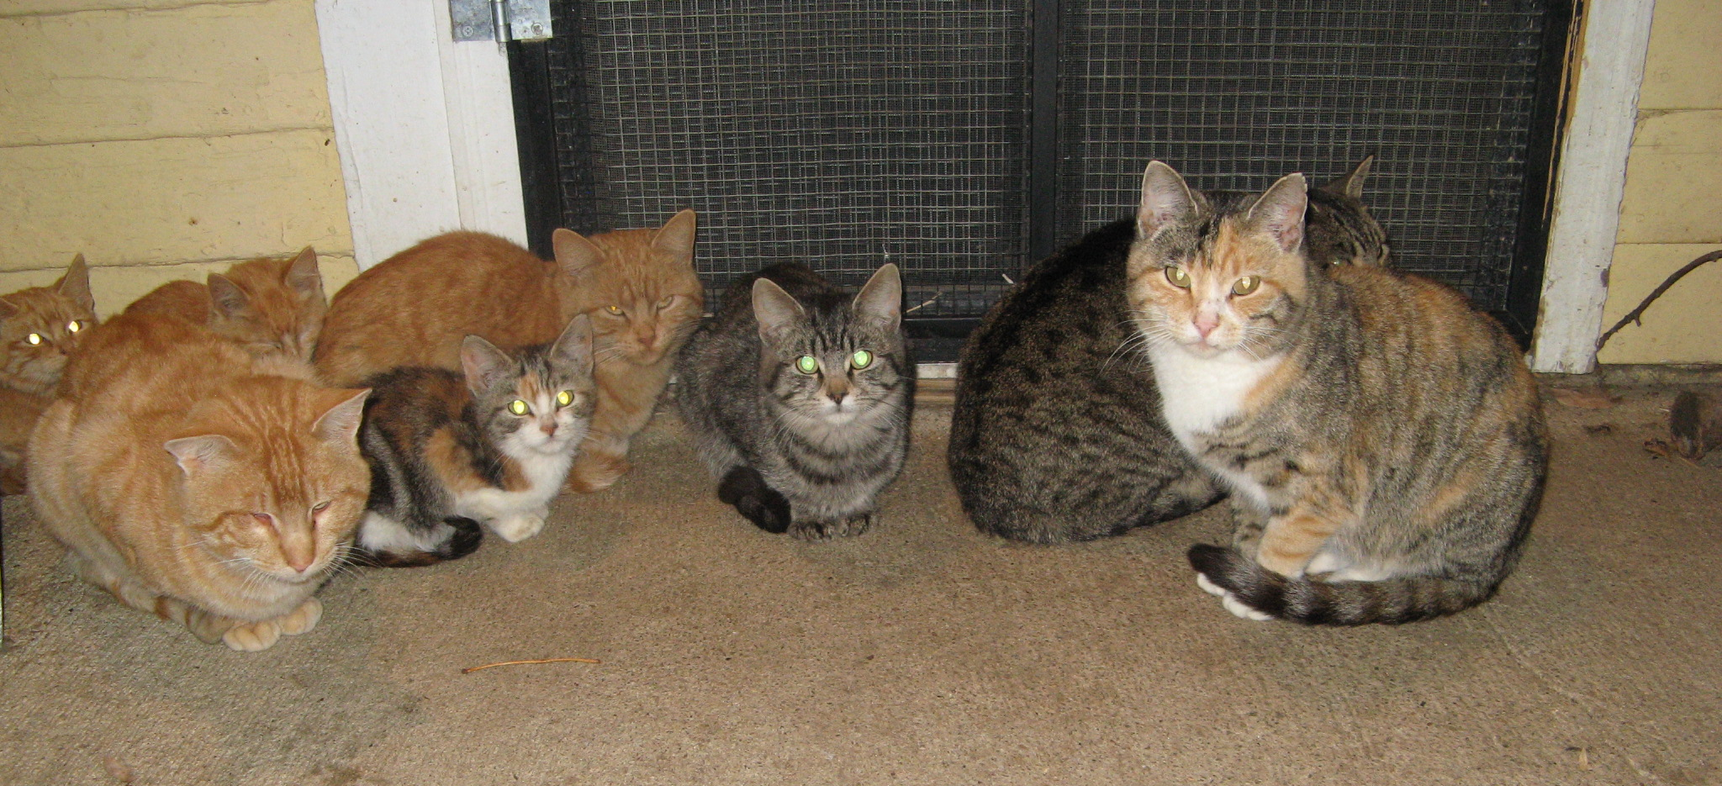
Collective Nouns
A glaring of cats
Fixed look of fierceness or anger
Notes:
Notes to the teacher: Meaning of difficult words could be explained by the teacher wherever required.
Click for text boxes to appear
Reference: https://www.jellyfish.com/en-gb/training/blog/collective-nouns
Suggestions: <Ideas/ Images/ Animations / Others – To make better representation of the content >
Source of Multimedia used in this slide - <Please provide source URL where we find the image and the license agreement>
https://www.flickr.com/photos/27435717@N00/4062257255 By Ali Eminov

Slide 3
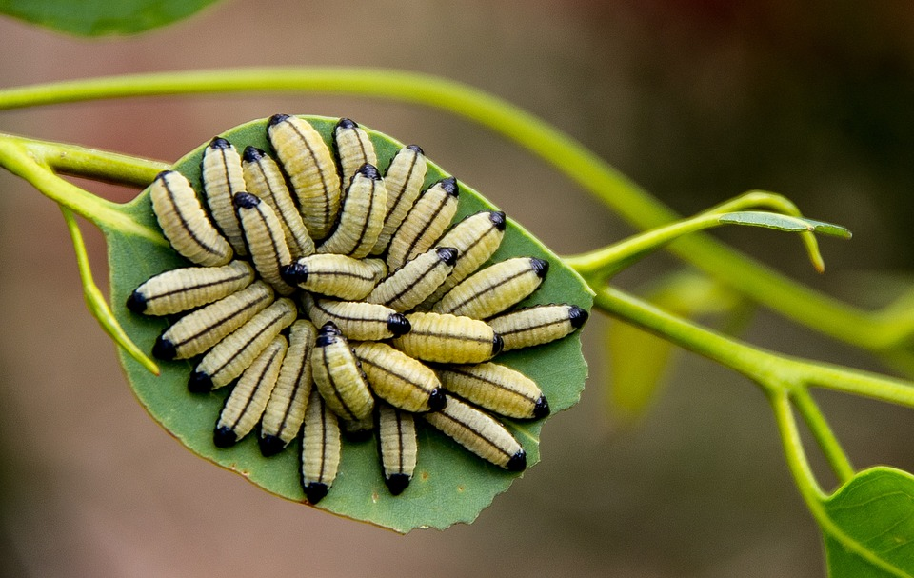
Collective Nouns
An army of caterpillars
Travel in large groups
Notes:
Notes to the teacher: Meaning of difficult words could be explained by the teacher wherever required.
Click for text boxes to appear
Reference: https://www.jellyfish.com/en-gb/training/blog/collective-nouns
Suggestions: <Ideas/ Images/ Animations / Others – To make better representation of the content >
Source of Multimedia used in this slide - <Please provide source URL where we find the image and the license agreement>
https://pixabay.com/photos/pet-purebred-cat-cat-feline-animal-6877246/
https://pixabay.com/photos/cat-pet-feline-animal-fur-3504008/
https://pixabay.com/photos/larvae-yellow-black-many-1054724/

Slide 4
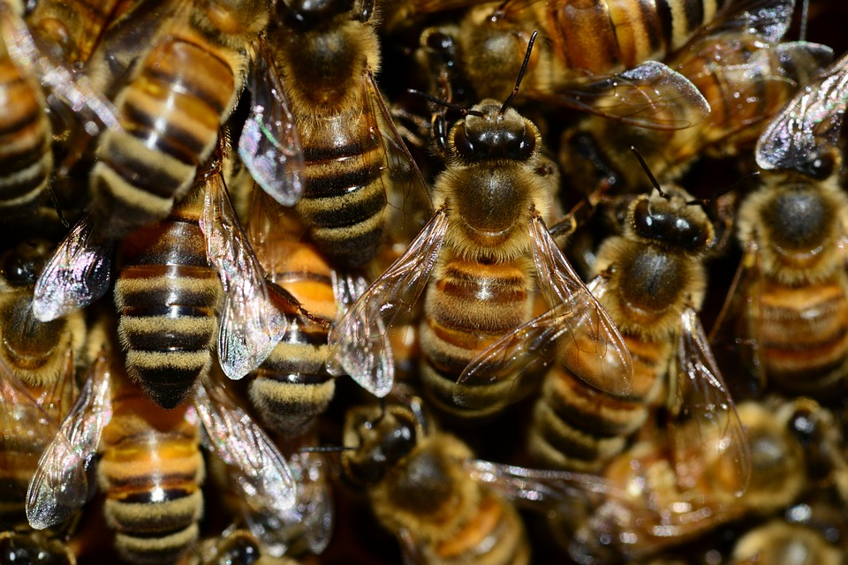
Collective Nouns
A bike of bees
‘Bike’ means colony, nest or swarm
Notes:
Notes for Teacher - < Information for further reference or explanation >
Suggestions: <Ideas/ Images/ Animations / Others – To make better representation of the content >
Source of Multimedia used in this slide - <Please provide source URL where we find the image and the license agreement>
https://pixabay.com/photos/bees-insects-macro-honey-bees-292133/

Slide 5
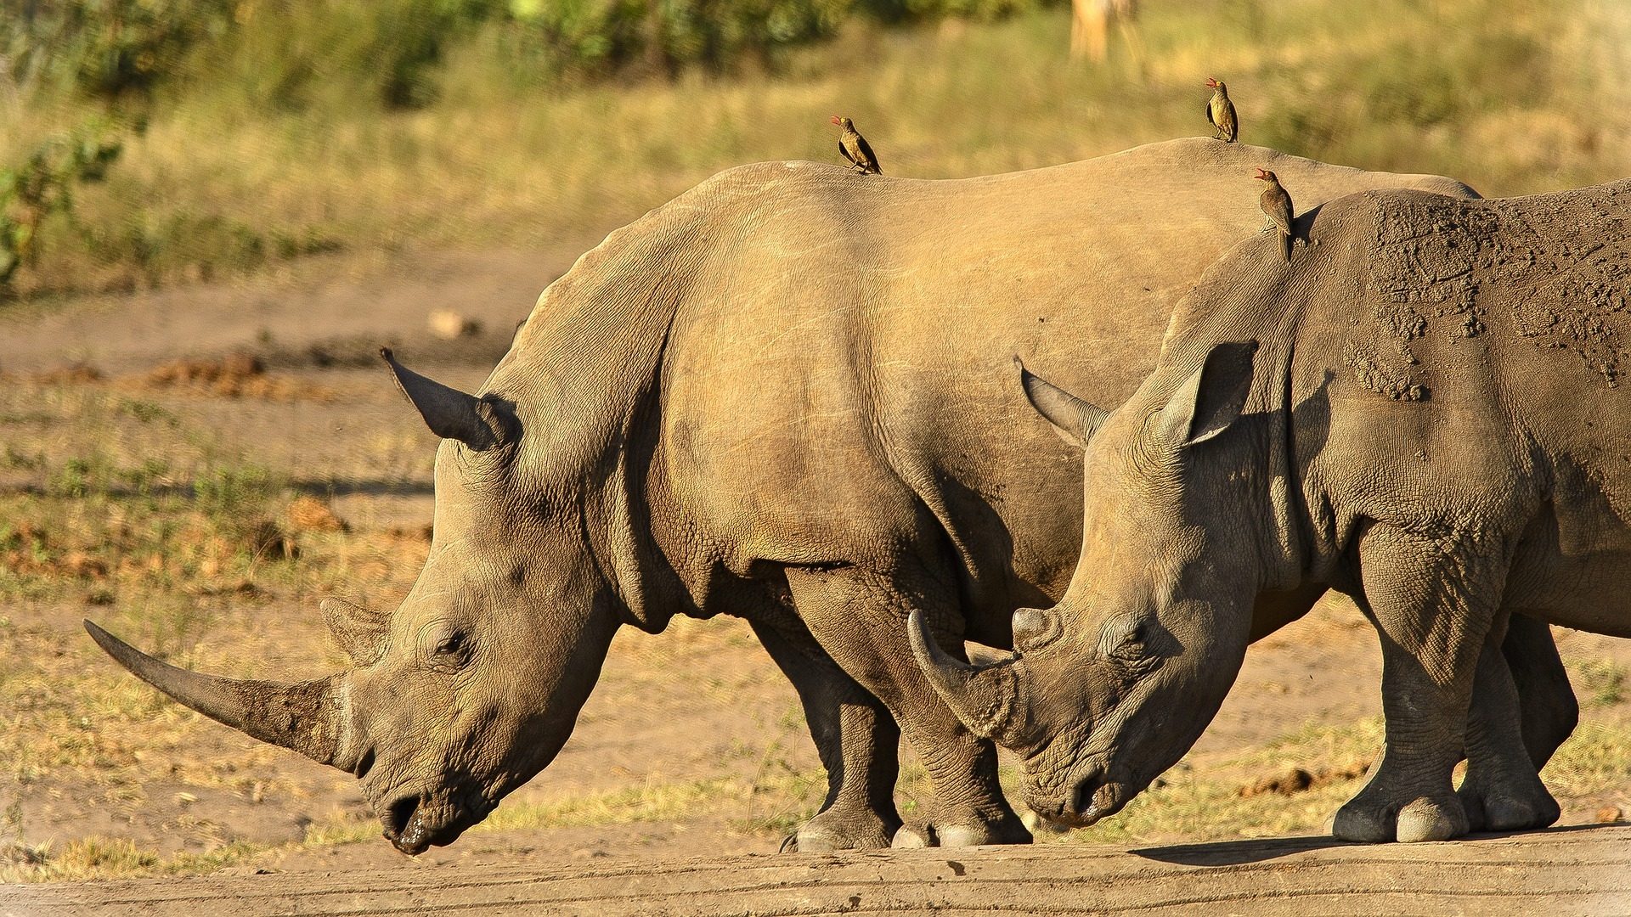
Collective Nouns
A crash of rhinoceros
Rhino’s tendency to charge at anything unfamiliar
Notes:
Notes for Teacher - < Information for further reference or explanation >
Suggestions: <Ideas/ Images/ Animations / Others – To make better representation of the content >
Source of Multimedia used in this slide - <Please provide source URL where we find the image and the license agreement> https://pixabay.com/photos/rhinoceros-close-horns-dangerous-2808194/

Slide 6
Collective Nouns
A shiver of sharks
Reaction of a person that comes across a group of sharks
Notes:
Notes for Teacher - < Information for further reference or explanation >
Suggestions: <Ideas/ Images/ Animations / Others – To make better representation of the content >
Source of Multimedia used in this slide - <Please provide source URL where we find the image and the license agreement>
https://pixabay.com/photos/fish-sharks-sea-water-ocean-6010472/

Slide 7
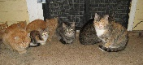
MM Index
Slide # | Thumbnail | Source link and Attribution
1 |  | https://pixabay.com/illustrations/ask-asking-guess-business-3070333/
2 |  | https://www.flickr.com/photos/27435717@N00/4062257255 By Ali Eminov
3 |  | https://pixabay.com/photos/larvae-yellow-black-many-1054724/
4 |  | https://pixabay.com/photos/bees-insects-macro-honey-bees-292133/
5 |  | https://pixabay.com/photos/rhinoceros-close-horns-dangerous-2808194/
6 |  | https://pixabay.com/photos/fish-sharks-sea-water-ocean-6010472/
Notes:
Notes for Teacher - < Information for further reference or explanation >
Suggestions: <Ideas/ Images/ Animations / Others – To make better representation of the content >
Source of Multimedia used in this slide - <Please provide source URL where we find the image and the license agreement>

