Slide 1
Together is Happiness
Notes:
Notes for Teacher - < Information for further reference or explanation >
Suggestions: <Ideas/ Images/ Animations / Others – To make better representation of the content >
Source of Multimedia used in this slide - <Please provide source URL where we find the image and the license agreement>

Slide 2
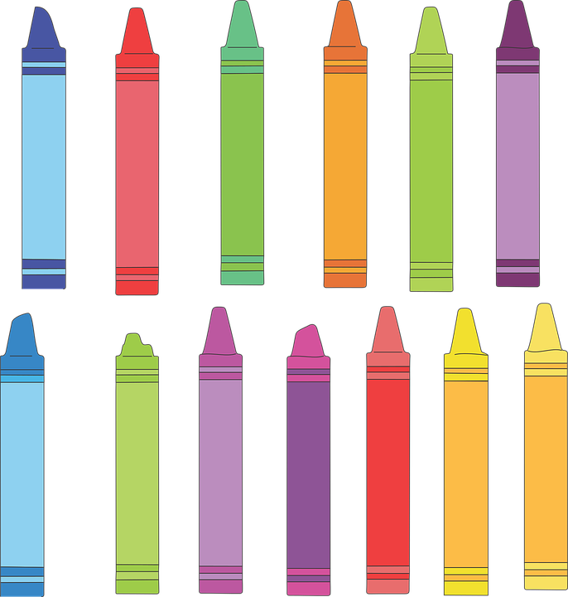
Together is Happiness
Colours started to
quarrel….
I am
the best,
important, useful, and favorite….
Notes:
Notes for Teacher – The collective nouns represent the group of people or things
Teacher asks the children:
· Children, do you like rain?
· What is that you can see in the sky only during the rainy season?
Answer:
Yes, it is the rainbow that you can see during the rainy season.
Suggestions: <Ideas/ Images/ Animations / Others – To make better representation of the content >
Source of Multimedia used in this slide -
Colour - https://pixabay.com/vectors/crayon-art-drawing-school-color-2214272/
Man - https://pixabay.com/vectors/figure-person-stick-standing-slim-25590/

Slide 3
Story Contd…
PURPLE
Authority ,
Wisdom & royalty
INDIGO
Twilight &
deep waters, silence
RED
Danger, bravery, love & blood
BLUE
Sky & sea peace & serenity
ORANGE
Carrots,pumpkins oranges for health & strength
YELLOW Sunflower, laughter, gaiety & warmth
GREEN
Grass,trees & leaves, life giving plants
Notes:
Notes for Teacher - < Information for further reference or explanation >
Suggestions: <Ideas/ Images/ Animations / Others – To make better representation of the content >
Source of Multimedia used in this slide -
https://pixabay.com/vectors/star-pentagons-rainbow-colors-3615972/

Slide 4
Story Contd…
Story Contd…
The colours went on quarrelling loudly,
Suddenly there were flashes of lightening and sounds of thunder!!!
Colours came closer and huddled together to comfort each other.
That is when rain spoke out to them, “Each of you is unique in your own way, all the seven of you should join hands and stretch across the sky to form a beautiful rainbow, as a symbol of peace and happiness.
Notes:
Notes for Teacher - < Information for further reference or explanation >
Suggestions: <Ideas/ Images/ Animations / Others – To make better representation of the content >
Source of Multimedia used in this slide - <Please provide source URL where we find the image and the license agreement>
Thunder: https://www.flaticon.com/free-icon/weather_992289 By geotatah
https://pixabay.com/vectors/circle-colorful-cooperation-1300241/

Slide 5
Points to ponder/reflect
Just like the colours joined together to form a beautiful rainbow, we need to love everyone and live together in peace and harmony.
Notes:
Notes for Teacher - < Information for further reference or explanation >
Suggestions: <Ideas/ Images/ Animations / Others – To make better representation of the content >
Source of Multimedia used in this slide - <Please provide source URL where we find the image and the license agreement>
https://www.freepik.com/free-vector/flower-garden-beautiful-rainbow_2439628.htm attribution to brgfx
https://pixabay.com/vectors/family-love-rainbow-boy-child-2112266/

Slide 6
MM INDEX
Slide # | Thumbnail | Source link and Attribution
2 |  | Colour - https://pixabay.com/vectors/crayon-art-drawing-school-color-2214272/ Man - https://pixabay.com/vectors/figure-person-stick-standing-slim-25590/
3 |  | https://pixabay.com/vectors/star-pentagons-rainbow-colors-3615972
4 |  | Thunder: https://www.flaticon.com/free-icon/weather_992289 By geotatah https://pixabay.com/vectors/circle-colorful-cooperation-1300241
5 |  | https://www.freepik.com/free-vector/flower-garden-beautiful-rainbow_2439628.htm attribution to brgfx https://pixabay.com/vectors/family-love-rainbow-boy-child-2112266/
Notes:
Notes for Teacher - < Information for further reference or explanation >
Suggestions: <Ideas/ Images/ Animations / Others – To make better representation of the content >
Source of Multimedia used in this slide - <Please provide source URL where we find the image and the license agreement>

