Slide 1
Quiz Time for Collective Nouns
Notes:
Notes for Teacher - < Information for further reference or explanation >
Suggestions: <Ideas/ Images/ Animations / Others – To make better representation of the content >
Source of Multimedia used in this slide - <Please provide source URL where we find the image and the license agreement>
Image - https://pixabay.com/illustrations/question-mark-question-mark-sign-1722862/ by Arek Socha

Slide 2
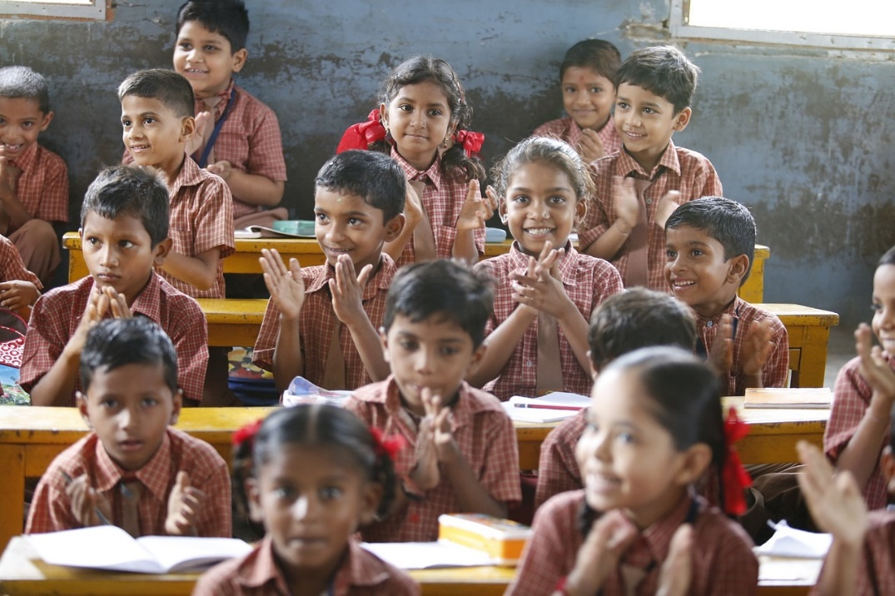
Round 1 – Visual Round
Choose the right collective nouns for the following nouns. 10 points for each correct answer. (*No passing of questions)
1st Question to Group A
school | team | class
Notes:
Notes for Teacher - < Information for further reference or explanation >The teacher could use the following quiz to assess the understanding of collective nouns.
How to conduct the quiz?
—> The class could be divided into four groups namely Groups A, B, C and D.
—> The quiz consists of three rounds of four questions each.
—> The time allotted to answer each question is only 30 seconds.
—> In round 1&3, if a group fails to answer the question, then the question is not passed on to the next group. The question gets passed only in round 2.The team that answers the passed question gets a bonus point of 5.
—> In round 1&2, each correct answer gets 10 points.
—> One child could be asked to keep the scoreboard going.
—> The team with the maximum points at the end is the winning team.
PLEASE NOTE- Any one child from a group can answer in consultation with the group. NO MASS ANSWERING. If that happens, the group can lose a round.
The teacher could repeat the rules of each round at the beginning of each round.
Suggestions: <Ideas/ Images/ Animations / Others – To make better representation of the content >
Source of Multimedia used in this slide - <Please provide source URL where we find the image and the license agreement>
Classroom - https://pixabay.com/photos/happy-children-education-876541/ by AkshayaPatra Foundation

Slide 3
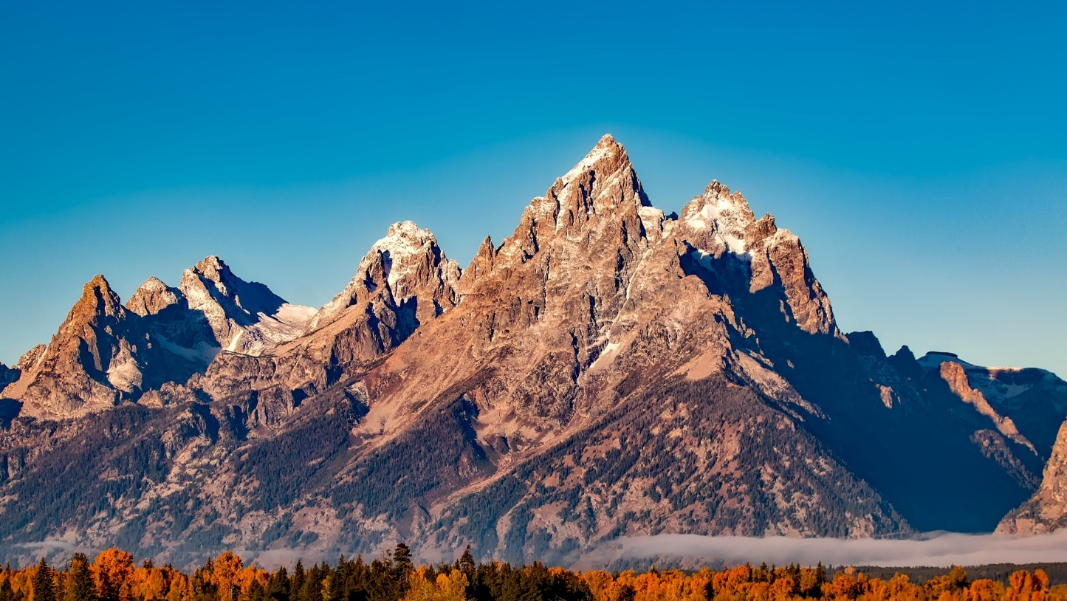
Round 1 – Visual Round
2nd Question to Group B
range | block | group
Notes:
Notes for Teacher - < Information for further reference or explanation >
Suggestions: <Ideas/ Images/ Animations / Others – To make better representation of the content >
Source of Multimedia used in this slide - <Please provide source URL where we find the image and the license agreement>
Mountains - https://www.pexels.com/photo/green-fields-near-brown-mountain-210243/ by Pixabay

Slide 4
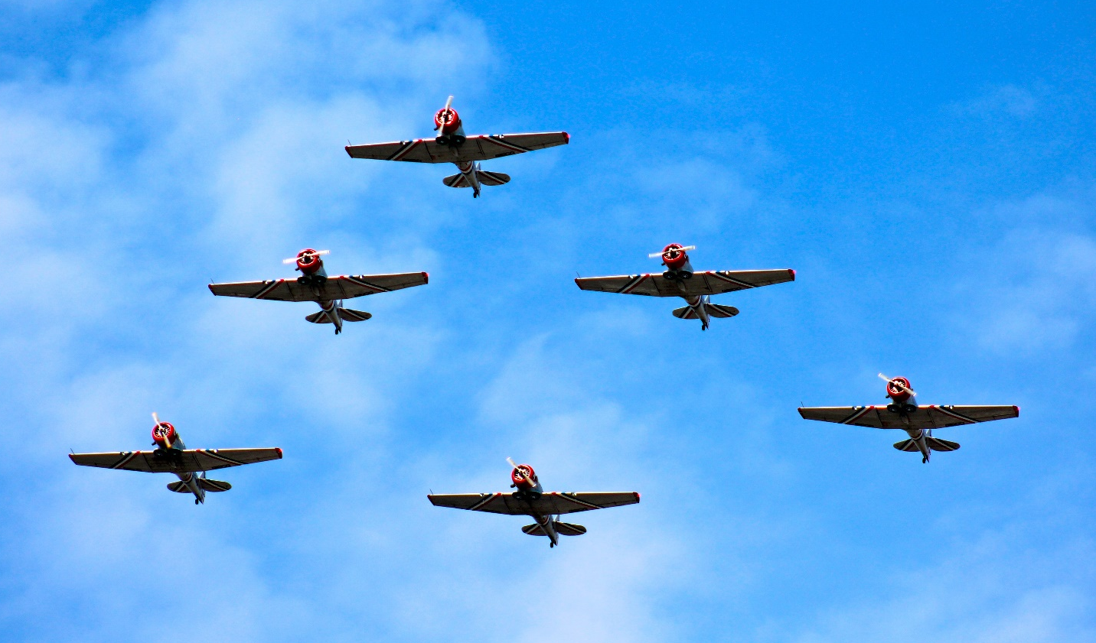
Round 1 – Visual Round
3rd Question to Group C
group | pile | fleet
Notes:
Notes for Teacher - < Information for further reference or explanation >
Suggestions: <Ideas/ Images/ Animations / Others – To make better representation of the content >
Source of Multimedia used in this slide - <Please provide source URL where we find the image and the license agreement>
Six aircrafts - https://www.pexels.com/photo/six-aircrafts-in-formation-flying-in-the-skies-298207/ by Leigh Patrick

Slide 5
Round 1 – Visual Round
4th Question to Group D
bunch | group | galaxy
Notes:
Notes for Teacher - < Information for further reference or explanation >
Suggestions: <Ideas/ Images/ Animations / Others – To make better representation of the content >
Source of Multimedia used in this slide - <Please provide source URL where we find the image and the license agreement>
Starry sky galaxy - https://pixabay.com/illustrations/night-stars-starry-sky-heaven-927168/ by Gerd Altmann

Slide 6
Round 2 – Audio Round
Let us watch the video for audio round
Notes:
Notes for Teacher - < Information for further reference or explanation > Video for the audio round has been uploaded separately.
Suggestions: <Ideas/ Images/ Animations / Others – To make better representation of the content >
Source of Multimedia used in this slide - <Please provide source URL where we find the image and the license agreement>
Clapper Board – From icons of PowerPoint
Sheep bleat - https://pixabay.com/sound-effects/search/sheep/?theme=nature by Gitanki
Group of dogs Barking - https://pixabay.com/sound-effects/search/dogs%20barking/ by ivolipa
Dog barking - https://pixabay.com/sound-effects/search/dogs%20barking/ by Ken788
Bees buzzing - https://pixabay.com/sound-effects/search/bee%20buzz/ by JonCon Library
Elephant trumpet - https://pixabay.com/sound-effects/search/elephant/ by D.jones
Image of nature - https://pixabay.com/photos/hills-india-nature-kodaikanal-2836301/ by Sathish kumar Periyasamy
Field image - https://pixabay.com/photos/field-grass-nature-landscape-5429112/ by inactive account
Leaves background - https://pixabay.com/illustrations/leaves-foliage-background-flora-5643327/ by Dung Tran

Slide 7
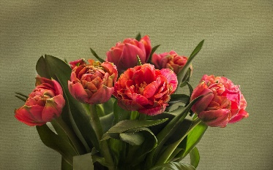
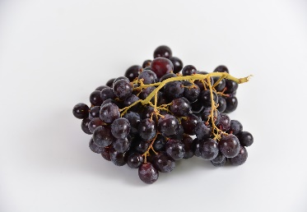
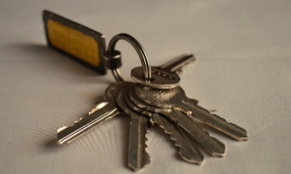
Round 3 – Rapid Fire Round
No passing of questions.
3 questions will be asked orally, one after another. At the end of each question the answer should be given.
5 points awarded for each right answer. (A total of 15 points could be won in this round.)
a _________ of flowers
a _________ of grapes
a _________ of keys
Group A
bouquet
bunch
bunch
Notes:
Notes for Teacher - < Information for further reference or explanation >
Suggestions: <Ideas/ Images/ Animations / Others – To make better representation of the content >
Source of Multimedia used in this slide - <Please provide source URL where we find the image and the license agreement>
Flowers - https://pixabay.com/photos/tulips-flowers-bunch-bouquet-1997282/ by Angelina Ho.
Grapes – https://pixabay.com/photos/black-grapes-power-fruit-eat-2205732/ by inactive account
Keys - https://pixabay.com/photos/bunch-of-keys-keys-key-fob-unlock-390979/ by PDPics

Slide 8
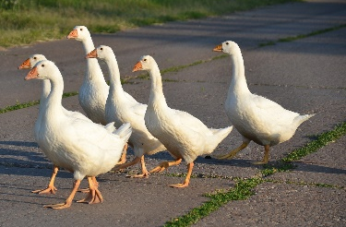
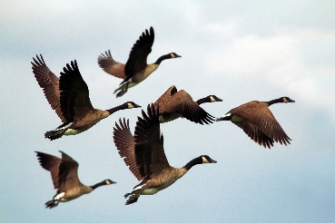
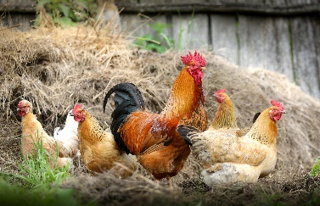
Round 3 – Rapid Fire Round
Group B
a _________ of geese
a _________ of birds
a _________ of chickens
gaggle
flock
brood
Notes:
Notes for Teacher - < Information for further reference or explanation >
Suggestions: <Ideas/ Images/ Animations / Others – To make better representation of the content >
Source of Multimedia used in this slide - <Please provide source URL where we find the image and the license agreement>
Geese - https://pixabay.com/photos/geese-bird-nature-white-geese-3568536/ by Russian Federation
Birds flying - https://pixabay.com/photos/geese-birds-flock-wildlife-flying-1990202/ by inactive account
Chickens - https://pixabay.com/photos/chickens-birds-poultry-rooster-hen-2522623/ by svklimkin

Slide 9
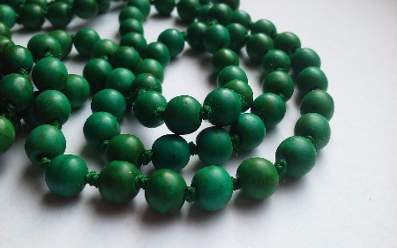
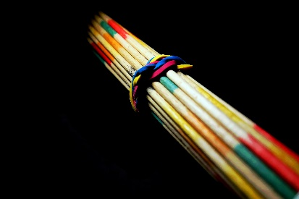
Round 3 – Rapid Fire Round
Group C
a _________ of beads
a _________ of sticks
a _________ of books
string
bundle
pile
Notes:
Notes for Teacher - < Information for further reference or explanation >
Suggestions: <Ideas/ Images/ Animations / Others – To make better representation of the content >
Source of Multimedia used in this slide - <Please provide source URL where we find the image and the license agreement>
Beads - https://pixabay.com/photos/necklace-jewelry-accessory-green-2413006/ by Jenny Porter
Sticks - https://pixabay.com/photos/pick-up-sticks-sticks-game-5606767/ by moritz320
Books - https://pixabay.com/photos/books-library-pile-old-reading-6976790/ by Alexei

Slide 10
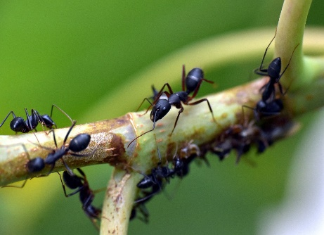
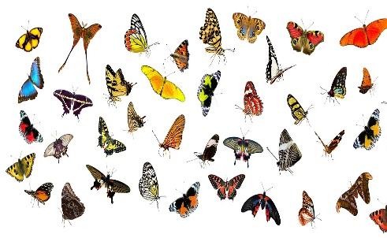
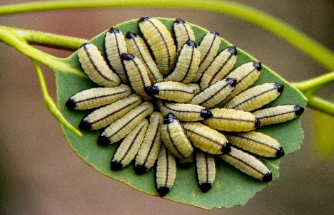
Round 3 – Rapid Fire Round
Group D
a _____________ of ants
a _____________ of butterflies
an _____________ of caterpillars
colony
flight
army
Notes:
Notes for Teacher - < Information for further reference or explanation > At the end, the points can be tallied and the group with the highest points is declared the winner.
Suggestions: <Ideas/ Images/ Animations / Others – To make better representation of the content >
Source of Multimedia used in this slide - <Please provide source URL where we find the image and the license agreement>
Ants - https://pixabay.com/photos/black-ant-insect-garden-ant-3667014/ by Sandeep Handa
Butterflies - https://pixabay.com/photos/animals-butterflies-butterfly-2772006/ by Gerhard G
Caterpillars - https://pixabay.com/photos/larvae-yellow-black-many-1054724/ by Sandid

Slide 11
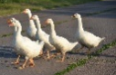
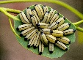
MM INDEX
Slide # | Thumbnail | Source link and Attribution
1 |  | https://pixabay.com/illustrations/question-mark-question-mark-sign-1722862/ by Arek Socha
2 |  | https://pixabay.com/photos/happy-children-education-876541/ by AkshayaPatra Foundation
3 |  | https://www.pexels.com/photo/green-fields-near-brown-mountain-210243/ by Pixabay
4 |  | https://www.pexels.com/photo/six-aircrafts-in-formation-flying-in-the-skies-298207/ by Leigh Patrick
5 |  | https://pixabay.com/illustrations/night-stars-starry-sky-heaven-927168/ by Gerd Altmann
7 |  | Flowers - https://pixabay.com/photos/tulips-flowers-bunch-bouquet-1997282/ by Angelina Ho. Grapes – https://pixabay.com/photos/black-grapes-power-fruit-eat-2205732/ by inactive account Keys - https://pixabay.com/photos/bunch-of-keys-keys-key-fob-unlock-390979/ by PDPics
8 |  | Geese - https://pixabay.com/photos/geese-bird-nature-white-geese-3568536/ by Russian Federation Birds flying - https://pixabay.com/photos/geese-birds-flock-wildlife-flying-1990202/ by inactive account Chickens - https://pixabay.com/photos/chickens-birds-poultry-rooster-hen-2522623/ by svklimkin
9 |  | Beads - https://pixabay.com/photos/necklace-jewelry-accessory-green-2413006/ by Jenny Porter Sticks - https://pixabay.com/photos/pick-up-sticks-sticks-game-5606767/ by moritz320 Books - https://pixabay.com/photos/books-library-pile-old-reading-6976790/ by Alexei
10 |  | Ants - https://pixabay.com/photos/black-ant-insect-garden-ant-3667014/ by Sandeep Handa Butterflies - https://pixabay.com/photos/animals-butterflies-butterfly-2772006/ by Gerhard G Caterpillars - https://pixabay.com/photos/larvae-yellow-black-many-1054724/ by Sandid
Notes:
Notes for Teacher - < Information for further reference or explanation >
Suggestions: <Ideas/ Images/ Animations / Others – To make better representation of the content >
Source of Multimedia used in this slide - <Please provide source URL where we find the image and the license agreement>

Slide 12
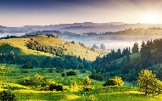
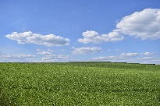
MM INDEX for video
# | Thumbnail | Source link and Attribution
1 |  | https://pixabay.com/photos/hills-india-nature-kodaikanal-2836301/ by Sathish kumar Periyasamy
2 | Audios of sheep, dog, bees and elephant | Sheep bleat - https://pixabay.com/sound-effects/search/sheep/?theme=nature by Gitanki Group of dogs Barking - https://pixabay.com/sound-effects/search/dogs%20barking/ by ivolipa Dog barking - https://pixabay.com/sound-effects/search/dogs%20barking/ by Ken788 Bees buzzing - https://pixabay.com/sound-effects/search/bee%20buzz/ by JonCon Library Elephant trumpet - https://pixabay.com/sound-effects/search/elephant/ by D.jones
3 |  | https://pixabay.com/photos/field-grass-nature-landscape-5429112/ by inactive account
4 |  | https://pixabay.com/illustrations/leaves-foliage-background-flora-5643327/ by Dung Tran
Notes:
Notes for Teacher - < Information for further reference or explanation >
Suggestions: <Ideas/ Images/ Animations / Others – To make better representation of the content >
Source of Multimedia used in this slide - <Please provide source URL where we find the image and the license agreement>

