Slide 1
MATCHING COLLECTIVE NOUNS
Notes:
Notes for Teacher - < Information for further reference or explanation >
Suggestions: <Ideas/ Images/ Animations / Others – To make better representation of the content >
Source of Multimedia used in this slide - https://pixabay.com/illustrations/read-book-boy-study-sit-childhood-2799818/

Slide 2
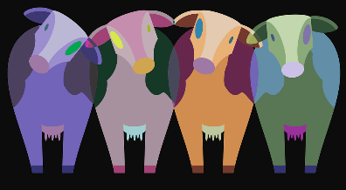
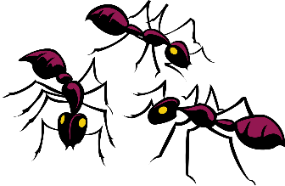
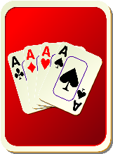
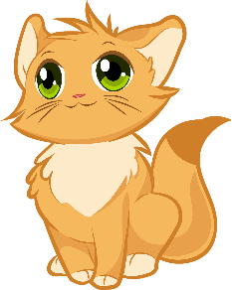
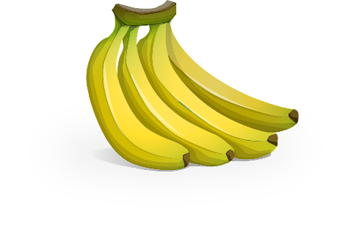
EXERCISE
Click on Each Word for Answer
Match the collective noun with the phrase
of bananas
deck
of bananas
army
of cattle
of cattle
litter
of cards
of cards
herd
of kittens
of kittens
bunch
of ants
of ants
Notes:
Notes for Teacher – The initial display of all the elements on the slide is automatic. For the matching answers to appear, click on each word on the left.
Suggestions: N/A
Source of Multimedia used in this slide -
https://pixabay.com/vectors/bananas-fruit-food-yellow-fruit-575773/
https://pixabay.com/vectors/kitten-cute-cat-animals-furry-4794761/
https://pixabay.com/vectors/ants-three-insects-group-bug-team-45805/
https://pixabay.com/vectors/cows-animals-nature-farm-1789577/
https://pixabay.com/vectors/back-hand-card-face-game-playing-48947/

Slide 3
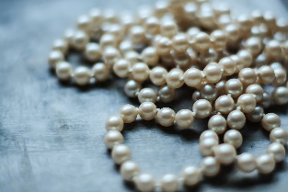
EXERCISE (Contd.)
Click on Each Word for Answer
Match the collective noun with the phrase
of people
pack
of people
string
of ships
of ships
bouquet
of wolves
of wolves
fleet
of flowers
of flowers
crowd
of pearls
of pearls
Notes:
Notes for Teacher - The initial display of all the elements on the slide is automatic. For the matching answers to appear, click on each word on the left.
Suggestions: N/A
Source of Multimedia used in this slide - https://pixabay.com/vectors/bouquet-bouquet-of-flowers-flowers-161758/ https://pixabay.com/photos/pearl-chaplet-beads-white-2407275/
https://pixabay.com/vectors/pirate-ship-ship-pirates-sail-2028574/
https://pixabay.com/illustrations/crowd-people-silhouettes-2045499/
https://pixabay.com/photos/wolves-wolf-pack-forest-woods-2864647/

Slide 4
MM INDEX
Slide # | Thumbnail | Source link and Attribution
1 |  | https://pixabay.com/illustrations/read-book-boy-study-sit-childhood-2799818/
2 |  | https://pixabay.com/vectors/bananas-fruit-food-yellow-fruit-575773/ https://pixabay.com/vectors/kitten-cute-cat-animals-furry-4794761/ https://pixabay.com/vectors/ants-three-insects-group-bug-team-45805/ https://pixabay.com/vectors/cows-animals-nature-farm-1789577/ https://pixabay.com/vectors/back-hand-card-face-game-playing-48947/
3 |  | https://pixabay.com/vectors/bouquet-bouquet-of-flowers-flowers-161758/ https://pixabay.com/photos/pearl-chaplet-beads-white-2407275/ https://pixabay.com/vectors/pirate-ship-ship-pirates-sail-2028574/ https://pixabay.com/illustrations/crowd-people-silhouettes-2045499/ https://pixabay.com/photos/wolves-wolf-pack-forest-woods-2864647/
Notes:
Notes for Teacher - < Information for further reference or explanation >
Suggestions: <Ideas/ Images/ Animations / Others – To make better representation of the content >
Source of Multimedia used in this slide - <Please provide source URL where we find the image and the license agreement>

