Slide 1
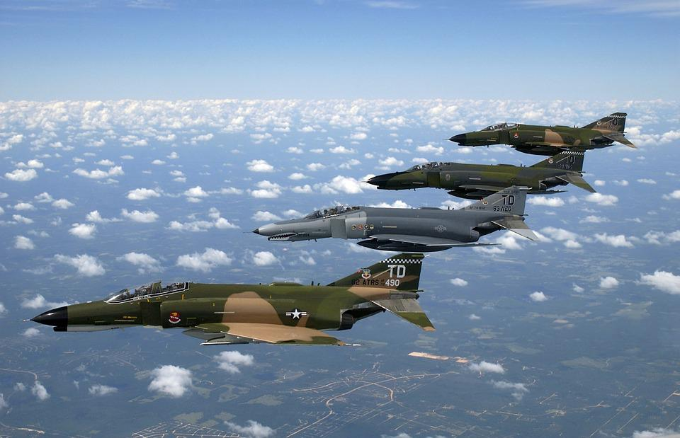
Summary_Collective Nouns
Notes:
Notes for Teacher - < Information for further reference or explanation >
Suggestions: <Ideas/ Images/ Animations / Others – To make better representation of the content >
Source of Multimedia used in this slide - <Please provide source URL where we find the image and the license agreement>
https://pixabay.com/photos/fighter-jet-air-force-phantom-ii-60528/

Slide 2
Collective Nouns
Revision of Nouns
Identification
Daily life experiences
Living in harmony
Demonstrate the understanding
Joy of Learning
Using collective nouns
Match the correct nouns
Notes:
Notes for Teacher - < Information for further reference or explanation >
Suggestions: <Ideas/ Images/ Animations / Others – To make better representation of the content >
Source of Multimedia used in this slide - <Please provide source URL where we find the image and the license agreement>

Slide 3
MM INDEX
Slide # | Thumbnail | Source link and Attribution
1 |  | https://pixabay.com/photos/fighter-jet-air-force-phantom-ii-60528/
Notes:
Notes for Teacher - < Information for further reference or explanation >
Suggestions: <Ideas/ Images/ Animations / Others – To make better representation of the content >
Source of Multimedia used in this slide - <Please provide source URL where we find the image and the license agreement>

