Slide 1
Think Conjunctions
Notes:
Notes for Teacher - < Information for further reference or explanation >
Suggestions: <Ideas/ Images/ Animations / Others – To make better representation of the content >
Source of Multimedia used in this slide - <Please provide source URL where we find the image and the license agreement>

Slide 2
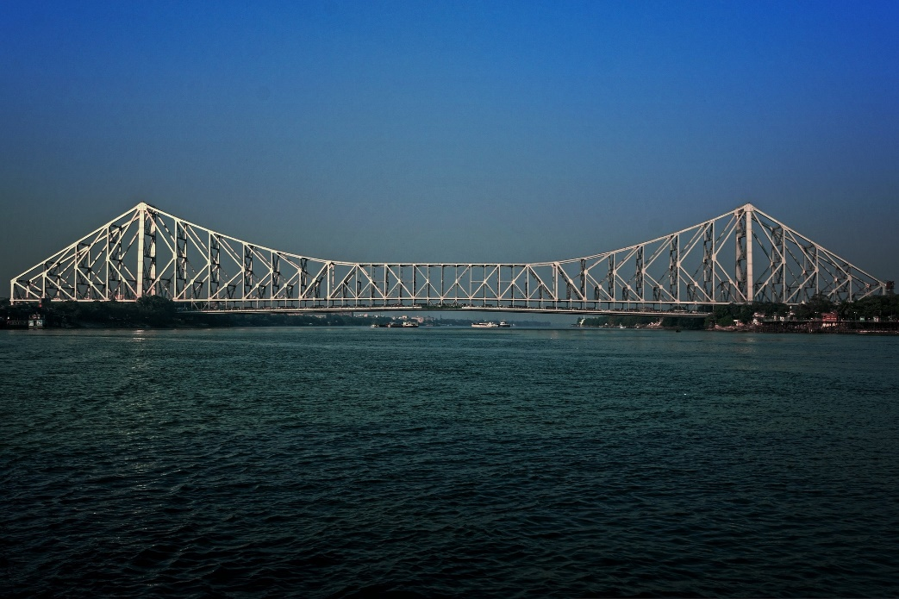
Conjunction - AND
AND
I like mangoes.
I like grapes.
I like mangoes and grapes.
Notes:
Notes for Teacher - <The teacher could begin the class with a talk (using the ppt to arouse the interest and curiosity of the students) about how a bridge is used as a connector. Different types of bridges are used in different situations. In the process, the teacher could slowly introduce the use of conjunctions and help students to notice how different conjunctions are used as connectors in different situations, similar to bridges.>
Suggestions: <Ideas/ Images/ Animations / Others – To make better representation of the content >
Source of Multimedia used in this slide -
https://pixabay.com/photos/bridge-water-construction-sky-3100742/ By subhamshome

Slide 3
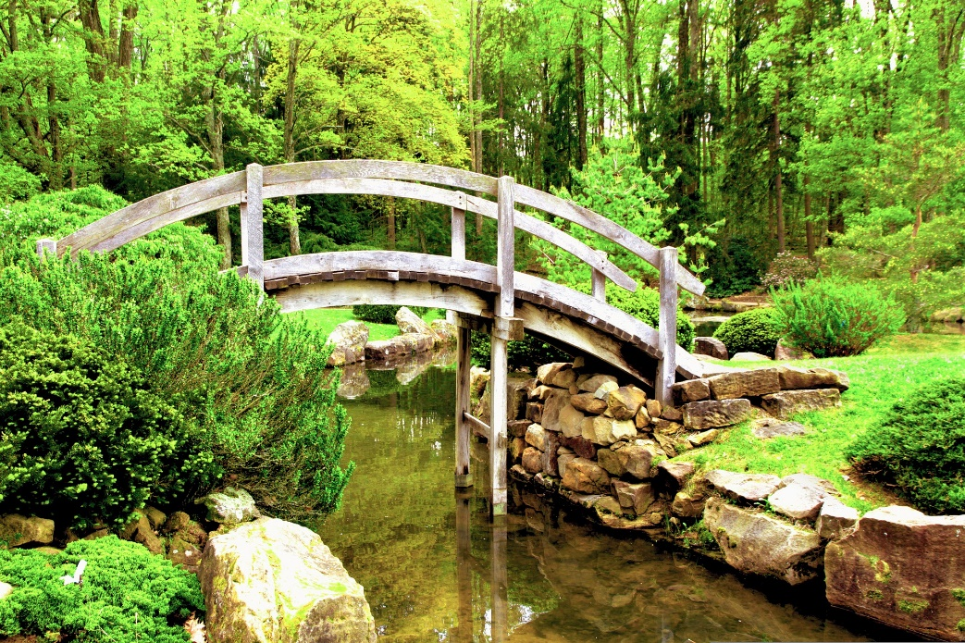
Conjunction - BUT
BUT
They want to go to the beach.
They do not know the way.
They want to go to the beach but they do not know the way.
Notes:
Notes for Teacher - < Information for further reference or explanation >
Suggestions: <Ideas/ Images/ Animations / Others – To make better representation of the content >
Source of Multimedia used in this slide -
https://pixabay.com/photos/bridge-japanese-garden-stream-1590346/ By ataribravo99

Slide 4
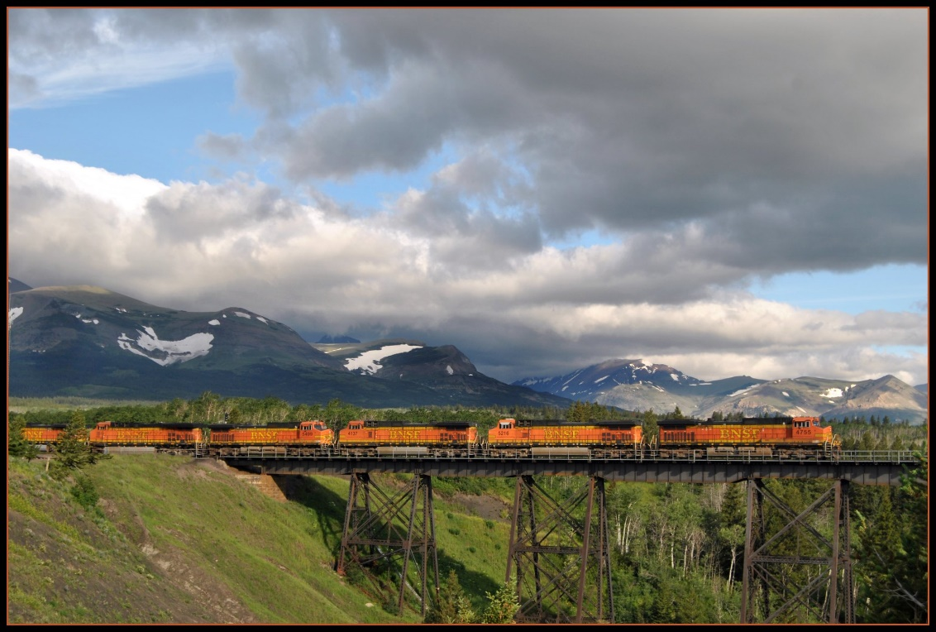
Conjunction-BECAUSE
BECAUSE
We won the match.
We worked hard.
We won the match because we worked hard.
Notes:
Notes for Teacher - < Information for further reference or explanation >
Suggestions: <Ideas/ Images/ Animations / Others – To make better representation of the content >
Source of Multimedia used in this slide - <Please provide source URL where we find the image and the license agreement>
https://www.flickr.com/photos/36989019@N08/6004852821 By Loco Steve

Slide 5
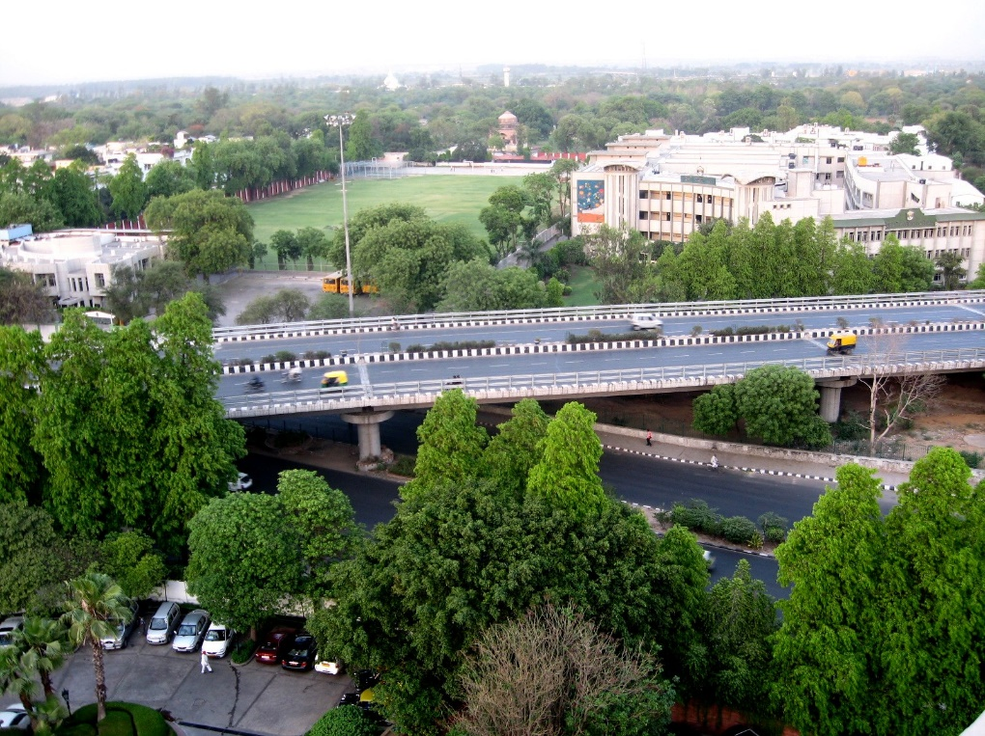
Conjunction - IF
IF
You can score good marks.
You study well.
You can score good marks if you study well.
Notes:
Notes for Teacher - <The teacher could conclude the class by emphasising on the use of conjunctions to connect sentences and make communication more meaningful.>
Suggestions: <Ideas/ Images/ Animations / Others – To make better representation of the content >
Source of Multimedia used in this slide - <Please provide source URL where we find the image and the license agreement>
https://www.flickr.com/photos/40299872@N00/2448087043 By Niyam Bhushan

Slide 6
MM Index
Slide # | Thumbnail | Source link and Attribution
1 |  | Background: https://www.publicdomainpictures.net/en/view-image.php?image=399947 By Karen Arnold Smiley: https://pixabay.com/illustrations/smiley-laugh-at-humor-fun-pleasure-1981935/ By Conmongt
2 |  | https://pixabay.com/photos/bridge-water-construction-sky-3100742 By subhamshome
3 |  | https://pixabay.com/photos/bridge-japanese-garden-stream-1590346 By ataribravo99
4 |  | https://www.flickr.com/photos/36989019@N08/6004852821 By Loco Steve
5 |  | https://www.flickr.com/photos/40299872@N00/2448087043 By Niyam Bhushan
Notes:
Notes for Teacher - < Information for further reference or explanation >
Suggestions: <Ideas/ Images/ Animations / Others – To make better representation of the content >
Source of Multimedia used in this slide - <Please provide source URL where we find the image and the license agreement>

