Slide 1
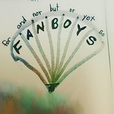
At the Junction
Notes:
Notes for Teacher - < Information for further reference or explanation >
The teacher could begin the class on a lighter note about how funny our conversations would be if conjunctions did not exist. Then the PPT provided could be played and the students could be allowed to enjoy and absorb the information provided.
Suggestions: <Ideas/ Images/ Animations / Others – To make better representation of the content >
Source of Multimedia used in this slide - <Please provide source URL where we find the image and the license agreement>
https://www.flickr.com/photos/mrsdkrebs/33028706722 Attributed by DEnise Krebs Learning coordinating conjuctions in grade 5

Slide 2
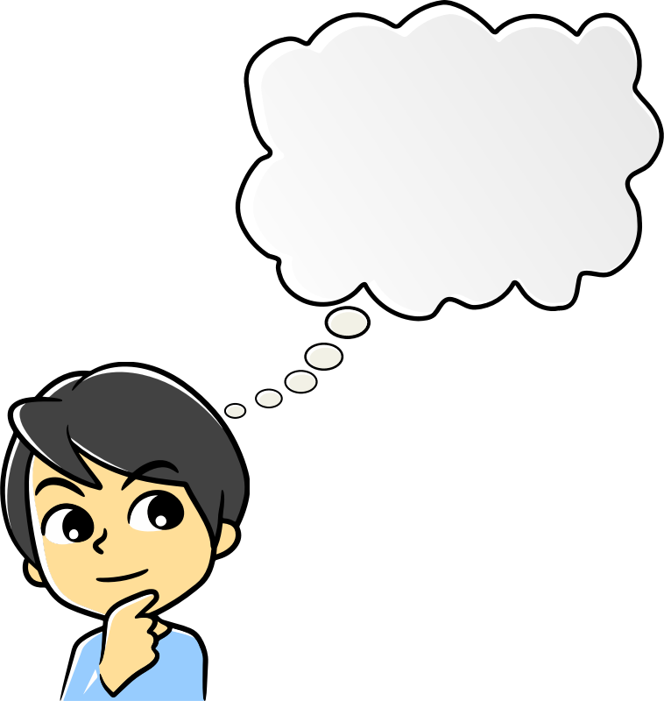
If Conjunctions did not exist
I am going to buy some bananas. I am going to buy some oranges. I am going
to buy some apples.
I would like to come with you. I have to finish my homework. I will join you. I can finish my homework early.
Notes:
Notes for Teacher – Please increase the volume as there is an audio narration in this slide.
Suggestions: <Ideas/ Images/ Animations / Others – To make better representation of the content >
Source of Multimedia used in this slide - <Please provide source URL where we find the image and the license agreement>
Boy - https://openclipart.org/detail/304902/scheming-boy-remix-1 By Arvin61r58
Girl - https://freesvg.org/1554467034

Slide 3
Same Dialogue with Conjunctions
I am going to buy some bananas, oranges and apples.
I would like to
come with you but
I have to finish my homework. I will join you if I finish
my homework
early.
Notes:
Notes for Teacher - < Information for further reference or explanation >
The teacher could conclude by emphasising about how the right use of conjunctions is necessary to make communication meaningful.
Suggestions: <Ideas/ Images/ Animations / Others – To make better representation of the content >
Source of Multimedia used in this slide - <Please provide source URL where we find the image and the license agreement>
Boy - https://openclipart.org/detail/304902/scheming-boy-remix-1 By Arvin61r58
Girl - https://freesvg.org/1554467034

Slide 4
MM Index
Slide # | Thumbnail | Source link and Attribution
1 |  | https://www.flickr.com/photos/mrsdkrebs/33028706722 Attributed by Denise Krebs Learning coordinating conjunctions in grade 5
2, 3 |  | Boy - https://openclipart.org/detail/304902/scheming-boy-remix-1 By Arvin61r58 Girl - https://freesvg.org/1554467034
Notes:
Notes for Teacher - < Information for further reference or explanation >
Suggestions: <Ideas/ Images/ Animations / Others – To make better representation of the content >
Source of Multimedia used in this slide - <Please provide source URL where we find the image and the license agreement>

