Slide 1
Conjunctions in daily use
Notes:
Notes for Teacher - < Information for further reference or explanation >
Suggestions: <Ideas/ Images/ Animations / Others – To make better representation of the content >
Source of Multimedia used in this slide - <Please provide source URL where we find the image and the license agreement>

Slide 2
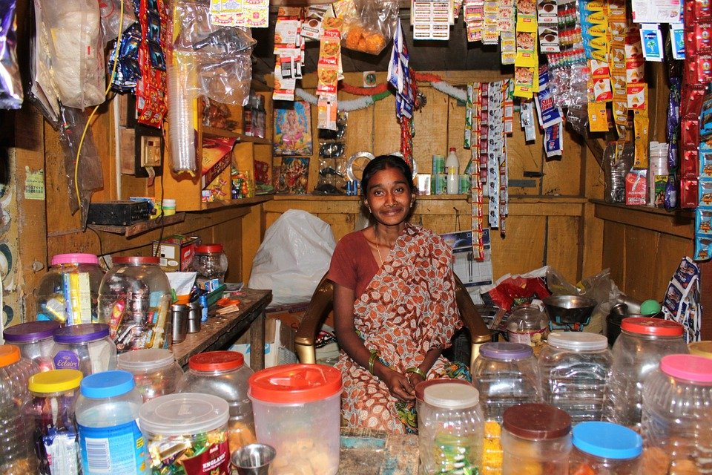
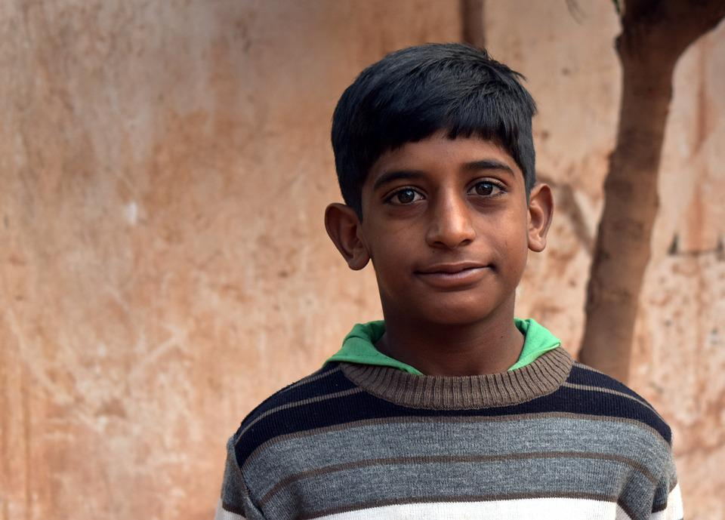
Conjunctions
Shopkeeper: What do you want?
Boy: I want one kg of rice and a small packet of cumin seeds.
Notes:
Notes for Teacher - < Information for further reference or explanation >
The teacher could begin with a reminder to the students about the ‘IA_At the junction’ to tell them how funny and meaningless our conversations would be without Conjunctions. Now, he/she could proceed to highlight the fact that conjunctions are used in all conversations without any conscious effort. An example could be given:
Teacher: Mohan, did you have breakfast this morning or did you skip it?
Mohan: My mother insists on having a good breakfast as it is the most important meal of the day. I had idli and sambar today ma’am.
The teacher could now encourage students (calling out a mix of active and passive ones) to come up with questions and answers in different situations and notice the use of conjunctions.
Suggestions: <Ideas/ Images/ Animations / Others – To make better representation of the content >
Source of Multimedia used in this slide - <Please provide source URL where we find the image and the license agreement>
Grocery - https://pixabay.com/photos/india-vendor-shop-market-street-1006222/
Boy - https://pixabay.com/photos/people-portrait-a-village-boy-child-3125603/

Slide 3
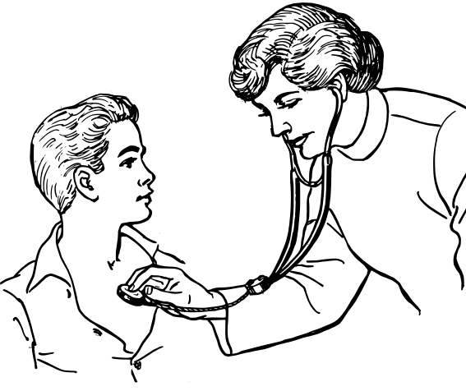
Conjunctions
What happened to you?
I have a stomach ache so I am unable to sleep.
Notes:
Notes for Teacher - < Information for further reference or explanation >
Suggestions: <Ideas/ Images/ Animations / Others – To make better representation of the content >
Source of Multimedia used in this slide - <Please provide source URL where we find the image and the license agreement>
Doctor - https://freesvg.org/doctor-examining-a-patient-illustration

Slide 4
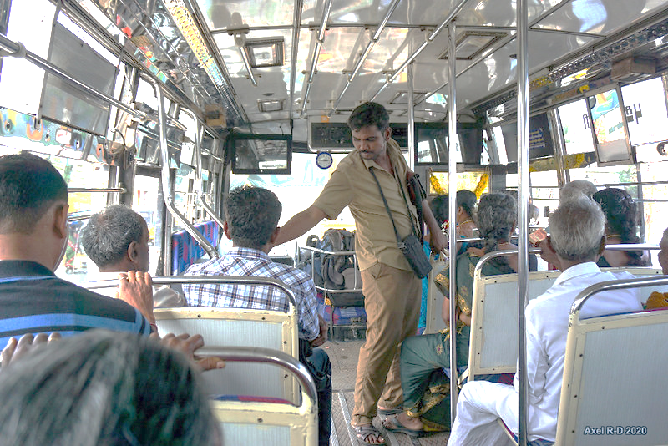
Conjunctions
Conductor: You have to pay 12; can you give me the exact fare?
Passenger: I can give you 20 because I have no change.
Notes:
Notes for Teacher - < Information for further reference or explanation >
The teacher could use similar situations and encourage maximum participation. The students could be asked to identify the conjunctions as a reinforcement. The class could be concluded with an emphasis on the use of conjunctions in our daily conversations.
Suggestions: <Ideas/ Images/ Animations / Others – To make better representation of the content >
Source of Multimedia used in this slide - <Please provide source URL where we find the image and the license agreement>
Conductor bus - https://www.flickr.com/photos/axelrd/50004678203 (by Axel Drainville)

Slide 5
MM Index
Slide # | Thumbnail | Source link and Attribution
2 |  | https://pixabay.com/photos/india-vendor-shop-market-street-1006222/
2 |  | https://pixabay.com/photos/people-portrait-a-village-boy-child-3125603/
3 |  | https://freesvg.org/doctor-examining-a-patient-illustration
4 |  | https://www.flickr.com/photos/axelrd/50004678203 (by Axel Drainville)
Notes:
Notes for Teacher - < Information for further reference or explanation >
Suggestions: <Ideas/ Images/ Animations / Others – To make better representation of the content >
Source of Multimedia used in this slide - <Please provide source URL where we find the image and the license agreement>

