Slide 1
Using Conjunctions
Notes:
Notes for Teacher - < Information for further reference or explanation >
Suggestions: <Ideas/ Images/ Animations / Others – To make better representation of the content >
Source of Multimedia used in this slide - <Please provide source URL where we find the image and the license agreement>
<join> <https://pixabay.com/vectors/puzzle-pieces-jigsaw-piece-concept-308908/>

Slide 2
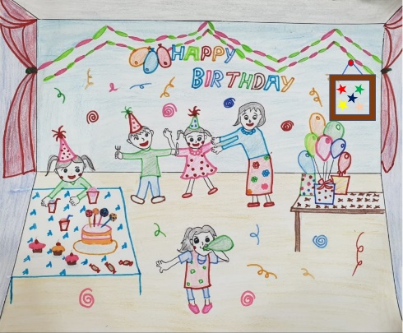
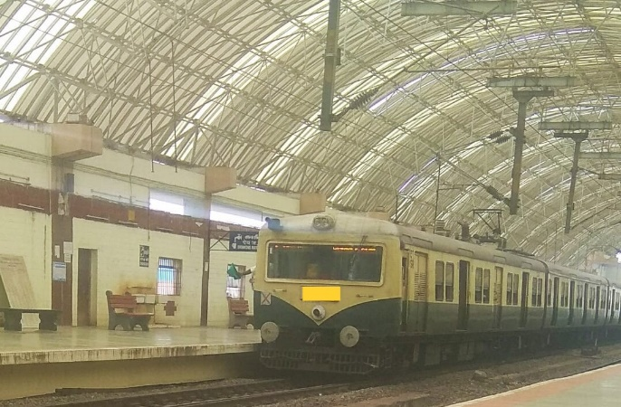
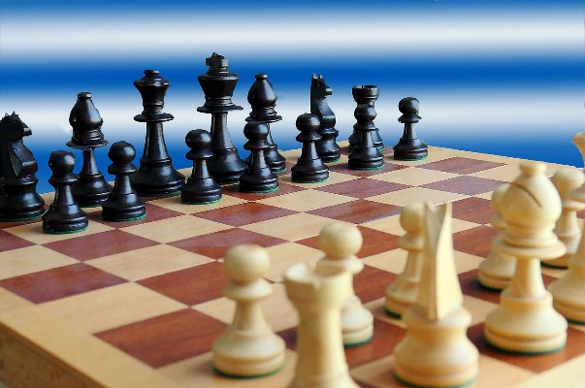
Exercise 1
Combine the two sentences using the most suitable conjunction from the list given below.
If and though because but
I am going to Seema’s house. It is Seema’s birthday.
You will miss the train. You reach the station late.
I like reading books. I like playing chess.
I am going to Seema’s house because it is her birthday.
You will miss the train if you reach the station late.
I like reading books and playing chess.
Notes:
Notes for Teacher - < Information for further reference or explanation >
Suggestions: <Ideas/ Images/ Animations / Others – To make better representation of the content >
Source of Multimedia used in this slide - <Please provide source URL where we find the image and the license agreement>
<birthday> <SSSVV-Birthday party, Birthday celebration>
<Train> <SSSVV - Electric train electric-train-6992 Electric train>
<chess> <https://pixabay.com/photos/chess-chess-board-chess-pieces-5112895/>

Slide 3
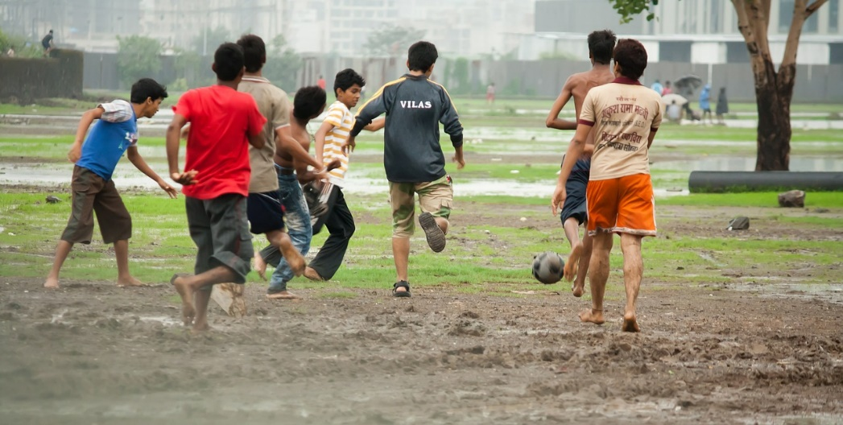
Exercise 1
Combine the two sentences using the most suitable conjunction from the list given below.
If and though because but
Geeta wants to buy the new story book. She forgot to bring her purse.
The boys are playing football. It is raining.
Geeta wants to buy the new story book but she forgot to bring her purse.
The boys are playing football though it is raining.
Notes:
Notes for Teacher - < Information for further reference or explanation >
Suggestions: <Ideas/ Images/ Animations / Others – To make better representation of the content >
Source of Multimedia used in this slide - <Please provide source URL where we find the image and the license agreement>
<girl> <https://pixabay.com/photos/girl-books-library-student-6120275/>
<football> <https://pixabay.com/photos/football-slush-soccer-muddy-mud-390945/>

Slide 4
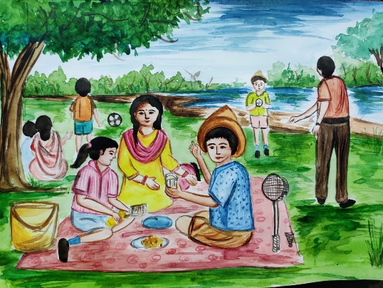
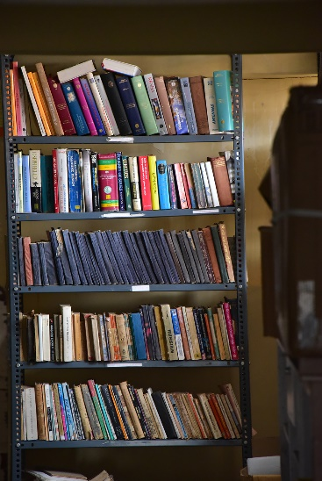
Exercise 2
Make meaningful sentences using the conjunctions or the pair of conjunctions given below:
We decided to go for a picnic since it was a holiday.
Since: _________________________________________
The students can either play or go to the library.
Either, or: _________________________________________
Sample Answers
Notes:
Notes for Teacher - < Information for further reference or explanation >
Suggestions: <Ideas/ Images/ Animations / Others – To make better representation of the content >
Source of Multimedia used in this slide - <Please provide source URL where we find the image and the license agreement>
<picnic> <SSSVV-picnic at the lakeside, outdoor picnic, family time>
<library> <SSSVV-library-7273 Book Shelf>

Slide 5
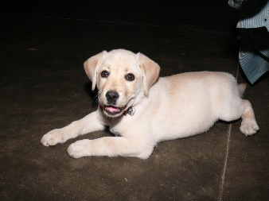
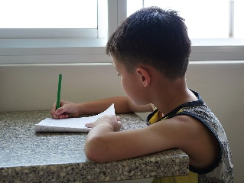
Exercise 2
Make meaningful sentences using the conjunctions given below.
My pet dog is sick so I am not taking him out.
So: ______________________________________
You can have an apple or a banana for breakfast.
Or: ____________________________________________
I cannot disturb my brother as he is busy with his work.
As: _________________________________________________
Sample Answers
Notes:
Notes for Teacher - < Information for further reference or explanation >
Suggestions: <Ideas/ Images/ Animations / Others – To make better representation of the content >
Source of Multimedia used in this slide - <Please provide source URL where we find the image and the license agreement>
<Dog> <SSSVV - Dog - White animals-34 Pet Dog, puppy, White in colour>
<singer> <https://pixabay.com/vectors/singer-female-silhouette-woman-4753813/>
<boy writing> <https://pixabay.com/photos/writing-boy-child-student-kid-711286/>

Slide 6
MM INDEX
Slide # | Thumbnail | Source link and Attribution
1 |  | <join> <https://pixabay.com/vectors/puzzle-pieces-jigsaw-piece-concept-308908/>
2 |  | <birthday> <SSSVV-Birthday party, Birthday celebration> <Train> <SSSVV - Electric train electric-train-6992 Electric train> <chess> <https://pixabay.com/photos/chess-chess-board-chess-pieces-5112895/>
3 |  | <girl> <https://pixabay.com/photos/girl-books-library-student-6120275/> <football> <https://pixabay.com/photos/football-slush-soccer-muddy-mud-390945/>
4 |  | <picnic> <SSSVV-picnic at the lakeside, outdoor picnic, family time> <library> <SSSVV-library-7273 Book Shelf>
5 |  | <Dog> <SSSVV - Dog - White animals-34 Pet Dog, puppy, White in colour> <singer> <https://pixabay.com/vectors/singer-female-silhouette-woman-4753813/> <boy writing> <https://pixabay.com/photos/writing-boy-child-student-kid-711286/>
Notes:
Notes for Teacher - < Information for further reference or explanation >
Suggestions: <Ideas/ Images/ Animations / Others – To make better representation of the content >
Source of Multimedia used in this slide - <Please provide source URL where we find the image and the license agreement>

