Slide 1
ONE WORD TWO MEANINGS
Notes:
Notes for Teacher - < Information for further reference or explanation >
Suggestions: <Ideas/ Images/ Animations / Others – To make better representation of the content >
Source of Multimedia used in this slide - <Please provide source URL where we find the image and the license agreement>

Slide 2
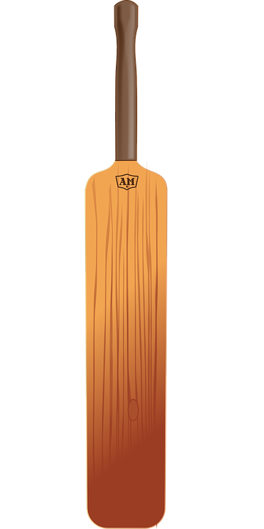
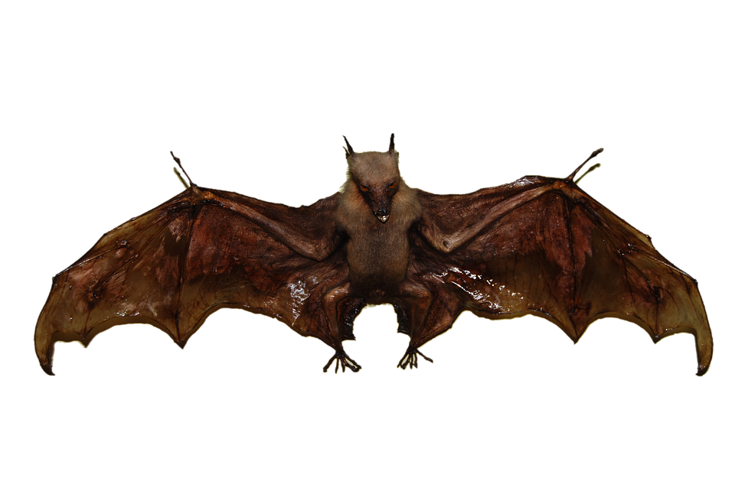
One Word Two Meanings
Bat
Click here for examples
Cricket Bat
Bat (A mammal)
Notes:
Notes for Teacher - The teacher may begin the class by using a few sentences with homonyms like- “ Vanita has to submit her book for correction. Our school is going to book tickets for all of us to go for the magic show. We used to draw water from the well when we were young. Ria is absent because she is not well”. Then probe the students to notice the use of similar sounding words with two meanings.
To kindle their curiosity, the teacher may use the PPT or the placards and let the students discover how the same word could carry two meanings.
Suggestions: <Ideas/ Images/ Animations / Others – To make better representation of the content >
Source of Multimedia used in this slide - <Please provide source URL where we find the image and the license agreement>
Boy : https://pixabay.com/vectors/school-kids-back-to-school-children-7040281/ (ryuzakiahmad)
Cricket : https://pixabay.com/vectors/bat-cricket-equipment-sports-158866/ (OpenClipart- vectors)
Bat : https://pixabay.com/illustrations/bat-bird-animal-embalmed-569442/ (pcdazero)

Slide 3
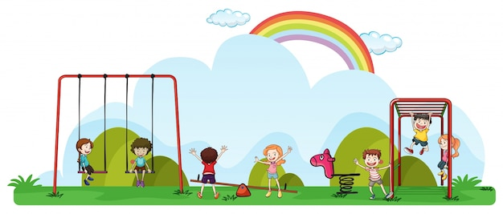
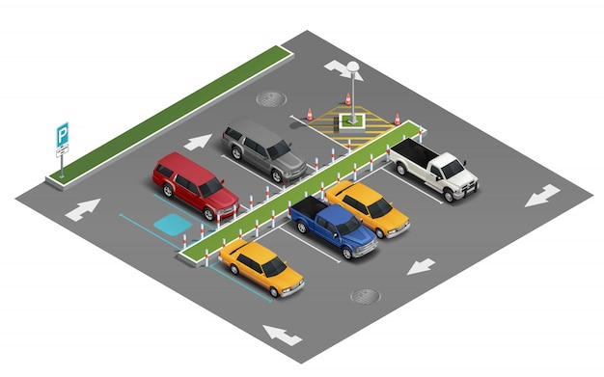
One Word Two Meanings
Park
Click here for examples
Children’s park
Car park
Notes:
Notes for Teacher - < Information for further reference or explanation >
Suggestions: <Ideas/ Images/ Animations / Others – To make better representation of the content >
Source of Multimedia used in this slide - <Please provide source URL where we find the image and the license agreement>
Girl : Boy : https://pixabay.com/vectors/school-kids-back-to-school-children-7040281/ (ryuzakiahmad)
Park : https://www.freepik.com/free-vector/happy-children-playing-playground_1502995.htm#query=kids%20park&position=17&from_view=keyword&track=ais (brgfx)
Car : https://www.freepik.com/free-vector/transport-parking-isometric-composition_6883525.htm#query=parking%20lot%20car%20park&position=28&from_view=search&track=ais (macrovector)

Slide 4
One Word Two Meanings
Nails
Fingernails
Click here for examples
Carpenter’s nails
Notes:
Notes for Teacher - < Information for further reference or explanation >
Suggestions: <Ideas/ Images/ Animations / Others – To make better representation of the content >
Source of Multimedia used in this slide - <Please provide source URL where we find the image and the license agreement>
Nail : https://pixabay.com/vectors/nail-finger-women-manicure-6091253/ (illust-dwh)
Nail 2: https://pixabay.com/photos/metal-nails-steel-metallic-950169/ (InspiredImages)

Slide 5
One Word Two Meanings
HOMONYMS: are words which have the same spelling and sound but different meanings.
Notes:
Notes for Teacher - The teacher could now introduce the term Homonyms with definition.
Suggestions: <Ideas/ Images/ Animations / Others – To make better representation of the content >
Source of Multimedia used in this slide - <Please provide source URL where we find the image and the license agreement>

Slide 6
Attribution / Citation
Slide # | Thumbnail | Source link | Author
2,4 |  | Boy : https://pixabay.com/vectors/school-kids-back-to-school-children-7040281/ (ryuzakiahmad) Cricket : https://pixabay.com/vectors/bat-cricket-equipment-sports-158866/ (OpenClipart- vectors) Bat : https://pixabay.com/illustrations/bat-bird-animal-embalmed-569442/ (pcdazero) | ryuzakiahmad OpenClipart- vectors pcdazero
3 |  | Girl : Boy : https://pixabay.com/vectors/school-kids-back-to-school-children-7040281/ (ryuzakiahmad) Park : https://www.freepik.com/free-vector/happy-children-playing-playground_1502995.htm#query=kids%20park&position=17&from_view=keyword&track=ais (brgfx) Car : https://www.freepik.com/free-vector/transport-parking-isometric-composition_6883525.htm#query=parking%20lot%20car%20park&position=28&from_view=search&track=ais (macrovector) | ryuzakiahmad brgfx macrovector
4 |  | Nail : https://pixabay.com/vectors/nail-finger-women-manicure-6091253/ (illust-dwh) Nail 2: https://pixabay.com/photos/metal-nails-steel-metallic-950169/ (InspiredImages) | illust-dwh InspiredImages
COPYRIGHT Cum DISCLAIMER NOTICE
Content owned by Sri Sathya Sai Central Trust, Prashanthi Nilayam, Puttaparthi, Sathya Sai District, Andhra Pradesh, India.
Strictly not for Commercial Use, excluding content that falls in Public Domain or common knowledge facts.
Content can be downloaded and used for personal, educational, informational and other non-commercial purposes, subject to attribution in the name of ‘Sri Sathya Sai Central Trust, Prashanthi Nilayam, Puttaparthi’ only. Any attempt to remove, alter, circumvent, or distort the data that is accessed is illegal and strictly prohibited.
Some of the content is owned by Third Parties and are used in compliance with their licensing conditions. Anyone infringing the Copyright of such Third Parties will be doing so at their own risks and costs.
Notes:
Notes for Teacher - < Information for further reference or explanation >
Suggestions: <Ideas/ Images/ Animations / Others – To make better representation of the content >
Source of Multimedia used in this slide - <Please provide source URL where we find the image and the license agreement>

