Slide 1
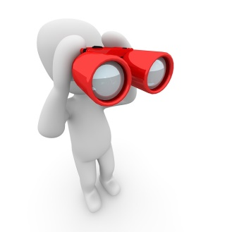
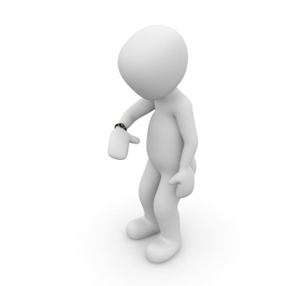
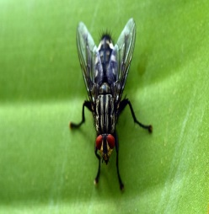
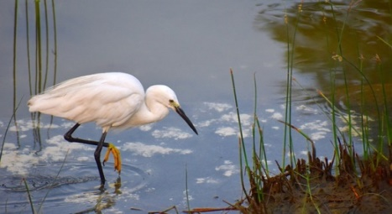
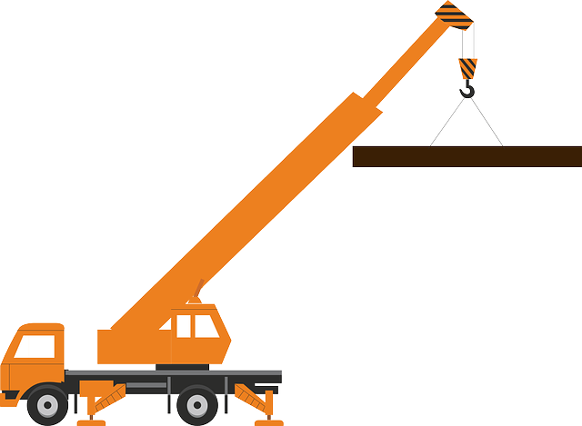
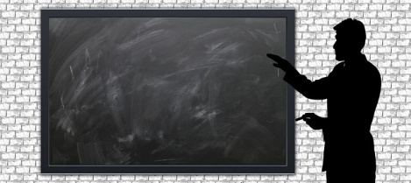
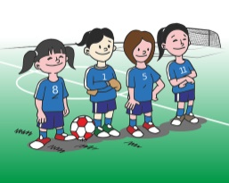
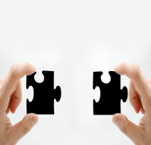
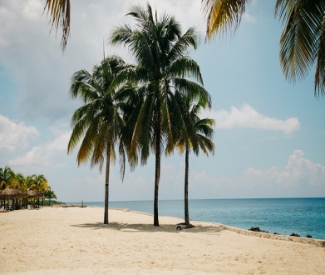
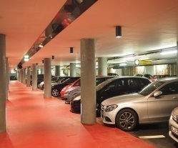
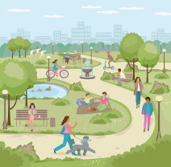
Understanding Homonyms
Homonyms
book, crane, park
palm , fly, match
watch, letter
Notes:
Notes for Teacher - < Information for further reference or explanation >
Suggestions: <Ideas/ Images/ Animations / Others – To make better representation of the content >
Source of Multimedia used in this slide - <Please provide source URL where we find the image and the license agreement>

Slide 2
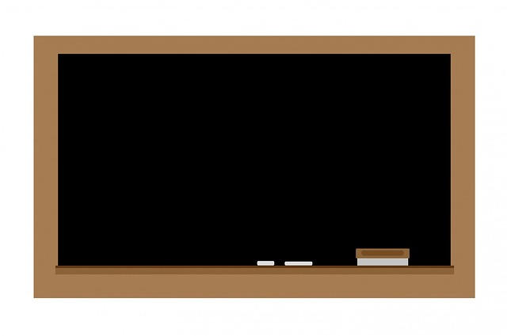
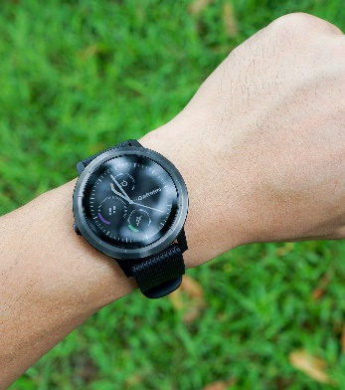
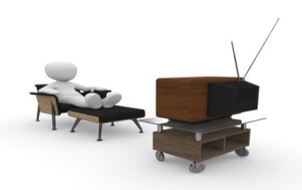
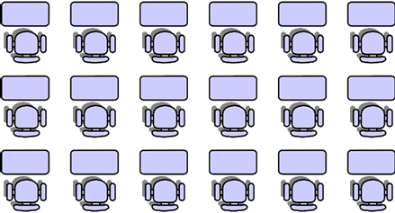
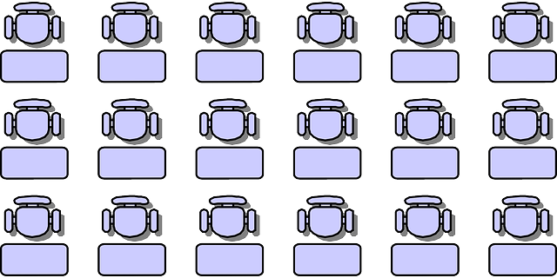
Fill in the blanks
Children, look at the images and fill in the blanks with appropriate words.
watch
1. Raju is looking at his ________ to know the time.
2. Sania likes to _________ TV.
watch
Watch
Notes:
Notes for Teacher – N/A
Suggestions: N/A
Source of Multimedia used in this slide - N/A

Slide 3
Homonym- ‘Watch’
Do you agree that ‘watch’ is the word for both the sentences?
watch
1. Raju is looking at his ________ to know the time.
2. Sania likes to _________ TV.
watch
Yes teacher
Notes:
Notes for Teacher – N/A
Suggestions: N/A
Source of Multimedia used in this slide - N/A

Slide 4
Homonym- ‘Watch’
Is the word ‘watch’ pronounced the same way in both the sentences?
watch
1. Raju is looking at his ________ to know the time.
2. Sania likes to _________ TV.
watch
Yes
Notes:
Notes for Teacher – N/A
Suggestions: N/A
Source of Multimedia used in this slide - N/A

Slide 5
Homonym- ‘Watch’
Is the meaning of the word ‘watch’ the same in both the sentences?
watch
1. Raju is looking at his ________ to know the time.
2. Sania likes to _________ TV.
watch
No teacher
Notes:
Notes for Teacher – N/A
Suggestions: N/A
Source of Multimedia used in this slide - N/A

Slide 6
What is a Homonym?
That’s right. Although the word ‘watch’ is spelled and pronounced in the same way in both the sentences, its meaning differs.
watch
1. Raju is looking at his ________ to know the time.
2. Sania likes to _________ TV.
watch
Homonyms are words with similar spelling and pronunciation but different meanings.
Notes:
Notes for Teacher – N/A
Suggestions: N/A
Source of Multimedia used in this slide - N/A

Slide 7
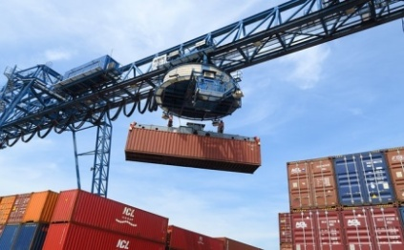
Homonym- ‘Crane’
Now give the homonyms for these sentences.
crane
1. A _____ is being used to lift the heavy load.
crane
2. The Siberian _____ is standing in the water.
crane
Notes:
Notes for Teacher – N/A
Suggestions: N/A
Source of Multimedia used in this slide - N/A

Slide 8
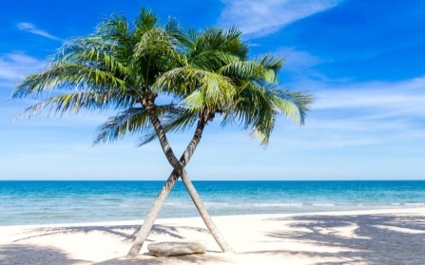
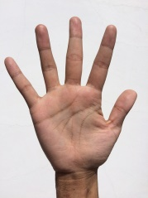
Homonym- ‘Palm’
Give the homonyms for these sentences.
palm
1. This is a ______ tree.
palm
2. This is the _______ of my right hand.
palm
Notes:
Notes for Teacher – N/A
Suggestions: N/A
Source of Multimedia used in this slide - N/A

Slide 9
Make sentences…
Make sentences of your own using the following homonyms.
1. book
2. fly
3. letter
4. match
5. park
Notes:
Notes for Teacher - Tell the students to make sentences with different meanings for each homonym.
Encourage all the students to write the sentences on their own in their notebooks.
Ask the students to read out their sentences and correct them if necessary.
Suggestions: N/A
Source of Multimedia used in this slide - <Please provide source URL where we find the image and the license agreement>

Slide 10
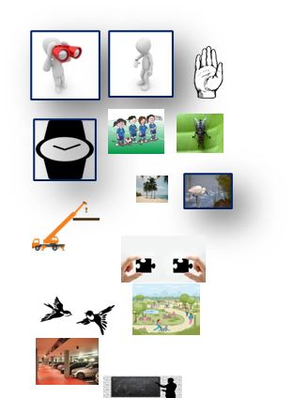
Attribution / Citation
Slide # | Thumbnail | Source link | Author
1 |  | Look: https://pixabay.com/illustrations/binoculars-looking-for-see-find-1015265/ Wristwatch: https://pixabay.com/illustrations/clock-wrist-watch-time-bracelet-1015428/ Watch: https://pixabay.com/vectors/watch-icon-wrist-isolated-watches-1633260/ Load Crane: https://pixabay.com/vectors/large-load-crane-construction-310665/ Beach: https://pixabay.com/photos/beach-idyllic-island-ocean-1845637/ Hand: https://pixabay.com/vectors/palm-hand-human-raised-right-open-32411/ Blackboard: https://pixabay.com/illustrations/board-classroom-training-school-1523537/ Fly: https://pixabay.com/photos/fly-close-up-insect-compound-eyes-2391041/ Birds: https://pixabay.com/vectors/stylized-birds-flying-animal-1320972/ Crane: https://pixabay.com/photos/white-crane-fishing-aquatic-bird-2863525/ Football: https://pixabay.com/vectors/football-girl-team-play-field-1459573/ Puzzle: https://pixabay.com/photos/hand-keep-puzzle-finger-match-523231/ Park: https://pixabay.com/vectors/park-city-park-people-walk-stroll-7153125/ Car: https://pixabay.com/photos/multi-storey-car-park-parking-spot-1271918/ | Peggy_Marco Peggy_Marco TukTuk Design Clkr-Free-Vector-Images Pexels Clkr-Free-Vector-Images Geralt Ulleo GDJ Sandeep Handa MoteOo Geralt Dandelion_Tea Hans
2,3,4,5,6,7,8,9 |  | Teacher: https://pixabay.com/vectors/silhouette-wand-teacher-professor-3178687/ Blackboard: https://pixabay.com/illustrations/chalkboard-blackboard-chalk-board-163601/ Classroom: https://pixabay.com/vectors/classroom-students-sitting-three-36509/ TV: https://pixabay.com/illustrations/tv-watch-gawk-watch-tv-eve-1015427/ Wristwatch: https://pixabay.com/photos/watch-smartwatch-sportwatch-sport-2910920/ | Mohamed_Hassan No-Longer-Here Clkr-Free-Vector-Images Peggy_Marco namair
7. |  | Loading Crane: https://pixabay.com/photos/container-loading-port-transport-2539942/ Bird: https://pixabay.com/photos/white-crane-fishing-aquatic-bird-2863525/ | Derks24 Sandeep Handa
8. |  | Tree: https://pixabay.com/photos/beach-palm-trees-sea-seascape-1822544/ Hand: https://pixabay.com/photos/palm-hand-finger-exposed-palmistry-1701989/ | Sasint HNDPTBSBC
Notes:
Notes for Teacher - < Information for further reference or explanation >
Suggestions: <Ideas/ Images/ Animations / Others – To make better representation of the content >
Source of Multimedia used in this slide - <Please provide source URL where we find the image and the license agreement>

