Slide 1
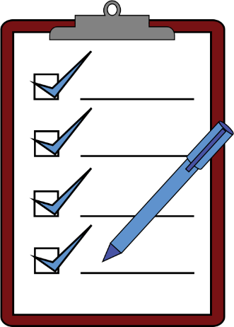
Make the right choice
Notes:
Notes for Teacher - < Information for further reference or explanation >
Suggestions: <Ideas/ Images/ Animations / Others – To make better representation of the content >
Source of Multimedia used in this slide - <Please provide source URL where we find the image and the license agreement>
Smile – https://openclipart.org/detail/104083/smile-curioso
Traffic Light – https://openclipart.org/detail/143287/traffic-light-v
Tick mark – https://openclipart.org/detail/285265/ok
Checklist pad – https://openclipart.org/detail/289225/clipboard-check

Slide 2
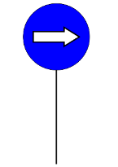
Homonyms - Concept
Homonyms are words that have different meanings but are pronounced or spelled the same.
Choose the right word at the right place.
We must choose the right and best thing and act accordingly.
Notes:
Notes for Teacher - < Information for further reference or explanation >
Suggestions: <Ideas/ Images/ Animations / Others – To make better representation of the content >
Source of Multimedia used in this slide - <Please provide source URL where we find the image and the license agreement>
Clover - https://openclipart.org/detail/282330/four-leaf-clover-vectorized
Thumbs Up – https://openclipart.org/detail/148843/thumbs-up
Right arrow - https://openclipart.org/detail/251865/signal-2

Slide 3
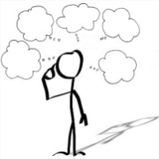
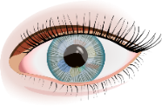
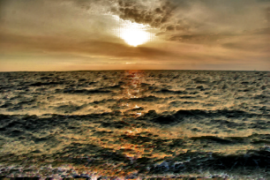
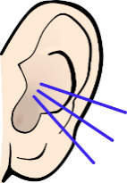
Homonyms - Activity
1. Always ______ (see/sea) good in others.
(When we always see the good in others, it brings happiness to us.)
2. Always ______ (hear/here) only what is true.
(It is better not to listen to people who spread untruth and gossip about others.)
see
hear
Choose the right word & click for answer
Notes:
Notes for Teacher - < Information for further reference or explanation >
Suggestions: <Ideas/ Images/ Animations / Others – To make better representation of the content >
Source of Multimedia used in this slide - <Please provide source URL where we find the image and the license agreement>
Clover - https://openclipart.org/detail/282330/four-leaf-clover-vectorized
Lost in thought - https://openclipart.org/image/400px/263006
Eye –https://openclipart.org/detail/317143/eye-17
Sea – https://openclipart.org/detail/268812/surreal-sea-sunset,
Ear –https://openclipart.org/detail/204865/listening-colored

Slide 4
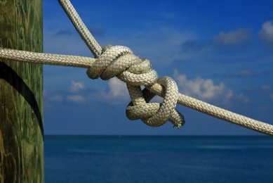
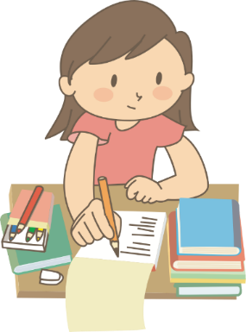
Homonyms - Activity
3. Do____ (knot/not) eat unhealthy food.
(Eating unhealthy food affects both mind and body.)
4. Always do what is _______. (write/right)
(By doing the right things we attract the right people in our lives.)
not
right
Choose the right word & click for answer
Notes:
Notes for Teacher - < Information for further reference or explanation >
Suggestions: <Ideas/ Images/ Animations / Others – To make better representation of the content >
Source of Multimedia used in this slide - <Please provide source URL where we find the image and the license agreement>
Clover - https://openclipart.org/detail/282330/four-leaf-clover-vectorized
Lost in thought - https://openclipart.org/image/400px/263006
Write –https:// /openclipart.org/detail/325744/girl-doing-homework
Right –https://openclipart.org/detail/295112/check-mark

Slide 5
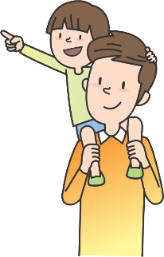
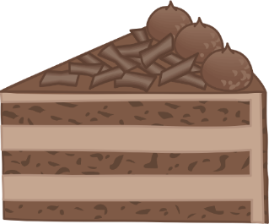
Homonyms - Activity
5. The ______ (sun/son) gives light to all selflessly.
(The sun teaches us to help others without expecting anything in return.)
6. A dove is the symbol of ______.(peace/piece)
(When we respect and love each other in spite of many differences, we live in peace.)
sun
peace
Choose the right word & click for answer
Notes:
Notes for Teacher - < Information for further reference or explanation >
Suggestions: <Ideas/ Images/ Animations / Others – To make better representation of the content >
Source of Multimedia used in this slide - <Please provide source URL where we find the image and the license agreement>
Clover - https://openclipart.org/detail/282330/four-leaf-clover-vectorized
Lost in thought - https://openclipart.org/image/400px/263006
Sun – https://openclipart.org/detail/302656/cool-sun
Son – https://openclipart.org/detail/313721/fun-with-dad-2
Piece –https://openclipart.org/detail/298464/piece-of-cake-2
Peace –https:// openclipart.org/detail/298646/peace-dove-2

Slide 6
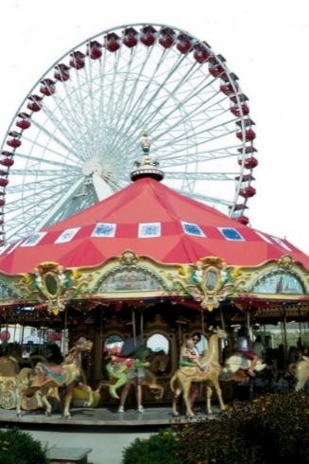
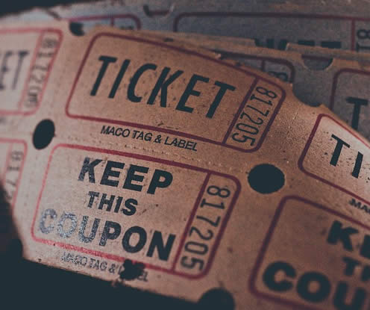
Homonyms - Activity
7. Rohan always plays a_______ (fair/fare) game.
(When we are fair in our life, people will respect and trust us.)
fair
Choose the right word & click for answer
Notes:
Notes for Teacher - < Information for further reference or explanation >
Suggestions: <Ideas/ Images/ Animations / Others – To make better representation of the content >
Source of Multimedia used in this slide - <Please provide source URL where we find the image and the license agreement>
Clover - https://openclipart.org/detail/282330/four-leaf-clover-vectorized
Lost in thought - https://openclipart.org/image/400px/263006
Fair –https://www.dreamstime.com/carousel-ferris-wheel-public-domain-image-free-84968480 | Lisa Ann Yount | Flickr (Public Domain) Uploaded on April 20, 2016
Ticket – https://www.rawpixel.com/image/3338021/free-photo-image-theater-ticket-cc0 "Raffle tickets" is marked with CC0 1.0.

Slide 7
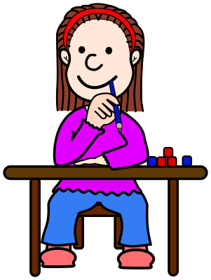
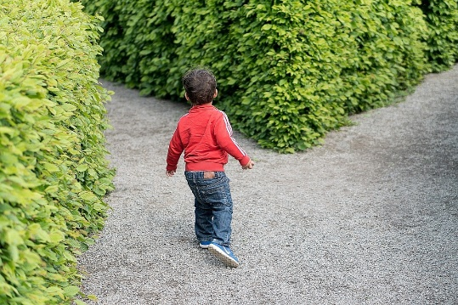
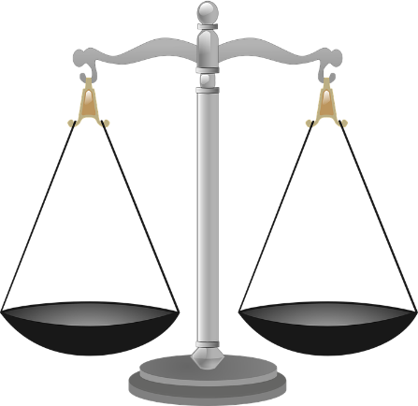
Points to Reflect
We should always:
think before we act
choose wisely
do the right thing
Notes:
Notes for Teacher - < Information for further reference or explanation >
Suggestions: <Ideas/ Images/ Animations / Others – To make better representation of the content >
Source of Multimedia used in this slide - <Please provide source URL where we find the image and the license agreement>
Clover - https://openclipart.org/detail/282330/four-leaf-clover-vectorized
Comic-girl-tini-at-school - https://openclipart.org/image/400px/190242
Child - https://pixabay.com/photos/child-crossroad-kid-choice-1721906/
Scale - https://pixabay.com/vectors/scales-justice-scale-libra-balance-147219/

Slide 8
Attribution / Citation
Slide # | Thumbnail | Source link | Author
1 |  | Smile – https://openclipart.org/detail/104083/smile-curioso Traffic Light – https://openclipart.org/detail/143287/traffic-light-v Tick mark - openclipart.org/detail/285265/ok Checklist pad – https://openclipart.org/detail/289225/clipboard-check | Guerreiro TheByteMan hana_mr Mahua_Sarkar
2-7 |  | Clover - https://openclipart.org/detail/282330/four-leaf-clover-vectorized | Firkin
2 |  | Right arrow - https://openclipart.org/detail/251865/signal-2 Thumbs Up – https://openclipart.org/detail/148843/thumbs-up | sincrosergio Balex
3-6 |  | Lost in thought - https://openclipart.org/detail/300343/lostinthoughttransparent | by kevinolive
3 |  | Eye – https://openclipart.org/detail/317143/eye-17 Sea – https://openclipart.org/detail/268812/surreal-sea-sunset Ear – https://openclipart.org/detail/204865/listening-colored | oksmith GDJ frankes
4 |  | Knot –https://www.flickr.com/photos/56534467@N04/14605341837-"Knot" by gabepopa is licensed under CC BY 2.0 No sign –https://openclipart.org/detail/28690/nosign-x Write –https://openclipart.org/detail/325744/girl-doing-homework Right – https://openclipart.org/detail/295112/check-mark | gabepopa skotan oksmith oksmith
5 |  | Sun – https://openclipart.org/detail/302656/cool-sun Son – https://openclipart.org/detail/313721/fun-with-dad-2 Piece – https://openclipart.org/detail/298464/piece-of-cake-2 Peace –https://openclipart.org/detail/298646/peace-dove-2 | Firkin oksmith oksmith oksmith
6 |  | Fair –https://www.dreamstime.com/carousel-ferris-wheel-public-domain-image-free-84968480 | Lisa Ann Yount | Flickr (Public Domain) Uploaded on April 20, 2016 Ticket – https://www.rawpixel.com/image/3338021/free-photo-image-theater-ticket-cc0 "Raffle tickets" is marked with CC0 1.0. | Lisa Ann Yount
7 |  | Comic-girl-tini-at-school - https://openclipart.org/detail/190242/comic-girl-tini-at-school Child - https://pixabay.com/photos/child-crossroad-kid-choice-1721906/ Scale - https://pixabay.com/vectors/scales-justice-scale-libra-balance-147219/ | frankes qimono OpenClipart-Vectors
Notes:
Notes for Teacher - < Information for further reference or explanation >
Suggestions: <Ideas/ Images/ Animations / Others – To make better representation of the content >
Source of Multimedia used in this slide - <Please provide source URL where we find the image and the license agreement>

