Slide 1
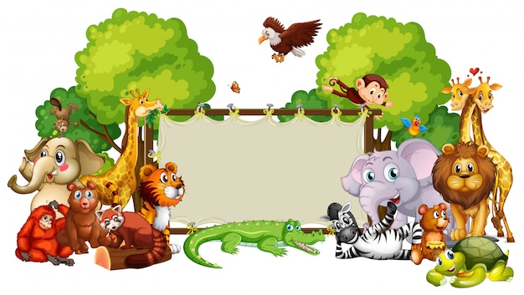
A Visit To The Zoo
Notes:
Notes for Teacher - < Information for further reference or explanation >
Suggestions: <Ideas/ Images/ Animations / Others – To make better representation of the content >
Source of Multimedia used in this slide - <Please provide source URL where we find the image and the license agreement>
Zoo : https://www.freepik.com/free-vector/border-template-with-cute-animals_6997467.htm#query=zoo%20kids&position=18&from_view=search&track=ais (brgfx)

Slide 2
Identity the homonyms
A VISIT TO THE ZOO
It was Saturday and my father took us to the zoo. We left home early. It was 9 a.m. by my watch when we reached the zoo. I asked my sister, “Can I carry my camera along?” She replied that photography was not allowed. Inside the zoo, I saw the giraffe from very close. Such a tall animal! As we turned left, I was surprised to see the peacock spreading its beautiful feathers. As it was sunny and hot, we bought a can of juice to drink. I could see the elephant swinging its trunk and was eager to watch the elephant show. But it was time for the zoo to close. So we sat under a large tree with a huge trunk to rest for a while. Then we returned home tired but happy.
Notes:
Notes for Teacher - The teacher may begin the class by drawing the attention of the students to the fact that Homonyms are commonly used in daily conversations. For better understanding the teacher may use the PPT or write the paragraph on the board (in the absence of AV facility) and call out students (a mix of active and passive) to identify the homonyms and explain their meanings in the given context.
Suggestions: <Ideas/ Images/ Animations / Others – To make better representation of the content >
Source of Multimedia used in this slide - <Please provide source URL where we find the image and the license agreement>
Father : https://www.freepik.com/free-vector/children-back-school-with-parents_9469571.htm#query=father%20child%20walking&position=12&from_view=search&track=ais (pikisuperstar)
Watch : https://www.freepik.com/free-vector/cartoon-character-sticker-with-sport-coach-boy-holding-timer_18607177.htm#query=boy%20wrist%20watch&position=2&from_view=keyword&track=ais (brgfx)
Sister : https://www.freepik.com/free-vector/girl-abused-by-other-kids_32478763.htm#page=2&query=brother%20and%20sister&position=1&from_view=search&track=ais (brgfx)
Boy : https://www.freepik.com/free-vector/two-boy-characters-with-happy-face_4955111.htm#query=smart%20boy&position=27&from_view=search&track=ais (brgfx)

Slide 3
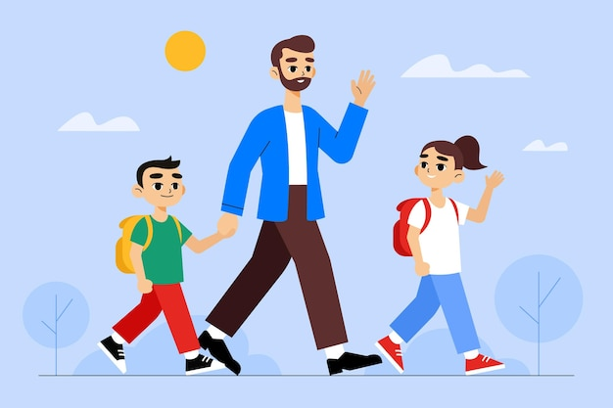
A Visit to the Zoo
It was Saturday and my father took us to the zoo. We left home early.
It was 9 a.m. by my watch when we reached the zoo.
I asked my sister, ”Can I carry my camera along?” She replied that photography was not allowed.
Notes:
Notes for Teacher - The teacher may begin the class by drawing the attention of the students to the fact that Homonyms are commonly used in daily conversations. For better understanding the teacher may use the PPT or write the paragraph on the board (in the absence of AV facility) and call out students (a mix of active and passive) to identify the homonyms and explain their meanings in the given context.
Suggestions: <Ideas/ Images/ Animations / Others – To make better representation of the content >
Source of Multimedia used in this slide - <Please provide source URL where we find the image and the license agreement>
Father : https://www.freepik.com/free-vector/children-back-school-with-parents_9469571.htm#query=father%20child%20walking&position=12&from_view=search&track=ais (pikisuperstar)
Watch : https://www.freepik.com/free-vector/cartoon-character-sticker-with-sport-coach-boy-holding-timer_18607177.htm#query=boy%20wrist%20watch&position=2&from_view=keyword&track=ais (brgfx)
Sister : https://www.freepik.com/free-vector/girl-abused-by-other-kids_32478763.htm#page=2&query=brother%20and%20sister&position=1&from_view=search&track=ais (brgfx)
Boy : https://www.freepik.com/free-vector/two-boy-characters-with-happy-face_4955111.htm#query=smart%20boy&position=27&from_view=search&track=ais (brgfx)

Slide 4
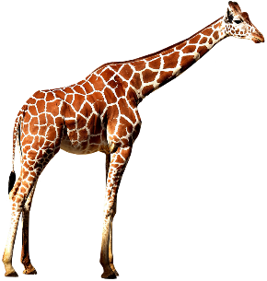
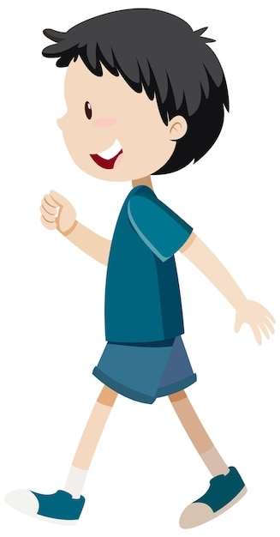
A Visit to the Zoo
Inside the zoo, I saw the giraffe from very close. Such a tall animal!
As we turned left, I was surprised to see the peacock spreading its beautiful feathers.
As it was sunny and hot, we bought a can of juice to drink.
Notes:
Notes for Teacher - < Information for further reference or explanation >
Suggestions: <Ideas/ Images/ Animations / Others – To make better representation of the content >
Source of Multimedia used in this slide - <Please provide source URL where we find the image and the license agreement>
Giraffe : https://pixabay.com/illustrations/giraffe-animal-savannah-africa-6328701/ ( pixabay)
Boy : https://www.freepik.com/free-vector/cartoon-people-looking-up-illustrated_14669670.htm#page=4&query=boy%20looking%20up&position=0&from_view=search&track=ais (pikisuperstar)
Boy : https://www.freepik.com/free-vector/active-boy-simple-cartoon-character_26160930.htm#query=child%20looking%20up&position=9&from_view=search&track=ais (brgfx)
Peacock : https://pixabay.com/vectors/peacock-peafowl-peachick-bird-154128/ (OpenClipart-Vectors)
Can : https://www.freepik.com/free-vector/flat-background-with-orange-juice_1113827.htm#page=2&query=water%20juice&position=3&from_view=search&track=ais (freepik)

Slide 5
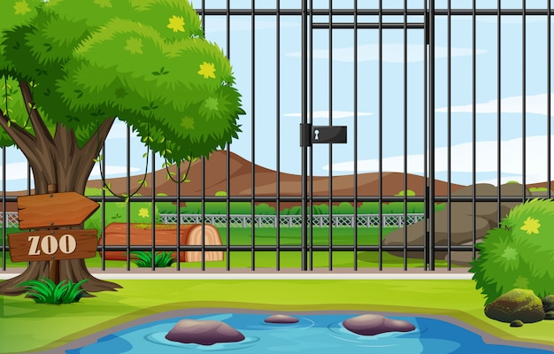
A Visit to the Zoo
I could see the elephant swinging its trunk and was eager to watch the elephant show.
But it was time for the zoo to close.
Notes:
Notes for Teacher - < Information for further reference or explanation >
Suggestions: <Ideas/ Images/ Animations / Others – To make better representation of the content >
Source of Multimedia used in this slide - <Please provide source URL where we find the image and the license agreement>
Elephant : https://www.freepik.com/free-vector/wild-animals-set-with-nature-elements_29094782.htm#query=elephant%20trunk&position=3&from_view=search&track=ais (brgfx)
Zoo : https://www.freepik.com/free-vector/background-scene-zoo-park-with-cage_6105121.htm#query=zoo%20gate&position=40&from_view=search&track=ais (brgfx)

Slide 6
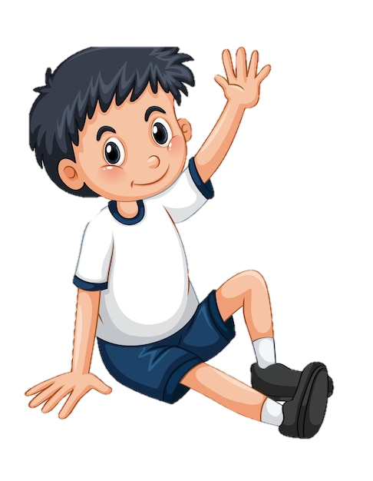
A Visit to the Zoo
So we sat under a large tree with a huge trunk to rest for a while. Then we returned home tired but happy.
Notes:
Notes for Teacher - The teacher may encourage students to come up with more familiar homonyms and help them relate to the use in daily conversations.
Suggestions: <Ideas/ Images/ Animations / Others – To make better representation of the content >
Source of Multimedia used in this slide - <Please provide source URL where we find the image and the license agreement>
Tree : https://www.freepik.com/free-vector/isolated-tree-white-background_4115846.htm#query=tree%20trunk&position=9&from_view=keyword&track=ais (brgfx)
Boy : https://www.freepik.com/free-vector/sticker-template-with-boy-sitting-pose-isolated_16845484.htm#query=boy%20sitting&position=48&from_view=search&track=ais (brgfx)

Slide 7
Attribution / Citation
Slide # | Thumbnail | Source link | Author
1 |  | Zoo : https://www.freepik.com/free-vector/border-template-with-cute-animals_6997467.htm#query=zoo%20kids&position=18&from_view=search&track=ais (brgfx) | brgfx
2,4 |  | Father : https://www.freepik.com/free-vector/children-back-school-with-parents_9469571.htm#query=father%20child%20walking&position=12&from_view=search&track=ais (pikisuperstar) Watch : https://www.freepik.com/free-vector/cartoon-character-sticker-with-sport-coach-boy-holding-timer_18607177.htm#query=boy%20wrist%20watch&position=2&from_view=keyword&track=ais (brgfx) Sister : https://www.freepik.com/free-vector/girl-abused-by-other-kids_32478763.htm#page=2&query=brother%20and%20sister&position=1&from_view=search&track=ais (brgfx) Boy : https://www.freepik.com/free-vector/two-boy-characters-with-happy-face_4955111.htm#query=smart%20boy&position=27&from_view=search&track=ais (brgfx) | pikisuperstar) brgfx brgfx brgfx
3 |  | Giraffe : https://pixabay.com/illustrations/giraffe-animal-savannah-africa-6328701/ ( pixabay) Boy : https://www.freepik.com/free-vector/cartoon-people-looking-up-illustrated_14669670.htm#page=4&query=boy%20looking%20up&position=0&from_view=search&track=ais (pikisuperstar) Boy : https://www.freepik.com/free-vector/active-boy-simple-cartoon-character_26160930.htm#query=child%20looking%20up&position=9&from_view=search&track=ais (brgfx) Peacock : https://pixabay.com/vectors/peacock-peafowl-peachick-bird-154128/ (OpenClipart-Vectors) Can : https://www.freepik.com/free-vector/flat-background-with-orange-juice_1113827.htm#page=2&query=water%20juice&position=3&from_view=search&track=ais (freepik | Pixabay pikisuperstar) brgfx OpenClipart-Vectors) freepik
4 |  | Elephant : https://www.freepik.com/free-vector/wild-animals-set-with-nature-elements_29094782.htm#query=elephant%20trunk&position=3&from_view=search&track=ais (brgfx) Zoo : https://www.freepik.com/free-vector/background-scene-zoo-park-with-cage_6105121.htm#query=zoo%20gate&position=40&from_view=search&track=ais (brgfx) | brgfx brgfx
5 |  | Tree : https://www.freepik.com/free-vector/isolated-tree-white-background_4115846.htm#query=tree%20trunk&position=9&from_view=keyword&track=ais (brgfx) Boy : https://www.freepik.com/free-vector/sticker-template-with-boy-sitting-pose-isolated_16845484.htm#query=boy%20sitting&position=48&from_view=search&track=ais (brgfx) | brgfx brgfx
Notes:
Notes for Teacher - < Information for further reference or explanation >
Suggestions: <Ideas/ Images/ Animations / Others – To make better representation of the content >
Source of Multimedia used in this slide - <Please provide source URL where we find the image and the license agreement>

