Slide 1
Test time for Homonyms
Notes:
Notes for Teacher - < Information for further reference or explanation >
Suggestions: <Ideas/ Images/ Animations / Others – To make better representation of the content >
Source of Multimedia used in this slide - <Please provide source URL where we find the image and the license agreement>

Slide 2
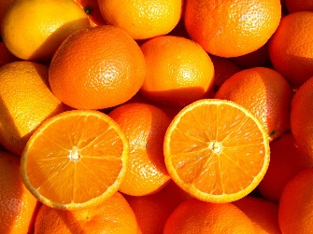
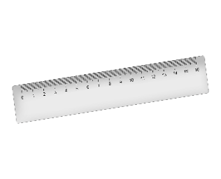
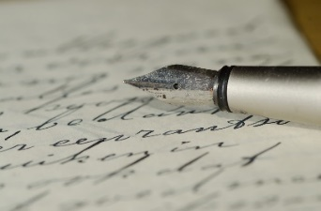
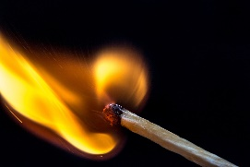
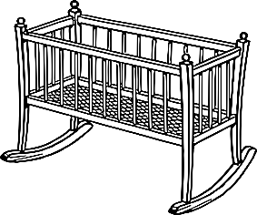
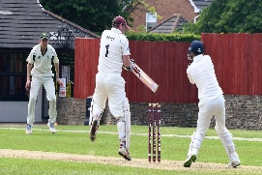
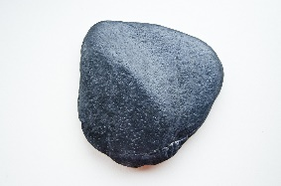
Test 1
For each homonym in column A, find the correct meaning from each of column B and Column C.
 | Column A |  | Column B |  | Column C
1 | Orange | a | India won against England in cricket. | P | A king is also called this.
2 | Ruler | b | The juice of this fruit is rich in vitamin C. | Q | To light a fire you will need this stick.
3 | Letter | c | You have to do this to the cradle to put the baby asleep. | R | A solid mass made up of minerals.
4 | Match | d | It is used to measure length or draw a line. | S | This fruit has the same colour as its name.
5 | Rock | e | There are 26 of these in the English language. | T | People do not write these anymore to friends or relatives.
b,S
d,P
e,T
a,Q
c,R
Answers on Click
Notes:
Notes for Teacher - < Information for further reference or explanation >
Suggestions: <Ideas/ Images/ Animations / Others – To make better representation of the content >
Source of Multimedia used in this slide - <Please provide source URL where we find the image and the license agreement>

Slide 3
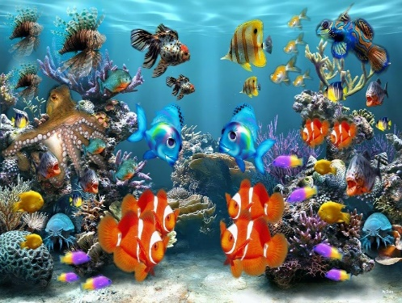
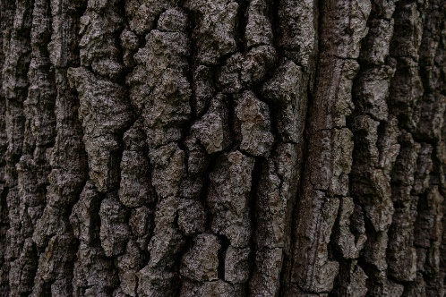
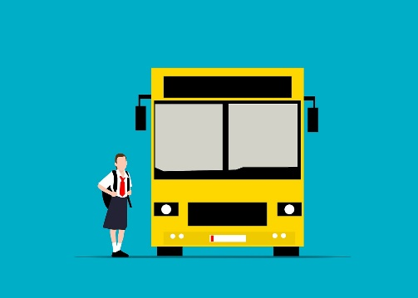
Test 2
Choose the correct homonym from the list given.
drop | board | saw | tie | sink
book | school | beat | bark | rose
1.a. I go to _________ five days a week.
1.b A ________ of fish.
2.a. The dog doesn't _____ at strangers.
2.b. The tree has a thick _______.
3.a. The teacher writes on the black_______.
3.b. I will _______ the bus in ten minutes.
school
school
bark
bark
board
board
Answers on Click
Notes:
Notes for Teacher - < Information for further reference or explanation >
Suggestions: <Ideas/ Images/ Animations / Others – To make better representation of the content >
Source of Multimedia used in this slide - <Please provide source URL where we find the image and the license agreement>

Slide 4
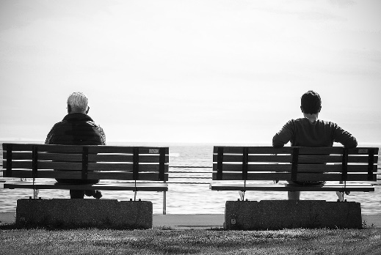
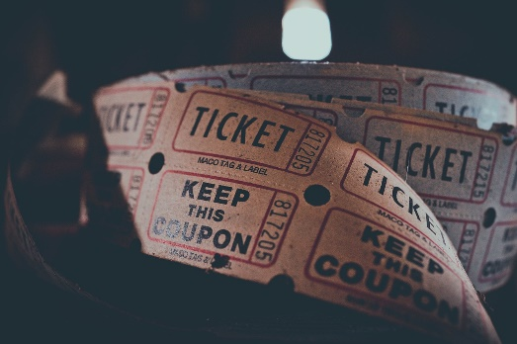
Test 2
Choose the correct homonym from the list given.
drop | board | saw | tie | sink
book | school | beat | bark | rose
4.a. I gave a red ______ to my teacher.
4.b. She _____ and gave a seat to the old man.
5.a.My friend gave me a ________ to read.
5.b. I went to the railway station to ______ the tickets.
rose
rose
book
book
Answers on Click
Notes:
Notes for Teacher - < Information for further reference or explanation >
Suggestions: <Ideas/ Images/ Animations / Others – To make better representation of the content >
Source of Multimedia used in this slide - <Please provide source URL where we find the image and the license agreement>

Slide 5
Attribution / Citation
Slide # | Thumbnail | Source link | Author
2 |  | <orange> https://pixabay.com/photos/orange-fruit-orange-color-697268/ <ruler> https://pixabay.com/illustrations/ruler-school-supplies-6940898/ <letter> https://pixabay.com/photos/fountain-pen-letter-handwriting-447576/ <matchstick> https://pixabay.com/photos/fire-match-light-flame-burn-macro-1492098/ <cricket> <https://pixabay.com/photos/cricket-batsman-cricketer-player-4297916/> <cradle> <https://pixabay.com/vectors/baby-bed-cradle-infant-rocker-2027212/> <rock> <https://pixabay.com/photos/rock-stone-nature-pebble-black-603965/> | ArmbrustAnna frau_schatzkist Andrys Harutmovsisyan Shauking OpenClipart-Vector BRRT
3 |  | <school> <https://pixabay.com/illustrations/school-building-school-building-7408262/> <fishes> https://pixabay.com/illustrations/aquarium-fish-fish-tank-sea-life-284551/ <dog> <https://pixabay.com/illustrations/dog-cartoon-fido-brown-art-fun-163527/> <bark of tree> <https://pixabay.com/photos/bark-tree-tree-bark-nature-7384291/> <black board> https://pixabay.com/vectors/blackboard-school-chalkboard-1295632/ <bus> <https://pixabay.com/illustrations/school-bus-student-transportation-7340076/> | RosZie AzDude No-longer-here Eplv OpenClipart-Vector Mohamed_hassan
4 |  | <bench> <https://pixabay.com/photos/bench-resting-sitting-wait-waiting-1839287/> <rose> https://pixabay.com/vectors/rose-flower-love-romantic-31411/ <book> <https://pixabay.com/illustrations/book-reading-read-coffee-knowledge-4155805/> <ticket> <https://pixabay.com/photos/ticket-coupon-admission-carnival-2974645/> | Pexels Clker-Free-Vector-Images Katillustrationlondon igorovsyannykov
COPYRIGHT Cum DISCLAIMER NOTICE
Content owned by Sri Sathya Sai Central Trust, Prashanthi Nilayam, Puttaparthi, Sathya Sai District, Andhra Pradesh, India.
Strictly not for Commercial Use, excluding content that falls in Public Domain or common knowledge facts.
Content can be downloaded and used for personal, educational, informational and other non-commercial purposes, subject to attribution in the name of ‘Sri Sathya Sai Central Trust, Prashanthi Nilayam, Puttaparthi’ only. Any attempt to remove, alter, circumvent, or distort the data that is accessed is illegal and strictly prohibited.
Some of the content is owned by Third Parties and are used in compliance with their licensing conditions. Anyone infringing the Copyright of such Third Parties will be doing so at their own risks and costs.
Notes:
Notes for Teacher - < Information for further reference or explanation >
Suggestions: <Ideas/ Images/ Animations / Others – To make better representation of the content >
Source of Multimedia used in this slide - <Please provide source URL where we find the image and the license agreement>

