Slide 1
Possession
Possessive Pronouns
His
Notes:
Notes for Teacher - < Information for further reference or explanation >
Suggestions: <Ideas/ Images/ Animations / Others – To make better representation of the content >
Source of Multimedia used in this slide - <Please provide source URL where we find the image and the license agreement>

Slide 2
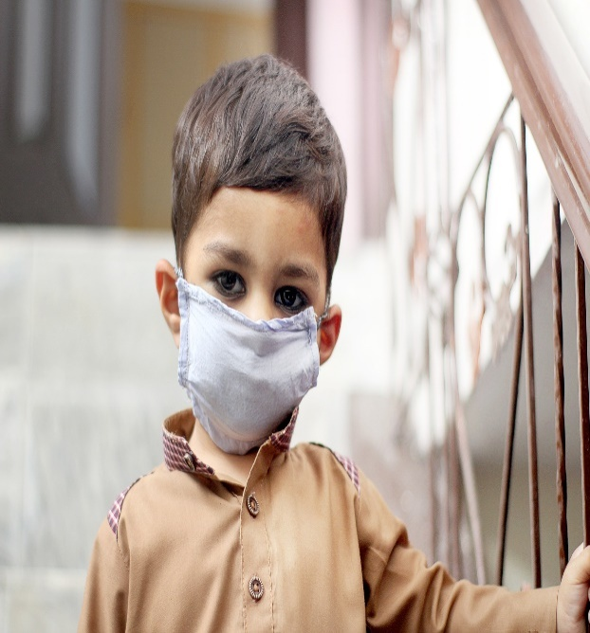
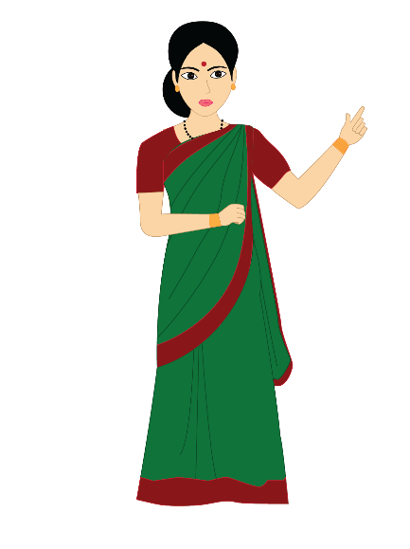
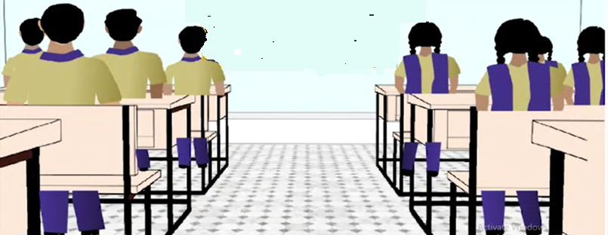
Possessive Pronouns
Look at this boy. What is he wearing?
Whose mask is it?
He is wearing a mask.
It is his mask.
Notes:
Source of Multimedia used in this slide -
Classroom: SSSVV Gallery
Teacher: SSSVV Gallery
Blackboard: https://pixabay.com/illustrations/chalkboard-background-decorative-517818/

Slide 3
Possessive Pronouns
Do you agree that the mask belongs to him?
In other words, the mask is ……
Yes, teacher.
‘His’
Notes:
Source of Multimedia used in this slide -
Classroom: SSSVV Gallery
Teacher: SSSVV Gallery
Blackboard: https://pixabay.com/illustrations/chalkboard-background-decorative-517818/

Slide 4
Possessive Pronouns
What is the other way of saying that it belongs to him?
He ‘possesses’ it
Notes:
Source of Multimedia used in this slide -
Classroom: SSSVV Gallery
Teacher: SSSVV Gallery
Blackboard: https://pixabay.com/illustrations/chalkboard-background-decorative-517818/

Slide 5
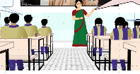
MM Index
Slide # | Thumbnail | Source link and Attribution
2,3,4 |  | https://pixabay.com/photos/little-boy-mask-face-mask-5637245/
2,3,4 |  | Class - SSSVV Gallery
2,3,4 |  | Teacher - SSSSVV Gallery
Notes:
Notes for Teacher - < Information for further reference or explanation >
Suggestions: <Ideas/ Images/ Animations / Others – To make better representation of the content >
Source of Multimedia used in this slide - <Please provide source URL where we find the image and the license agreement>

