Slide 1
Possessive Pronouns
Notes:
Notes for Teacher - Not applicable
Suggestions: Not applicable
Source of Multimedia used in this slide - Not applicable

Slide 2
Let’s Answer!
mine
I am Arjun. This cap is _____.
Click for answer
Notes:
Notes for Teacher – Not applicable
Suggestions: Not applicable
Source of Multimedia used in this slide - Teenager with baseball cap by vectorportal.com available at https://vectorportal.com/vector/teenager-with-baseball-cap.ai/31962

Slide 3
Let’s Answer!
his
He is Vinay. This bag is _____.
Click for answer
Notes:
Notes for Teacher – Not applicable
Suggestions: Not applicable
Source of Multimedia used in this slide - ‘Character Illustration’ by Yorkun Cheng available at https://iconscout.com/illustration/character-2671546

Slide 4
Let’s Answer!
She is my teacher. This desk is _____.
hers
Click for answer
Notes:
Notes for Teacher – Not applicable
Suggestions: Not applicable
Source of Multimedia used in this slide - Woman at desk by vectorportal.com available at https://vectorportal.com/vector/reception-desk-vector-clip-art/23988

Slide 5
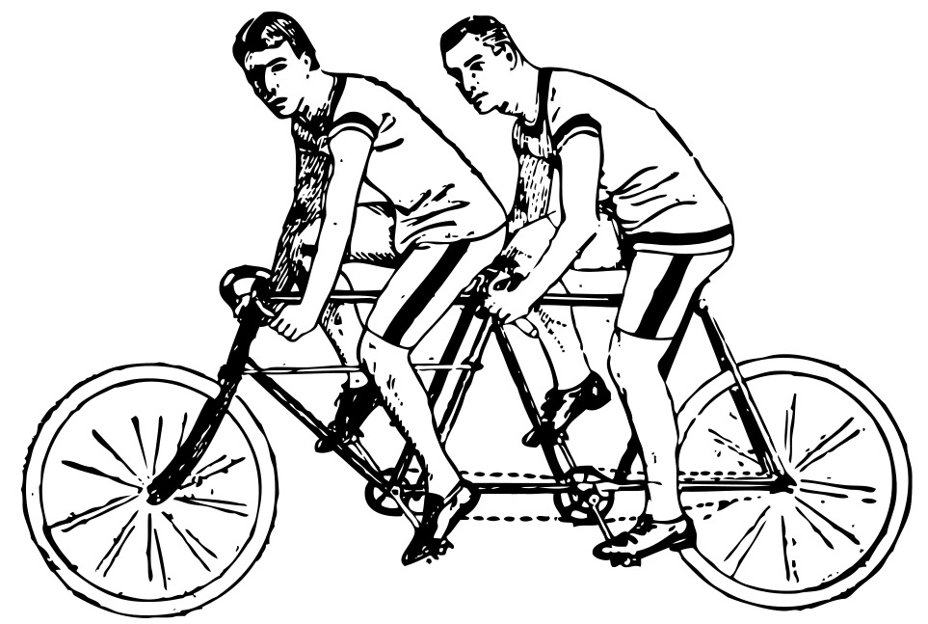
Let’s Answer!
ours
We are brothers. This bicycle is _____.
Click for answer
Notes:
Notes for Teacher – Not applicable
Suggestions: Not applicable
Source of Multimedia used in this slide - Boys on cycle available at https://freesvg.org/vector-clip-part-of-tandem-bike-riders

Slide 6
Let’s Answer!
yours
My pencil is broken. Can I borrow _____?
Click for answer
Notes:
Notes for Teacher – Not applicable
Suggestions: Not applicable
Source of Multimedia used in this slide - Broken pencil by vectorportal.com available at https://vectorportal.com/vector/broken-pencil/33442

Slide 7
Let’s Answer!
They are my aunt and uncle. That house is _____.
theirs
Click for answer
Notes:
Notes for Teacher – Not applicable
Suggestions: Not applicable
Source of Multimedia used in this slide -
Couple: https://www.freepik.com/free-vector/illustration-indian-family_26293114.htm By freepik
House: https://www.freepik.com/free-vector/two-storey-house-with-red-roof_5913341.htm By brgfx

Slide 8
Introduction
show that something
Possessive pronouns
belongs to someone
Notes:
Notes for Teacher – Not applicable
Suggestions: Not applicable
Source of Multimedia used in this slide - Not applicable

Slide 9
Possessive Pronouns
We use a possessive pronoun instead of the complete noun phrase to avoid repeating words.
E.g. This book is mine, not yours. (Sounds natural)
E.g. This book is my book, it is not your book. (Sounds repetitive)
Notes:
Notes for Teacher – Not applicable
Suggestions: Not applicable
Source of Multimedia used in this slide - Not applicable

Slide 10
Placement of Possessive Pronoun
A possessive pronoun is always placed at the end of a sentence.
Possessive Pronoun
Owner
Example
mine
the speaker/person talking
I bought this pen. It is mine.
yours
the person you are talking to
I think this book is yours. It has your name on it.
his
a boy / male
Gopi is playing with a ball. It is his.
hers
a girl / female
Rani wears a watch. It is hers.
ours
more than one owner including you
This TV is ours. We bought it yesterday.
theirs
more than one owner and you are not included
My uncle and aunt travel in a car. It is theirs.
Notes:
Notes for Teacher – Not applicable
Suggestions: Not applicable
Source of Multimedia used in this slide - Not applicable

Slide 11
Choose the Correct Answer
mine yours his hers ours theirs
his
1. Give this water bottle to Nakul. It is _____.
2. The Nayaks needed a water can, so we lent _____ to them.
ours
mine
Click for answers
3. I found your book but I can’t find _____.
theirs
4. My parents live in a farmhouse. It is _____.
yours
5. This scale has your name on it. Is it _____?
6. Give this pen to Latha. It is _____.
hers
Notes:
Notes for Teacher – Not applicable
Suggestions: Not applicable
Source of Multimedia used in this slide - Not applicable

Slide 12
Attribution / Citation
Slide # | Thumbnail | Source link | Author
2 |  | Teenager with baseball cap : https://vectorportal.com/vector/teenager-with-baseball-cap.ai/31962 | By vectorportal.com
3 |  | ‘Character Illustration’ : https://iconscout.com/illustration/character-2671546 | By Yorkun Cheng
4 |  | Woman at desk : https://vectorportal.com/vector/reception-desk-vector-clip-art/23988 | By vectorportal.com
5 |  | Boys : https://freesvg.org/vector-clip-part-of-tandem-bike-riders | By OpenClipart
6 |  | Broken pencil : https://vectorportal.com/vector/broken-pencil/33442 | By vectorportal.com
7 |  | Couple: https://www.freepik.com/free-vector/illustration-indian-family_26293114.htm House: https://www.freepik.com/free-vector/two-storey-house-with-red-roof_5913341.htm | By freepik By brgfx
Notes:
Notes for Teacher – N/A
Suggestions: N/A
Source of Multimedia used in this slide - N/A

