Slide 1
Whose Umbrella?
Notes:
Notes for Teacher - < Information for further reference or explanation >
Suggestions: <Ideas/ Images/ Animations / Others – To make better representation of the content >
Source of Multimedia used in this slide - <Please provide source URL where we find the image and the license agreement>
Umbrella : https://pixabay.com/illustrations/rain-umbrella-background-cloud-4391508/; Author: neotam

Slide 2
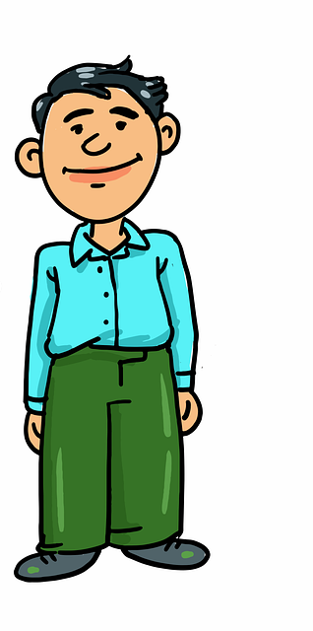
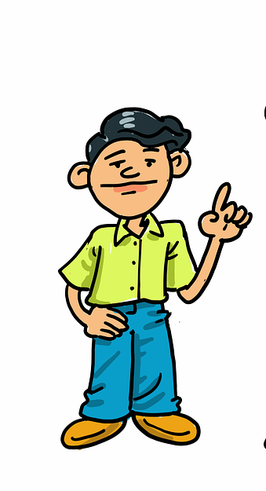
Father and Son Conversation - 1
Hey Lokesh! Mother and I need to go to the market. It is raining outside and I have a problem.
What’s that, father?
Lokesh
Father
Notes:
Notes for Teacher - < Information for further reference or explanation >
Suggestions: <Ideas/ Images/ Animations / Others – To make better representation of the content >
Source of Multimedia used in this slide - <Please provide source URL where we find the image and the license agreement>
Father and son : https://pixabay.com/vectors/cartoon-father-dad-happy-son-7041484/ Author: azmeyart-design

Slide 3
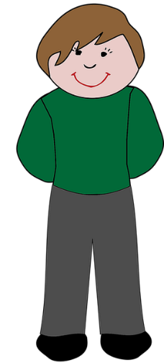
Father and Son Conversation - 2
We need an umbrella. We gave ______ to Surya uncle yesterday and he is not at home now. Can we use ______ ?
ours
Anil
yours
I gave ______to my friend Anil and he has gone for his tuition classes.
mine
Father
Lokesh
Notes:
Source of Multimedia used in this slide - <Please provide source URL where we find the image and the license agreement>
Father and son : https://pixabay.com/vectors/cartoon-father-dad-happy-son-7041484/ Author: azmeyart-design

Slide 4
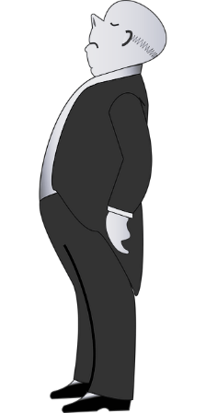
Father and Son Conversation - 3
Sister’s Umbrella
Oh! Ask Tulasi sister if she can give __________.
Rao Uncle
hers
Her umbrella will be too small for you. I shall ask Rao uncle if he can lend _______.
his
Tulasi
Lokesh
Father
Notes:
Source of Multimedia used in this slide - <Please provide source URL where we find the image and the license agreement>
Boy: https://pixabay.com/vectors/boy-cartoon-children-1296412/ Author: OpenClipart- Vectors
Girl: https://pixabay.com/vectors/cartoon-child-comic-2027156/ Author: OpenClipart –Vectors
Father and son : https://pixabay.com/vectors/cartoon-father-dad-happy-son-7041484/ Author: azmeyart-design

Slide 5
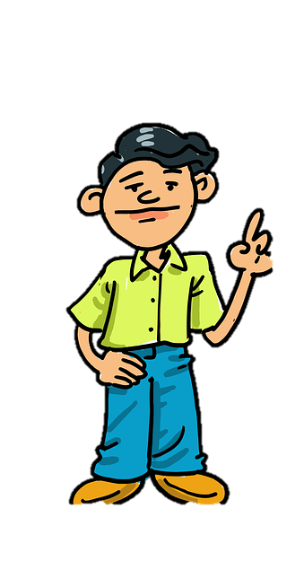
End of Conversation
Rao uncle is out of town. Could you go and ask the Patels if we can borrow _______?
Sure, father.
theirs
Lokesh
Father
Notes:
Source of Multimedia used in this slide - <Please provide source URL where we find the image and the license agreement>
Elderly Man: https://pixabay.com/vectors/cartoon-cold-comic-comic-characters-1300661/ Author : OpenClipart-Vector
Girl with Umbrella: https://pixabay.com/vectors/cartoon-girl-girls-puddle-rain-1296436/ Author: Openclipart-Vector
Father and son : https://pixabay.com/vectors/cartoon-father-dad-happy-son-7041484/ Author: azmeyart-design
Umbrella:

Slide 6
MM Index
Slide # | Thumbnail | Source link and Attribution
1 |  | Umbrella : https://pixabay.com/illustrations/rain-umbrella-background-cloud-4391508/; Author: neotam
2, 3, 4, 5 |  | Father and son : https://pixabay.com/vectors/cartoon-father-dad-happy-son-7041484/ Author: azmeyart-design
3 |  | Boy: https://pixabay.com/vectors/boy-cartoon-children-1296412/ Author: OpenClipart- Vectors
4 |  | Elderly Man: https://pixabay.com/vectors/cartoon-cold-comic-comic-characters-1300661/ Author : OpenClipart-Vector Girl with Umbrella: https://pixabay.com/vectors/cartoon-girl-girls-puddle-rain-1296436/ Author: Openclipart-Vector Girl: https://pixabay.com/vectors/cartoon-child-comic-2027156/ Author: OpenClipart -Vectors
Notes:
Notes for Teacher - < Information for further reference or explanation >
Suggestions: <Ideas/ Images/ Animations / Others – To make better representation of the content >
Source of Multimedia used in this slide - <Please provide source URL where we find the image and the license agreement>

