Slide 1
Possessive Adjectives
Use of Possessive adjectives
Possessive Adjectives With Examples
Notes:
Notes for Teacher - < Information for further reference or explanation >
Suggestions: <Ideas/ Images/ Animations / Others – To make better representation of the content >
Source of Multimedia used in this slide - <Please provide source URL where we find the image and the license agreement>
Teacher image - https://pixabay.com/id/illustrations/guru-sekolah-universitas-papan-1015630/

Slide 2
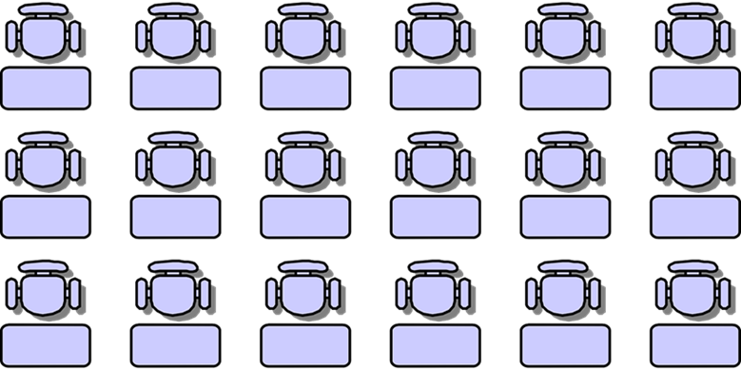
Possessive Pronoun and Possessive Adjective
This pen is mine.
This is my pen.
Notes:
Notes for Teacher - < Information for further reference or explanation >
Suggestions: <Ideas/ Images/ Animations / Others – To make better representation of the content >
Source of Multimedia used in this slide - <Please provide source URL where we find the image and the license agreement>
Teacher and Board - https://www.needpix.com/photo/download/846892/teacher-an-array-of-science-school-chalk-wooden-table-writing-education-equipment-class
Pen image - https://creazilla.com/nodes/3164082-pen-clipart , author - Clker-Free-Vector-Images

Slide 3
Possessive Pronoun and Possessive Adjective
This pen is mine.
This is my pen.
Both the sentences mean the same thing.
Mine
My
Possessive Pronoun
Shows ownership
Placed at the end of a sentence
Possessive Adjective
Also shows ownership
Placed before a noun in a sentence
Notes:
Notes for Teacher - < Information for further reference or explanation >
Suggestions: <Ideas/ Images/ Animations / Others – To make better representation of the content >
Source of Multimedia used in this slide - <Please provide source URL where we find the image and the license agreement>

Slide 4
Examples
Possessive Pronoun
Possessive Adjective
This is my pen.
This pen is mine.
Notes:
Notes for Teacher - < Information for further reference or explanation >
Suggestions: <Ideas/ Images/ Animations / Others – To make better representation of the content >
Source of Multimedia used in this slide - <Please provide source URL where we find the image and the license agreement>
3d man source - https://pixabay.com/illustrations/post-it-note-write-down-5033079/ , Author - Peggy_Marco
Kid face - https://pixabay.com/vectors/redhead-girl-face-ponytails-31106/ , Author - Clker-Free-Vector-Images

Slide 5
Examples
Possessive Pronoun
Possessive Adjective
Is this your book?
Is this book yours?
Notes:
Notes for Teacher - < Information for further reference or explanation >
Suggestions: <Ideas/ Images/ Animations / Others – To make better representation of the content >
Source of Multimedia used in this slide - <Please provide source URL where we find the image and the license agreement>
Book: SSSVV Image Gallery: Search Keyword “book”
Boy source - https://creazilla.com/nodes/3164874-boy-clipart , Author - Clker-Free-Vector-Images , attribution link - : Clker-Free-Vector-Images on Pixabay

Slide 6
Examples
Possessive Pronoun
Possessive Adjective
That is his ball.
That ball is his.
Notes:
Notes for Teacher - < Information for further reference or explanation >
Suggestions: <Ideas/ Images/ Animations / Others – To make better representation of the content >
Source of Multimedia used in this slide - <Please provide source URL where we find the image and the license agreement>
Ball: https://pixabay.com/vectors/cricket-ball-cricket-ball-sports-295206/
kid face - https://openclipart.org/detail/525/girl-face-cartoon , Author- Gerald_G

Slide 7
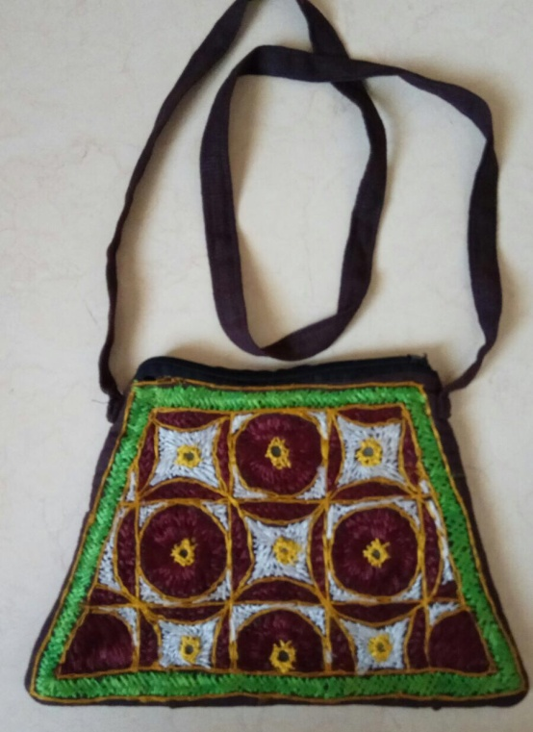
Examples
Possessive Pronoun
Possessive Adjective
This is her bag.
This bag is hers.
Notes:
Notes for Teacher - < Information for further reference or explanation >
Suggestions: <Ideas/ Images/ Animations / Others – To make better representation of the content >
Source of Multimedia used in this slide - <Please provide source URL where we find the image and the license agreement>
Bag: SSSVV Image Gallery: Search Keyword “bag”
Kid face - https://creazilla.com/nodes/7804652-face-clipart , Author - gahag.net

Slide 8
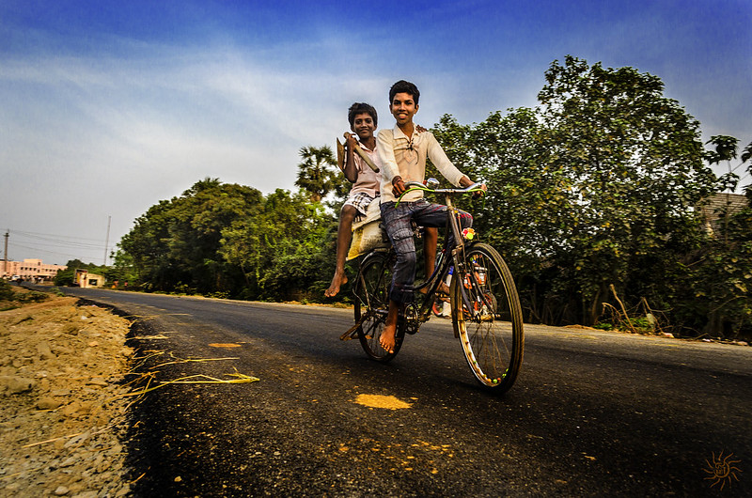
Examples
Possessive Pronoun
Possessive Adjective
This is our bicycle.
This bicycle is ours.
Notes:
Notes for Teacher - < Information for further reference or explanation >
Suggestions: <Ideas/ Images/ Animations / Others – To make better representation of the content >
Source of Multimedia used in this slide - <Please provide source URL where we find the image and the license agreement>
Bicycle: https://www.flickr.com/photos/76877832@N06/9170370727 By Ravisankar Pandian
kid face -https://pixabay.com/vectors/child-girls-women-s-woman-face-5191478/ , Author – D-HH

Slide 9
Examples
Possessive Pronoun
Possessive Adjective
That is their house.
That house is theirs.
Notes:
Notes for Teacher - < Information for further reference or explanation >
Suggestions: <Ideas/ Images/ Animations / Others – To make better representation of the content >
Source of Multimedia used in this slide - <Please provide source URL where we find the image and the license agreement>
Bicycle: SSSVV Image Gallery: Search Keyword “house”
kid face- https://www.needpix.com/photo/download/174137/boy-face-man-young-happy-person-male-people-child-kid-white-cheerful-happiness-joy-handsome-laughing-human-head-free-vector-graphics , Author - Clker-Free-Vector-Images (pixabay.com)

Slide 10
MM Index
Slide #zzzz | Thumbnail | Source link and Attribution
1 |  | Teacher image - https://pixabay.com/id/illustrations/guru-sekolah-universitas-papan-1015630/
2 |  | Teacher and Board - https://www.needpix.com/photo/download/846892/teacher-an-array-of-science-school-chalk-wooden-table-writing-education-equipment-class Student &Benches- https://pixabay.com/id/vectors/kelas-siswa-duduk-tiga-baris-36509/ , Author - Clker-Free-Vector-Images
4 |  | 3d man source - https://pixabay.com/illustrations/post-it-note-write-down-5033079/ , Author - Peggy_Marco Kid face - https://pixabay.com/vectors/redhead-girl-face-ponytails-31106/ , Author - Clker-Free-Vector-Image
5 |  | Boy source - https://creazilla.com/nodes/3164874-boy-clipart , Author - Clker-Free-Vector-Images , attribution link - : Clker-Free-Vector-Images on Pixabay
6 |  | Ball: https://pixabay.com/vectors/cricket-ball-cricket-ball-sports-295206/ Kid face - https://openclipart.org/detail/525/girl-face-cartoon , Author- Gerald_G
7 |  | Kid face - https://creazilla.com/nodes/7804652-face-clipart , Author - gahag.net
8 |  | Kid face -https://pixabay.com/vectors/child-girls-women-s-woman-face-5191478/ , Author – D-HH Bicycle: https://www.flickr.com/photos/76877832@N06/9170370727 By Ravisankar Pandian
9 |  | Kid face- https://www.needpix.com/photo/download/174137/boy-face-man-young-happy-person-male-people-child-kid-white-cheerful-happiness-joy-handsome-laughing-human-head-free-vector-graphics , Author - Clker-Free-Vector-Images (pixabay.com)
Notes:
Notes for Teacher - < Information for further reference or explanation >
Suggestions: <Ideas/ Images/ Animations / Others – To make better representation of the content >
Source of Multimedia used in this slide - <Please provide source URL where we find the image and the license agreement>

