Slide 1
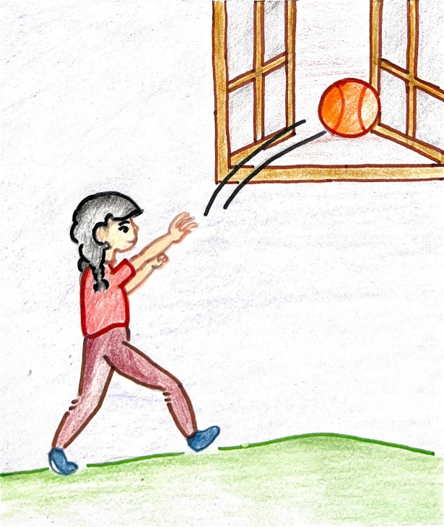
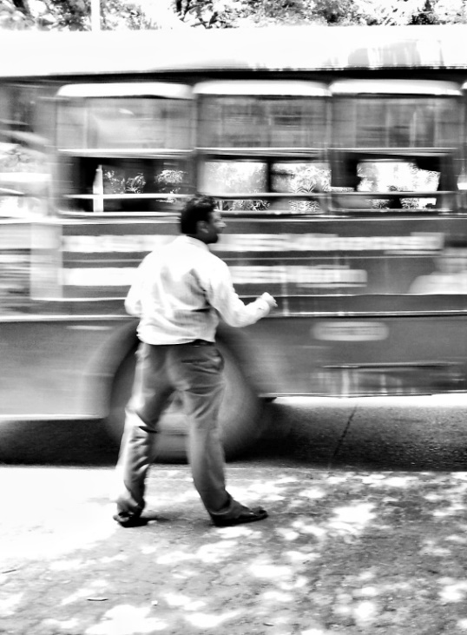
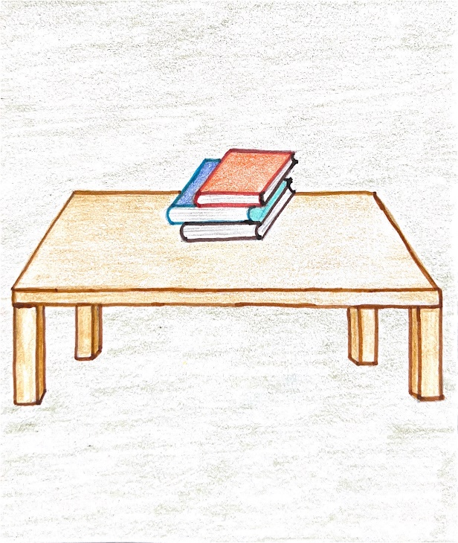
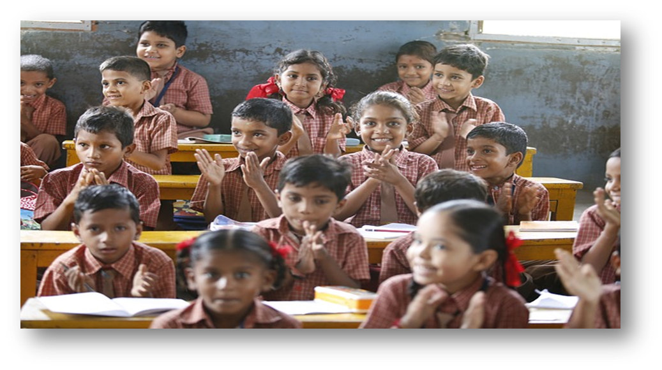
The Missing Prepositions
Notes:
Notes for Teacher: The teacher could use the following sample, incomplete sentences, to enable the students to complete them with as many answers as possible, before giving them the right answers. The sentences could be written on the blackboard or the PPT that is provided could be used. The following questions could be posed to probe the answers.
Suggestions: <Ideas/ Images/ Animations / Others – To make better representation of the content
Source of Multimedia used in this slide - <Please provide source URL where we find the image and the license agreement>
Basketball: https://drive.google.com/drive/folders/1CWLPk-BEA4bUNAAHyiIRxjza3n-44Jo1
Books: https://drive.google.com/drive/folders/1AM_sdladRZpz6OT2xBU-HJOp9yS4qCNw
Bus: https://www.flickr.com/photos/63173682@N04/14512134273 By abhijit chendvankar
Students: https://pixabay.com/photos/happy-children-education-876541/ By akshayapatra

Slide 2
Read the following sentence and tell if it is complete. (Click on one of the boxes)
Missing Preposition
Renu threw the ball the window
Yes, the sentence is complete
No, the sentence is incomplete
Can you complete the sentence?
Sample Answer: Renu threw the ball through/out of the window.
Notes:
Notes for Teacher - < Information for further reference or explanation >
Suggestions: <Ideas/ Images/ Animations / Others – To make better representation of the content >
Source of Multimedia used in this slide - <Please provide source URL where we find the image and the license agreement>
Basketball: https://drive.google.com/drive/folders/1CWLPk-BEA4bUNAAHyiIRxjza3n-44Jo1
Wrong: https://pixabay.com/vectors/incorrect-delete-remove-cancel-red-294245/ By Clker-Free-Vector-Images
Right: https://pixabay.com/vectors/check-correct-mark-right-choice-40319/ By Clker-Free-Vector-Images

Slide 3
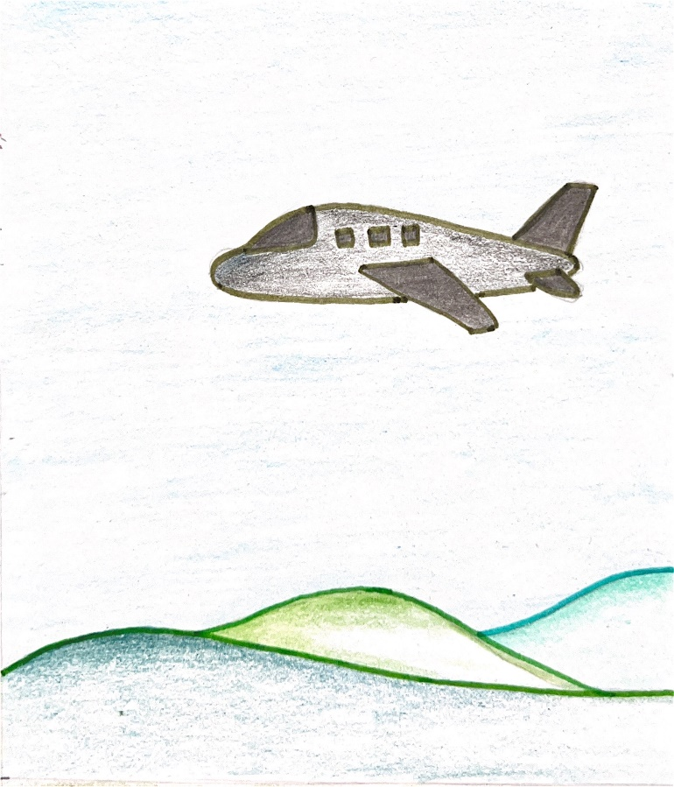
Read the following sentence and tell if it is complete. (Click on one of the boxes)
Missing Preposition
The aeroplane flew the hills
Yes, the sentence is complete
No, the sentence is incomplete
Can you complete the sentence?
Sample Answer: The aeroplane flew over the hills.
Notes:
Notes for Teacher - < Information for further reference or explanation >
Suggestions: <Ideas/ Images/ Animations / Others – To make better representation of the content >
Source of Multimedia used in this slide - <Please provide source URL where we find the image and the license agreement>
Aeroplane: https://drive.google.com/drive/folders/1ctViPTyCAuHD0QRXe3fW-WpSubI6WstH
Wrong: https://pixabay.com/vectors/incorrect-delete-remove-cancel-red-294245/ By Clker-Free-Vector-Images
Right: https://pixabay.com/vectors/check-correct-mark-right-choice-40319/ By Clker-Free-Vector-Images

Slide 4
Read the following sentence and tell if it is complete. (Click on one of the boxes)
Missing Preposition
He is waiting the bus stop
Yes, the sentence is complete
No, the sentence is incomplete
Can you complete the sentence?
Sample Answer: He is waiting at the bus stop.
Notes:
Notes for Teacher - < Information for further reference or explanation >
Suggestions: <Ideas/ Images/ Animations / Others – To make better representation of the content >
Source of Multimedia used in this slide - <Please provide source URL where we find the image and the license agreement>
Bus stop: https://www.flickr.com/photos/63173682@N04/14512134273 By abhijit chendvankar
Wrong: https://pixabay.com/vectors/incorrect-delete-remove-cancel-red-294245/ By Clker-Free-Vector-Images
Right: https://pixabay.com/vectors/check-correct-mark-right-choice-40319/ By Clker-Free-Vector-Images

Slide 5
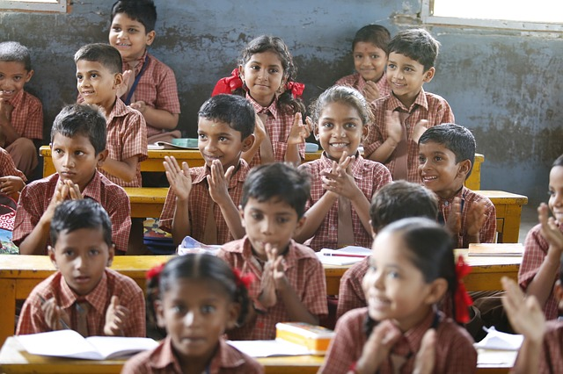
Read the following sentence and tell if it is complete. (Click on one of the boxes)
Missing Preposition
We are sitting the classroom
Yes, the sentence is complete
No, the sentence is incomplete
Can you complete the sentence?
Sample Answer: We are sitting in the classroom.
Notes:
Notes for Teacher - < Information for further reference or explanation >
Suggestions: <Ideas/ Images/ Animations / Others – To make better representation of the content >
Source of Multimedia used in this slide - <Please provide source URL where we find the image and the license agreement>
Classroom: https://pixabay.com/photos/happy-children-education-876541/ By akshayapatra
Wrong: https://pixabay.com/vectors/incorrect-delete-remove-cancel-red-294245/ By Clker-Free-Vector-Images
Right: https://pixabay.com/vectors/check-correct-mark-right-choice-40319/ By Clker-Free-Vector-Images

Slide 6
Read the following sentence and tell if it is complete. (Click on one of the boxes)
Missing Preposition
The books are the table
Yes, the sentence is complete
No, the sentence is incomplete
Can you complete the sentence?
Sample Answer: The books are on the table.
Notes:
Notes for Teacher - < Information for further reference or explanation >
Suggestions: <Ideas/ Images/ Animations / Others – To make better representation of the content >
Source of Multimedia used in this slide - <Please provide source URL where we find the image and the license agreement>
Books: https://drive.google.com/drive/folders/1AM_sdladRZpz6OT2xBU-HJOp9yS4qCNw
Wrong: https://pixabay.com/vectors/incorrect-delete-remove-cancel-red-294245/ By Clker-Free-Vector-Images
Right: https://pixabay.com/vectors/check-correct-mark-right-choice-40319/ By Clker-Free-Vector-Images

Slide 7
The Missing words are called …..
Prepositions
‘Prepositions’ show the relationship of one noun in the sentence to the other noun or pronoun.
‘Prepositions’ are words that tell us about the position of a noun with reference to another noun or pronoun in a sentence.
Notes:
Notes for Teacher - At this point of discussion, the teacher need not emphasise on the right answers. The whole point is to make the students think and answer confidently. The teacher could conclude by saying that the missing words are called ‘Prepositions’ as they show the relationship of one noun in the sentence to the other noun or pronoun.
Suggestions: <Ideas/ Images/ Animations / Others – To make better representation of the content >
Source of Multimedia used in this slide - <Please provide source URL where we find the image and the license agreement>

Slide 8
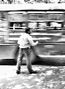
MM Index
Slide # | Thumbnail | Source link and Attribution
1. |  | Basketball: https://drive.google.com/drive/folders/1CWLPk-BEA4bUNAAHyiIRxjza3n-44Jo1 Books: https://drive.google.com/drive/folders/1AM_sdladRZpz6OT2xBU-HJOp9yS4qCNw Bus: https://www.flickr.com/photos/63173682@N04/14512134273 By abhijit chendvankar Students: https://pixabay.com/photos/happy-children-education-876541/ By akshayapatra
2. |  | Basketball: https://drive.google.com/drive/folders/1CWLPk-BEA4bUNAAHyiIRxjza3n-44Jo1
3. |  | Aeroplane: https://drive.google.com/drive/folders/1ctViPTyCAuHD0QRXe3fW-WpSubI6WstH
4. |  | https://www.flickr.com/photos/63173682@N04/14512134273 By abhijit chendvankar
5. |  | https://pixabay.com/photos/happy-children-education-876541/ By akshayapatra
6. |  | Books: https://drive.google.com/drive/folders/1AM_sdladRZpz6OT2xBU-HJOp9yS4qCNw
2,3,4,5,6 |  | Wrong: https://pixabay.com/vectors/incorrect-delete-remove-cancel-red-294245/ By Clker-Free-Vector-Images Right: https://pixabay.com/vectors/check-correct-mark-right-choice-40319/ By Clker-Free-Vector-Images
Notes:
Notes for Teacher - < Information for further reference or explanation >
Suggestions: <Ideas/ Images/ Animations / OtherSource of Multimedia used in this slide - <Please provide source URL where we find the image and the license agreement>

