Slide 1
More About Prepositions
Notes:
Notes for Teacher - N/A
Suggestions: N/A
Source of Multimedia used in this slide -
Title - https://www.freepik.com/free-vector/golden-halftone-rectangle-frame-background_17565220.htm (Attribution – starline)
Background:

Slide 2
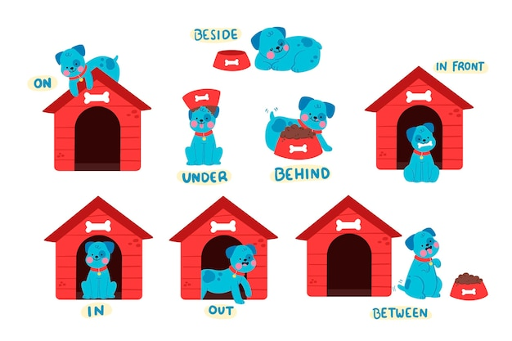
Preposition
What is a Preposition?
A preposition is a word or a group of words that shows a relationship between a noun or a pronoun with another word in a sentence.
Notes:
Notes for Teacher - < Information for further reference or explanation >
Teaching Learning Material (TLM): An object
What do you need? An object like a ball, a toy, a bag, or a fruit:
Get Ready: The teacher brings an object mentioned above, to class, on the day this topic is introduced.
Notes to the teacher: The teacher could begin the class by bringing an object mentioned above. She/he then places the object in different places. Some sample questions that could be asked are as follows-
Where is the ball? (The teacher places the ball on the table.Likewise the ball could be held behind, above, beside, in front of her and so on and the responses could be recorded on the board. Children should be encouraged to answer in complete sentences.)
The ball is on the table.
The ball is under the table.
When do you wake up in the morning? I wake up at 6 in the morning.
When does it generally rain here? It always rains in July here.
The teacher could ask a student to go out of the classroom and enter again.
Where did Rakesh go? Rakesh went out of the classroom.
From where did he enter the classroom? He entered the classroom through the door.
Through these examples the teacher could introduce the prepositions that indicate place, time and movement and reinforce the topic through a graphic organiser or the PPT provided.
Suggestions: N/A
Source of Multimedia used in this slide -
https://www.freepik.com/free-vector/english-prepositions-collection-with-dog_11790735.htm;By pikisuperstar

Slide 3
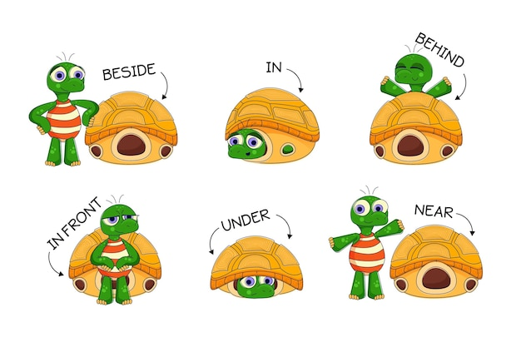
Preposition
What does it do?
A preposition adds extra information to sentences such as place, time and movement.
Notes:
Notes for Teacher - N/A
Suggestions: N/A
Source of Multimedia used in this slide -
https://www.freepik.com/free-vector/english-prepositions-kids-with-turtles_11434918.htm;By pikisuperstar

Slide 4
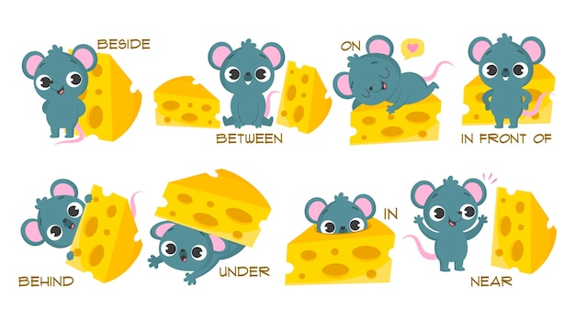
Preposition
Where is it placed?
A preposition is placed usually in front of nouns.
Notes:
Notes for Teacher - N/A
Suggestions: N/A
Source of Multimedia used in this slide -
https://www.freepik.com/free-vector/english-prepositions-kids_11374894.htm;By pikisuperstar

Slide 5
Prepositions of place/position
Usually indicate position
Answers the question ‘Where is/are/was/were?’
Some prepositions of place are:
under, over, near, above, below, in front of, next to, among,
far from, behind, beside, outside, inside and between.
Notes:
Notes for Teacher - N/A
Suggestions: N/A
Source of Multimedia used in this slide -

Slide 6
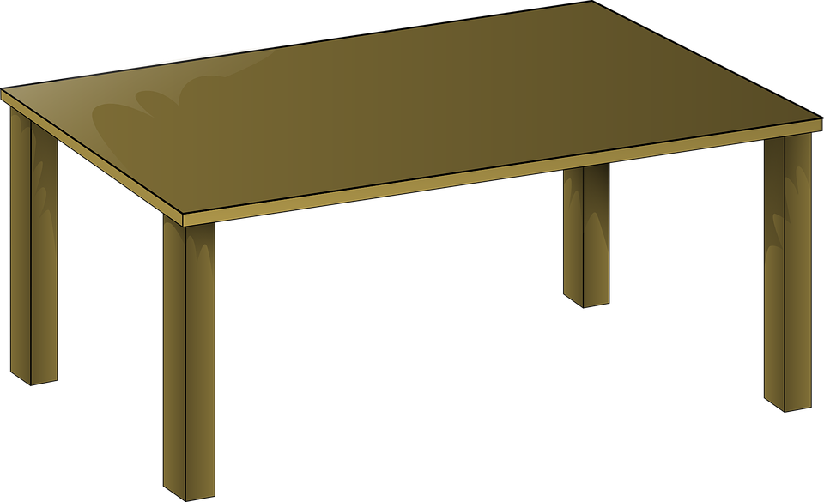
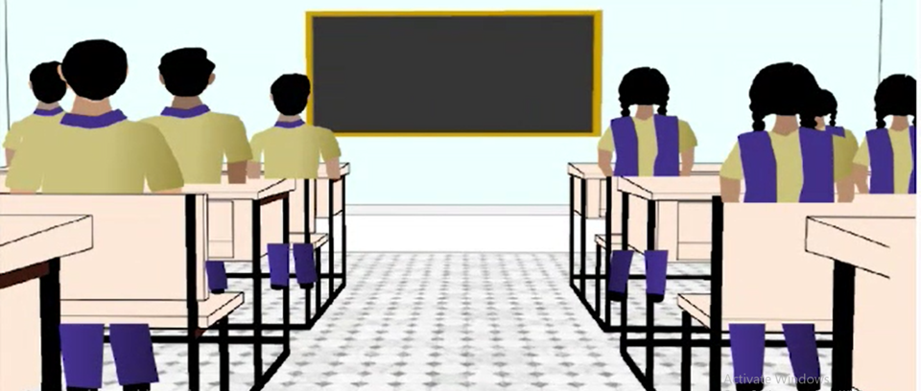
Examples: Prepositions of place/position
The book is on the table.
The students are in the classroom.
Notes:
Notes for Teacher - N/A
Suggestions: N/A
Source of Multimedia used in this slide -
Table - https://pixabay.com/vectors/table-wooden-desk-furniture-23627/ attribution - Clker-Free-Vector-Images / 29539 images
Book - https://pixabay.com/vectors/author-book-closed-cover-149694/ attribution - OpenClipart-Vectors / 27376 images
Students – SSSVV Gallery – search word - classroom

Slide 7
Prepositions of Time
Prepositions of time usually indicate when something happens, happened or will happen in the future.
When
They answer the question ‘when?’.
Some prepositions of time: at, on, in, before, during, by, around and after.
Notes:
Notes for Teacher - N/A
Suggestions: N/A
Source of Multimedia used in this slide -
Question mark - https://openclipart.org/detail/281601/animation-bouncy-question-mark

Slide 8
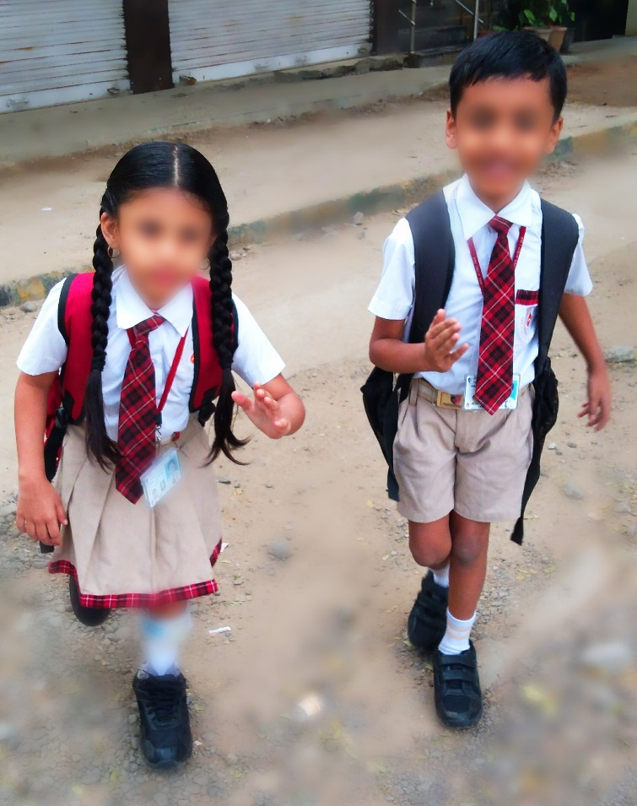
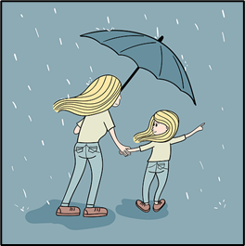
Examples: Prepositions of Time
It usually rains in July.
I go to school at nine.
Notes:
Notes for Teacher - N/A
Suggestions: N/A
Source of Multimedia used in this slide -
Rain - https://pixabay.com/vectors/mother-daughter-umbrella-rain-mom-5709418/ - - attribution - Saydung89
School – SSSVV Gallery – search word - School

Slide 9
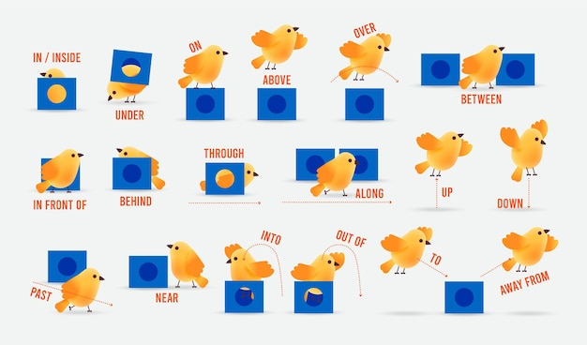
Prepositions of Movement
Indicate direction or destination towards which something or someone is moving.
They generally answer the question 'Where?’
Some prepositions of movement are:
to, across, through, into, over, out of, onto, off, away from, towards, down, up, past, along and around.
Notes:
Notes for Teacher - N/A
Suggestions: N/A
Source of Multimedia used in this slide -
https://www.freepik.com/free-vector/english-prepositions-kids_11376119.htm;By pikisuperstar

Slide 10
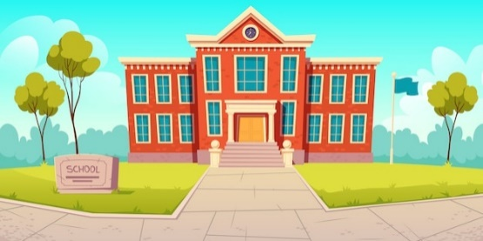
Examples: Prepositions of Movement
I went to school on Monday.
The dog ran across the road.
Notes:
Notes for Teacher - N/A
Suggestions: N/A
Source of Multimedia used in this slide -
School : https://www.freepik.com/free-vector/school-building-educational-institution-college_7101629.htm;By upklyak
Dog: https://pixabay.com/vectors/dog-happy-running-puppy-animals-35483/ attribution - Clker-Free-Vector-Images / 29539 images

Slide 11
MM INDEX
Slide # | Thumbnail | Source link and Attribution
1-10 |  | Title - https://www.freepik.com/free-vector/golden-halftone-rectangle-frame-background_17565220.htm (Attribution – starline)
2 |  | https://www.freepik.com/free-vector/english-prepositions-collection-with-dog_11790735.htm By pikisuperstar
3 |  | https://www.freepik.com/free-vector/english-prepositions-kids-with-turtles_11434918.htm By pikisuperstar
4 |  | https://www.freepik.com/free-vector/english-prepositions-kids_11374894.htm;By pikisuperstar
6 |  | Table - https://pixabay.com/vectors/table-wooden-desk-furniture-23627/ attribution - Clker-Free-Vector-Images / 29539 images Book - https://pixabay.com/vectors/author-book-closed-cover-149694/ attribution - OpenClipart-Vectors / 27376 images Students – SSSVV Gallery – search word - classroom
7 |  | https://openclipart.org/detail/281601/animation-bouncy-question-mark
8 |  | Rain - https://pixabay.com/vectors/mother-daughter-umbrella-rain-mom-5709418/ - - attribution - Saydung89 School –SSSVV Gallery – search word school
9 |  | https://www.freepik.com/free-vector/english-prepositions-kids_11376119.htm;By pikisuperstar
10 |  | School : https://www.freepik.com/free-vector/school-building-educational-institution-college_7101629.htm;By upklyak Dog: https://pixabay.com/vectors/dog-happy-running-puppy-animals-35483/ - attribution Clker-Free-Vector-Images / 29539 images
Notes:
Notes for Teacher –
Suggestions:
Source of Multimedia used in this slide -

