Slide 1
See and Enjoy
Notes:
Notes for Teacher - < Information for further reference or explanation >N/A
Suggestions: <Ideas/ Images/ Animations / Others – To make better representation of the content >N/A
Source of Multimedia used in this slide - <Please provide source URL where we find the image and the license agreement> N/A

Slide 2
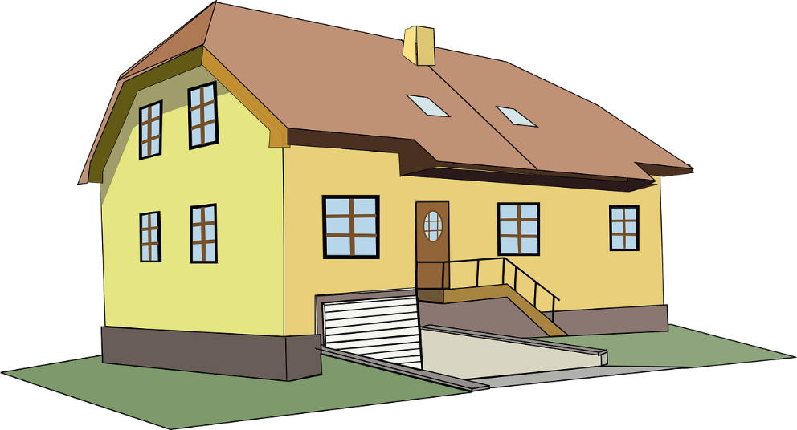
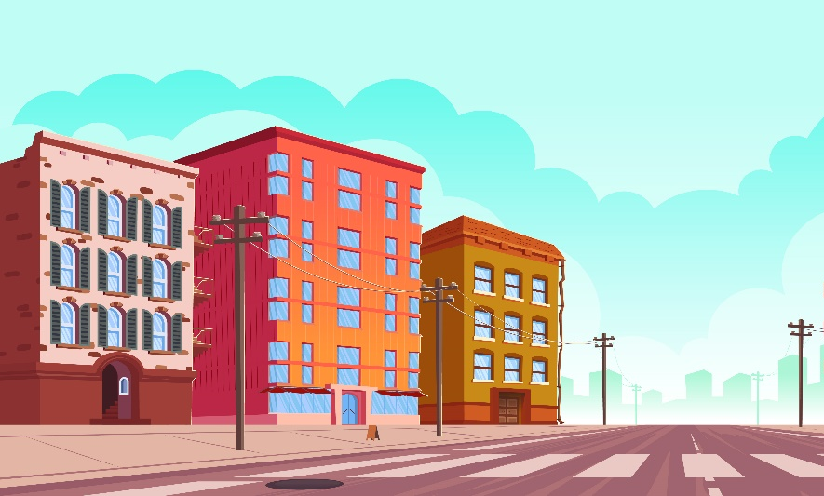
See and Enjoy
From where is the dog entering the house?
Where is the cat sitting?
Where is the bird flying?
Where is the school?
Notes:
Notes for Teacher - < Information for further reference or explanation >
The teacher may use the attached PPT and play it in the classroom, to enhance the students’ understanding of the usage of different prepositions. The following questions could be posed to draw the attention of the students to the usage of prepositions. No need for the teacher to elicit answers, the children can just see the pictures and enjoy.
Suggestions: <Ideas/ Images/ Animations / Others – To make better representation of the content >N/A
Source of Multimedia used in this slide - <Please provide source URL where we find the image and the license agreement>
<Cat> <https://pixabay.com/illustrations/cat-cartoon-kitten-kitty-animal-5746771/>
<table> <https://pixabay.com/vectors/table-furniture-wooden-1300555/>
<garden> <https://pixabay.com/vectors/garden-sparrow-bird-spring-nature-6097539/>
<dog> <https://pixabay.com/illustrations/dog-animal-playing-catch-vector-2329172/>
<house> <https://pixabay.com/vectors/house-estate-home-property-31078/>
<house 2> <https://pixabay.com/illustrations/house-countryside-architecture-163526/>
<bird flying> <https://pixabay.com/vectors/squab-pigeon-animal-bird-flight-151212/>
<school> <https://pixabay.com/vectors/school-building-education-property-295210/>
<building> <https://www.freepik.com/free-vector/urban-street-landscape-empty-road-electric-poles_29222733.htm By upklyak>

Slide 3
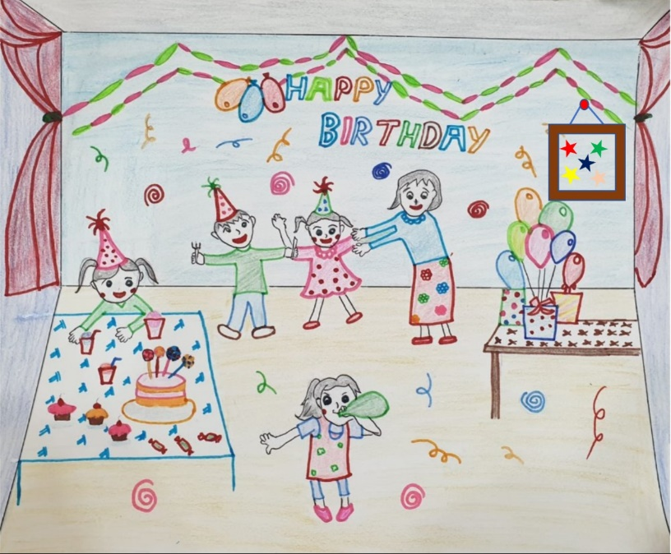
See and Enjoy
When is Nitin’s birthday?
What time does the train arrive?
When does Komala wake up everyday?
Notes:
Notes for Teacher - < Information for further reference or explanation >N/A
Suggestions: <Ideas/ Images/ Animations / Others – To make better representation of the content >N/A
Source of Multimedia used in this slide - <Please provide source URL where we find the image and the license agreement>
<train> <https://pixabay.com/vectors/train-rail-railway-161015/>
<clock> <https://pixabay.com/vectors/clock-day-hour-measure-minute-160966/>
<pool> <https://pixabay.com/vectors/diving-pool-man-swimming-jumping-6156187/>
<girl sleeping> <https://pixabay.com/illustrations/girl-sleep-bed-woman-person-young-5846058/>
<clock> <https://pixabay.com/vectors/clock-time-hours-alarm-alarm-clock-6800641/>
<birthday party> <SSSVV - Birthday party, Birthday celebration>
<Friday> <https://pixabay.com/vectors/calendar-day-first-month-tear-305650/>

Slide 4
MM Index
Slide # | Thumbnail | Source link and Attribution
2 |  | <Cat> <https://pixabay.com/illustrations/cat-cartoon-kitten-kitty-animal-5746771/> <table> <https://pixabay.com/vectors/table-furniture-wooden-1300555/> <garden> <https://pixabay.com/vectors/garden-sparrow-bird-spring-nature-6097539/> <dog> <https://pixabay.com/illustrations/dog-animal-playing-catch-vector-2329172/> <house> <https://pixabay.com/vectors/house-estate-home-property-31078/> <house 2> <https://pixabay.com/illustrations/house-countryside-architecture-163526/> <bird flying> <https://pixabay.com/vectors/squab-pigeon-animal-bird-flight-151212/> <school> <https://pixabay.com/vectors/school-building-education-property-295210/> <building> <https://www.freepik.com/free-vector/urban-street-landscape-empty-road-electric-poles_29222733.htm By upklyak>
3 |  | <train> <https://pixabay.com/vectors/train-rail-railway-161015/> <clock> <https://pixabay.com/vectors/clock-day-hour-measure-minute-160966/> <girl sleeping> <https://pixabay.com/illustrations/girl-sleep-bed-woman-person-young-5846058/> <clock> <https://pixabay.com/vectors/clock-time-hours-alarm-alarm-clock-6800641/> <birthday party> <SSSVV - Birthday party, Birthday celebration> <Friday> <https://pixabay.com/vectors/calendar-day-first-month-tear-305650/>
Notes:
Notes for Teacher - < Information for further reference or explanation >N/A
Suggestions: <Ideas/ Images/ Animations / Others – To make better representation of the content >N/A
Source of Multimedia used in this slide - <Please provide source URL where we find the image and the license agreement> N/A

