Slide 1
Kiran with his friends
Notes:
Notes for Teacher - < Information for further reference or explanation >
Suggestions: <Ideas/ Images/ Animations / Others – To make better representation of the content >
Source of Multimedia used in this slide - <Please provide source URL where we find the image and the license agreement>
<children> https://pixabay.com/vectors/children-playing-exercise-play-310223/>

Slide 2
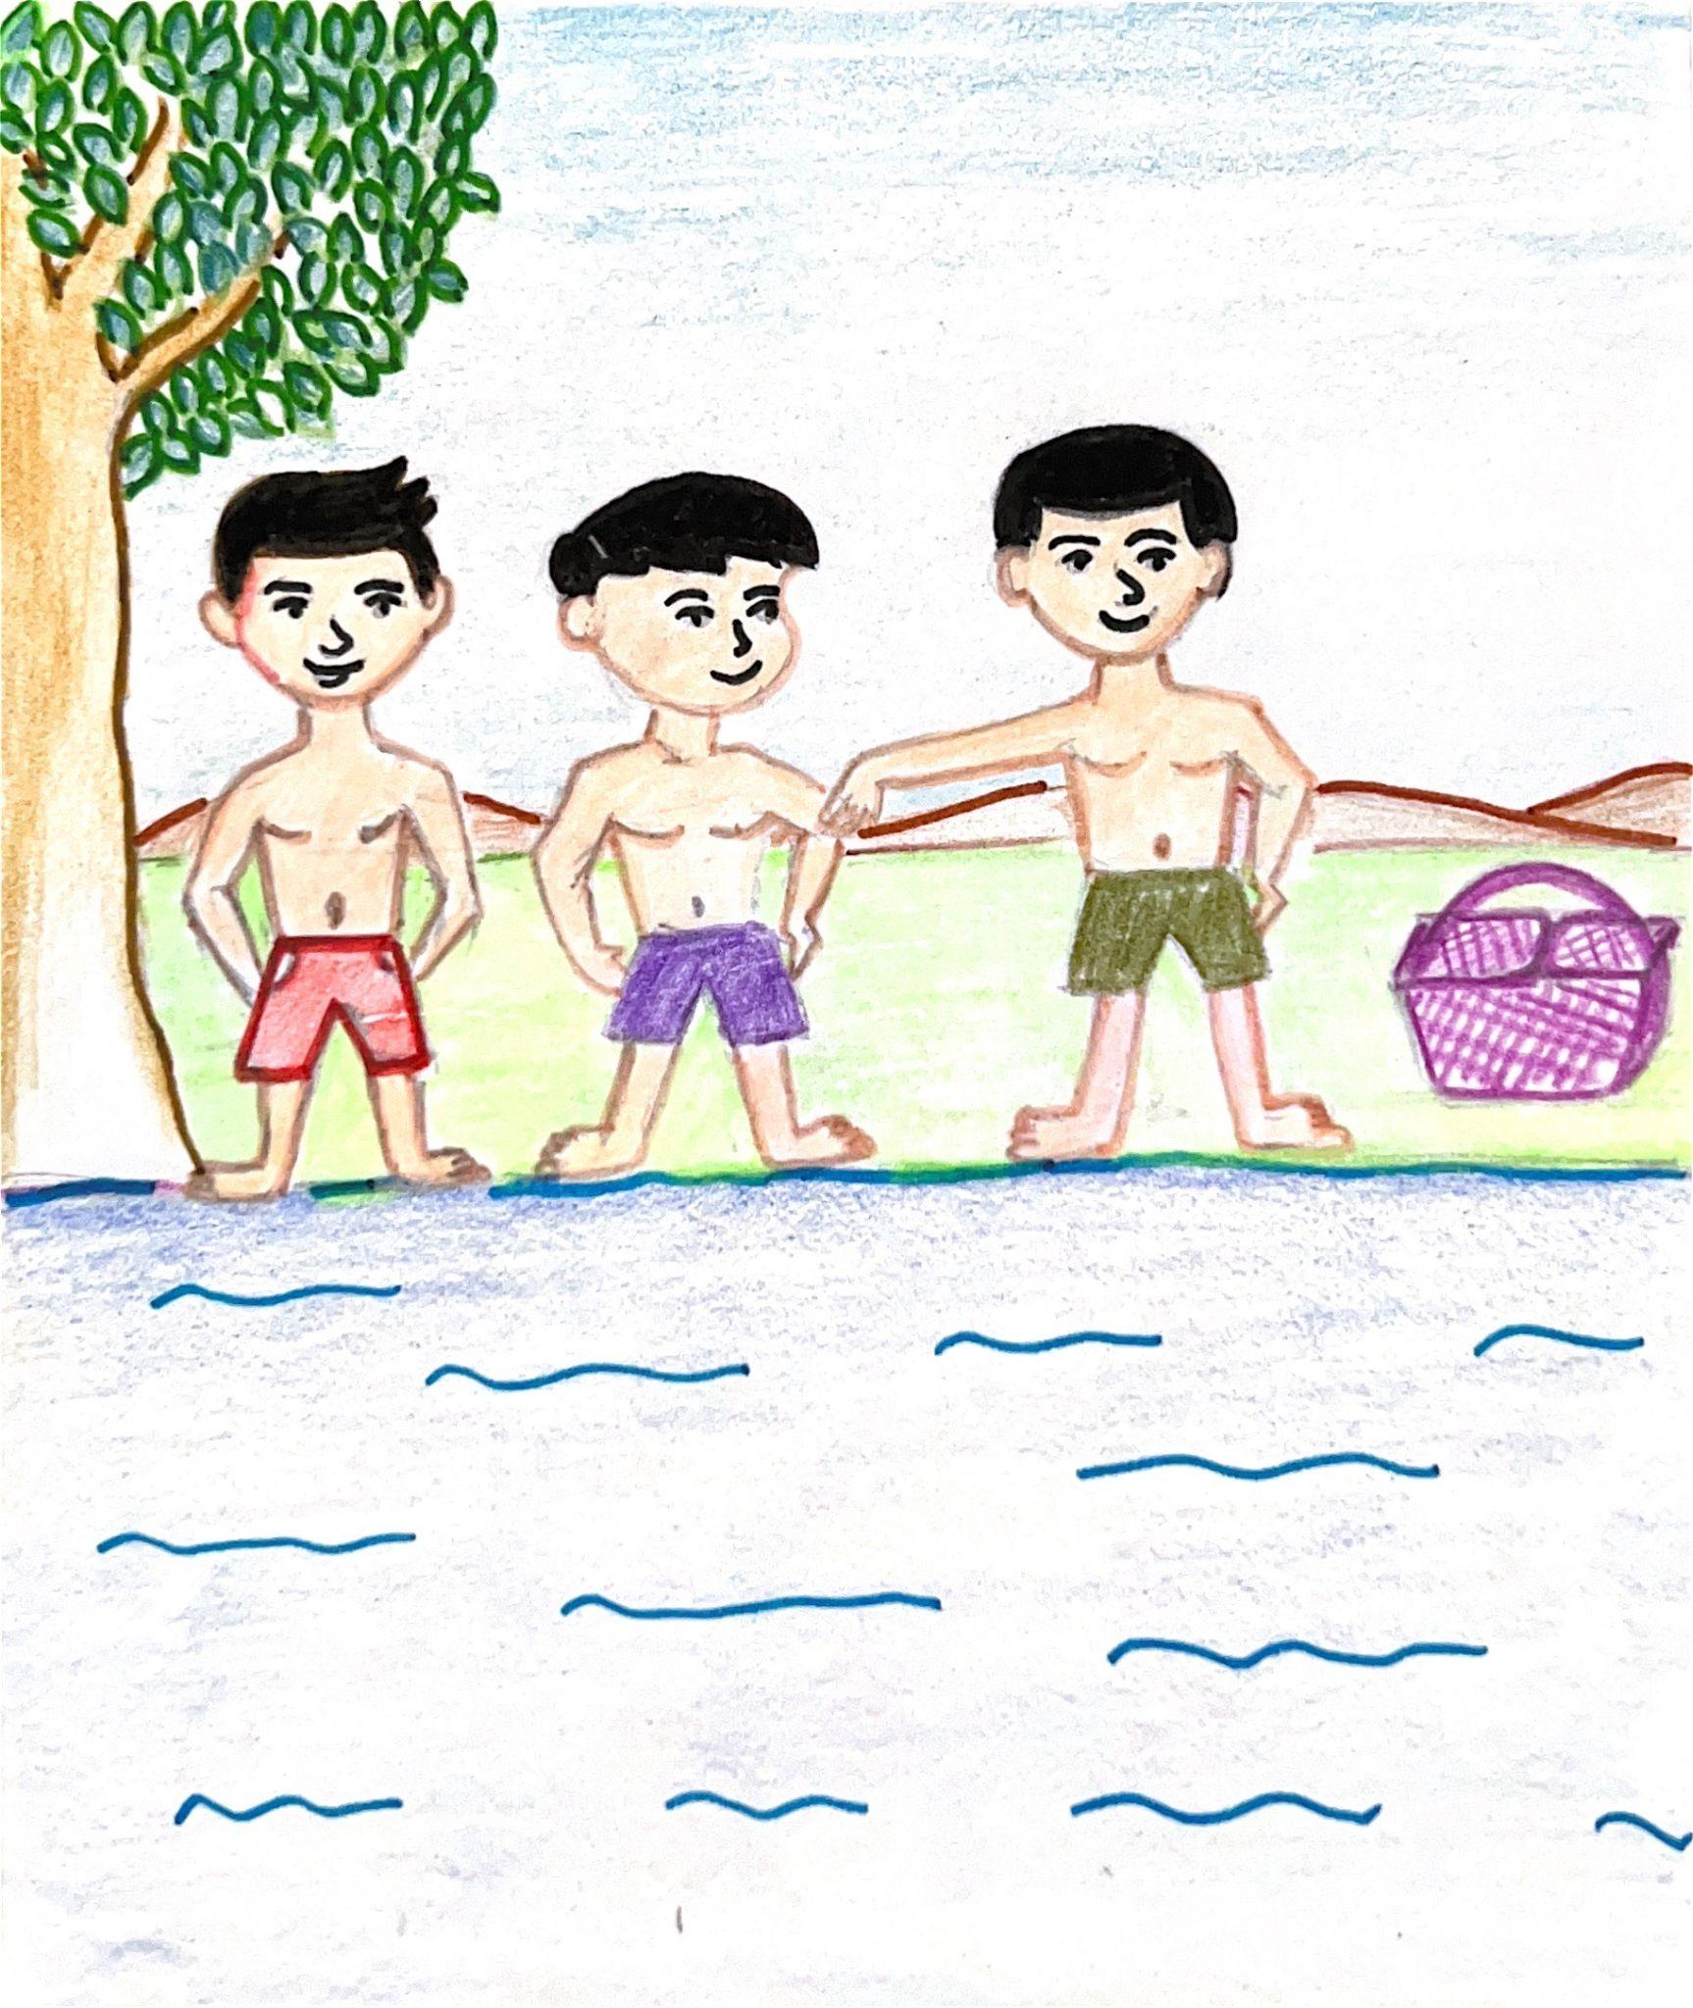
Kiran With his Friends
It was Sunday morning and Kiran was excited to spend the day with his friends.
He got up early to be with his friends at the riverside.
Notes:
Notes for Teacher - < Information for further reference or explanation >
Suggestions: <Ideas/ Images/ Animations / Others – To make better representation of the content >
Source of Multimedia used in this slide - <Please provide source URL where we find the image and the license agreement>
Ready to Swim - <https://drive.google.com/drive/folders/15qDOenWHco1QoHyOdPQSL2IlUGKaJKmo>

Slide 3
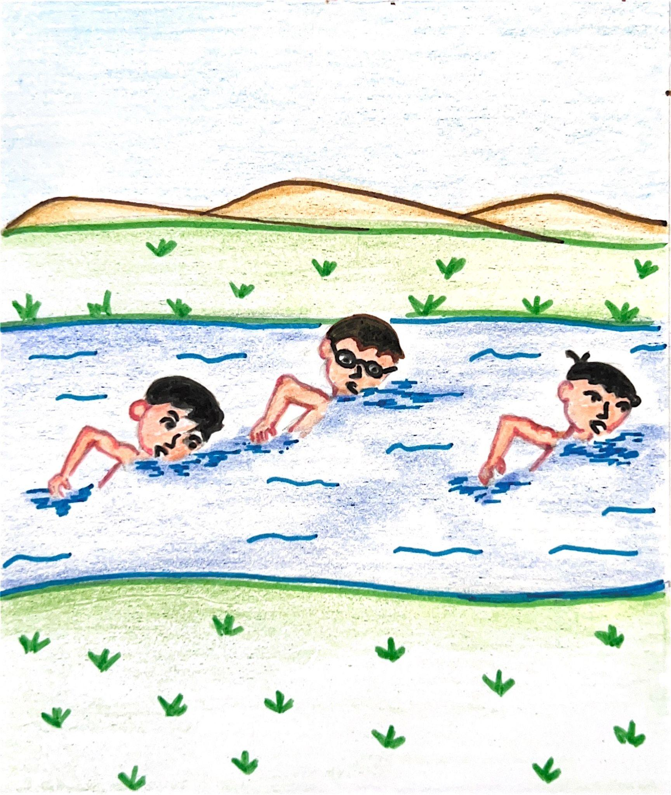
Kiran With his Friends
Kiran’s mother packed him a nice picnic bag. He ran to the river and met his friends there.
They went swimming in the river, then they swam across the river, got out of the river and had a picnic lunch under a tree near the river.
Notes:
Notes for Teacher - < Information for further reference or explanation >
Suggestions: <Ideas/ Images/ Animations / Others – To make better representation of the content >
Source of Multimedia used in this slide - <Please provide source URL where we find the image and the license agreement>
Swimming - <https://drive.google.com/drive/folders/1H2MUWAj1l9fsi4ZDQKCPeu3bwOIT5qjf>

Slide 4
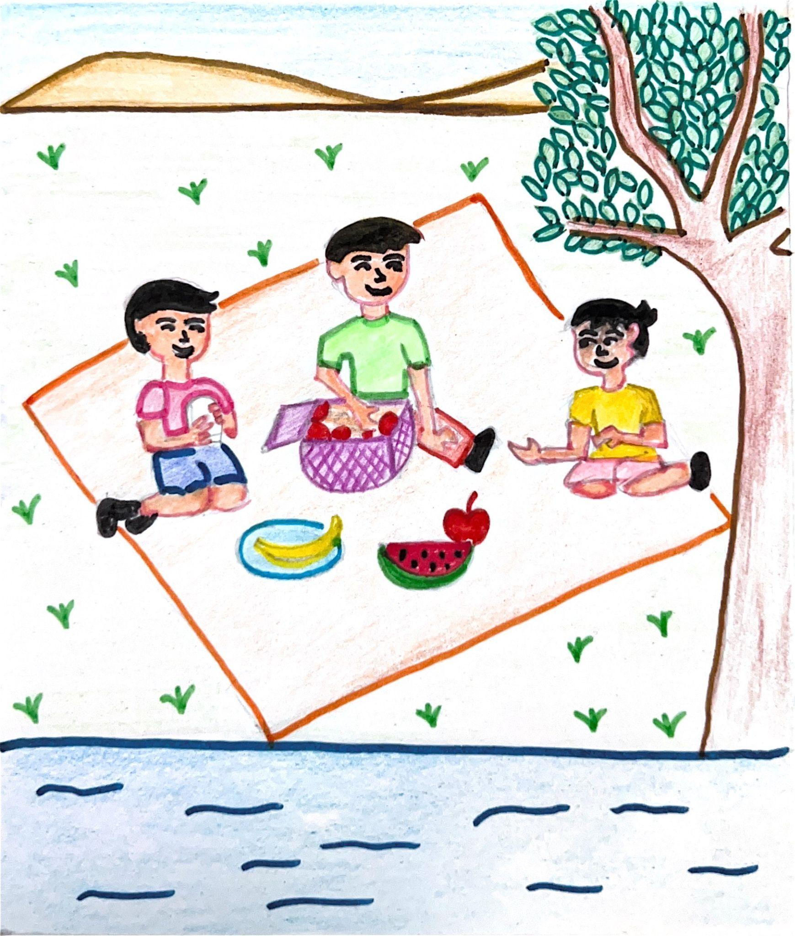
Kiran With his Friends
After lunch, they took a walk along the river and in the afternoon, they ran back home.
Kiran and his friends sat at the table and ate the mangoes that his mother gave them.
Notes:
Notes for Teacher - < Information for further reference or explanation >
Suggestions: <Ideas/ Images/ Animations / Others – To make better representation of the content >
Source of Multimedia used in this slide - <Please provide source URL where we find the image and the license agreement>
Picnic - https://drive.google.com/drive/folders/1MDm2DGDddxjp7jMNYQzDLkuWFVqvqcr1

Slide 5
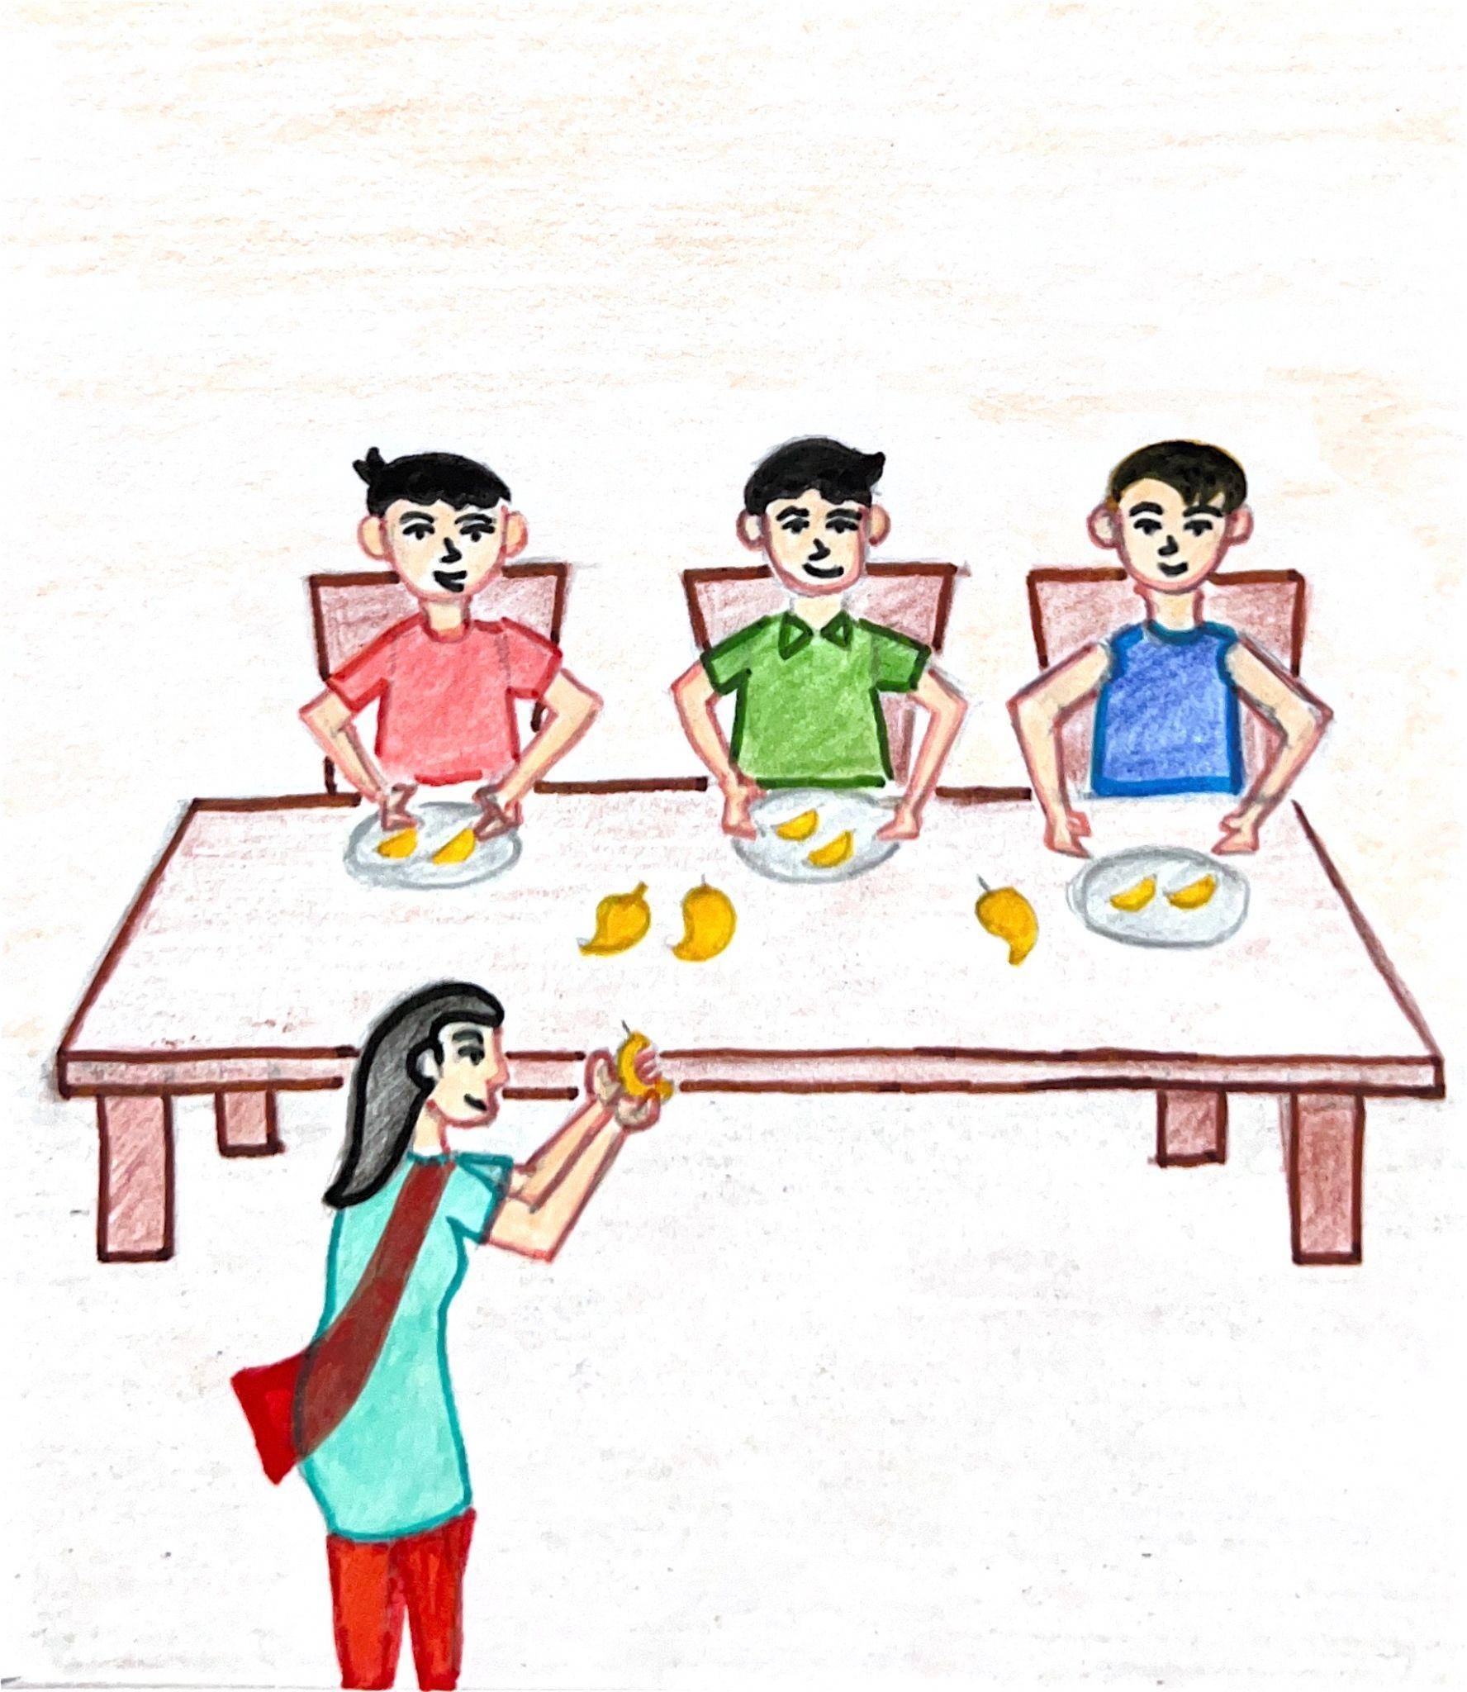
Kiran With his Friends
His friends thanked Kiran's mother for the mangoes and left. Kiran was tired after a long day at the river.
He got into bed and fell asleep, thinking of the fun he had with his friends.
Notes:
Notes for Teacher - < Information for further reference or explanation >
Suggestions: <Ideas/ Images/ Animations / Others – To make better representation of the content >
Source of Multimedia used in this slide - <Please provide source URL where we find the image and the license agreement>
Lunch - https://drive.google.com/drive/folders/1rep9chACmkYtWhT2x5OWNf5M3ll2PLAY

Slide 6
MM Index
Slide # | Thumbnail | Source link and Attribution
1 |  | <children> https://pixabay.com/vectors/children-playing-exercise-play-310223/>
2 |  | https://drive.google.com/drive/folders/1H2MUWAj1l9fsi4ZDQKCPeu3bwOIT5qjf
3 |  | https://drive.google.com/drive/folders/15qDOenWHco1QoHyOdPQSL2IlUGKaJKmo
4 |  | https://drive.google.com/drive/folders/1MDm2DGDddxjp7jMNYQzDLkuWFVqvqcr1
5 |  | https://drive.google.com/drive/folders/1rep9chACmkYtWhT2x5OWNf5M3ll2PLAY
Notes:
Notes for Teacher - < Information for further reference or explanation >
Suggestions: <Ideas/ Images/ Animations / Others – To make better representation of the content >
Source of Multimedia used in this slide - <Please provide source URL where we find the image and the license agreement>

