Slide 1
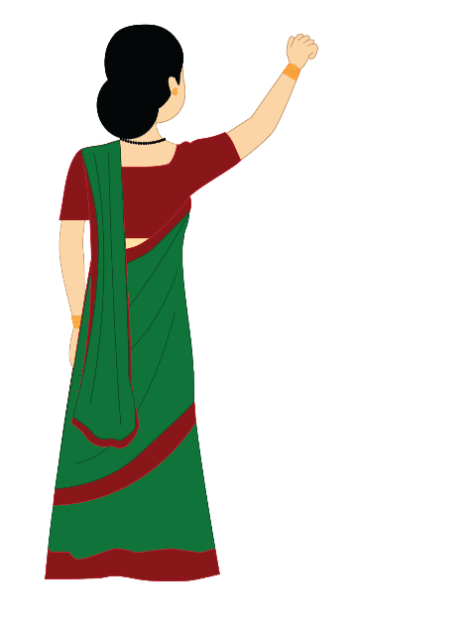
Nice Making Others Happy
Love and kindness can give happiness to both the receiver and the giver.
Notes:
Notes for Teacher - < Information for further reference or explanation >
Suggestions: <Ideas/ Images/ Animations / Others – To make better representation of the content >
Source of Multimedia used in this slide - https://www.freepik.com/free-photo/green-dirty-blackboard_13410582.htm By Vectonauta

Slide 2
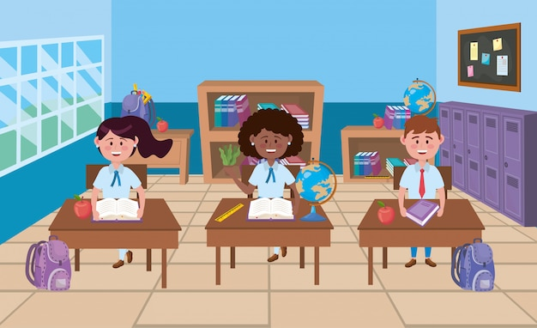
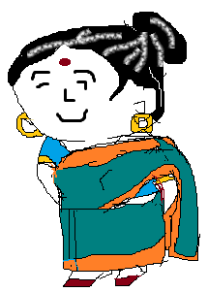
Story – Making others happy
The teacher held a surprise test for the students.
Surprise Test
Notes:
Notes for Teacher - < Information for further reference or explanation >
Suggestions: <Ideas/ Images/ Animations / Others – To make better representation of the content >
Source of Multimedia used in this slide – https://www.freepik.com/free-vector/boy-girls-school-classroom_4770653.htm?query=school%20classroom – by stockgiu
https://contentmanagement.srisathyasaividyavahini.org/index.php#,grandmother

Slide 3
Story – Making others happy
Qn : What is the name of the person who helps to keep the school clean?
Person who
cleans our school?
Notes:
Notes for Teacher - < Information for further reference or explanation >
Suggestions: <Ideas/ Images/ Animations / Others – To make better representation of the content >
Source of Multimedia used in this slide – https://pixabay.com/vectors/teacher-students-schoolboys-pupils-158711/ - OpenClipart-Vectors / 27376

Slide 4
Story – Making others happy
Some students remembered her appearance. No one knew her name.
Tall…dark haired…..Name??
Notes:
Notes for Teacher - < Information for further reference or explanation >
Suggestions: <Ideas/ Images/ Animations / Others – To make better representation of the content >
Source of Multimedia used in this slide –
Girl : https://pixabay.com/vectors/kid-study-book-child-figure-3326960/ - DavidRockDesign / 359 images
Boy : https://pixabay.com/vectors/boys-studying-children-student-1844435/ - eommina/152 images

Slide 5
Story – Making others happy
The students handed over the papers leaving that question blank
Yes, it will be counted
Ma’am, Does this question carry weightage?
Notes:
Notes for Teacher - < Information for further reference or explanation >
Suggestions: <Ideas/ Images/ Animations / Others – To make better representation of the content >
Source of Multimedia used in this slide –
– https://www.freepik.com/free-vector/boy-girls-school-classroom_4770653.htm?query=school%20classroom – by stockgiu
https://contentmanagement.srisathyasaividyavahini.org/index.php#,grandmother

Slide 6
Story – Making others happy
Every day in our lives, many people help us in different ways and they are all significant
Sorry ma’am…
We should respect and care despite their position or work
Notes:
Notes for Teacher - < Information for further reference or explanation >
Suggestions: <Ideas/ Images/ Animations / Others – To make better representation of the content >
Source of Multimedia used in this slide –
– https://www.freepik.com/free-vector/boy-girls-school-classroom_4770653.htm?query=school%20classroom – by stockgiu
https://contentmanagement.srisathyasaividyavahini.org/index.php#,grandmother

Slide 7
Points to Ponder
Be loving and Caring
Show respect to all
Look for opportunities to do good
Happiness comes from making others happy
Notes:
Notes for Teacher - < Information for further reference or explanation >
Suggestions: <Ideas/ Images/ Animations / Others – To make better representation of the content >
Source of Multimedia used in this slide –

Slide 8
MM INDEX
Slide # | Thumbnail | Source link and Attribution
1 |  | https://www.freepik.com/free-photo/green-dirty-blackboard_13410582.htm – by Vectonauta
2, 5, 6 |  | https://www.freepik.com/free-vector/boy-girls-school-classroom_4770653.htm – by stockgiu
3 |  | https://pixabay.com/vectors/teacher-students-schoolboys-pupils-158711/ - OpenClipart-Vectors / 27376
4 |  | Girl : https://pixabay.com/vectors/kid-study-book-child-figure-3326960/ - DavidRockDesign / 359 images Boy : https://pixabay.com/vectors/boys-studying-children-student-1844435/ - eommina/152 images
2, 5, 6 |  | https://contentmanagement.srisathyasaividyavahini.org/index.php#,grandmother
Notes:
Notes for Teacher - < Information for further reference or explanation >
Suggestions: <Ideas/ Images/ Animations / Others – To make better representation of the content >
Source of Multimedia used in this slide - <Please provide source URL where we find the image and the license agreement>

